Slide 1
Conga Composer

Slide 2



Conga Composer pagelayout Buttons
Standard-Opportunity-
Amendement Opportunity -
Contract -

Slide 3
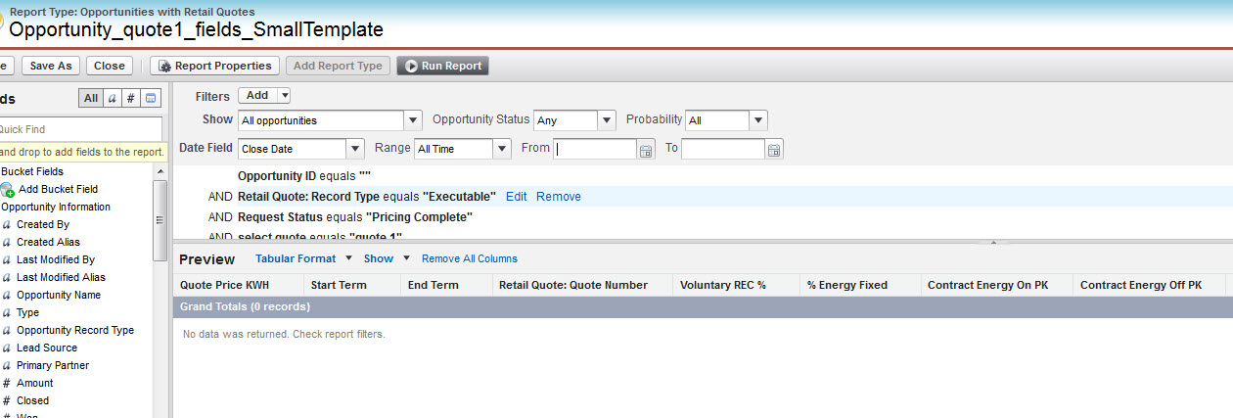
Sales force Reports with Conga Composer
Create a salesforce report based on opportunity and Retail Quotes.
Save the report into any publicly accessible folder, recommend Conga composer Reports

Slide 4
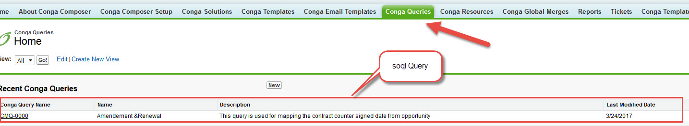
Soql Queries with Conga Composer
Sales force can use soql query stored in Conga Query.

Slide 5
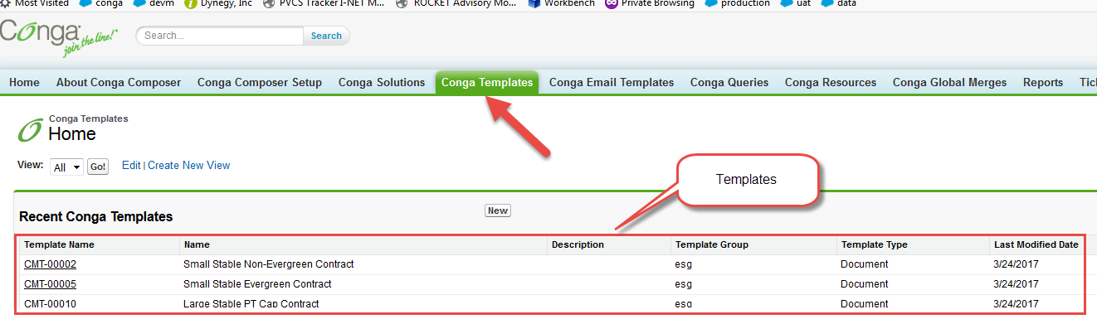
Word Templates with Conga Composer
Add created word templates to the Conga Templates Folder

Slide 6
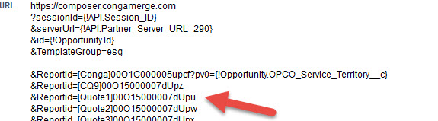
Create Conga composer button
Created Report id’s, Soql query id’s, word template id’s place in the creation of button
Each of these reports would be visible through the Template Builder window as a separate dataset.
Conga Composer automatically assigns the worksheet names based on the report alias specified.

Slide 7
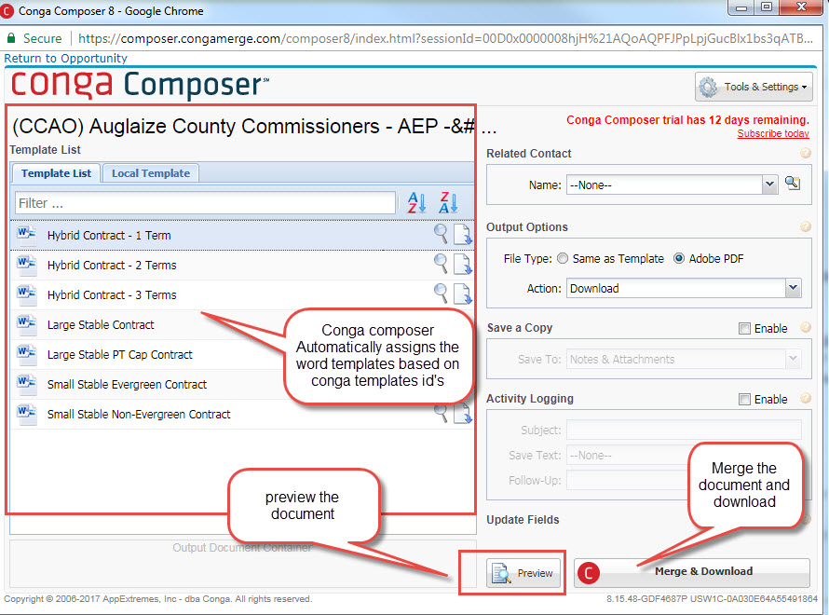
Create conga composer button and place it in opportunity page layout
Click on opportunity page layout button
Preview or merge& download the conga composer.

