Slide 1
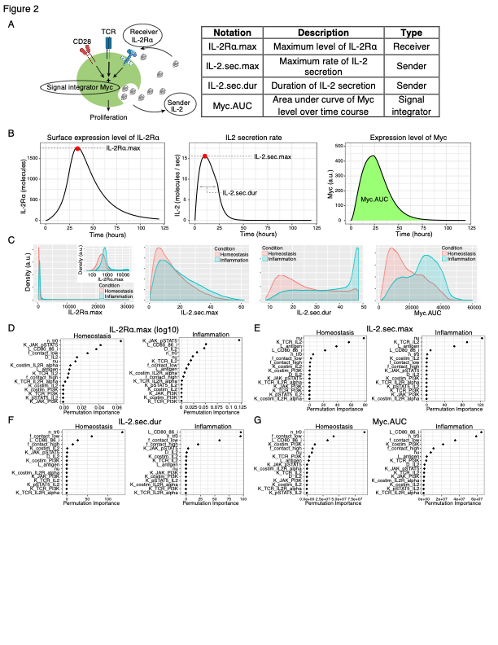
Results from the T cell model

Slide 3
From John.
don't get across the wrong message that our paper is about solving stochastic network dynamics, but it's about MAPPA - the method - which the editor is excited about. He said that after I explained what was on slide 1 (see attached) he felt much better about the paper and its chances with the reviewers.
Less and shorten stochastic network examples – emphasize those are examples and we illustrate using them because they are analytically intractable, can have long simulation times, etc. We can remove or move the feedforward to the supplement.
Ideally, illustrate using one more example – I mentioned potentially the GC in the immune system and the editor liked that, but I said that might take time and thus I will talk to you first. Another option is to use the T cell model, but that may be considered as "published", unless we show some other aspect of that network, e.g., increasing inflammation?
Code/usable by others - I think you are working on that - getting close?
https://github.com/pkm304/MAPPA
Make sure to make it "bullet proof" in terms of comparison with sensitivity analysis, etc. – check out R1 comments again….she/he was the most critical.

