Slide 1
5-9
Intentionality After Work
For new grads, dedicating purposeful time towards themselves and others can feel impossible—it’s easier to just watch Netflix every day after work. 5-9 solves this problem by making it straightforward to set, do, and reflect on intentions users set for themselves, whether it’s seeing an old friend or meditating after a long day of meetings.

Slide 2
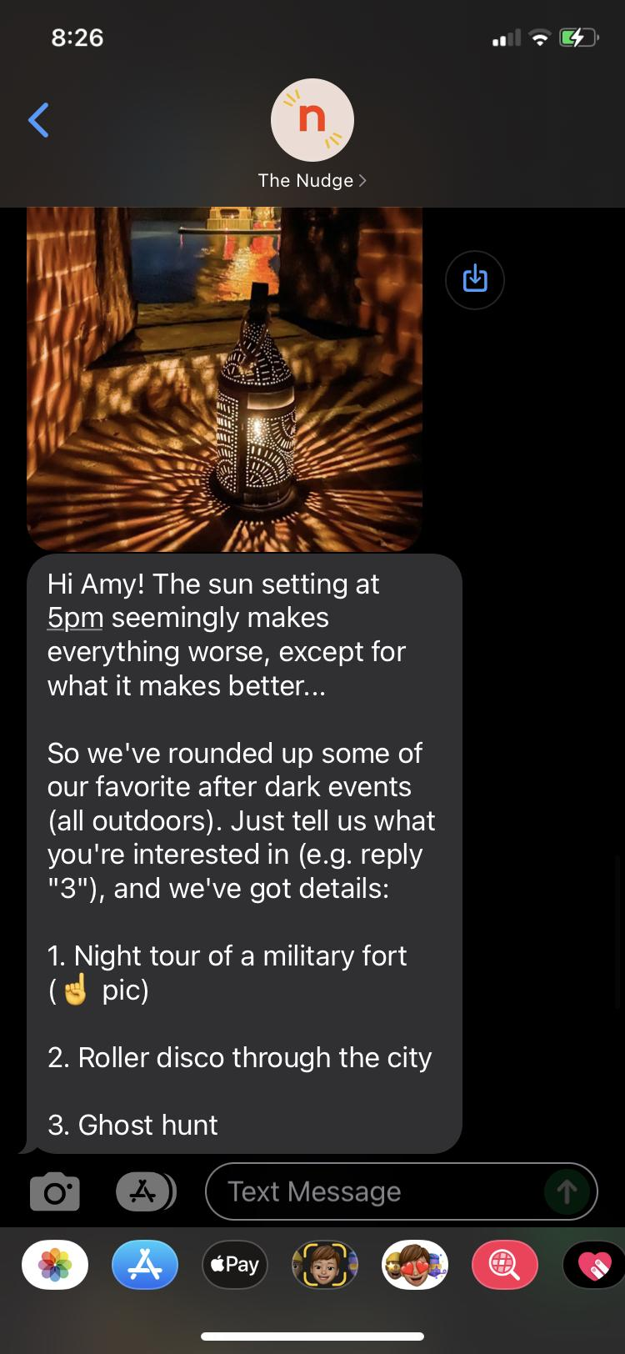
Market Research: Nudge
Product: Nudge
Product space: Geographically curated activity planning for young adults
Key Differentiators:
Nudge only presents users with activities, 5-9 also connects users with their friends during overlapping free times
Nudge relies on twice weekly text notifications, 5-9 is not notifications based
Nudge does not differentiate between social activities and self care activities, 5-9 will
What Works:
Sending text allows app to “circumvent app notification fatigue”
Works with local influencers to get trendy ideas
Texts contain activity idea and links to a more fully fledged plan (with photos, address, logistics, etc.) that also tracks user engagement
Writes texts in “friendly, narrative style”
Intentionally only sends two texts a week to avoid spamming user
What Doesn’t Work:
Customizing activities on a per user basis.
Says that they want to stay away from promoting specific products/services/events as it would ruin their credibility.
Venue overcrowding since they send the same plans out to a large group of people now.

Slide 3
Tasks
SET INTENTION (EASY):
Set intention for the rest of your day: self-care, social, nothing at all
DO INTENTION (HARD):
Either, find an interesting activity to do alone
Or, find an exciting activity to do with your friend,
and identify a suggested time slot when both you and a friend are free
REFLECT ON INTENTION (MEDIUM):
Rate how you spent your free time that day
Look back on how you spent your free time in the past

Slide 4
Values in Design
Embedded Values:
Create personal accountability
Cultivate personal wellness and lifestyle sustainability
Promote social exploration
Suggest user-specific activities for unique experience
Conflicting Values:
Customization and privacy surrounding scheduling
Active socialization and wellness/self-care
Addressing Conflicts:
Trading-off: allow user to choose how to prioritize socializing vs. self-care
Compromising: opt-in to sharing calendar and other personal details

Slide 5
Video
Storyboards
Notes:
Amy

Slide 6
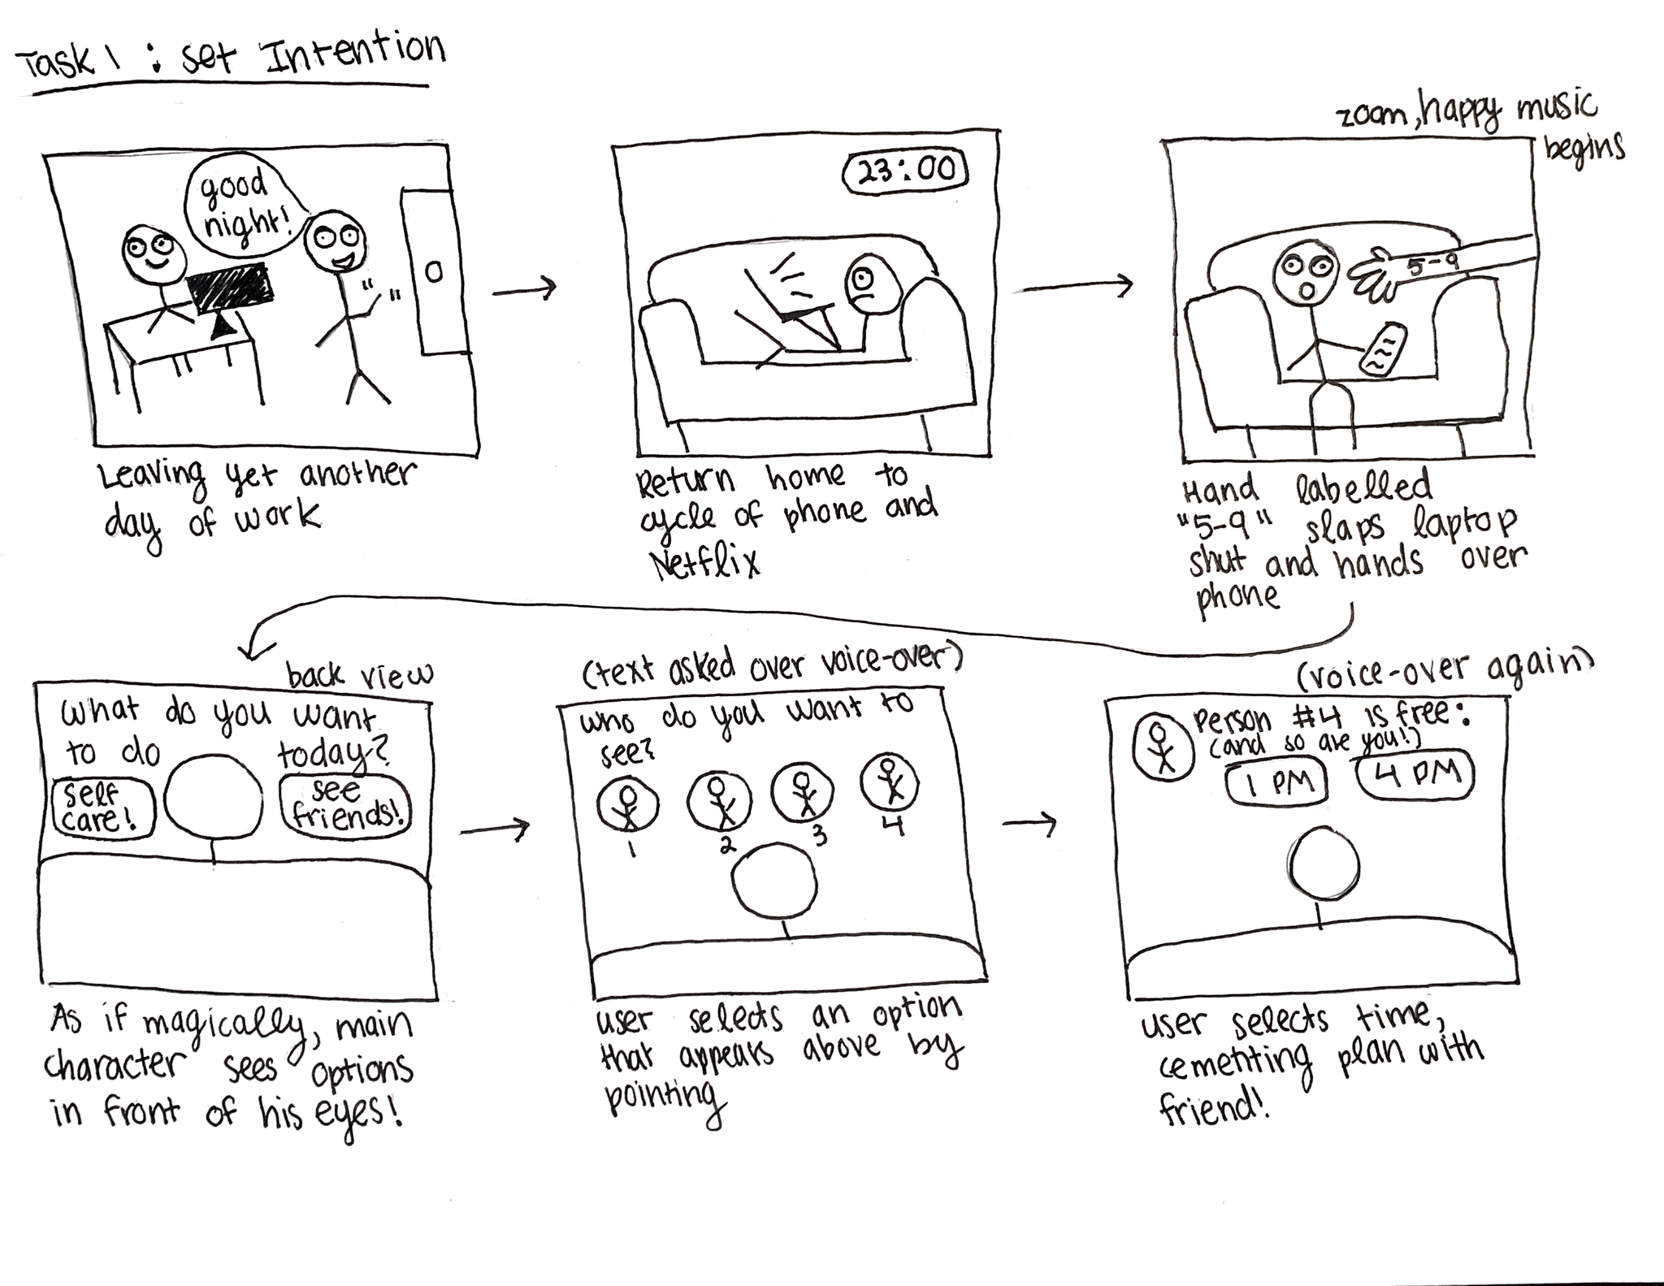
Notes:
Amy
We also interviewed Nebraska who is one year post grad from a non traditional international university called Minerva. She is currently living at home and is working as a freelancer and political organizer. She had this really interesting quote about the kinds of activities that she did in college vs in post grad life and importantly, with whom did she do these activities: close friends or acquaintances.

Slide 7
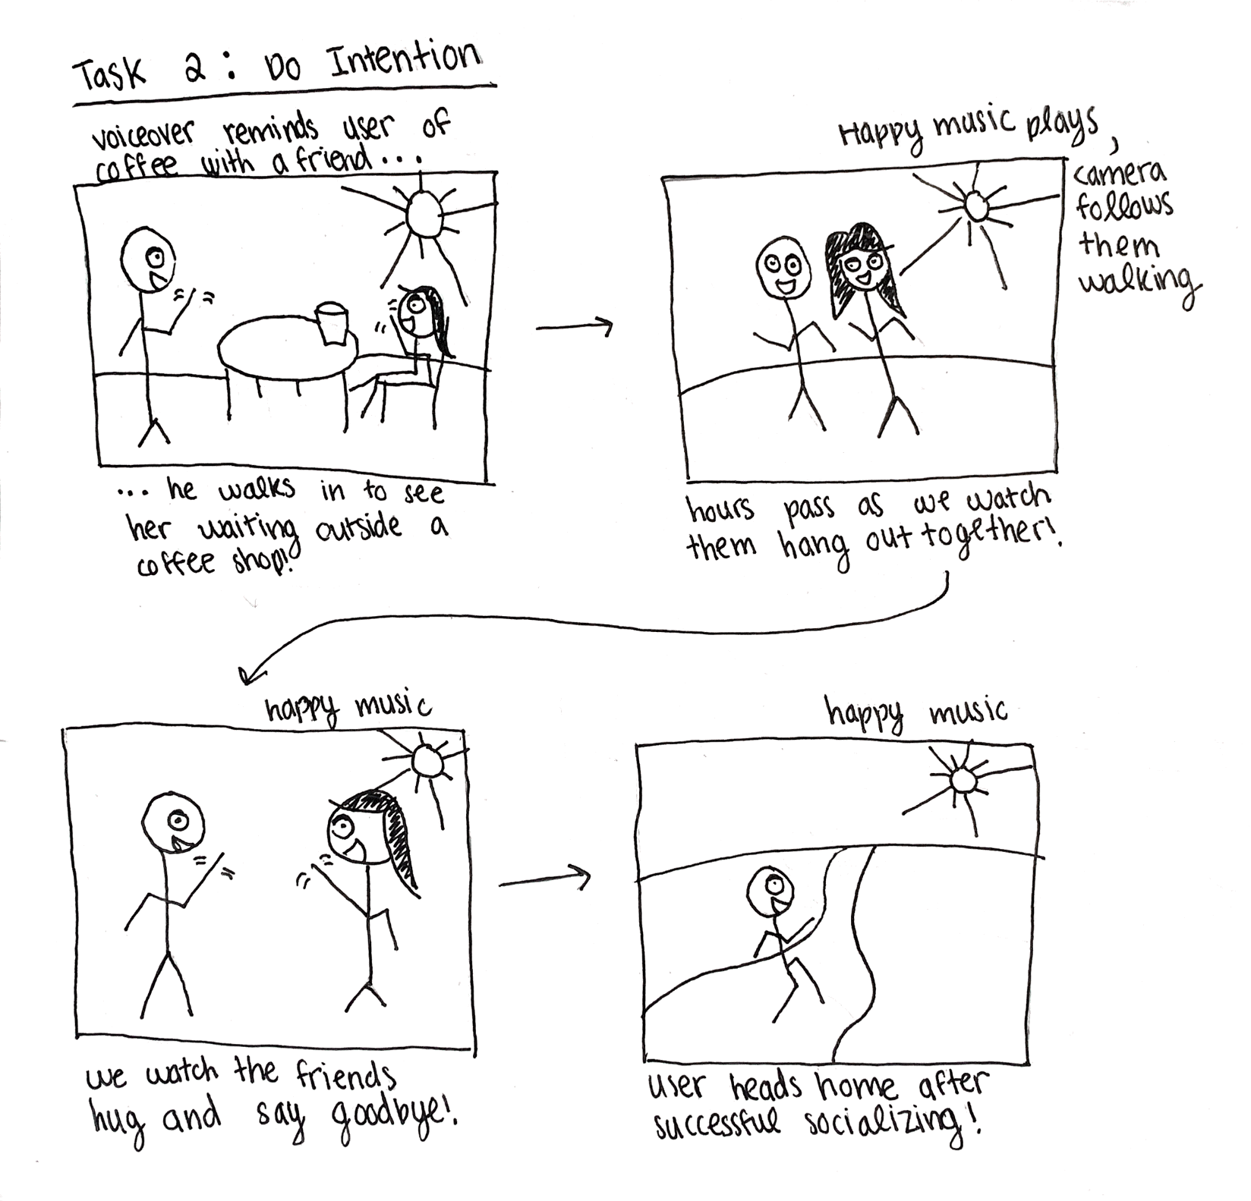
Notes:
Platon

Slide 8
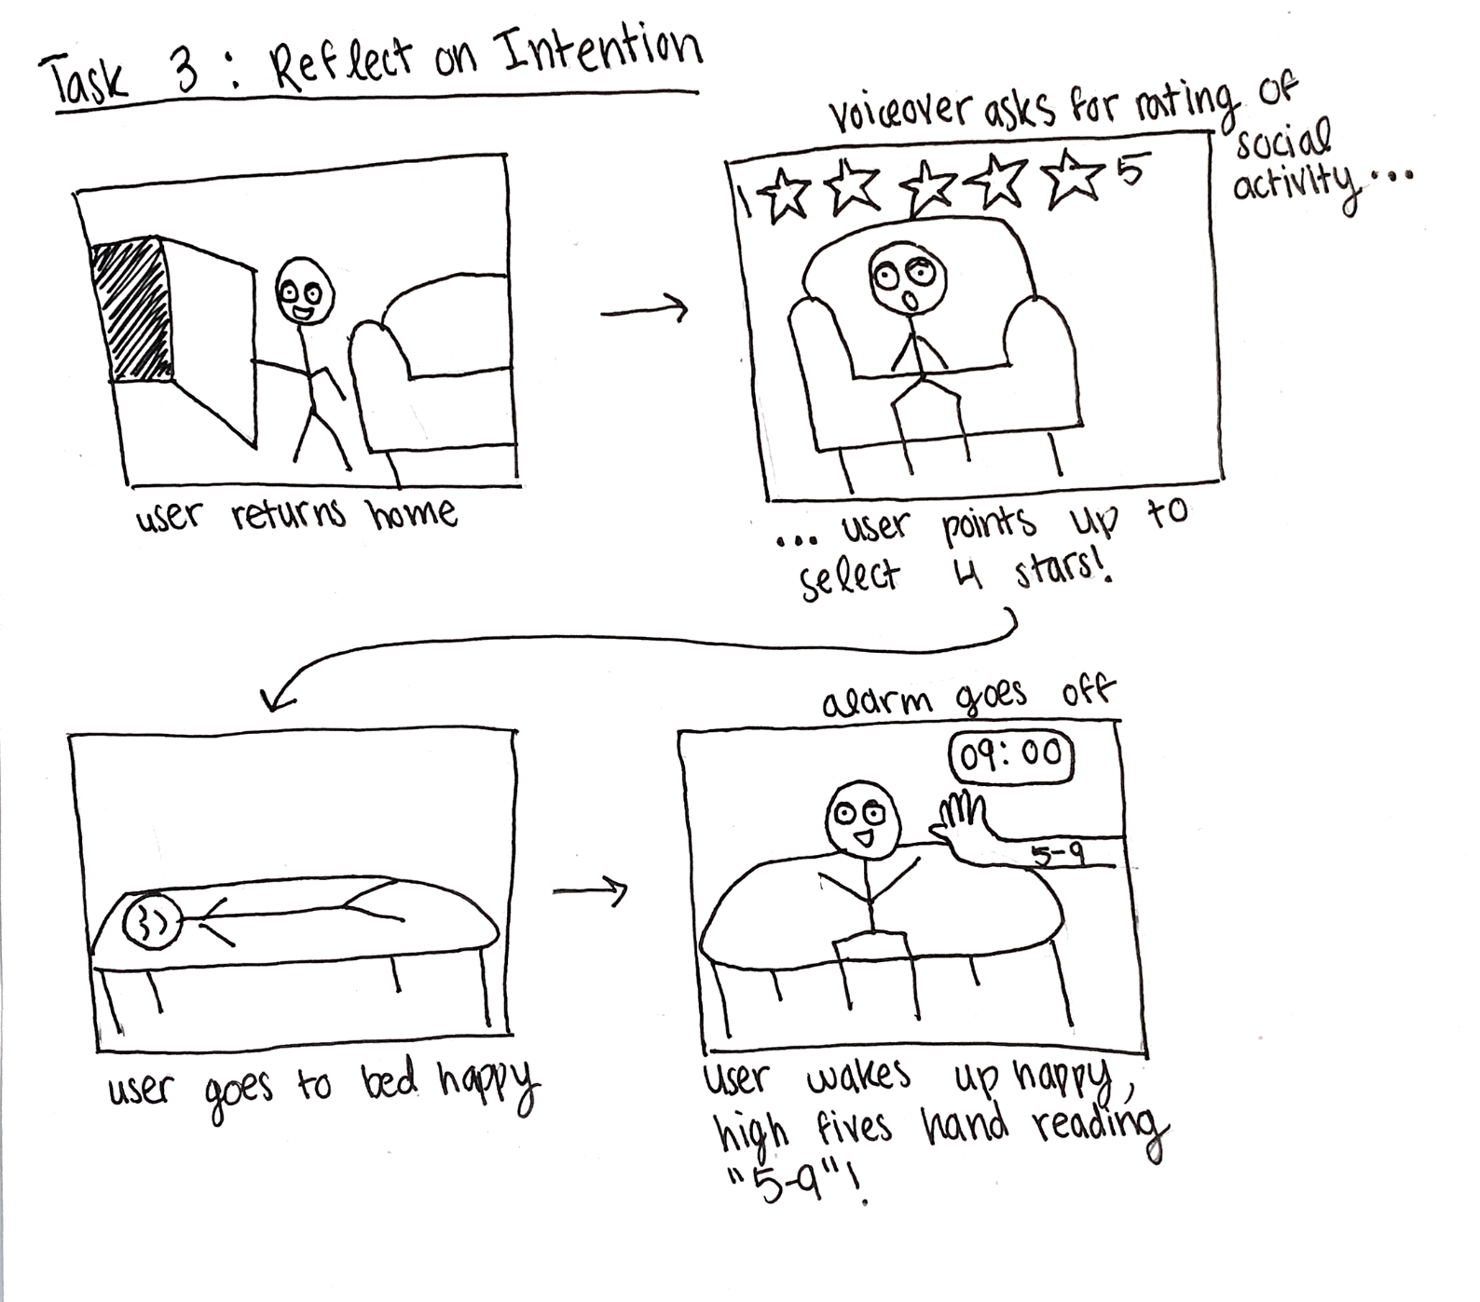
Notes:
Platon

Slide 9
Appendix
Notes:
Amy

Slide 10
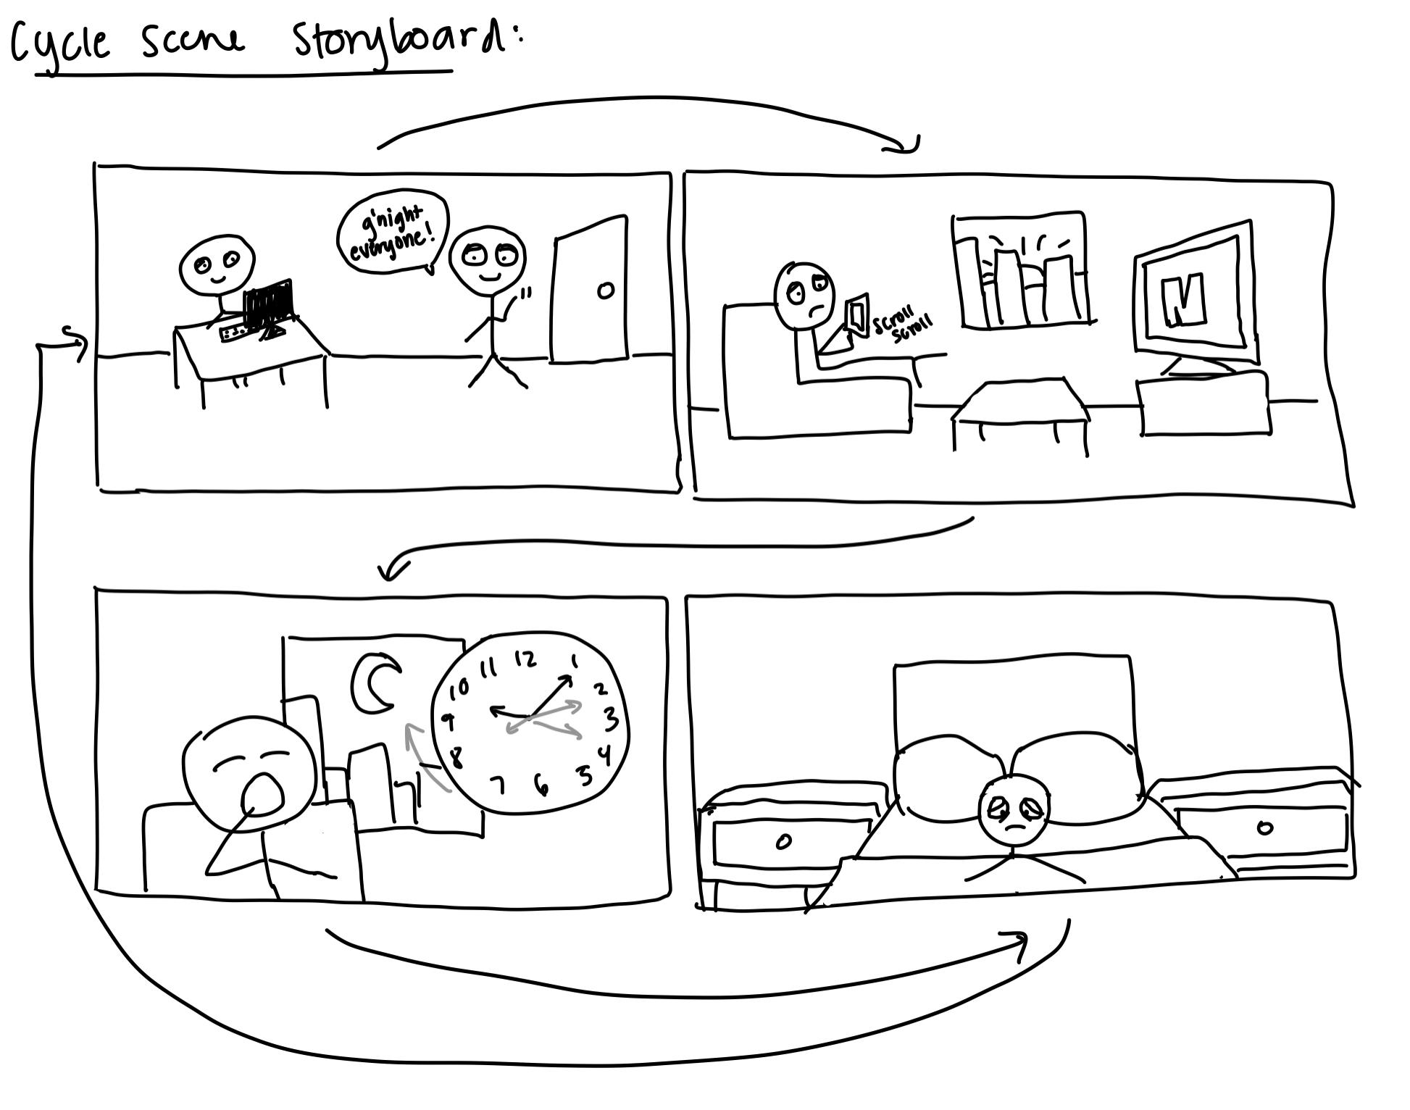
Notes:
Platon

