Slide 1



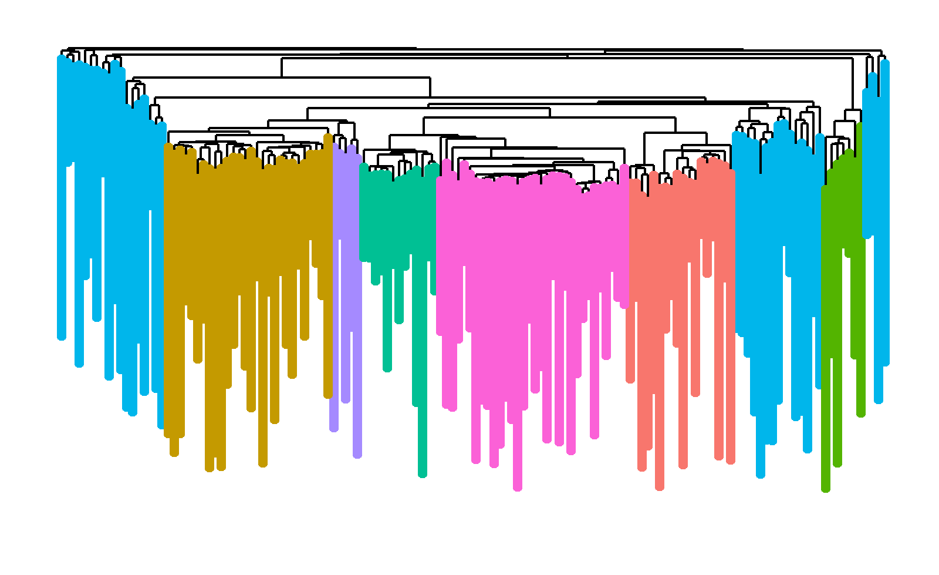
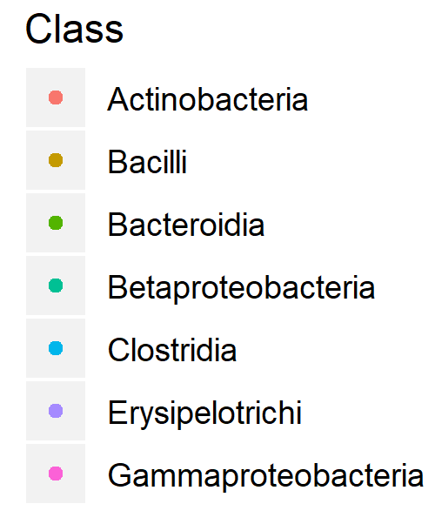
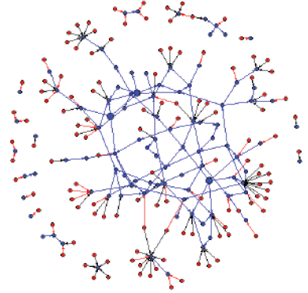
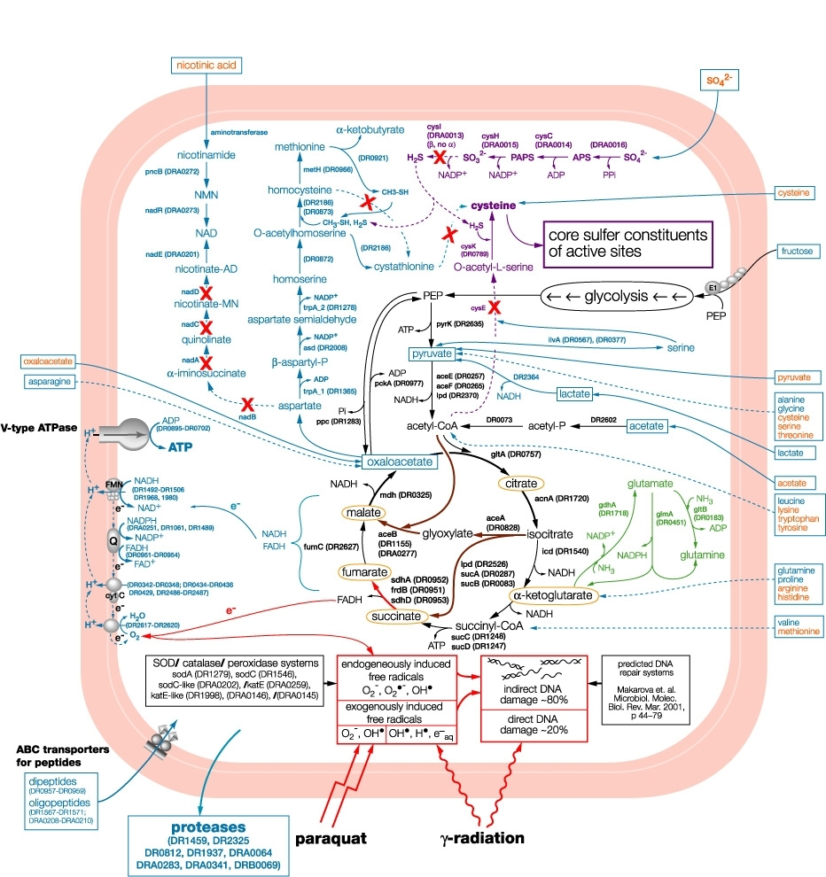
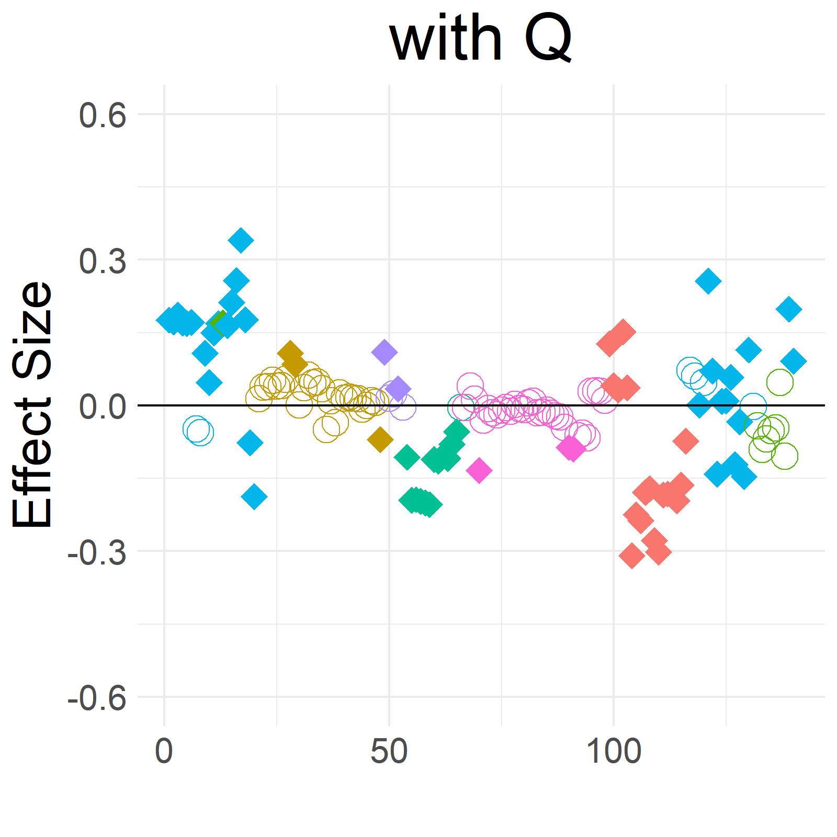
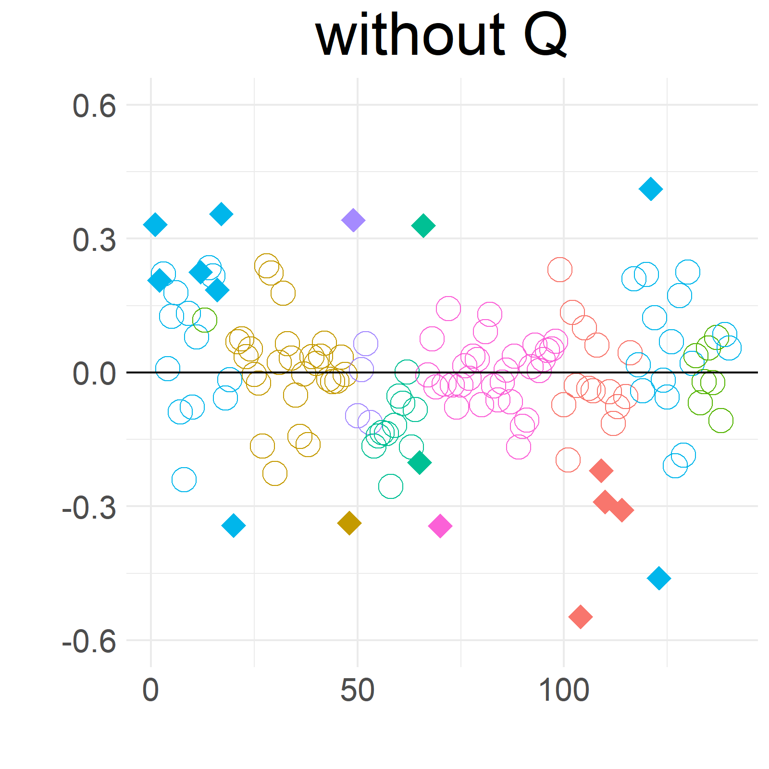

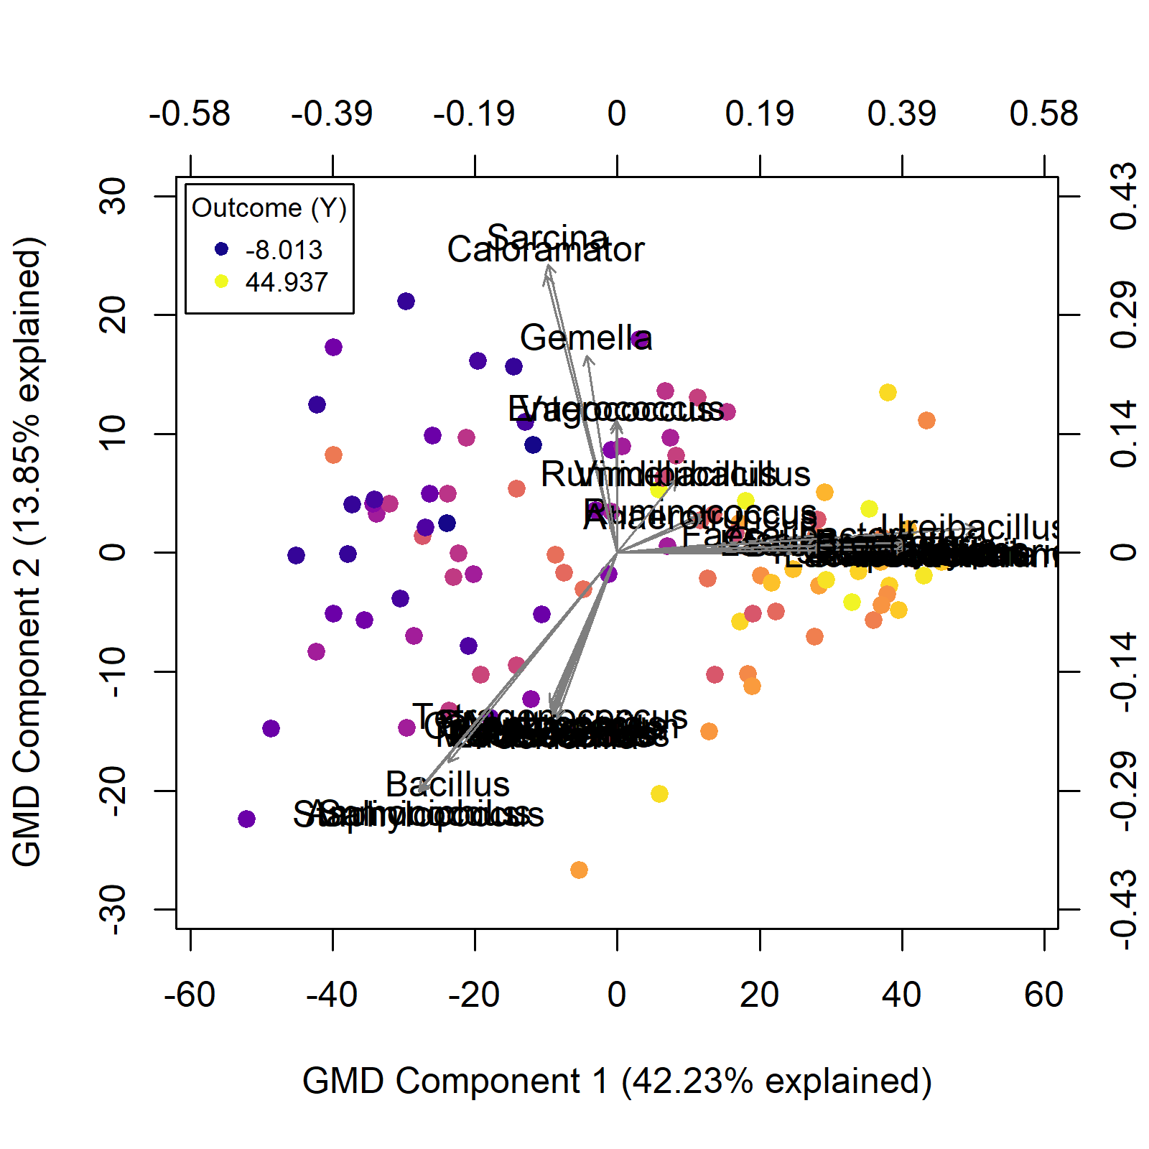
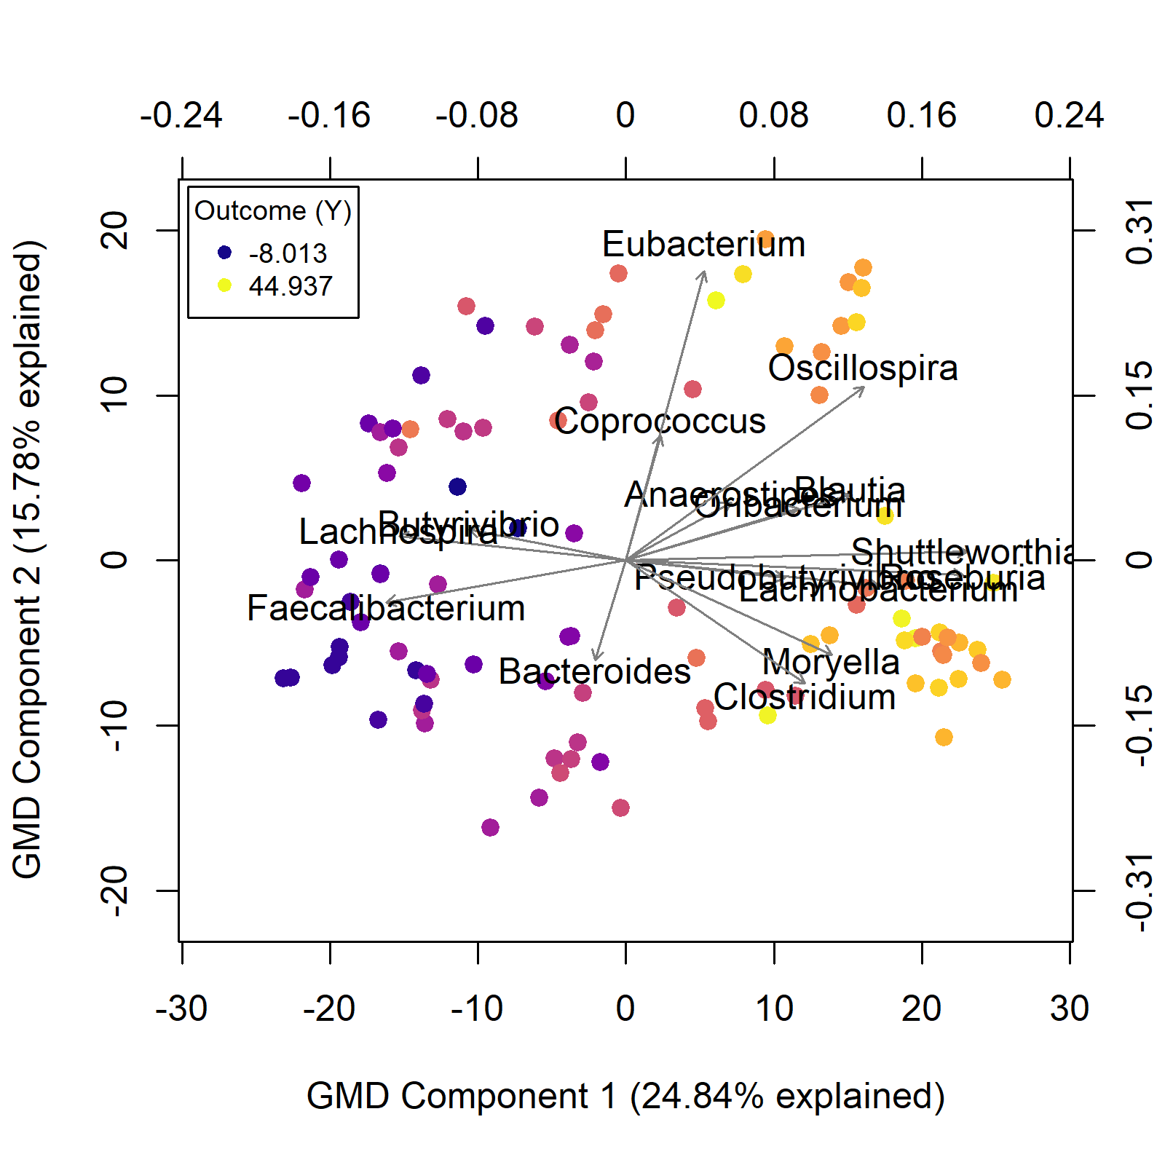
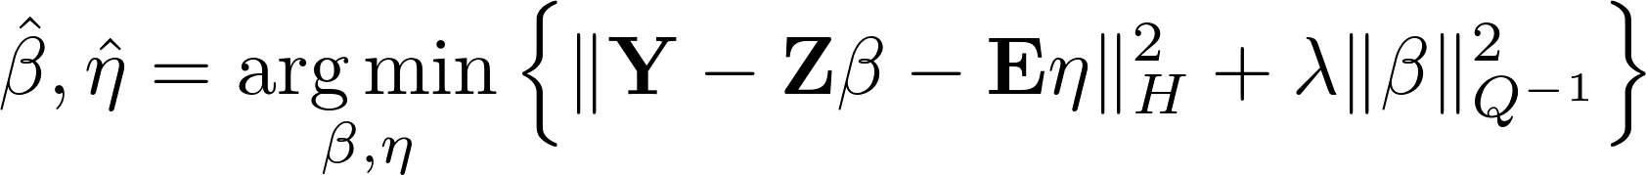
Estimation and inference for high dimensional, doubly-structured regression models
Parker Knight, Yue Wang, Timothy W. Randolph
Fred Hutchinson Cancer Research Center, Seattle, WA
University of Florida, Gainesville, FL
Background
Microbiome Data Analysis
Package Usage
Multiple regression models of the form
lack a unique solution in the high dimensional (p > n) case. This issue has been addressed by popular regularized regression models, such as the LASSO and Ridge regression. Kernel Penalized Regression (KPR) [1] is an extension of Ridge regression that incorporates external variable and subject structure, allowing researchers to include additional scientific information in high dimensional models.
We evaluated the KPR models by analyzing microbiome bacterial abundance data from [3], with subject age as the outcome.
The KPR package includes functions for processing structural data before it’s included in the regression model. For example, the generateSimilarityKernel function converts distance matrices to similarity kernels via Gower’s centering method.
library(KPR)
Q <- generateSimilarityKernel(patristic_dist)
H <- generateSimilarityKernel(unifrac_dist)
Users can fit models by passing their data matrices to the KPR function.
Figure 2: A phylogenetic tree constructed from 149 genera included in the analysis, colored by taxonomic class.
kpr.fit <- KPR(designMatrix = Z, covariates = E, Y = Y, Q = Q, H = H)
Regression Coefficient Estimates
Conclusions
With Q
Without Q
The KPR package provides an easy interface for fitting and interpreting Kernel Penalized Regression models. By using the package to analysis microbiome bacterial abundance data, we have shown that incorporating structured data into penalized regression models can improve interpretability and statistical power.
Moving forward, we plan on adding generalized KPR models (i.e. logistic regression), adaptive kernel penalties, and additional inference methods.
Figure 1: Examples of external variable structure; (left) a gene regulatory network, (right) metabolic pathways.
KPR models have the form
Figure 3: KPR coefficient estimates by index, colored by taxonomic class. Dark points indicate significance (p < 0.0001). (left) Coefficients from a KPR model with a Q matrix of phylogenetic data. (right) Coefficients from a model fit without a Q matrix.
where Z is a matrix of penalized variables and E is a matrix of unpenalized covariates.
We have developed an R software package for fitting KPR models by solving the following minimization problem:
Acknowledgements
This work is funded by Machine Learning Tools for Discovery and Analysis of Active Metabolic Pathways, R01GM114029; and Statistical models for multi-modal brain imaging studies, R01 MH108467. The Summer Undergraduate Research Program is supported in parts by the Cancer Center Support Grant (CCSG) CURE Supplement: NCI 3P30CA015704, the Fred Hutch Internship Program, and individual labs/research groups.
Q represents a matrix of variable structure and H is a matrix of sample structure. The penalized coefficients are tested for significance with the GMD Inference test [2].
References
[1] Randolph, T. et al (2018). Kernel-penalized regression for analysis of microbiome data. Ann. Appl. Stat. 12, no. 1, 540-566.
[2] Wang, Y. et al. Generalized Matrix Decomposition Regression. Technical report.
[3] Yatsunenko, T. et al (2012). Human gut microbiome viewed across age and geography. Nature, 486, 222-227.
[4] Wang, Y. et al. The GMD-biplot and its application to microbiome data. Technical report.
Figure 4: Generalized matrix decomposition biplots [4] of KPR models, colored by outcome. (left) Biplot of significant taxa from model fit with Q. (right) Biplot without Q.

