Slide 1
Genome Editing Efficiency Prediction
Woo chang Hwang
2018.08.24

Slide 2
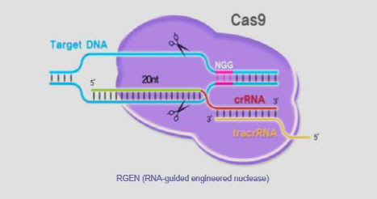
Genome Editing
Targeting a specific genomic location using complementary base-pairing of a single guide RNA (sgRNA) to the sequence of the genomic location.
Ontarget: perfect match
sgRNA
TGACTACGGCTAGCTAGCTTNGG
Target DNA
TGACTACGGCTAGCTAGCTTNGG
Offtarget: mismatch match
sgRNA
TGACTACGGCTAGCTAGCTTNGG
Target DNA
TGACTACGACTAGCTAGCTTNGG

Slide 3
Genome Editing Preliminary Result
Insertion-deletion(indel) frequency for each number of mismatches.

Slide 4
Genome Editing Preliminary Result
Indel frequency of ontargets with mapped reads(coverage) more than 49.

Slide 5
Genome Editing Preliminary Result
Indel frequency of 1 mm targets with mapped reads(coverage) more than 49.

Slide 6
Genome Editing Preliminary Result
Indel frequency of 2 mm targets with mapped reads(coverage) more than 49.

Slide 7
Machine Learning
sgRNA
A | C | G | T | T | G
PAM sequence
Indel frequency
Chromatin state
0 | 0 | 0 | 1 | 1 | 0
0 | 0 | 1 | 0 | 0 | 1
0 | 1 | 0 | 0 | 0 | 0
1 | 0 | 0 | 0 | 0 | 0
0 | 0 | 0 | 1 | 1 | 0
0 | 0 | 0 | 0 | 0 | 1
0 | 1 | 1 | 0 | 0 | 0
1 | 0 | 0 | 0 | 0 | 0
Target DNA
A | C | C | T | T | G

