Slide 1
시스템 개요
START
Focal length: Z,
INPUT_IMG,
Side length of QR code: DEFAULT_SIDE
Is QR code detected in INPUT_IMG?
Center point of detected QR code:
INPUT_CENTER
Distance measure
No
Angle measure
END
Output distance, angle

Slide 2



Slide 3

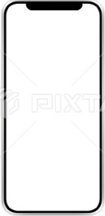

Slide 4
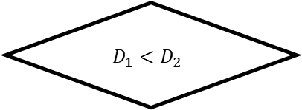
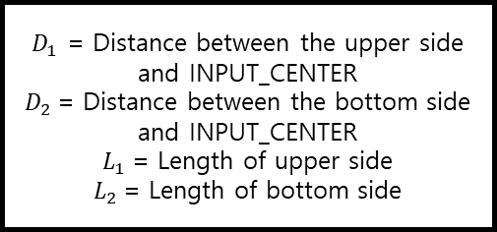

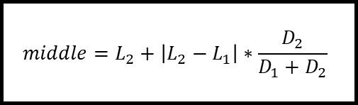

START
$$D_{1}<D_{2}$$
No
Four vertices of the detected QR code,
Center point of QR code: INPUT_CENTER
Yes
$$middle=L_{1}+\left|L_{2}−L_{1}\right|∗\frac{D_{1}}{D_{1}+D_{2}}$$
$$middle=L_{2}+\left|L_{2}−L_{1}\right|∗\frac{D_{2}}{D_{1}+D_{2}}$$
$D_{1}$ = Distance between the upper side and INPUT_CENTER
$D_{2}$= Distance between the bottom side and INPUT_CENTER
$L_{1}$= Length of upper side
$L_{2}$= Length of bottom side
$$result=Z∗DEFAULT_ SIDE/middle$$
END
Output result

Slide 6
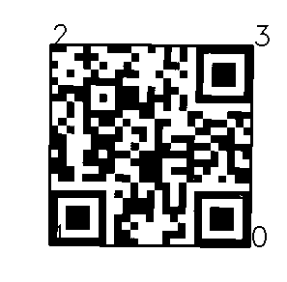
middle
Z
H
H=Z * DEFAULT_SIDE / middle
DEFAULT_SIDE

Slide 7








$$L_{1}$$
$$L_{1}$$
$$D_{1}$$
$$D_{1}$$
$$D_{2}$$
$$D_{2}$$
$$L_{2}$$
$$L_{2}$$

Slide 9
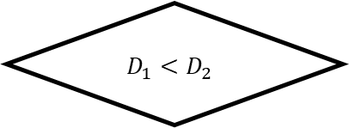
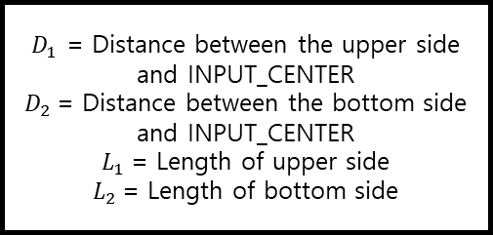

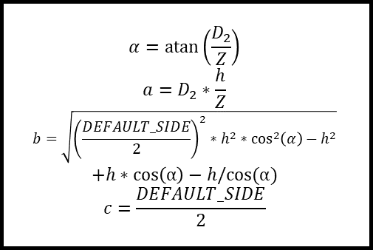

START
$$D_{1}<D_{2}$$
No
Four vertices of the detected QR code,
Center point of QR code: INPUT_CENTER,
Measurement Height: h
Yes
$$α=\operatorname{atan}\left(\frac{D_{1}}{Z}\right)$$
$$a=D_{1}∗\frac{h}{Z}$$
$$b=\sqrt{{\left(\frac{DEFAULT_SIDE}{2}\right)}^{2}∗h^{2}∗\cos^{2}\left(α\right)−h^{2}}$$
$$+h∗\cos\left(α\right)−h/cos⁡(α)$$
$$c=\frac{DEFAULT_SIDE}{2}$$
$$α=\operatorname{atan}\left(\frac{D_{2}}{Z}\right)$$
$$a=D_{2}∗\frac{h}{Z}$$
$$b=\sqrt{{\left(\frac{DEFAULT_SIDE}{2}\right)}^{2}∗h^{2}∗\cos^{2}\left(α\right)−h^{2}}$$
$$+h∗\cos\left(α\right)−h/cos⁡(α)$$
$$c=\frac{DEFAULT_SIDE}{2}$$
$D_{1}$ = Distance between the upper side and INPUT_CENTER
$D_{2}$= Distance between the bottom side and INPUT_CENTER
$L_{1}$= Length of upper side
$L_{2}$= Length of bottom side
$$result=acos⁡(\frac{a^{2}∗c^{2}−b^{2}}{2ac})$$
END
Output result

Slide 10
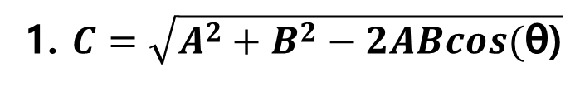
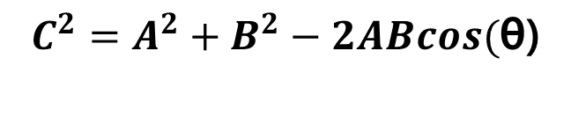
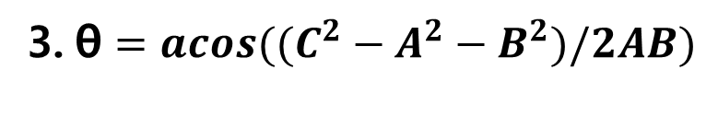
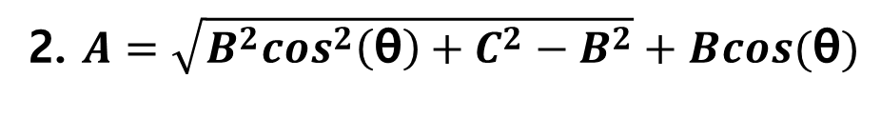
1. $C=\sqrt{A^{2}+B^{2}−2ABcos(\text{θ}\text{)}}$
A
C
2. $A=\sqrt{B^{2}cos^{2}\left(\text{θ}\right)+C^{2}−B^{2}}+Bcos(\text{θ})$
θ
3.$\text{θ}=acos((C^{2}−A^{2}−B^{2})/2AB)$
B
$$C^{2}=A^{2}+B^{2}−2ABcos(\text{θ}\text{)}$$

Slide 11
dist1
dist2
length1
dist1
Z
dist2
length2
height

Slide 12

dist1
dist2
dist1
dist2
Z
Z
α
height
$$\text{θ}$$
DEFAULT_SIDE/2

Slide 13

α
height
height/cos(α)
dist1*height/Z
$$\text{θ}$$
D
DEFAULT_SIDE/2

Slide 14
Z(고정)

Slide 15
Z(고정)

Slide 16
Z(고정)

Slide 17
α
D
A
α
α
D
C
A
A
B
D-E
α
C
B
E
A
C
B

Slide 18
B
θ
D-E
C

Slide 19
Z(고정)
Z(고정)

