Slide 1
Machine learning for predicting churn
Pongpisut KONGDAN (6370175121)

Slide 2
Background Information
In today telecommunication industry, there is a huge competition, on of the challenges in the telecommunication industry is the retention. Industry is struggling on maximizing profit from acquiring a new customer, which cost company a lot more when compare with retaining the existing customers; Therefore, for the company to increase it profitability.

Slide 3
Problems
Churn
Unpredictable churner tendency
Customer Behavior
New Customers Cost
Higher than retaining
No insight of customers behavior

Slide 4
Workable Solutions
Data Preparation
Separate data in to three sets
Algorithm & Parameter
Choosing algorithm which we going to use in this study
Test of algorithm
Diagnostic of result we acquire
Setting of parameters – for each machine learning algorithm we are going to implement
Plot graph and seek basis descriptive math on our dataset
Type of data

Slide 5
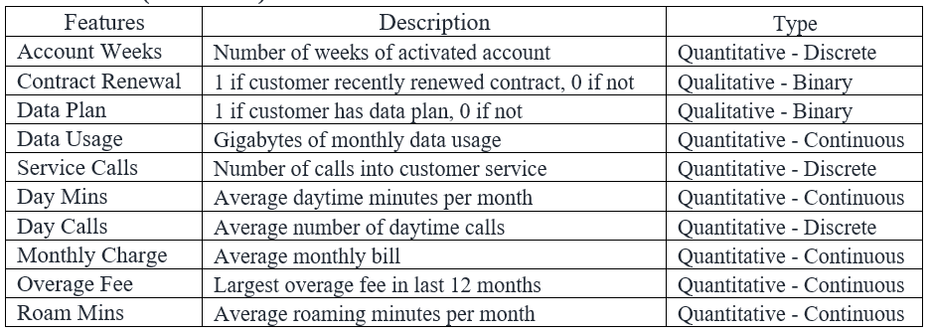
Variables (Attributes)

Slide 6
datasets
Training data (2,000 records – 60%)
Cross validation data (667 recodes – 20%)
Test data (666 records – 20%).

Slide 7
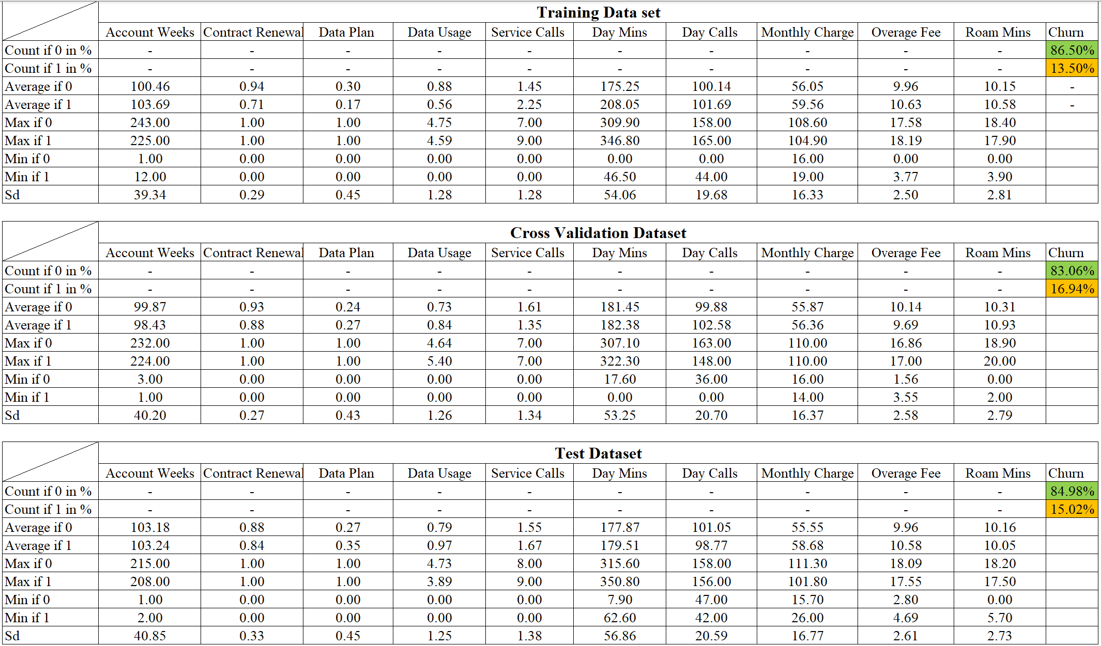
Exploration on dataset

Slide 8
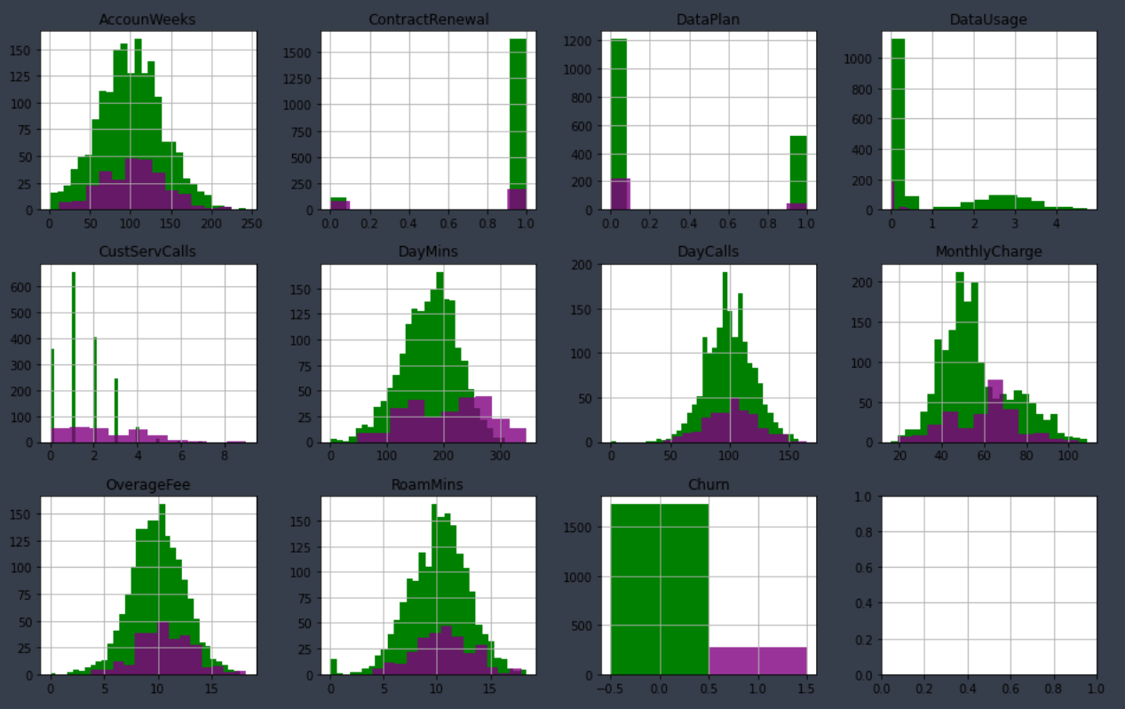
Visualize our data
Skewed Class
Differences on average values
Some outliers

Slide 9
methodology
Algorithms
Logistic Regression Algorithm
Support Vector Machine Algorithm
Neural Network Algorithm
Diagnostic Tools
Learning Curve
Gradient Checking
Precision, Recall, and F1 Score

Slide 10
Logistic Regression
Parameters
Account Weeks, Data Usage, Cust Service Calls, Day Mins, Monthly Charge, and Roam Mins.
Features will be normalized with and without Regularized Terms
Training using scipy.optimize
200 iterations, lambda = 1
Evaluation methods
Learning Curve
Precision, Recall, and F1 score

Slide 11
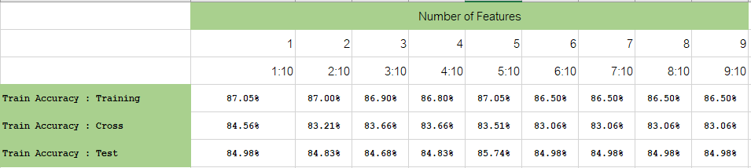
Logistic Trial and error

Slide 12
Support Vector Machine
Parameters
Account Weeks, Data Usage, Cust Service Calls, Day Mins, Monthly Charge, and Roam Mins.
Features will be normalized
Gaussian Kernel
C =1 , Sigma = 0.1
Evaluation methods
Precision, Recall, and F1 score

Slide 13
Neural network
Parameters
FW and BW propagation, using all the feature we have
Features will be normalized, and we will have regularized terms
Sigmoid Function
Trial and error for best of hidden layer (5, 10, 15, 20, 25, 50,70,100,200)
Trial and error for best of lambda (0.1, 0.2, 0.3, 0,4, 0.5, 0.7, 1, 1.5, 2, 2.5, 3)
Iteration = 50,000
Random initial theta
Evaluation methods
Precision, Recall, and F1 score
Gradient Checking

Slide 14
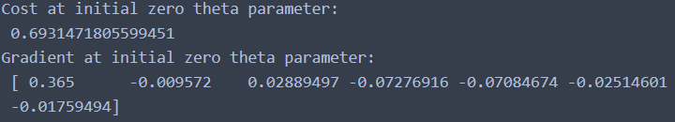
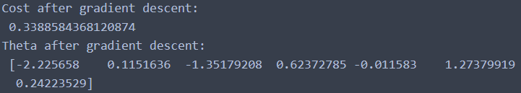
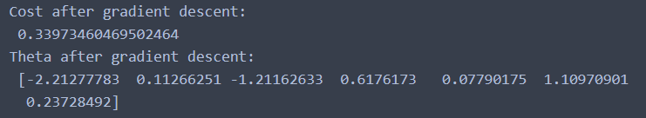


Result : Logistic Regression
Result from zero initial theta
Result from Regularized
Result from Non-regularize

Slide 15
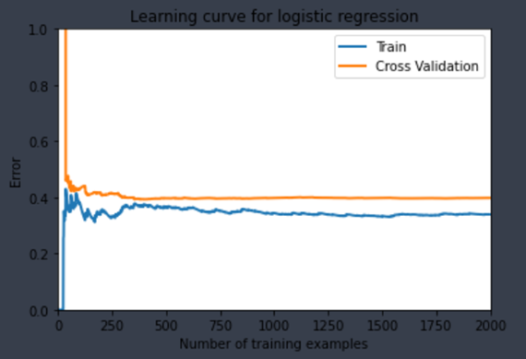
Model evaluations
Learning curve – non regularized
F1 score : Non-regularized

Slide 16
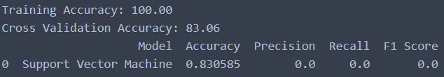
Result : support vector machine
Accuracy and F1 score
Overfitting
Zero True Positive
Complex non – Linear Function

Slide 17
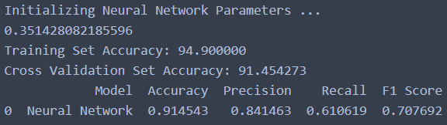
Result Neural network
Hidden layer beyond 25 prone to increase overfitting(high variance)
Lambda beyond 1 prone to increase underfitting (prediction accuracy)
8.4% and 8.39%
Close range precision and recall
0.7 F1Score
Handling Skewed dataset capability

Slide 18
Final Result
Computed by Neural Network Algorithm with Sigmoid Function

Slide 19
conclusion
Winner is Neural Network Algorithm
Logistic Regression result in low accuracy
Trying pairs of features
Support Vector Machine result in overfitting and always predict zero
Trying smaller set of features
Getting more training example data

Slide 20
conclusion
The model can allow company to have better chance to identify potential churner.
Craft the strategies to retain customers
Reduce cost
Gain insights into customer behavior
Data-driven method
Others algorithm
Random Forest
Decision tree

Slide 21
Q & A

Slide 22
Thank you

