Slide 1
Q1
18
W = 206
W/2 = 103
18<103
18
36
74<103
56
20
The optimal location for the tool crib is at coordinate (55, 55)
129>103
23
32
*
55
132>103
46
11
77<103
77<103
57
20
20<103
20
20
20
23
32
20
18
82
11
20<103
75<103
113>103
43<103
95<103
*
111>103
93<103
11<103

Slide 2
r_{A} = 0.08
r_{B} = 0.05
r_{C} = 0.15
r_{D} = 0.03
Q2
Durham
Asheville
Durham
r_{out} = 0.8
A
2 tons
10 t/year
Statesville
Winston-Salem
Statesville
B
0.55 tons
38 t/year
1 ton
NF
NF
C
1.2 tons
20 t/year
Greensboro
Wilmington
Greensboro
D
0.35 tons
46 t/year
D
0.35 tons
Annual demand of product is 114 tons
W = 134.292 $/mi-year
W/2 = 67.146 $/mi-year
Asheville
Raleigh
f_{A} = 2*114 = 228 t/year w_{A} = 228*0.08 = 18.24 $/mi-year f_{Ash} = 10*0.8 = 8 $/mi-year
f_{B} = 0.55*114 = 62.7 t/year w_{B} = 62.7*0.05 = 3.135 $/mi-year f_{WS} = 38*0.8 = 30.4 $/mi-year
f_{C} = 1.2*114 = 136.8 t/year w_{C} = 136.8 *0.15 = 20.52 $/mi-year f_{Gr} = 20*0.8 = 16 $/mi-year
f_{B} = 0.35*114 = 39.9 t/year w_{D} = 39.9 *0.03 = 1.197 $/mi-year f_{R} = 46*0.8 = 36.8 $/mi-year
W_{in} = 43.092
W_{out} = 91.2
As W_{in} < W_{out}, product is weight gaining
Asheville
Statesville
Winston-Salem
Greensboro
Durham
Raleigh
Wilmington
9.197
3.135
30.4
16
18.24
36.8
20.52
9.197<67.146 12.332<67.146 42.732<67.146 58.732<67.146 76.972>67.146
75.56>67.146 57.32<67.146 20.52<67.146
Durham is optimal place to locate a plant to in order to minimize transportation costs

Slide 3
Q4
k = 3
X TC
1 48779
2 43912
3 39393
4 35216
5 31375
6 27864
7 24677
8 21808
9 19251
10 17000
11 15049
12 13392
13 12023
14 10936
15 10125
X TC
16 9584
17 9307
18 9288
19 9521
20 10000
21 10719
22 11672
23 12853
24 14256
25 15875
26 17704
27 19737
28 21968
29 24391
30 27000
TC = Σw_{i}d³ = 1(x-0)³ + 2(30-x)³
dTC/dx = 3x² + 6(30-x)²*(-1) = 0
3x² – 5400 + 360x – 6x² = 0
-3x² + 360x – 5400 = 0
x² - 120x + 1800 = 0
x₁ = 17.57
x₂ = 102.43 – not feasible
x = 17.57 is the point with minimum TC
TC (17.57) = 1(17.57 - 0)³ + 2(30 - 17.57)³ =
= 5423.945093 + 3840.991814 = 9264.937

Slide 4
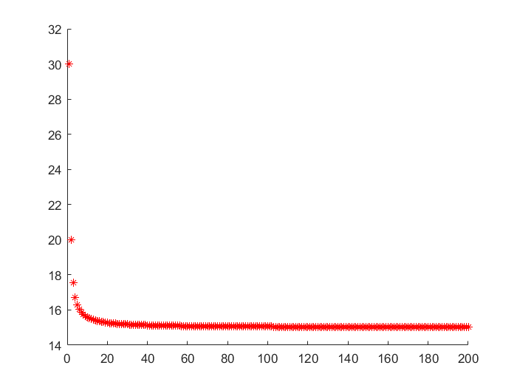
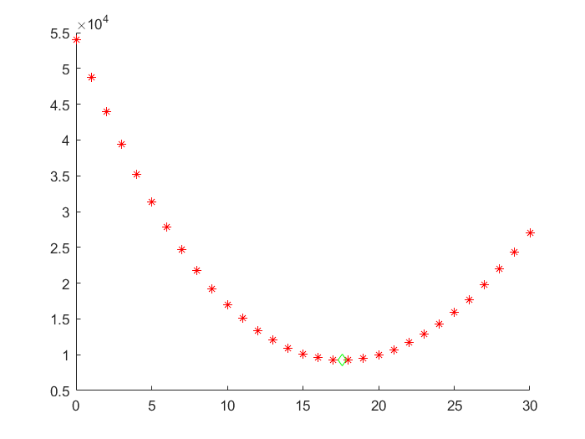
x
TC
X, when k → ∞
TC, when k = 3
k
x

