Slide 1
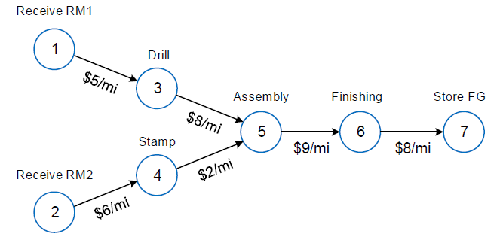
ISE 754 HW 4
Pavel Koprov
Question 2.
n = 4, m = 3
V_{4x4} = 1 2 3 4
1 0 0 8 0
2 0 0 2 0
3 0 0 0 9
4 0 0 0 0
W_{4x3} = 1 2 3
1 5 0 0
2 0 6 0
3 0 0 0
4 0 0 8
1
0 0 8 0
0 0 2 0
8 2 0 9
0 0 9 0
3
4
3
V = V+V’ =
2

Slide 2
ISE 754 HW 4
Pavel Koprov
Question 2.
5 0 0 |0 0 8 0
0 6 0 |0 0 2 0
0 0 0 |8 2 0 9
0 0 8 |0 0 9 0
Σ =17 => V_{4,3}= 9>8.5 => NF4 and NF3 should be co-located
1. [W V] =
5 0 0 |0 0 8
0 6 0 |0 0 2
0 0 8 |8 2 0
Σ = 13 => v_{1,3} = 8>6.5 => NF1 and NF3 (and NF4) co-located
Σ = 18 => all w and v < 9
[W V] =
[W V] =
5 0 8 |0 2
0 6 0 |0 0
Σ = 15 => w_{1,3} = 8>7.5 => NF1, NF3 and NF4 should be located at EF3
Σ = 6 => w_{2,2}= 6 > 0 => NF2 should be located at EF2
Drilling, assembling, and finishing should be performed at EF3. Stamping should be performed at facility EF2.

Slide 3
Question 3.
Greenville
RM4
4 gal
Portland
NF3
Mix 3
RM3
3 gal
Nashville
NF2
Mix 2
1 gal
1 gal
Gainesville
RM1
2 gal
Mix 1
1 gal
NF1
RM 2
1 gal
Roseville

Slide 4
Question 3.
n = 3, m = 5
V_{3x3} = 1 2 3
1 0 1 0
2 0 0 1
3 0 0 0
W_{3x5} = 1 2 3 4 5
1 2 1 0 0 0
2 0 0 3 0 0
3 0 0 0 4 1
0 1 0
1 0 1
0 1 0
V = V+V’ =
4
4 gal
3
3
1 gal
5
3 gal
1 gal
1
2
2 gal
1 gal
1
1 gal
2
2 1 0 0 0| 0 1 0 Σ =4 => w_{1,1}=2=2, NF1 locate at EF1
0 0 3 0 0| 0 0 1 Σ =4 => w_{2,3}=3>2, NF2 locate at EF3
0 0 0 4 1| 0 0 0 Σ =5 => w_{3,4}=4>2.5 NF3 locate at EF4
[W V] =
Mixture 1 should be produced in Gainesville.
Mixture 2 should be produced in Portland
Mixture 3 should be produced in Greenville.

Slide 5
Question 4.b)
3
0.6
4
2
2.4
1
1.488
4
2.1
5
1
0.9
2.2
6
0.4844
3
2
1.8
7
1.5
8

Slide 6
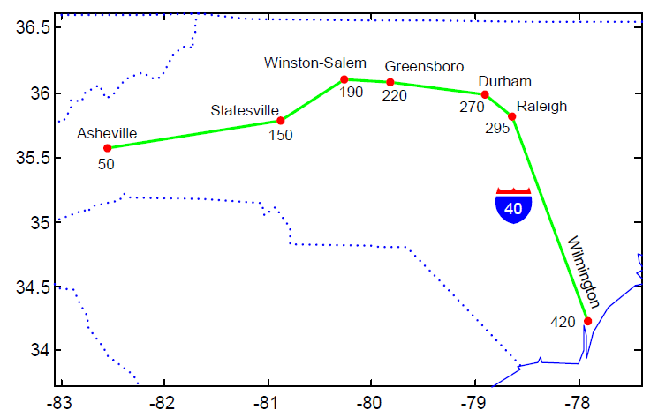
Question 5.a)
50
150
220
1 0 0 0 0 0 0
0 1 0 0 0 0 0
0 0 1 1 1 1 1
Allocate = W =
X₂ = [50 150 220]’
TC₂ = 30+50+75+200 = 355
TC₂ < TC₁
TC* = TC₂
50
150
270
1 0 0 0 0 0 0
0 1 1 0 0 0 0
0 0 0 1 1 1 1
Allocate = W =
X₃ = [50 150 270]’
TC₃ = 40+50+25+150 = 265
TC₃ < TC*
TC* = TC₃
50
150
295
1 0 0 0 0 0 0
0 1 1 1 0 0 0
0 0 0 0 1 1 1
Allocate = W =
X₄ = [50 150 295]’
TC₄ = 40+50+70+25+125 = 310
TC₄ > TC*
The ALA solution is (50, 150, 270), with TC = 265
P = [50 150 190 220 270 295 420]’
60
125
130
1 0 0 0 0 0 0
0 0 0 0 0 0 0
0 1 1 1 1 1 1
Allocate = W =
X₁ = [50 150 rand(P_{i})]’
TC₁ = 10+20+60+90+140+165+290 = 755

