Slide 1
ISE 754 HW 8
Pavel “Pasha” Koprov
Question 1a
Initial location sequence 1, 5, 2, 6, 4, 3, 1 with a total distance of 22. Sequences considered at end to verify local optimum for n = 6: 9.
1 2 5 6 4 3 1: TD = 38
1 6 2 5 4 3 1: TD = 22
1 4 6 2 5 3 1: TD = 40
1 3 4 6 2 5 1: TD = 27
1 5 6 2 4 3 1: TD = 28
1 5 4 6 2 3 1: TD = 20 – improvement.
Start verifying again:
1 4 5 6 2 3 1: TD = 41
1 6 4 5 2 3 1: TD = 34
1 2 6 4 5 3 1: TD = 41
1 3 2 6 4 5 1: TD = 28
1 5 6 4 2 3 1: TD = 25
1 5 2 6 4 3 1: TD = 26
1 5 3 2 6 4 1: TD = 25
1 5 4 2 6 3 1: TD = 20
1 5 4 3 2 6 1: TD = 13 – improvement.
Start verifying again:
1 4 5 3 2 6 1: TD = 39
1 3 4 5 2 6 1: TD = 34
1 2 3 4 5 6 1: TD = 31
1 6 2 3 4 5 1: TD = 27
1 5 3 4 2 6 1: TD = 24
1 5 2 3 4 6 1: TD = 24
1 5 6 2 3 4 1: TD = 25
1 5 4 2 3 6 1: TD = 12 – improvement.
Start verifying again:
1 4 5 2 3 6 1: TD = 34
1 2 4 5 3 6 1: TD = 40
1 3 2 4 5 6 1: TD = 39
1 6 3 2 4 5 1: TD = 33
1 5 2 4 3 6 1: TD = 21
1 5 3 2 4 6 1: TD = 30
1 5 6 3 2 4 1: TD = 31
1 5 4 3 2 6 1: TD = 13
1 5 4 6 3 2 1: TD = 18
The final location sequence determined after applying the twoopt improvement procedure is 1 5 4 2 3 6 1, with total distance 12.

Slide 2
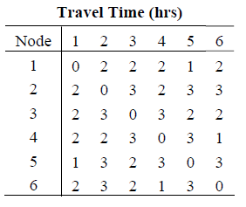
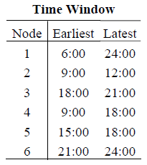
Question 2a
Sequence: 1 4 2 5 3 6 1
Earliest finish – Latest start = 23 – 8 = 15 hr = 13 travel + 2 delay
a = 8 – 9
b = 10
c = 10
a = 11
b = 14 – 12
c = 12
[9,18]
[9,12]
4
2 hr
2
Earliest start a = 6
Latest start: b = 8
c = 8
2 hr
3 hr
a = 13 – 15
b = 17
c = 15
[6,24]
1
5
[15,18]
a = 23
Earliest finish b = 23
c = 23
2 hr
2 hr
a = 20 – 21
b = 21
c = 20 – 21
6
2 hr
3
a = 17 – 18
b = 19 – 18
c = 17 – 18
[21,24]
[18,21]

Slide 3
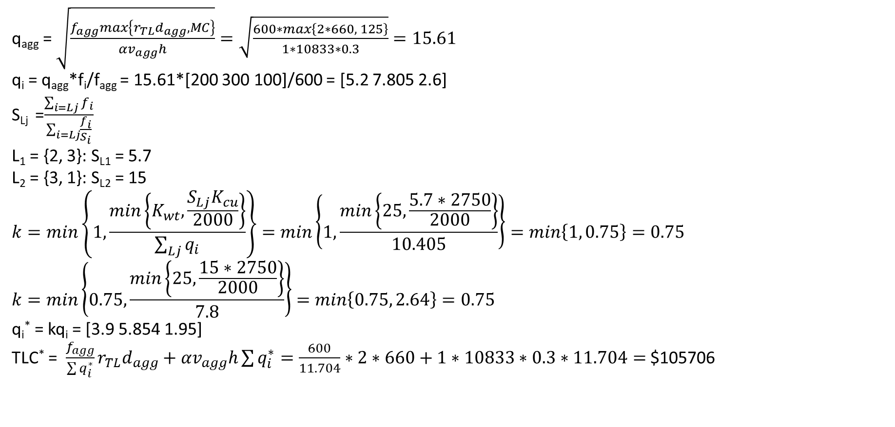
Question 3a
q_{agg} = $\sqrt{\frac{f_{agg}max\left\{r_{TL}d_{agg}, MC\right\}}{αv_{agg}h}}=\sqrt{\frac{600∗max\left\{2∗660, 125\right\}}{1∗10833∗0.3}}=15.61$
q_{i} = q_{agg}*f_{i}/f_{agg} = 15.61*[200 300 100]/600 = [5.2 7.805 2.6]
S_{Lj} =$\frac{\sum_{i=Lj}{f_{i}}}{\sum_{i=Lj}{\frac{f_{i}}{S_{i}}}}$
L₁ = {2, 3}: S_{L1} = 5.7
L₂ = {3, 1}: S_{L2} = 15
$$k=min\left\{1,\frac{min\left\{K_{wt},\frac{S_{Lj}K_{cu}}{2000}\right\}}{\sum_{Lj}{q_{i}}}\right\}=min\left\{1,\frac{min\left\{25,\frac{5.7∗2750}{2000}\right\}}{10.405}\right\}=min\left\{1, 0.75\right\}=0.75$$
$$k=min\left\{0.75,\frac{min\left\{25,\frac{15∗2750}{2000}\right\}}{7.8}\right\}=min\left\{0.75, 2.64\right\}=0.75$$
q_{i}* = kq_{i} = [3.9 5.854 1.95]
TLC* = $\frac{f_{agg}}{\sum{q_{i}^{∗}}}r_{TL}d_{agg}+αv_{agg}h\sum{q_{i}^{∗}}=\frac{600}{11.704}∗2∗660+1∗10833∗0.3∗11.704=$ $105706

