Slide 1
Smart Manufacturing
Dr. Binil Starly
James T. Ryan Professor
Edward P. Fitts Department of Industrial & Systems Engineering

Slide 2
What is Smart Manufacturing
Manufacturing Systems that are “fully-integrated, collaborative manufacturing systems that respond in real time to meet changing demands and conditions in the factory, in the supply network, and in customer needs.”
US National Institute of Standards and Technology (NIST)

Slide 3
Manufacturing Productivity
Tremendous Progress in Manufacturing Productivity Over the Last 30 years.
Traditional Levers
Lean Manufacturing
Total Quality Management
Flexible Manufacturing
Automation

Slide 4
What Next for Manufacturing ?
Experimenting with new technologies
Machine-to-machine digital connectivity
Advanced automation
Additive manufacturing
Artificial intelligence (AI)/Machine learning,
Connected Products
Since 2010, there has been a steady Movement in manufacturing leading to the Industry 4.0 movement
Notes:
In the US, for instance, the productivity of industrial workers has increased by 47 percent over the past 20 years. But the traditional levers that have driven these gains, such as lean operations, Six Sigma, and total quality management, are starting to run out of steam, and the incremental benefits they deliver are declining.

Slide 5
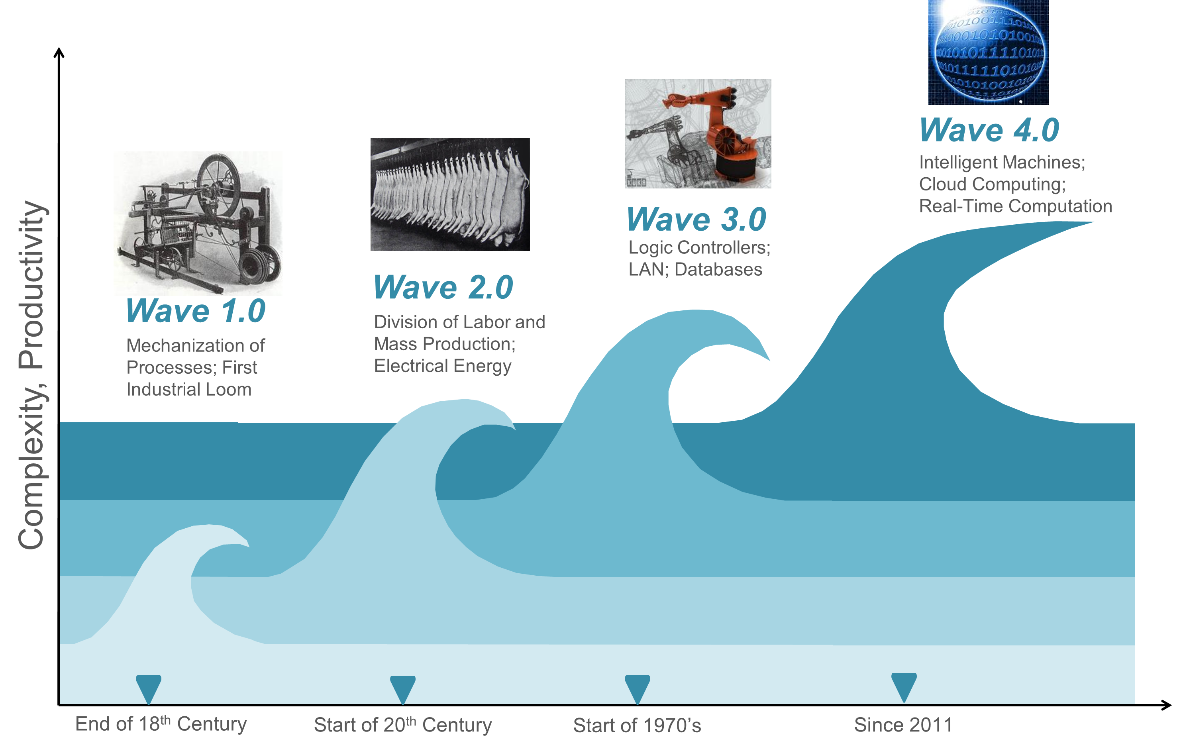
Industrial Revolution Waves

Slide 6
Synonym Terms for Smart Manufacturing
Industry 4.0
Industrial Internet of Things (IIoT)
Digitalization of Manufacturing
Digital Transformation of Manufacturing
Digital Manufacturing
Cyber-Physical Manufacturing
Digital Factories
Smart Factories
Cloud Manufacturing

Slide 7
Smart Manufacturing Characteristics
Connectivity
Sensors
Intelligence/Analytics
Smart Inspection
Human Machine Interaction
Collaborative Robots
Advanced Processes/Products
Additive Manufacturing
Nanomaterials
AR/VR/Wearable Devices
Real-time Forecasting
Connected Assets
Connected Products
Chat-Bots
Flexible Materials
Proactive Maintenance

Slide 8
Smart Manufacturing Characteristics
Connectivity
Sourcing Insights
Real-time tracking of assets
HMI
Reduced wastage and digitization to e-procure
Interactive dashboards that providing real-time decision making
Intelligence
Optimizing Product Cost through digitization
Simulation based forecasting from thousands of factors
Advanced Products
Distributed production and closer-to-customer manufacturing
Flexible production and reduced cost to mass customization
Visibility of Asset Utilization
Delivery Status Updates
Predictive/Proactive Maintenance
AI for optimizing logistics
Enhanced customer product interfaces
Joined tasks with robots and humans collaboration
Reducing components and integrating components
Sensors embedded in products predict future demand
VALUE
Optimizing Procurement
Forecasting & Planning
Digitizing Factories
Streamlining Distribution

Slide 9
6
GE – Industrial Internet
Peter Evans, Marco Annunziata, Pushing Boundaries of Minds and Machines, GE Industrial Internet, 2012

Slide 10
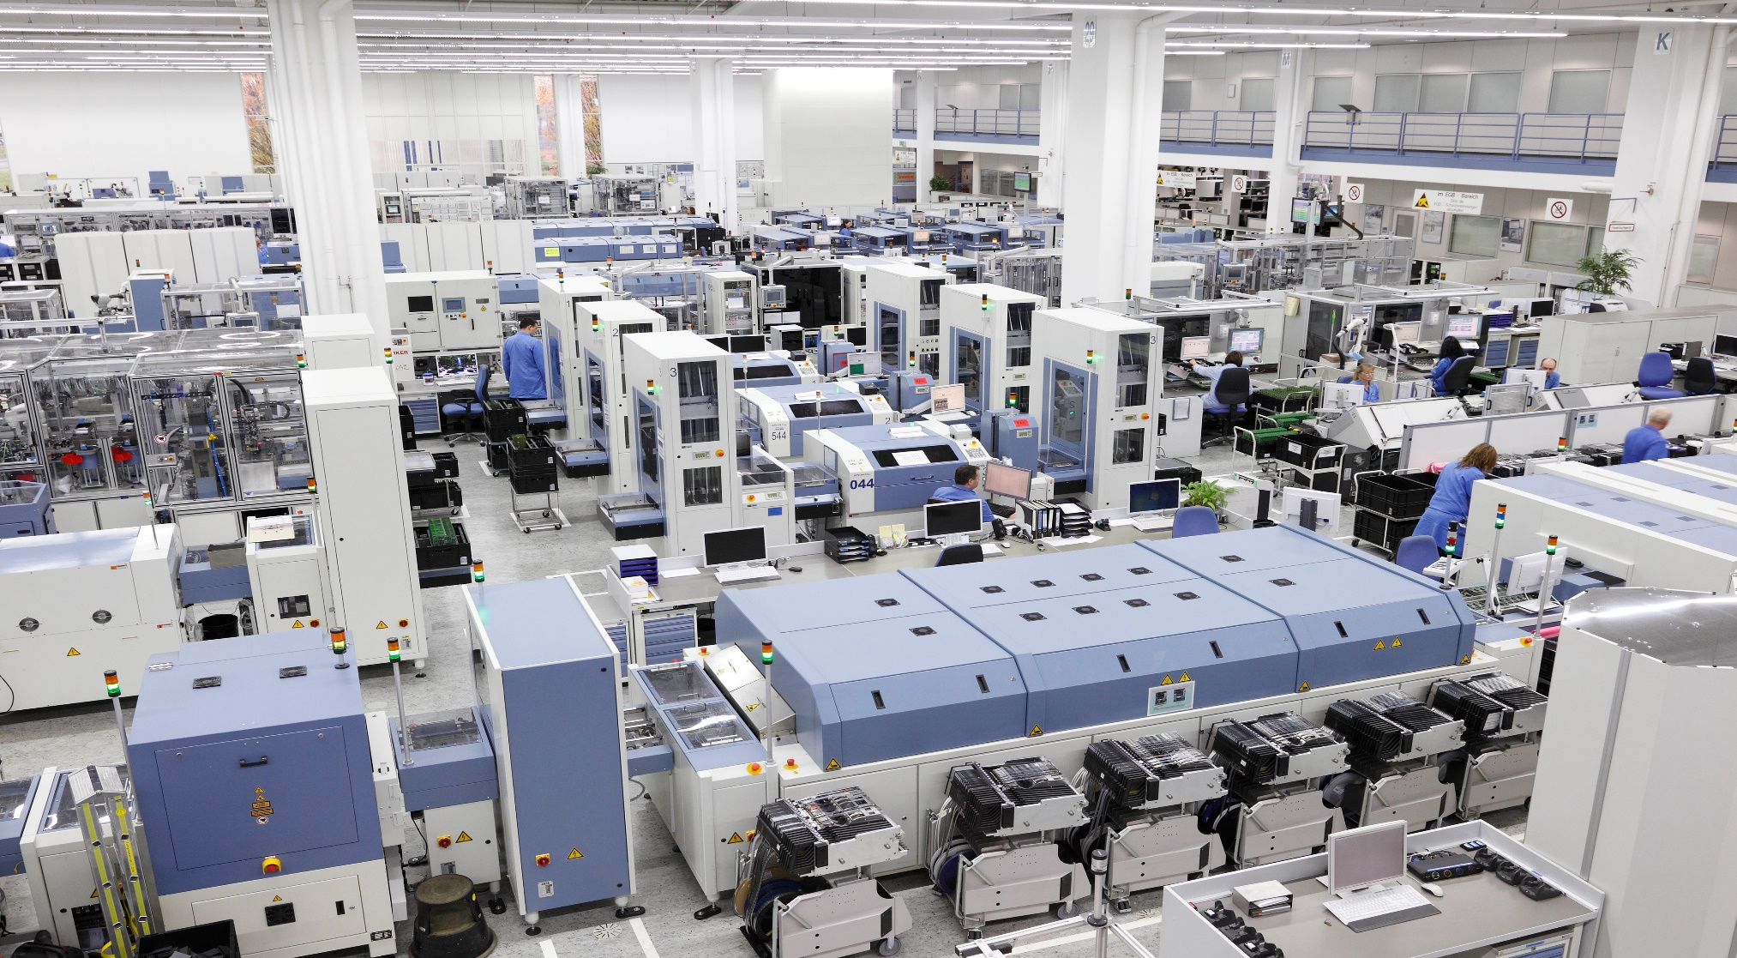
7
Siemens – Industry 4.0
Siemen Amberg Digital Factory with Mindshphere
Notes:
https://www.thefuturefactory.com/blog/32

Slide 11
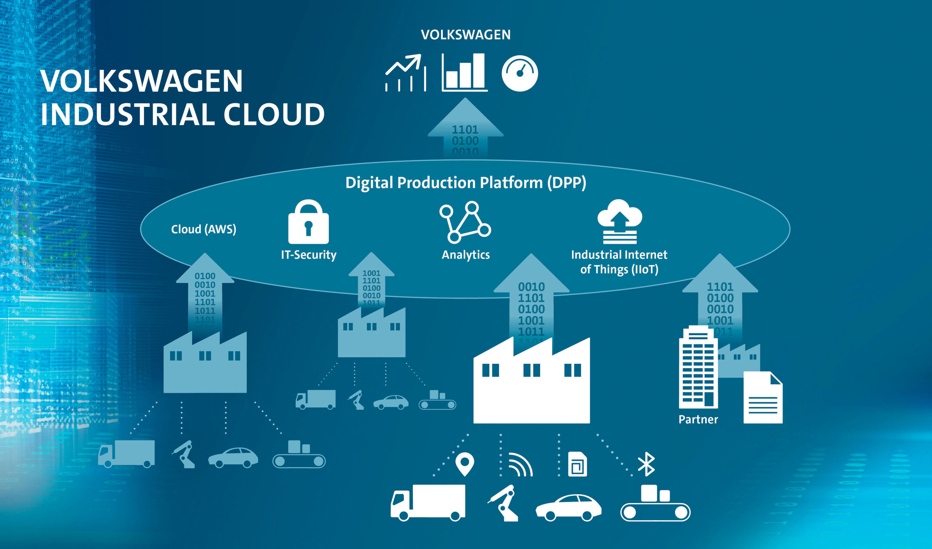
7
Volkswagen – Digital Production Platform
Digital Production Platform, Volkswagen
Notes:
https://www.forbes.com/sites/martingiles/2019/12/02/vw-cio-drives-digital-manufacturing/?sh=738695c75e02
https://www.volkswagen-newsroom.com/en/stories/industry-40-we-make-it-happen-4779

