Slide 1
Examples of Smart Manufacturing
Dr. Binil Starly
James T. Ryan Professor
Edward P. Fitts Department of Industrial & Systems Engineering

Slide 2
7
Manufacturing is ‘Smart’ when there is…
Remote Monitoring for System Wide Visibility
Predictive and Proactive Maintenance of Machines
Quality Inspection
Digitization of Records Across the Production Chain
Production Automation
Industrial Digital Thread
Real-time Simulation of What-if ‘Scenarios’
More….

Slide 3
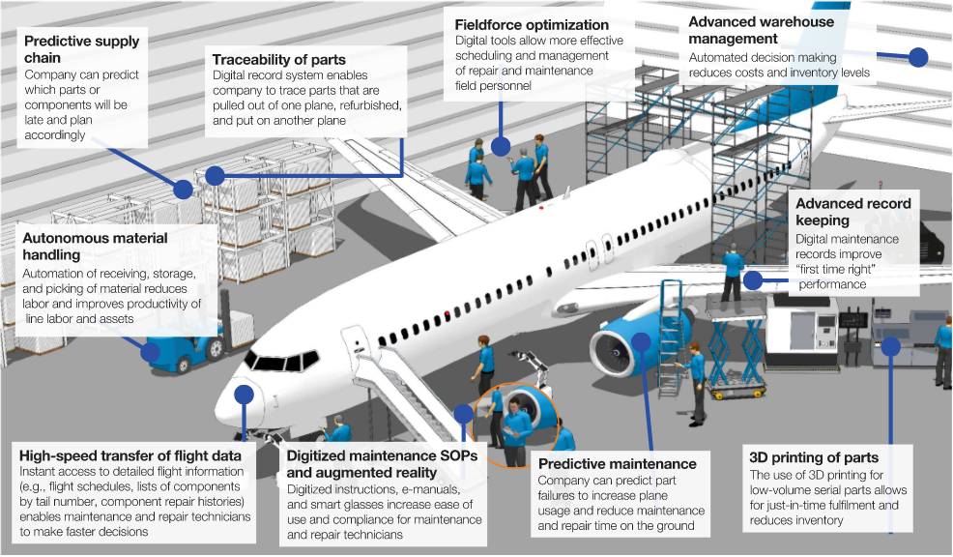
Image Credit: https://www.mckinsey.com/business-functions/mckinsey-digital/our-insights/the-next-horizon-for-industrial-manufacturing

