Slide 1
IIoT Infrastructure Stack
Dr. Binil Starly
James T. Ryan Professor
Edward P. Fitts Department of Industrial & Systems Engineering

Slide 2
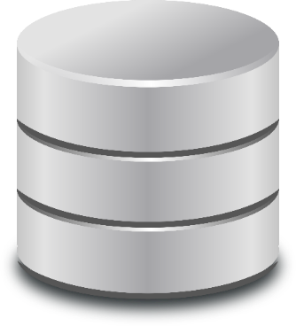
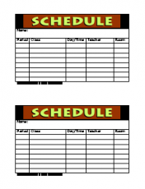

An Existing System in a Typical Factory
Enterprise Resource System
Warehouse Management Sys
Maintenance & Asset System
Customer Relation Management
Databases
PLC
PLC
PLC
Machines
Production Line
Robots

Slide 3
IIoT Infrastructure Stack
Enterprise Resource System
Warehouse Management Sys
Maintenance & Asset System
Customer Relation Management
PLC
PLC
PLC
Machines
Production Line
Robots
Notes:
https://www.trendmicro.com/vinfo/us/security/definition/industrial-internet-of-things-iiot
https://www.isa.org/intech-home/2020/may-june/features/simplifying-the-iiot-technology-stack

Slide 4
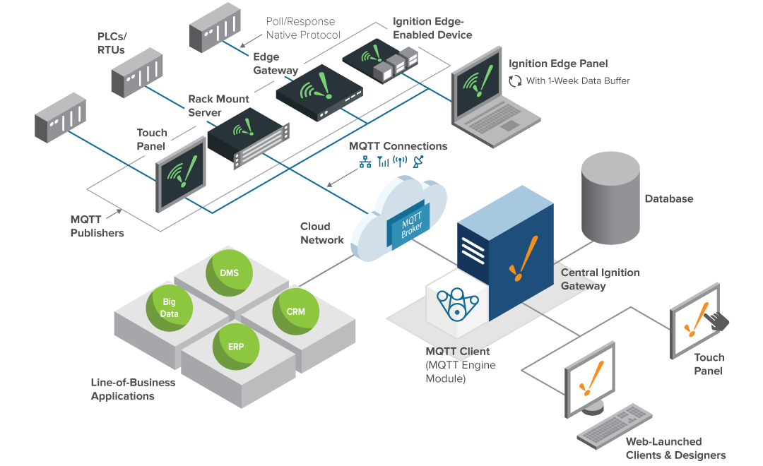
IIoT Infrastructure Stack
https://docs.inductiveautomation.com/display/DOC79/IIoT+Architecture
IGNITION IIOT
Notes:
https://www.trendmicro.com/vinfo/us/security/definition/industrial-internet-of-things-iiot
https://www.isa.org/intech-home/2020/may-june/features/simplifying-the-iiot-technology-stack

Slide 5
Core Information Technologies (IT) Enablers
Databases (capable to capture streaming data)
Visualization Dashboards (on Local Server or on Cloud)
Web Services (REST-ful API Services)
Publish-Subscribe Models (MQTT or others)
Computing Algorithms on the Edge Node (i.e. near or on the device/asset itself)
Computing Algorithms at the Factory / Enterprise Level

Slide 6
Core Hardware Enablers
Wireless Communication / Industrial Communication Infrastructure
Collaborative Robots
Advanced Computer Vision Systems for Monitoring & Inspection
On-Board Multi-Modal Sensors on Machine Asset
On-Node Computing (associated hardware)
Augmented Reality/Virtual Reality Devices

