Slide 1
Fundamentals of MQTT
Dr. Binil Starly
James T. Ryan Professor
Edward P. Fitts Department of Industrial & Systems Engineering
Notes:
What iS MQTT? Design Principles, its Model – the Publish-Subscribe data Model, Operations and its Features

Slide 2
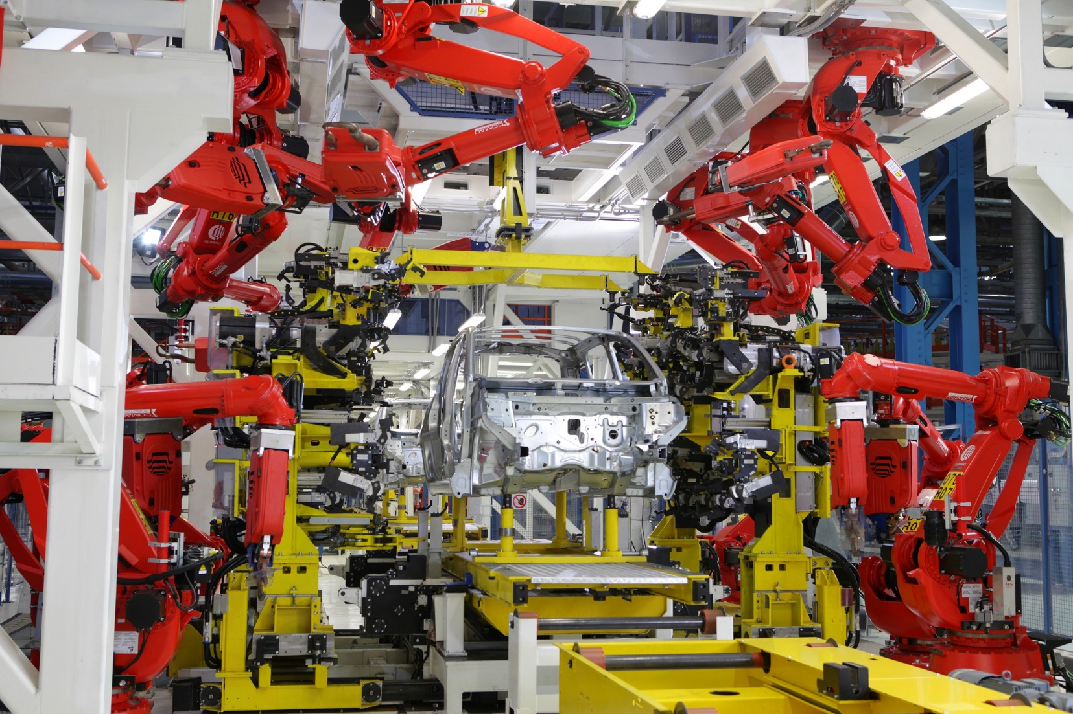
7
How is MQTT Relevant to SM
Various Machines Assets
From Various Vendors
Industrial Environment
Assets on the field with low infrastructure
Generated with varying frequencies.

Slide 3
What is MQTT
“MQTT is a Client Server publish/subscribe messaging transport protocol. It is light weight, open, simple, and designed so as to be easy to implement.
Ideal for use in many situations, including constrained environments such as for communication in Machine to Machine (M2M) and Internet of Things (IoT) contexts where a small code footprint is required and/or network bandwidth is at a premium.” Citation from the official MQTT 3.1.1 specification

Slide 4

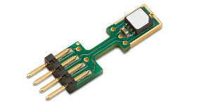


Poll-Response vs Report by Exception

Slide 5
Message Transfer Protocols
Asynchronous Message Transfer service between factory floor assets to higher order and lower order systems.
Enable interoperability between various machine asset vendors while creating the value chain of IIoT towards a digital factory.
Notes:
What Types of Message Transfer Protocols are available ?

Slide 6
Design Principles of MQTT
Simple Implementation
Lightweight Code
Bandwidth Efficient
Quality of Service Delivery
Continuous Session Awareness

Slide 7
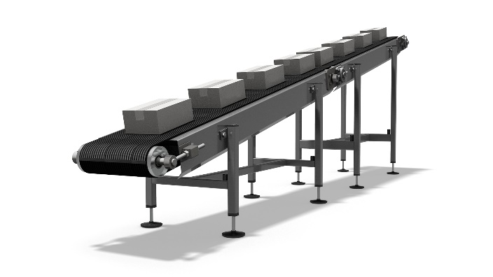
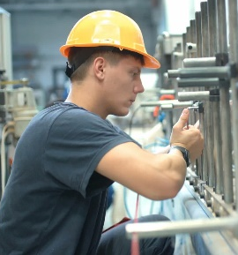
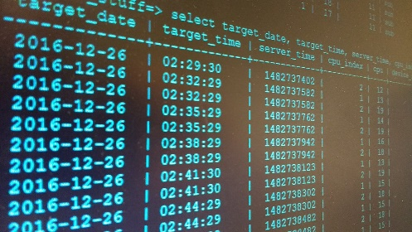



7
A Simple MQTT Client-Server Example
Machine Operator
Machine Device
IT System
Database or Live Report
Machine Alarm
Robot
Alarm
Machine Coolant Alarm

Slide 8
7
Characteristics
Built on top of TCP/IP – foundation of the internet communication
Binary Protocol
Efficient (can be as small as 2bytes)
Bi-Directional
Data structure/content agnostic
Scalable to millions of assets over the same installation
Built for push notifications
Built for constrained devices – particularly for devices with minimal computing / other constraints

