Slide 1
The Publish-Subscribe Pattern
Dr. Binil Starly
James T. Ryan Professor
Edward P. Fitts Department of Industrial & Systems Engineering
Notes:
What iS MQTT? Design Principles, its Model – the Publish-Subscribe data Model, Operations and its Features

Slide 2

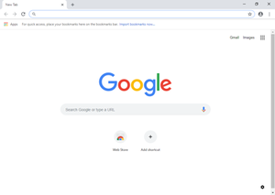

7
Conventional Client-Server Communication
REQUEST
RESPONSE

Slide 3





Publish-Subscribe Pattern Protocol
MQTT Clients
MQTT Broker
MQTT Clients
Subscribed to
Temperature from Sensor ID
Data Logging
Publish
Temperature from Sensor ID : 120C
Email Notification
Subscribed to
Temperature from Sensor ID

Slide 4
Pub-Sub Characteristics
Space De-coupling
Time De-coupling (queued)
Synchronization De-coupling
Producer Agnostic & Decoupled
Notes:
What Types of Message Transfer Protocols are available ?

Slide 5
Pub-Sub Scalability through Clustering
Publisher 1
Subscriber 1
Publisher 2
Subscriber 2
MQTT Broker
Publisher 3
Subscriber 3
Publisher 4
Subscriber 4
.
.
.
Notes:
What Types of Message Transfer Protocols are available ?

Slide 6
Pub-Sub Scalability through Topics
MQTT Broker
Publisher 1
Subscriber 1
TOPIC 1
Publisher 2
Subscriber 2
TOPIC 2
Publisher 3
Subscriber 3
TOPIC 3
Publisher 4
Subscriber 4
.
.
.
Notes:
What Types of Message Transfer Protocols are available ?

