Slide 1
Introduction to
Relational Databases
Dr. Binil Starly
James T. Ryan Professor
Edward P. Fitts Department of Industrial & Systems Engineering
Notes:
https://www.linkedin.com/learning/programming-foundations-databases-2/relational-databases-2?u=53565897

Slide 2
7
Relational Database
Machine Assets
Rows – Instances of a given entity
Columns – Attribute of a given entity

Slide 3
7
Relational Database
Machine Assets
machine ID | machine_name | oem_vendor | employee_operator | asset_acquired_on | description_machine | last_maintained
Rows – Instances of a given entity
Columns – Attribute of a given entity

Slide 4
7
Relational Database
Employees
id | first_name | last_name | email | start_date
Rows – Instances of a given entity
Columns – Attribute of a given entity
Relation between Tables is the essence of any R-DB

Slide 5
7
Relational Database: Multiple Tables in DB
Employees
id | first_name | last_name | email | start_date
Machine Assets
machine ID | machine_name | oem_vendor | employee_operator | asset_acquired_on | description_machine | last_maintained

Slide 6
7
Schemas
Collection of related database objects
In an R-DB, this includes tables, indexes, sequences and triggers
All entities are from a single business domain
Employees
ID | FirstName | LastName | Email | StartDate

Slide 7
7
What is a Domain
Set of Entities – ‘Nouns’ in a Business – Customers, Machines, Employees, Sales etc.
Entities have logical Relationships
Used together
Share a data lifecycle

Slide 8
7
Domain vs Schemas
Ideally no more than one domain per schema
Domains may have multiple schemas
Different organizational ownership
Size and complexity
Independent processes
Wrap monitoring, compliance, security and decision making

Slide 9
7
Examples
Asset Management
Production Schedules
Product Servicing
Product Lifecycle

Slide 10
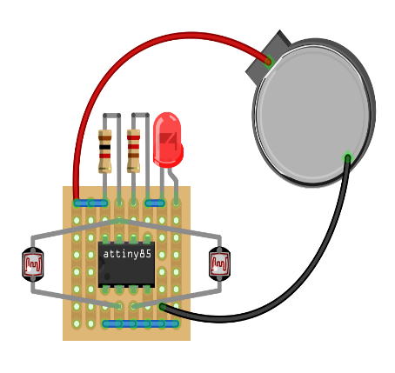
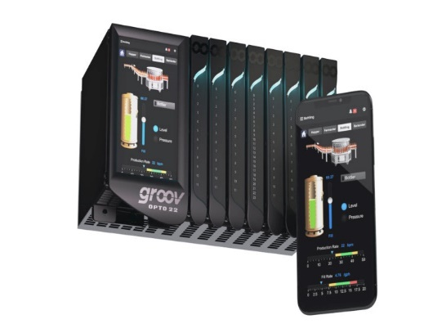
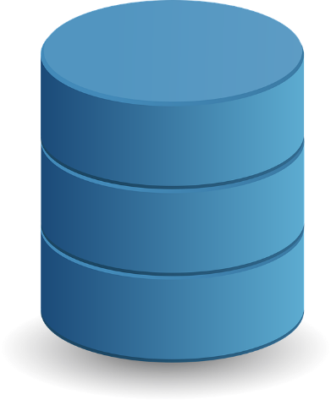

7
Describe Entities within IIoT
Sensors
Edge Device
Data Store
(Cloud or On-Premise)

