Slide 1
Machine Scale Data Ingestion for IIoT
Dr. Binil Starly
James T. Ryan Professor
Edward P. Fitts Department of Industrial & Systems Engineering
Notes:
Process with which we acquire data and store it.

Slide 2
7
Different Scales of Ingestion
Human Scale Data Ingestion
Machine Generated Data Ingestion

Slide 3
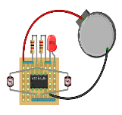
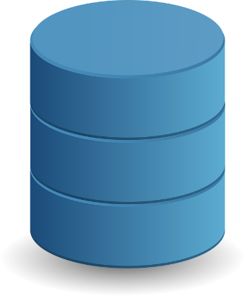
7
Ingestion of Machine Scale Data
Ingestion End Point
BUFFER
Application Processing
Database is always the end-point in a Machine data-ingestion flow
Device sends data to endpoint
Endpoint validates data , do some basic filtering and writes to the queue
Application subscribes from the queue and maintains control

Slide 4
7
Machine Generated Data
Average size of payload
Constant volume and rate at which is being sent
Average time to send data to ingestion point is the same
Writing to DB is independent of sending from device

Slide 5
7
CRUD Operations
Application
Front End Application
Update
Read / Update
LOCK ROW
Read from Data Store, Modify It and write back
Rows are Locked During Transactions Processing
Transactions are critical to ensure data integrity

Slide 6
7
Alternative to CRUD – Event Sourcing/Logging
Application
INSERT
Events are changes to data
Only Written, never updated to an existing row
Logs of operations on data
I can roll back through the events to find state in time

Slide 7
7
Event Sourcing Example
Machine Alarm State
Verified Machine Policy
Added Sensor Item
Added Sensor Item
Added Sensor Item
Added Sensor Item

Slide 8
7
Event Sourcing Example
Machine Alarm State
Verified Machine Policy
Machine ID | state verified | Alarm State | Operator
Added Sensor Item
Added Sensor Item
Added Sensor Item
Added Sensor Item
Machine ID |Alarm State | Avg Sensor 1 | Avg Sensor 2 …

Slide 9
7
Materialized Views
Application
EVENTS -> Materialized View
INSERT
Events data are read from ‘Views’
Materialized Views capture ‘State’ in time
Supports read operations from external applications
Eventually they will be consistent (between actual State vs What External user sees)

