Slide 1
Introduction to
REST-ful Application Programming Interfaces (API)
Dr. Binil Starly
James T. Ryan Professor
Edward P. Fitts Department of Industrial & Systems Engineering

Slide 2
7
REST
REpresentational State Transfer
A set of software architecture guidelines for efficient, reliable and scalable systems

Slide 3
7
What is REST and API
REpresentational State Transfer
Application Programming Interfaces

Slide 4
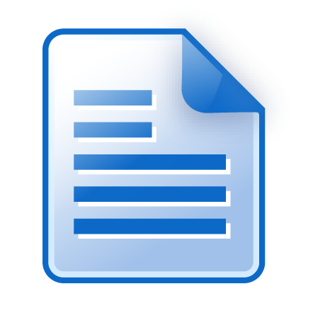

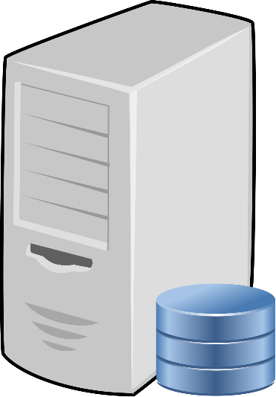
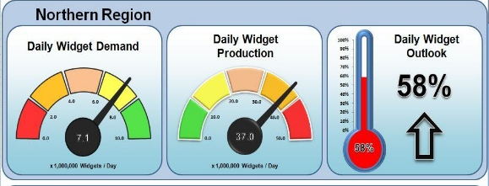
Client – Server Interaction through Data
Interaction between the Server and the Application is through the Data Object
Notes:
Can you give a more practical example with http://www.facebook.com through your Mobile vs Laptop.

Slide 5
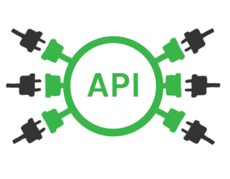
Client – Server Interaction enabled by API
Interaction between the Server and the Application is through the Application Programming Interface
Notes:
Can you give a more practical example with http://www.facebook.com through your Mobile vs Laptop.

Slide 6
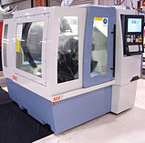
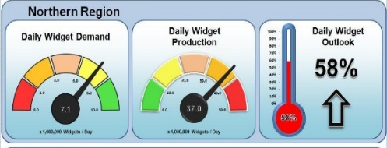
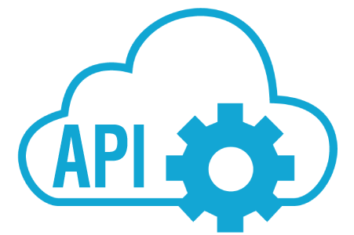
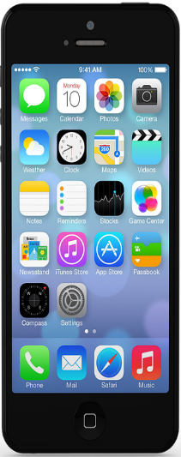

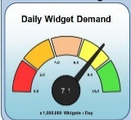

7
Use of REST in a Digital Factory - 1
Notes:
Is the API itself a server ?

Slide 7

7
Use of REST in a Digital Factory - 2

Slide 8
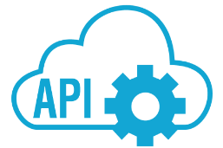
7
Use of REST in a Digital Factory - 3

Slide 9
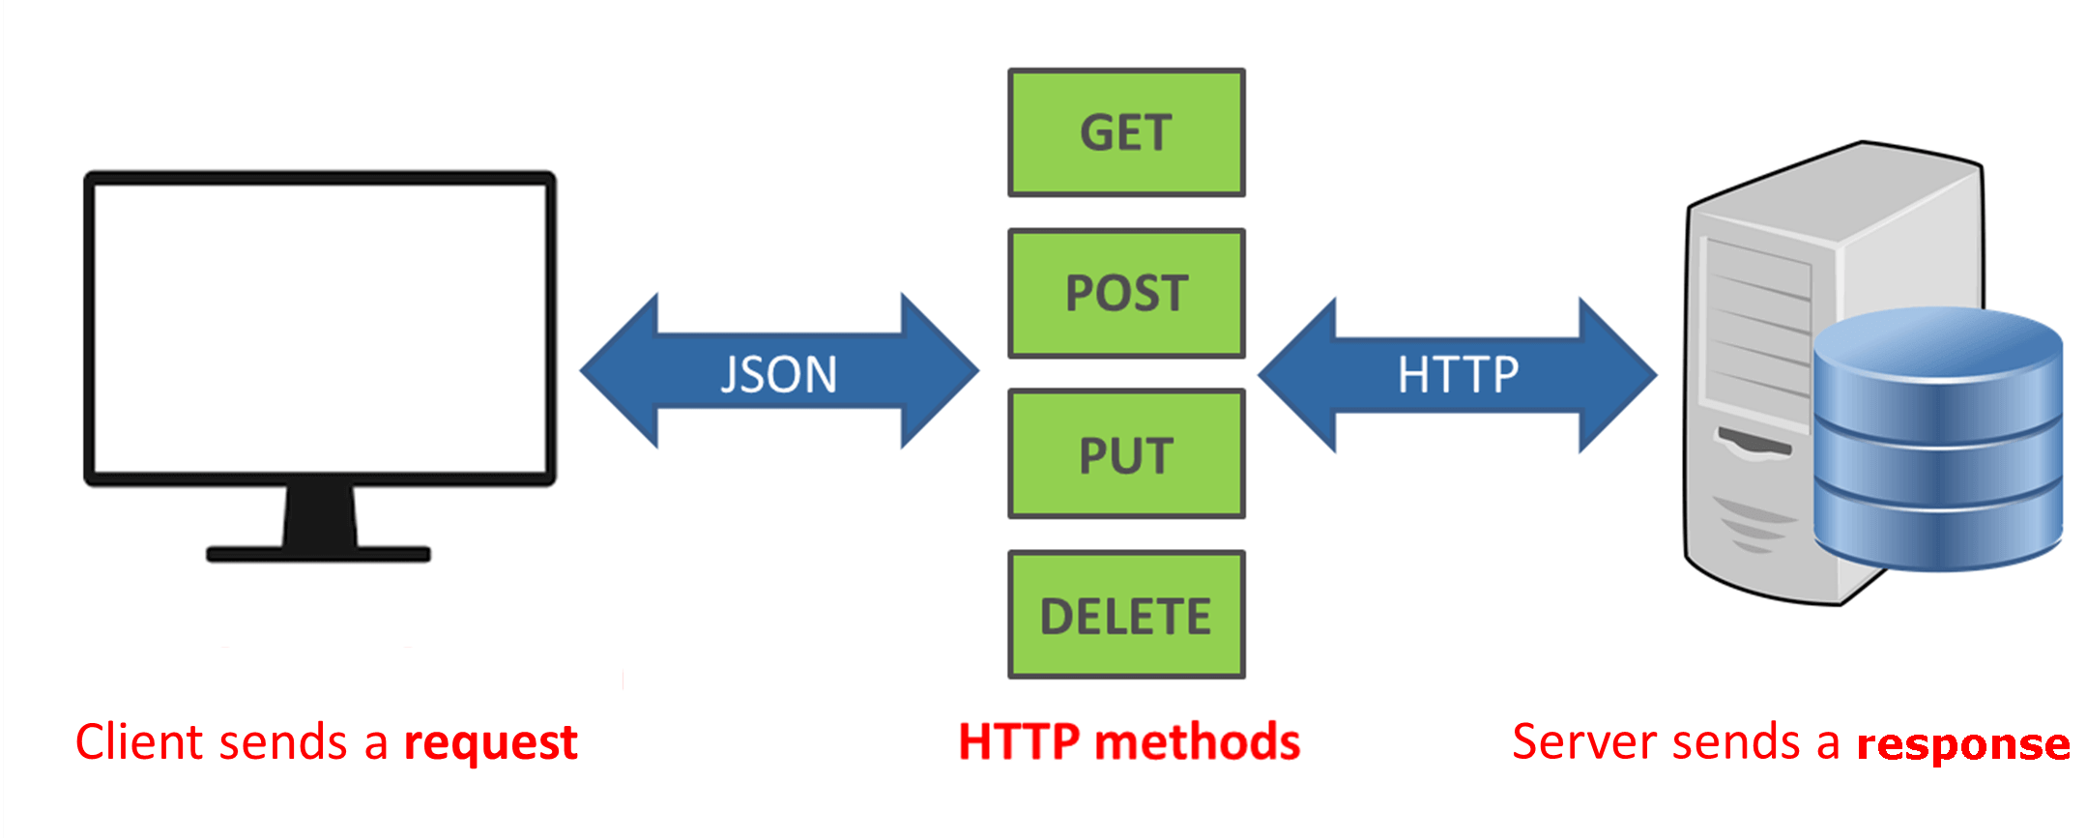
7
API as the language (REST VERBS)

Slide 10
7
Benefits of REST and API
Easier to create and modify
Data object payload is just what is needed..nimble and flexible.
Loose coupling between clients and server.
Can start small and grow as requirements change

