Slide 1
The SIX Constraints of REST
Dr. Binil Starly
James T. Ryan Professor
Edward P. Fitts Department of Industrial & Systems Engineering

Slide 2
7
The 6 Constraints
Client-Server Architecture
Statelessness
Cacheability
Layered System
Code on Demand
Uniform Interface

Slide 3
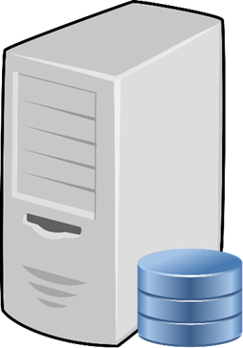
7
1. Client-Server Architecture
The client manages concerns regarding the user interface while the server manages data storage.
REST SERVER
Client
1
Client
2
Client
3
Client
4

Slide 4

7
2. State Less
The server does not store client context or the client information state between requests sent between a client and a server.
Each and every request from client must be able to execute on its own at the server end – hence state-less or self-contained.
I do not store states unless you ask me to.
REST SERVER
I am in State 3
Give me State 4
I am in State 6
Give me State 3
Client
1
Client
2

Slide 5
7
3. Cacheability
All REST responses from the Server must be tagged as cacheable or not cacheable for a certain period of time.
Store this data for 10 days
Will do.
REST SERVER
Client
1
RESPONSE DATA

Slide 6
7
4. Layered System
The client cannot know, but actually really shouldn’t care, whether it is connected directly to a server or through intermediary servers like a Content Delivery Network (CDN) or a mirror server.
CDN
Here is my request, just give me the response
Audit Trails
Client
1
REST SERVER
Load Balancer
Authentication

Slide 7
7
5. Code on Demand
Servers can respond with executable code back to the client (ex. Javascript code).
This is optional though.
Here, just run this code
I do not know what is in it, but I know how to run it
Client
1
REST SERVER
Javascript Code

Slide 8
7
6. Uniform Interfaces
6.1 Resource Identification in requests
6.2 Resource manipulation through representations
6.3 Self-descriptive messages
6.4 Hypermedia as the engine of application state (once the client has access to a resource – the server responds with all access to sub-resources and method VERBS available on that resource.

Slide 9
7
The 6 Constraints
Client-Server Architecture
Statelessness
Cacheability
Layered System
Code on Demand
Uniform Interface

