Slide 1
REST REQUEST & RESPONSE
Dr. Binil Starly
James T. Ryan Professor
Edward P. Fitts Department of Industrial & Systems Engineering

Slide 2
7
REST REQUEST (Method & URI)
GET
POST
PUT
PATCH
DELETE
OPTIONS
HEAD
Example:
GET
http://reqres.in/api/users?page=2

Slide 3
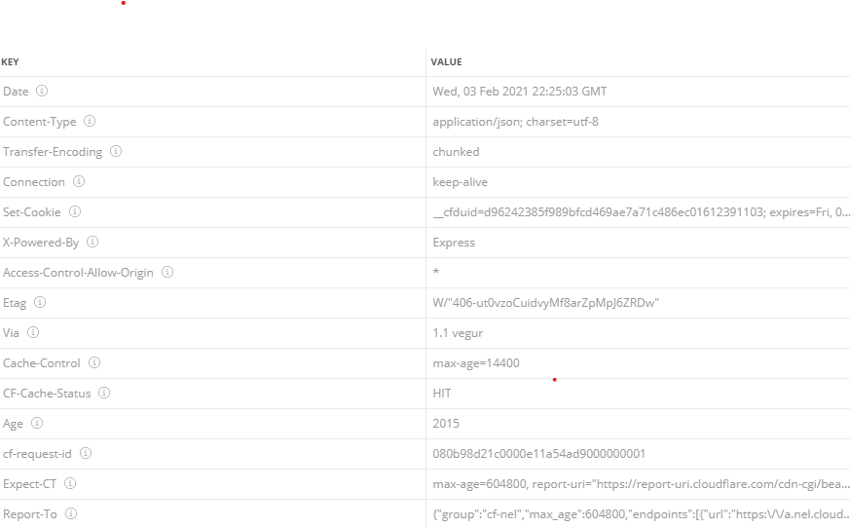
7
REST REQUEST (GET)
GET http://reqres.in/api/users?page=2

Slide 4
7
REST REQUEST (GET)
GET http://www.reqres.in/api/users?page=2
SUCCESS
200 OK
FAILURE
404 Not Found

Slide 5
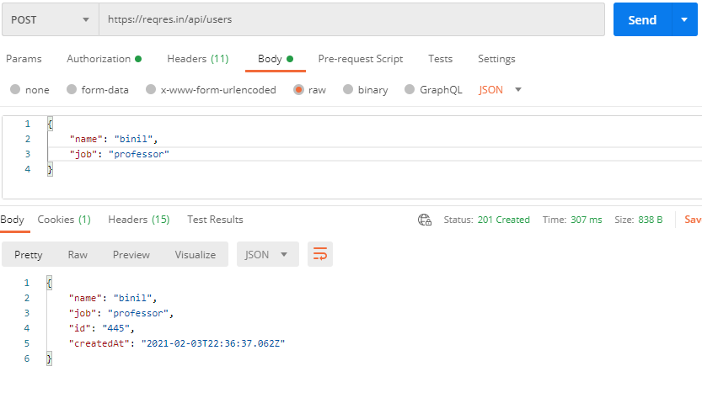
7
REST REQUEST (POST)
POST https//reqres.in/api/users + JSON Body data

Slide 6
7
REST REQUEST (POST)
POST
Body Data: Text or JSON
SUCCESS
201 Created
FAILURE
401 Unauthorized
409 Conflict
404 Not Found

Slide 7
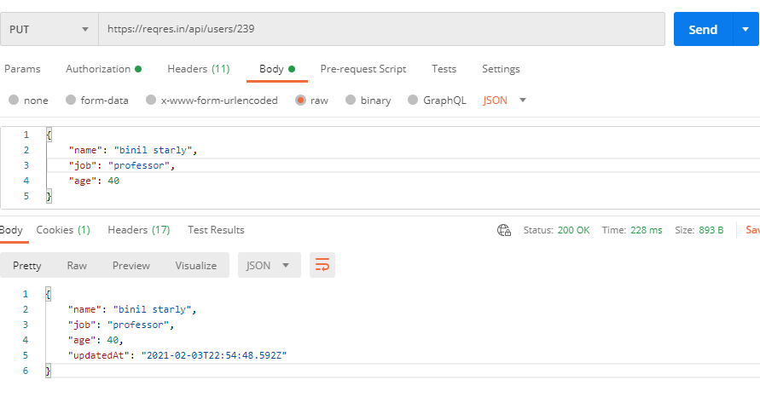
7
REST REQUEST (PUT)
PUT http://reqres.in/api/users/239 + JSON Body data

Slide 8
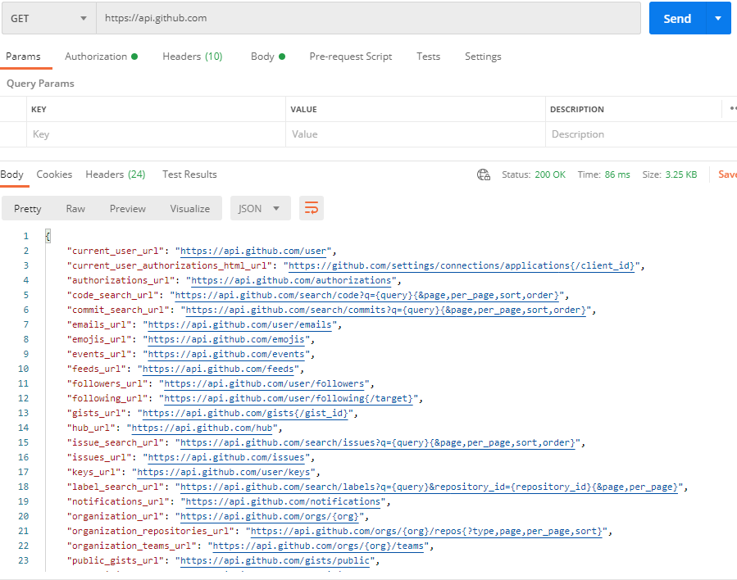
7
REST Services Discovery
GET http://api.github.com

