Slide 1
Tools for
REST-ful API Interfaces
Dr. Binil Starly
James T. Ryan Professor
Edward P. Fitts Department of Industrial & Systems Engineering

Slide 2
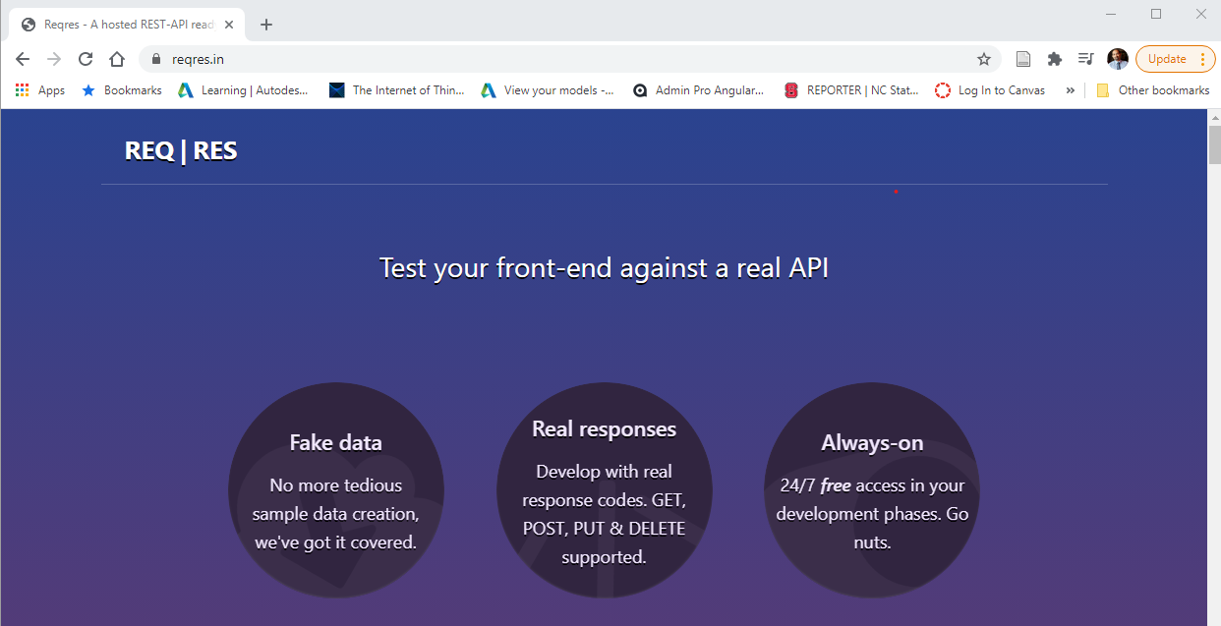
7
REQ|RES (https://www.reqres.in)
Notes:
https://www.reqres.in

Slide 3
7
REQ|RES (https://www.reqres.in)
Your Own Web Browser
POSTMAN or Insomnia
VS Code

