Slide 1
Modbus
Communication Protocol
Dr. Binil Starly
James T. Ryan Professor
Edward P. Fitts Department of Industrial & Systems Engineering

Slide 2
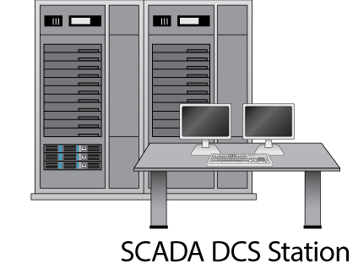
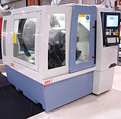
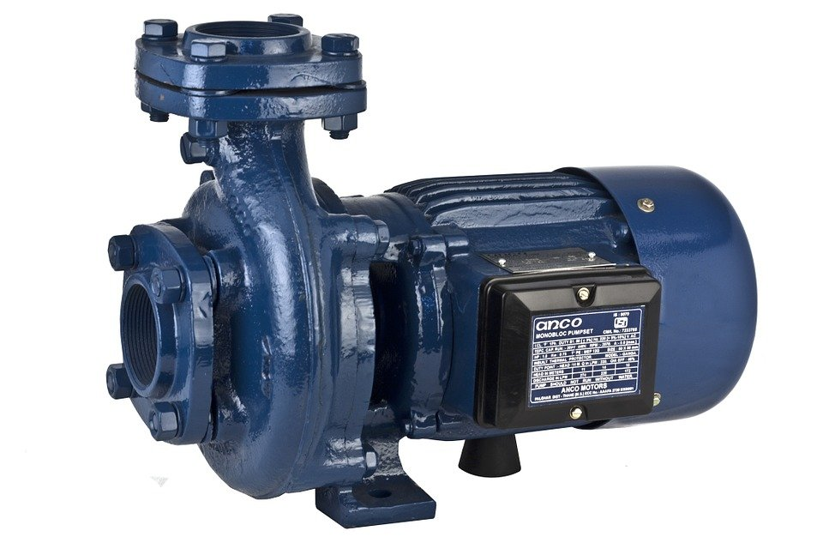
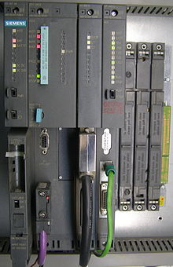
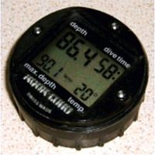
7
Factory Scenario

Slide 3
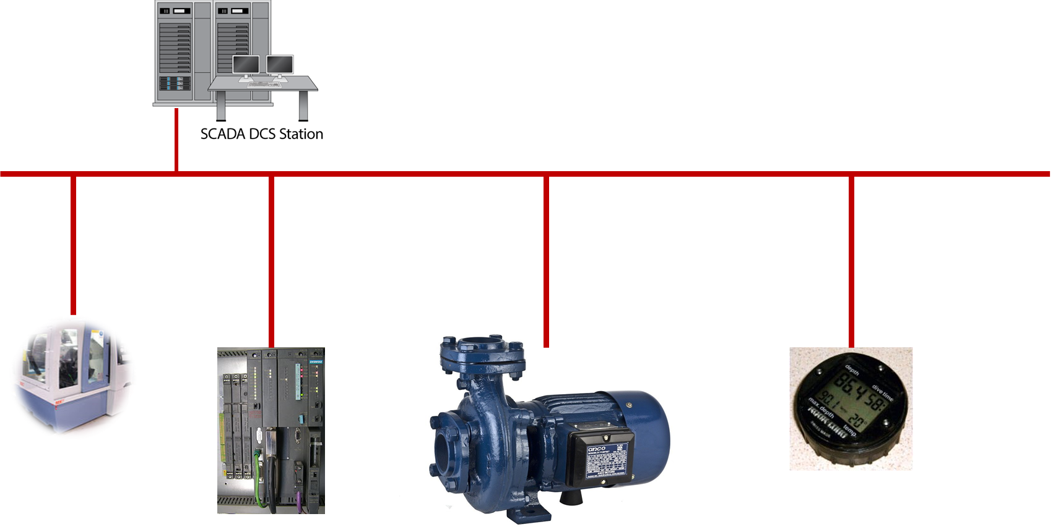
7
Modbus Protocol Types
Modbus TCP
Modbus RTU
Modbus ASCII
Modbus PLUS
Client - Server Architecture

Slide 4
7
Request - Response
1
REQUEST SEND
2
RESPONSE SENT

Slide 5
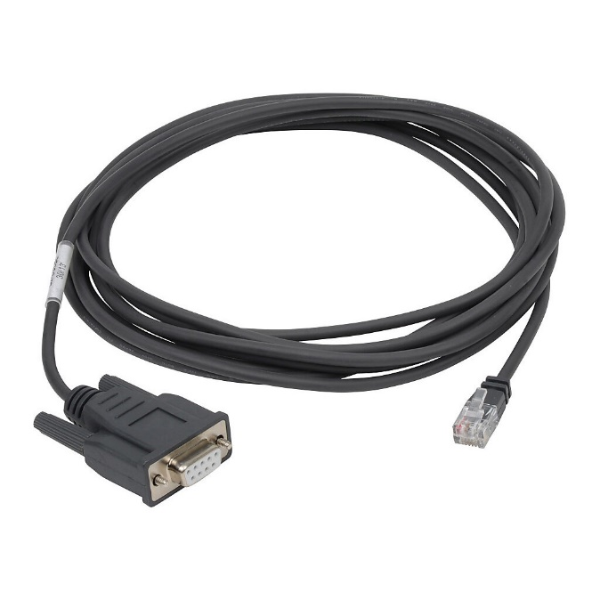
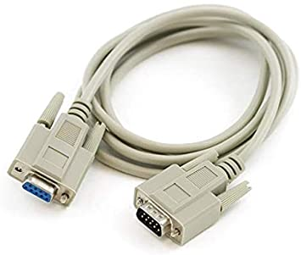
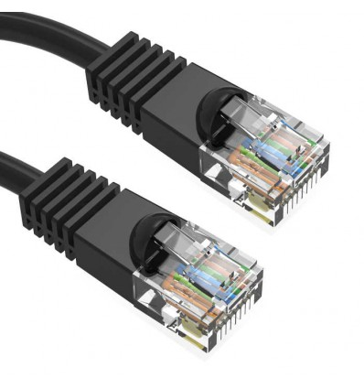
7
Communication over Physical Media
RS232
RS485
RS422
Ethernet Cable

Slide 6
7
Modbus in Plain Form (RS232 & RS485)
1
REQUEST SEND
Plain ASCII format
2
RESPONSE SENT

Slide 7
7
Modbus in Packet Form (Ethernet TCP-IP)
1
REQUEST SEND
TCP/IP Packets
2
RESPONSE SENT

Slide 8
7
Modbus Protocol
REQUESTOR
Responder Address | Function Code | Data Request | Error Code

Slide 9
7
Modbus Protocol
RESPONDER
Request Status | Data Payload | Error Code

Slide 10
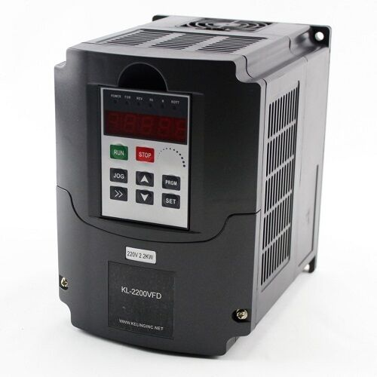
7
Modbus Protocol
Memory Register Structure
Discrete Inputs
Coils Outputs
Input Registers (Input Data)
Holding Registers (Output Data)

