Slide 1
Profibus and Profinet Communications
Dr. Binil Starly
James T. Ryan Professor
Edward P. Fitts Department of Industrial & Systems Engineering
Notes:
https://www.linkedin.com/learning/programming-foundations-databases-2/relational-databases-2?u=53565897

Slide 2
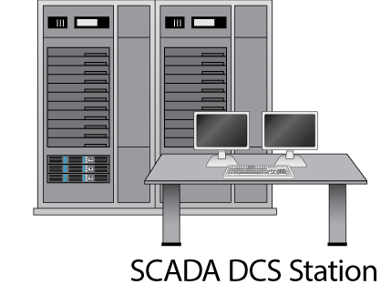
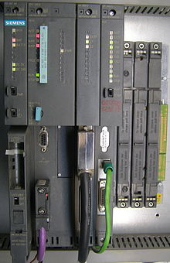
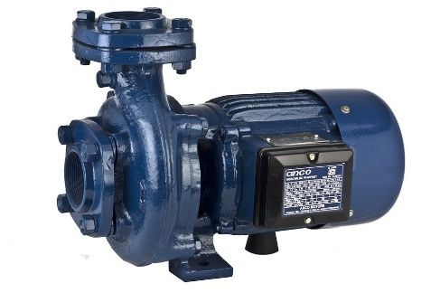
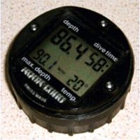
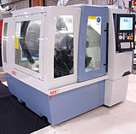
7
Factory Scenario
1500 ft

Slide 3

7
Profibus Protocol (usually Purple Cable)
RS485
Interface Module
I/O modules

Slide 4
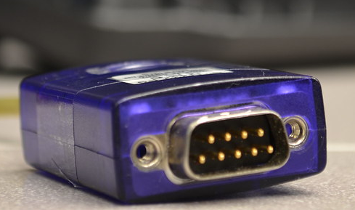
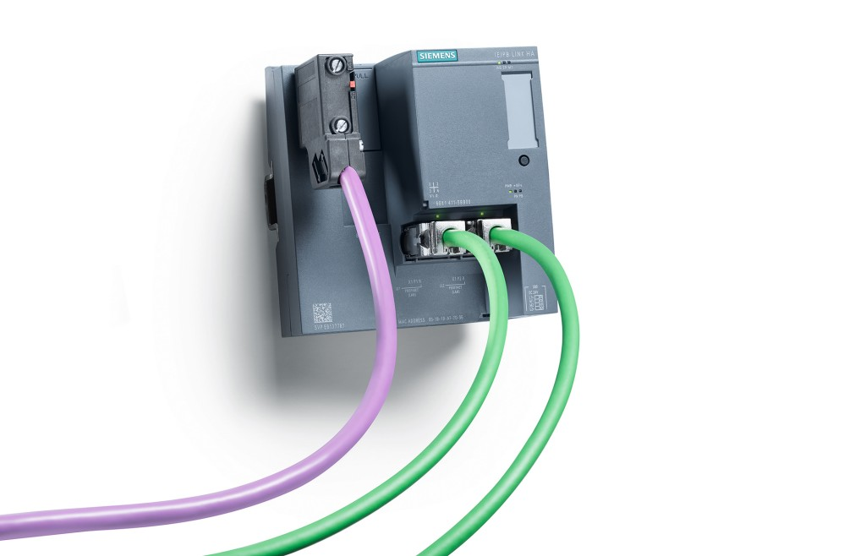
7
Profibus (Process field Bus)
Standard DB-9 serial connector
Purple Cable
9600 bits per sec to 12Mbits per sec
1000 meters long but shorter ones support faster data rates.
Faster than Modbus but slower than Profinet

Slide 5
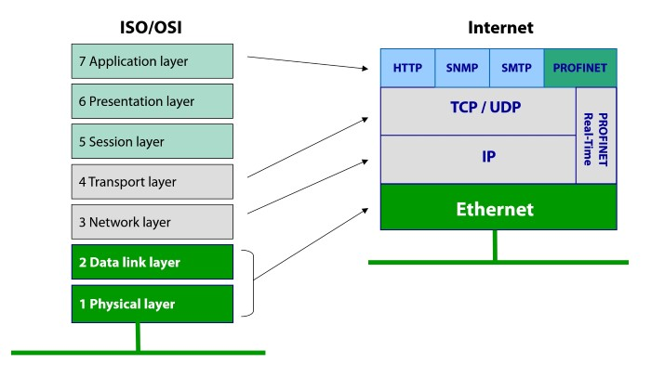
7
ISA-OSI Model

Slide 6
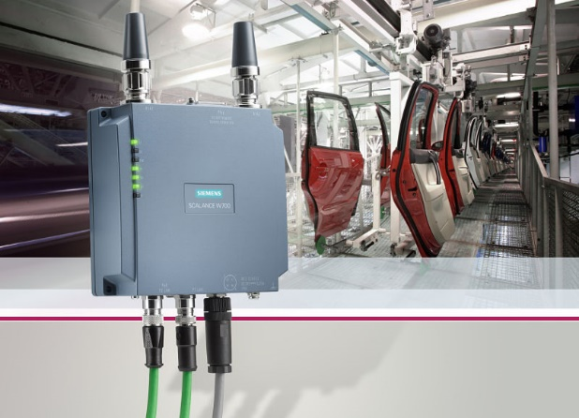
7
Profinet (Ethernet based)
Standard RJ45 Ethernet jack and cable
Green Cable
100Mbits per sec
100 meters long
High speed applications <1ms response times.

Slide 7
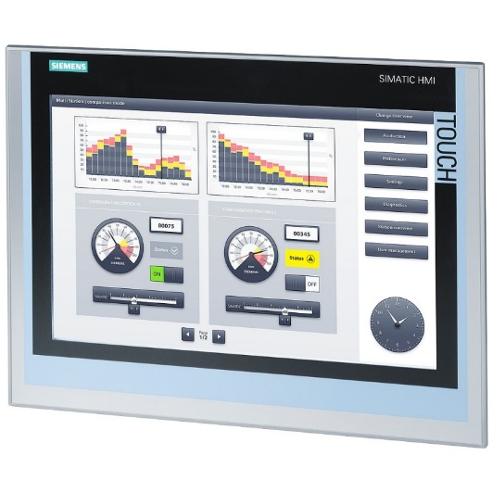
7
Profinet Controllers or Devices
HMI
PLC1
PLC2
IE-PB Link
Ethernet Network in Factory

Slide 8
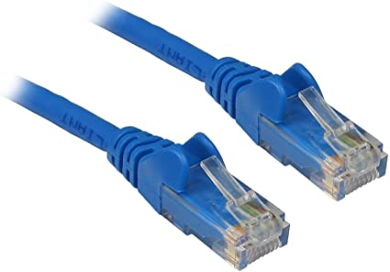
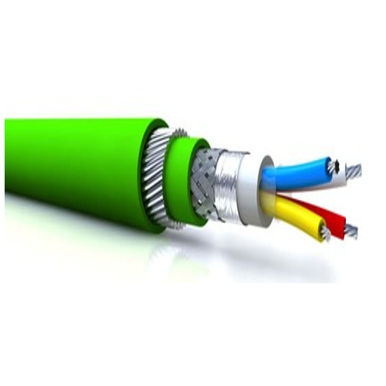
7
Profinet Cables
Standard Ethernet Cable (weak in industrial settings though it can be used)
Much More Robust Profinet Cable with less disturbances

Slide 9
7
More than just connecting cables!
Cloud Connectivity
Machine Synchronization
Alarms and Event Triggers
Functional Safety (Hazard Zones)

Slide 10

7
Very Extensible
MQTT
AMQP
MT-Connect
OPC/UA
HTTP

