Slide 1
OPC-UA (Open Encoding for Process Control – Unified Architecture
Dr. Binil Starly
James T. Ryan Professor
Edward P. Fitts Department of Industrial & Systems Engineering
Notes:
https://www.linkedin.com/learning/programming-foundations-databases-2/relational-databases-2?u=53565897

Slide 2
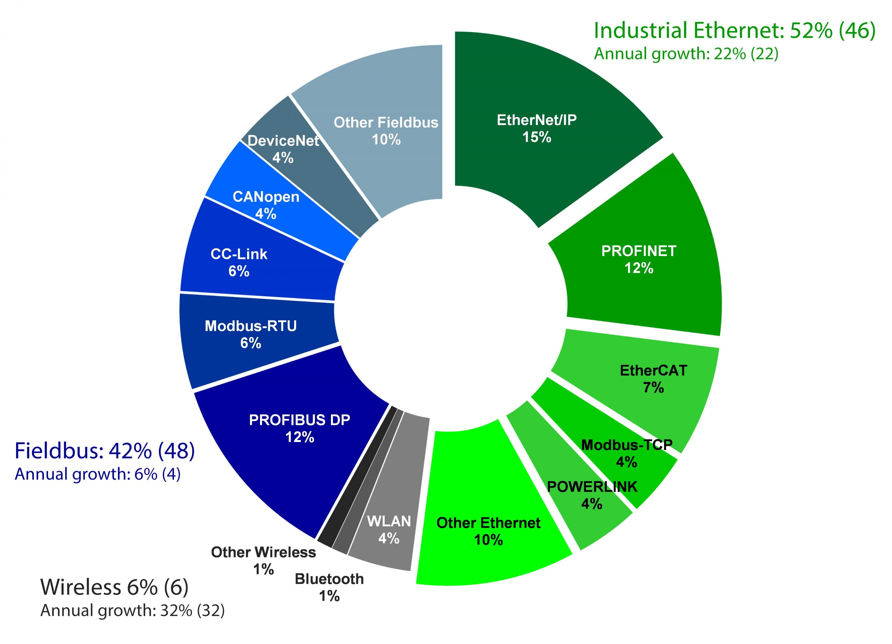
7
M2M Communication Protocols
Largest Method of communication for Industrial Automation (Mar 2nd 2018)

Slide 3
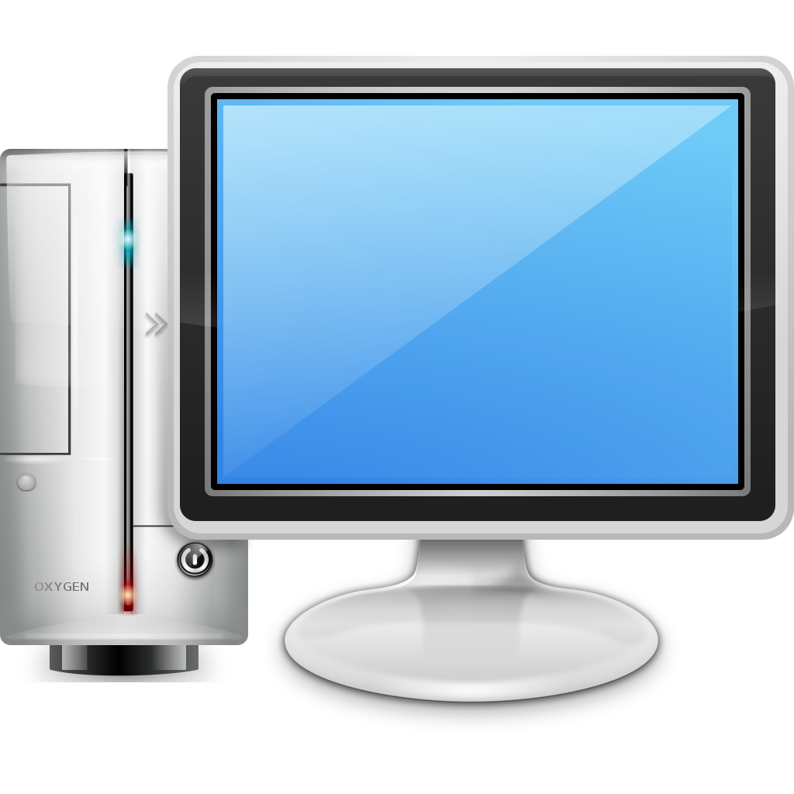
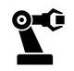

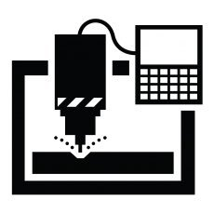
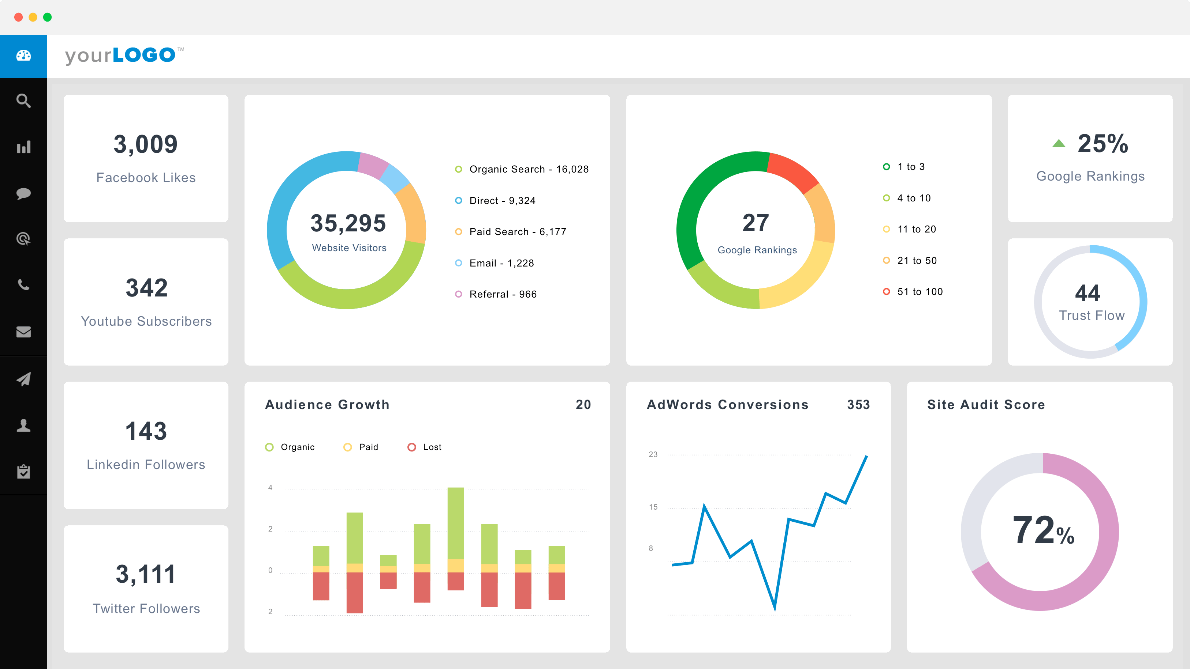
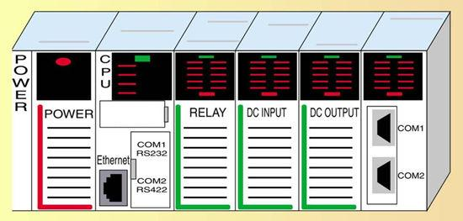
7
Machine to Machine Communication

Slide 4
7
Machine to Machine Communication
Drivers
Standard Interface
COM/DCOM

Slide 5
7
What is OPC
A standard that defines the communication of data between devices from sensor to business enterprise computing for automation systems in manufacturing and process control.

Slide 6
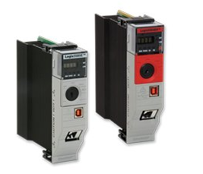
What is OPC
OPC Server
OPC Client
Read/Write Data

Slide 7
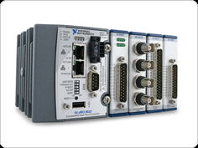
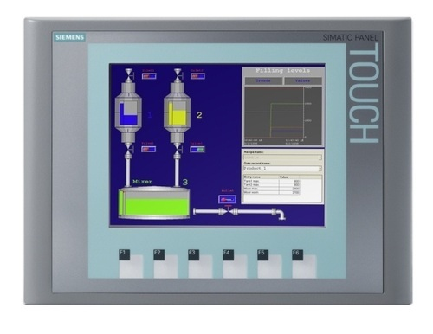
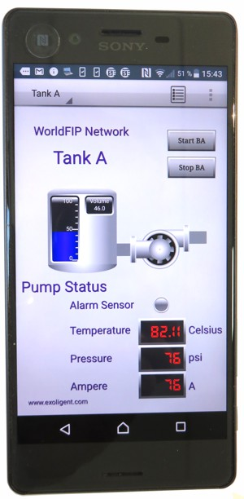

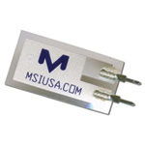

What is OPC
Ex. National instruments Programmable Automation Controller (PAC)
OPC Server
Write Data
Read Data
OPC Client 1
OPC Client
Various Sensors

Slide 8
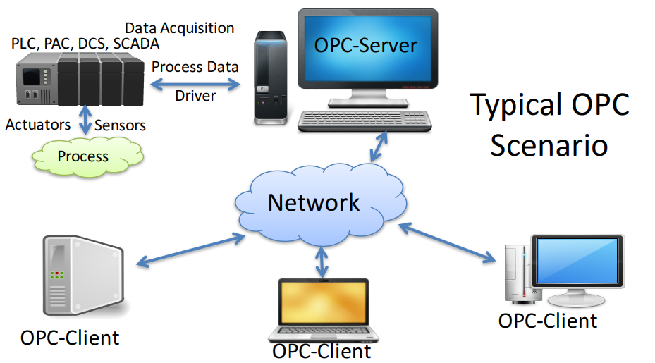
Typical Scenario

Slide 9
What is it with the “UA” – Unified Architecture
Classic OPC
OPC / UA
OPC DA
Data Access Server
OPC UA
OPC HDA
Historical Data Access Server
All data types stored in 1 server and serves any type of clients
OPC A&E
Alarms & Events Server
….

Slide 10
What is it with the “UA” – Unified Architecture
Classic OPC
(MS Windows Based)
OPC / UA
(Microsoft, Linux, MAC, Embedded Sys. etc.)
OPC DA
Data Access Server
OPC UA
OPC HDA
Historical Data Access Server
All data types stored in 1 server and serves any type of clients
OPC A&E
Alarms & Events Server
XML, HTTP, SOAP, REST based web communication
….

Slide 11
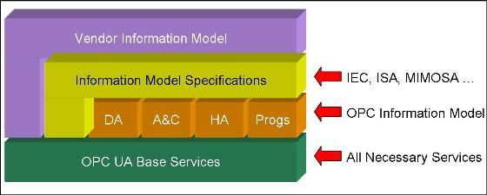
OPC UA Architecture

Slide 12

Complex Information Model
Units
Pressure Set points
Type of Pressure Sensor
Instrument Config Parameters
Hierarchical Position Among Sensor Suite
Related Components

Slide 13
What is OPC UA
An OPC UA server models data, information, processes and systems as objects and presents those objects to clients in ways that are useful to vastly different types of client applications.
OPC UA server provides sophisticated services that the client can use, including:
Discovery Services – Services that clients can use to know what objects are available, how they are linked to other objects, what kind of data and what type is available, and what meta-data is available that can be used to organize, classify and describe those objects and values.
Subscription Services – Services that the clients can use to identify what kind of data is available for notifications. Services that clients can use to decide how little, how much and when they wish to be notified about changes, not only to data values but to the meta-data and structure of objects

Slide 14
Query Services – Services that deliver bulk data to a client, like historical data for a data value.
Node Services – Services that clients can use to create, delete and modify the structure of the data maintained by the server.
Method Services – Services that the clients can use to make function calls associated with objects.

Slide 15
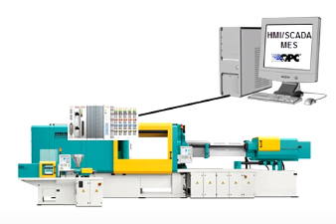
Example: Injection Molding Machines @ISE MFG Lab

Slide 16

Example: Injection Molding Machines @ISE MFG Lab
Cloud
ERP
MES
SCADA
PLCs – PACs
Sensors & Actuators
Machine Assets
Factory IT Network
X

Slide 17


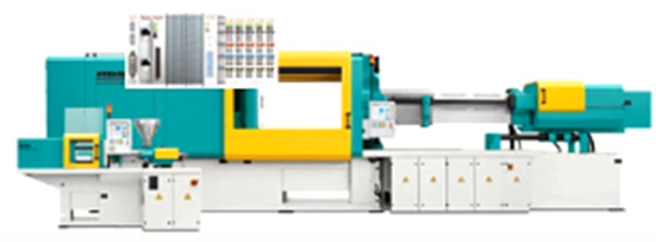
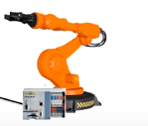
Example: Injection Molding Machines @ISE MFG Lab
Enterprise Level
BI
MES
ERP
OPC UA Client
OPC UA Client
OPC UA Client
OPC UA Client
OPC UA Server
OPC UA Server
Historian
Operations
Level
Command & Control
SCADA
OPC UA Client
OPC UA Client
OPC UA Server
OPC UA Server
OPC UA Server
Plant Floor Level

Slide 18
Summary of OPC-UA: Two Pillars
Data & Information Modeling
Data Transport Mechanism
Plant
Machine 1
Machine 2
Machine 3
Machine 4
Tag 1
Tag 2
Tag 1
Tag 2
Tag 1
Tag 2
Tag 3
TCP Protocol (Binary)
XML Over HTTPS/SOAP protocol
Publish-Subscribe Model Extension

