Slide 1
Image Processing Basics
Dr. Binil Starly
James T. Ryan Professor
Edward P. Fitts Department of Industrial & Systems Engineering

Slide 2
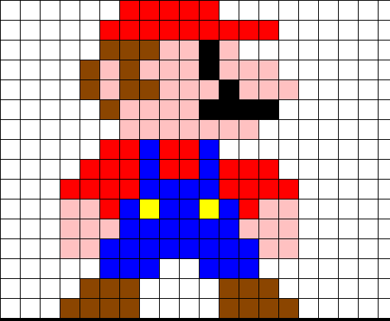
7
Pixels in Image
Image is a collection of pixels in distinct colorspaces.
Image resolution is the number of pixels present in an image.
Examples of Image Resolution can be 320 x 420 or 1024 x 768.
Higher the number of pixels in rows and columns, the better resolution it is and consequently larger in file size.

Slide 3
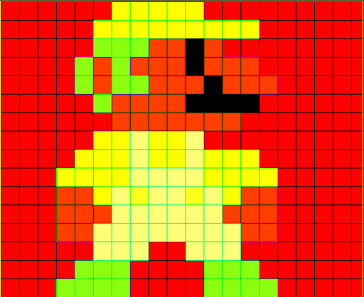
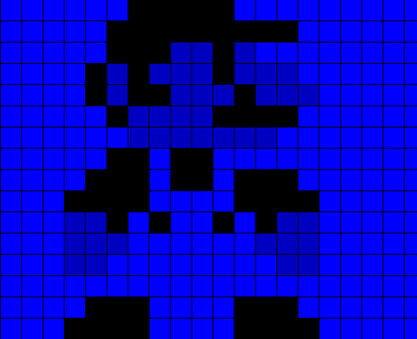
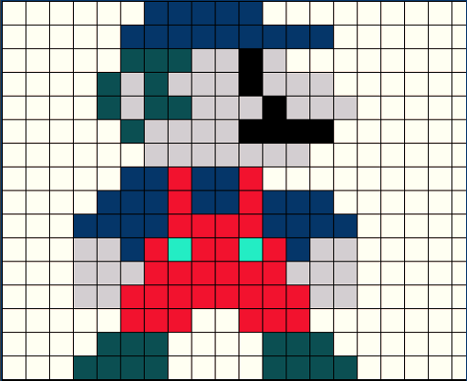
Color Spaces
The organization of the colors of in an image in a specific format is called color space. Each and every image uses one of the following color spaces for effective picture representation:
RGB: Red, Green, Blue
XYZ: Color in the x, y, and z dimensions
HSV or HSL: Hue, Saturation and Value
See full List of Color Spaces: LINK
RGB to HSV
R=0, G=0, Blue Channel
In XYZ form
Notes:
https://docs.opencv.org/3.4/d8/d01/group__imgproc__color__conversions.html

Slide 4
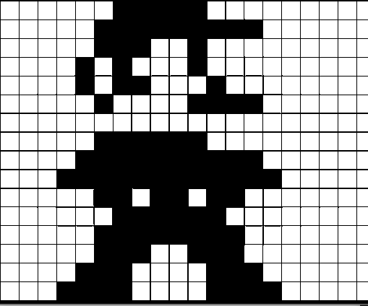
RGB Values in a Digital Image
(255, 255, 255)
(255, 0, 0)
(0,0,0)
RGB channels in a color image
Image in Binary with 0 and 1 representation

Slide 5
7
Lossless vs Lossy Compression
Lossless
Reducing size of image through compression
When de-compressed, quality of image is not lost.
Examples include TIFF, PNG
Lossy
Lossy compression prioritizes saving space
Quality or Data is not fully restored during de-compression
Examples include JPEG
Notes:
WebP: Lossless and lossy compression; small size,
but comparable image quality with JPEG

Slide 6
Pixel Thresholding and Extrapolation
Pixel Thresholding: A threshold value is used for establishing distinct divisions. For example, if a pixel intensity is greater than 60, then make it black or make it white; 60 is called a threshold.
Extrapolation: If we predict or estimate some value based upon its relationship with previous values, we are extrapolating. A neighbor to white pixel may be white (by extrapolation).
(255, 255, 255)
(255, 0, 0)
(0,0,0)
RGB channels in a color image

Slide 7
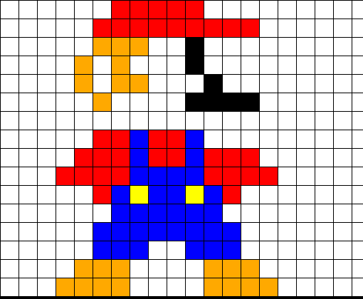
Pixel Interpolation & Extrapolation
+
=
Original image
Alpha = 0
Alpha = 1.5

Slide 8
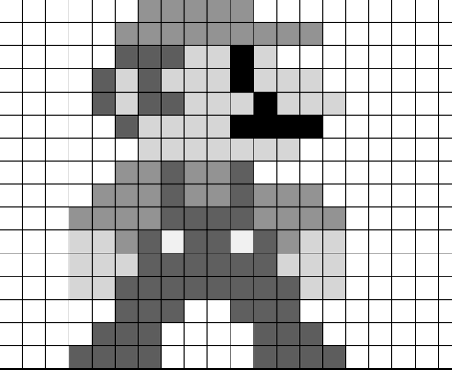
Otsu’s Thresholding
Auto-Thresholding: This technique is used when the algorithm needs to find the optimal threshold value to obtain a gray-scale image. Extremely useful when you have a variety of images to process and a single value may not always be applicable to all images.
RGB channels in a color image
Converted to Gray Scale Image
Ref: https://en.wikipedia.org/wiki/Otsu%27s_method

Slide 9
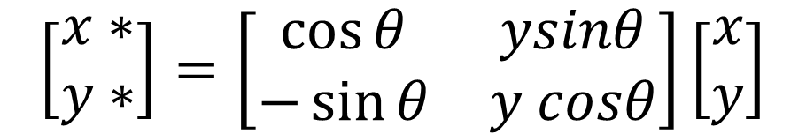
Rotating Images
$$\left[\begin{aligned}x∗ \\ y∗\end{aligned}\right]=\left[\begin{matrix}\cos{θ} & ysinθ \\ −\sin{θ} & y cosθ\end{matrix}\right]\left[\begin{aligned}x \\ y\end{aligned}\right]$$

Slide 10
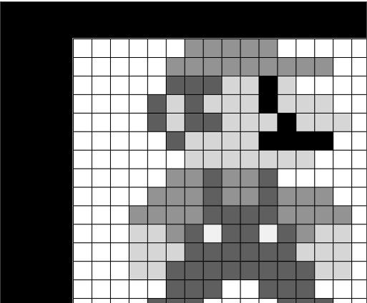

Translating Images
Translation is the shifting of an object's location given the known shift in x and y direction - (tx,ty), then the transformation matrix M is as follows:

