Slide 1
Comparing Images: MSE and SSIM techniques
Dr. Binil Starly
James T. Ryan Professor
Edward P. Fitts Department of Industrial & Systems Engineering

Slide 2


MSE vs SSIM
An image classifier that describes how similar two images are.
MSE (Mean Square Error): MSE will calculate the mean square error between each pixels for the two images
SSIM (Structure Similarity Index Measure): Checks if the pixels in the two images line up to have similar pixel density values.
The parameters include the (x, y) location of the N x N window in each image, the mean of the pixel intensities in the x and y direction, the variance of intensities in the x and y direction, along with the covariance. c₁ and c₂ are constants. SSIM is between -1 and 1.

Slide 3
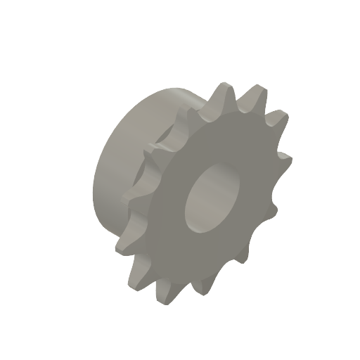
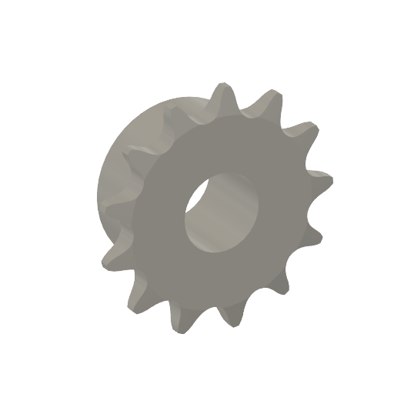
Mean Square Error (MSE)
(165, 156, 146)
(172, 160, 161)
REFERENCE
TEST
https://scikit-image.org/docs/dev/api/skimage.metrics.html#mean-squared-error

Slide 4
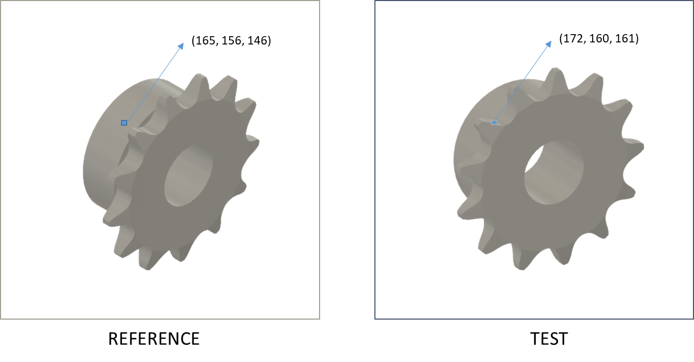
Normalized Mean Square Error (MSE)
https://scikit-image.org/docs/dev/api/skimage.metrics.html#skimage.metrics.normalized_root_mse

Slide 5
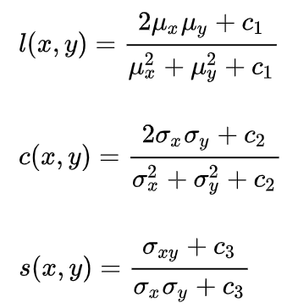



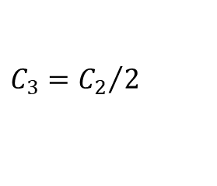
Structural Similarity Index Measure (SSIM)
Luminance
Contrast
Structure
$$C_{1}={k_{1}L}^{2}$$
$$C_{2}={k_{2}L}^{2}$$
$$C_{3}={C_{2}}/2$$
k₁ = 0.01; k₂ = 0.03; L = dynamic range of pixel values 2⁸ - 1
Paper: https://www.cns.nyu.edu/pub/eero/wang03-reprint.pdf
Notes:
https://www.cns.nyu.edu/pub/eero/wang03-reprint.pdf

Slide 6
MSE , Norm-MSE , SSIM
Images need to be of same size.
Images converted to Gray-Scale, although multi-channel is possible.
Useful when comparing good quality vs bad quality image.
Can tell if the images are mis-aligned.
Small defects are not identified.
Blurred or badly exposed images can be identified.
Does not detect the type of defect

