Slide 1
Hough Transforms
(Lines & Circles)
Dr. Binil Starly
James T. Ryan Professor
Edward P. Fitts Department of Industrial & Systems Engineering

Slide 2
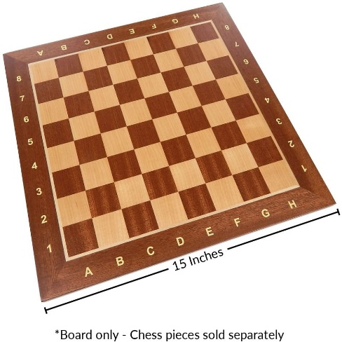
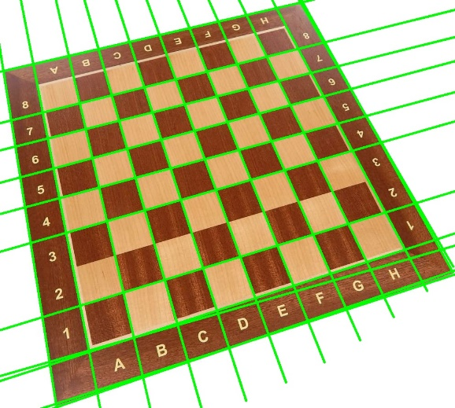
Hough Transform
To find shapes in an image
Robust method to find a shape in an image – Lines, Circles and even General Shapes.
Shape can be described in parametric form
A voting scheme is used to determine the correct parameters.
Given points that belong to a line,
What is the line?
How many lines are there?
Which points belong to which lines?

Slide 3

Polar Representation of Lines
From image space to hough space
Image Columns
$$ρ=x cosθ+y sinθ$$
Ѳ
Where,
ρ = perpendicular distance from line to origin
Ѳ = angle the perpendicular line makes with the x-axis
ρ
Image Rows

Slide 4
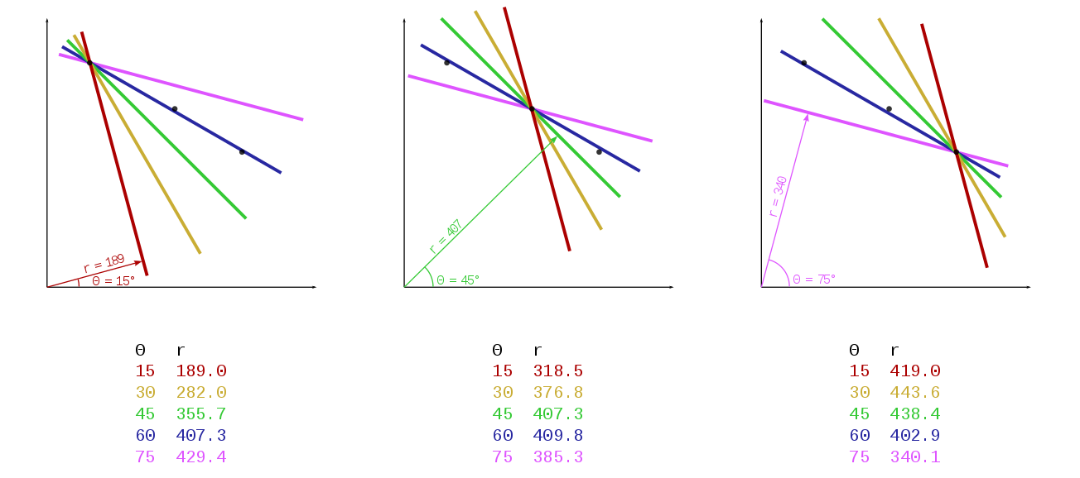




Voting of line to find ($ρ$, $θ$) pair
Highest votes determine the line
$$ρ$$
$$ρ$$
$$ρ$$
https://en.wikipedia.org/wiki/Hough_transform

Slide 5


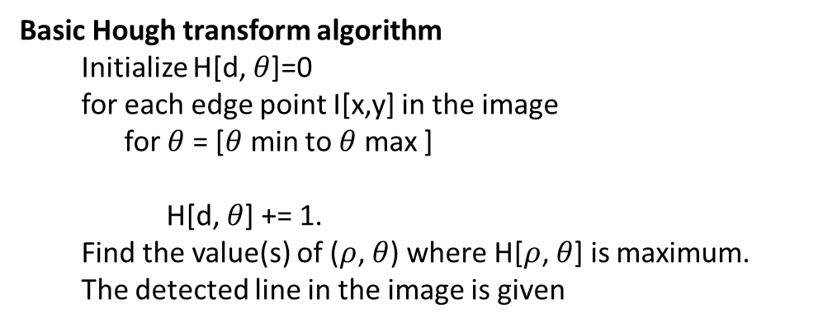



Accumular Array H($ρ$, $θ$)
Highest votes determine the line
$$θ$$
0 | 1 | 2 | 3 | . | . | . | . | . |  |  |  |  |  |  |  |  |  | 180
1
2
$$ρ$$
Max $ρ$
will be diagonal of given image
Basic Hough transform algorithm
Initialize H[d, $θ$]=0
for each edge point I[x,y] in the image
for $θ$= [$θ$min to $θ$max ]
H[d, $θ$] += 1.
Find the value(s) of ($ρ$, $θ$) where H[$ρ$, $θ$] is maximum.
The detected line in the image is given
$$ρ=x cosθ+y sinθ$$
https://en.wikipedia.org/wiki/Hough_transform

