Slide 1
Histogram of Oriented Gradients (HOG) Descriptors
Dr. Binil Starly
James T. Ryan Professor
Edward P. Fitts Department of Industrial & Systems Engineering

Slide 2

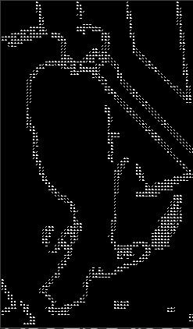
A HOG Descriptor
Object Classification based on Oriented Gradients of image pixels
Calculating image gradients that capture contour and silhouette information of grayscale images.
These descriptor transforms a 2D matrix of an image to a 1D vector, which can then be input into a machine learning algorithm (random forests, support vector machines, logistics regression).

Slide 3
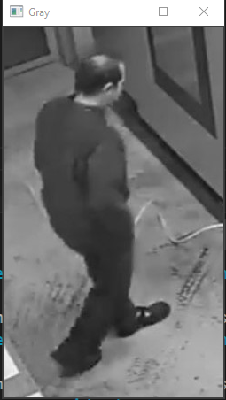
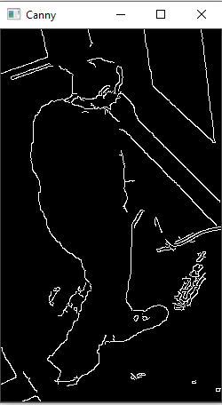
How to Calculate HOG
5 STEPS to Calculating HOG
STEP 1 : Preprocessing
Resize or crop the image while keeping aspect ratio the same.
Images can be coverted to Grayscale and then passed through to the next stage
They can be multi-channel, in which case the raw RGB image is passed.
A Canny Edge Detector applied can also be used particularly if the image is noisy.
HOG Function

Slide 4
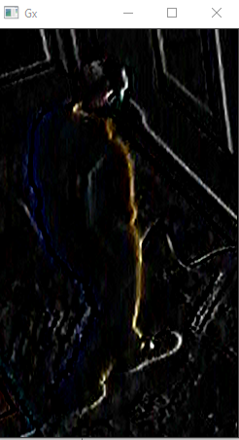
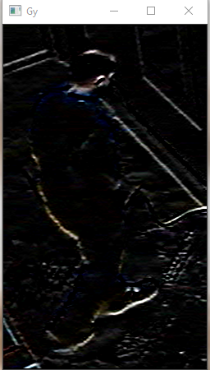
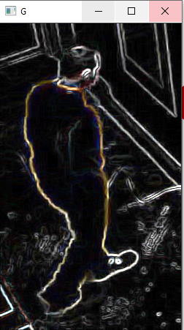
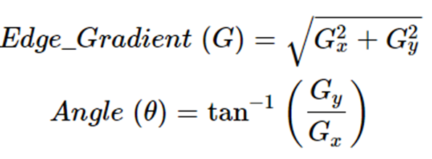
How to Calculate HOG
5 STEPS to Calculating HOG
STEP 2 : Calculating Gradients
Calculate the horizontal and vertical gradients.
Achieved by filtering the image with the following kernels or using the Sobel operator.
Find the magnitude and direction of gradient
-1 | 0 | 1
-1
0
1

Slide 5
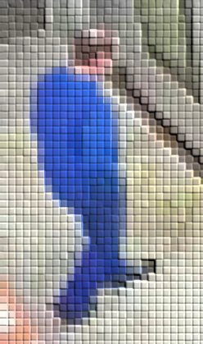
How to Calculate HOG
5 STEPS to Calculating HOG
Gradient Mag
STEP 3 : Histogram of Gradients
Calculate the horizontal and vertical gradients.
Achieved by filtering the image with the following kernels or using the Sobel operator.
Find the magnitude and direction of gradient
3 | 3 | 4 | 6 | 3 | 4 | 2 | 2
5 | 11 | 17 | 13 | 7 | 9 | 3 | 4
11 | 21 | 23 | 27 | 22 | 17 | 4 | 6
23 | 99 | 165 | 135 | 85 | 32 | 26 | 2
91 | 155 | 133 | 136 | 144 | 152 | 57 | 28
98 | 196 | 76 | 38 | 26 | 60 | 170 | 51
165 | 60 | 60 | 27 | 77 | 85 | 43 | 136
71 | 13 | 34 | 26 | 108 | 27 | 48 | 110
Gradient Direction
-1 | 0 | 1
-1
0
1
100 | 36 | 5 | 50 | 0 | 64 | 90 | 73
37 | 9 | 9 | 179 | 78 | 27 | 169 | 166
87 | 173 | 39 | 102 | 163 | 152 | 146 | 176
76 | 13 | 1 | 168 | 159 | 22 | 125 | 143
120 | 70 | 14 | 150 | 145 | 144 | 145 | 143
8 | 86 | 116 | 98 | 100 | 101 | 133 | 113
30 | 65 | 157 | 75 | 58 | 165 | 145 | 125
11 | 170 | 90 | 4 | 110 | 17 | 133 | 110

Slide 6
How to Calculate HOG
5 STEPS to Calculating HOG
Gradient Mag
The next step is to create a histogram of gradients in these 8×8 cells. The histogram contains 9 bins corresponding to angles 0, 20, 40 … 160.
A bin is selected based on the direction, and the vote ( the value that goes into the bin ) is selected based on the magnitude. Let’s first focus on the pixel encircled in blue. It has an angle ( direction ) of 60 degrees and magnitude of 3. So it adds 3 to the 6th bin. The gradient at the pixel encircled using green has an angle of 50 degrees and magnitude of 6. Since 50 degrees is half way between 40and 60, the vote by the pixel splits evenly into the two bins (40 and 60). The vote will be 3 each (3+3=6)
3 | 3 | 4 | 6 | 3 | 4 | 2 | 2
5 | 11 | 17 | 13 | 7 | 9 | 3 | 4
11 | 21 | 23 | 27 | 22 | 17 | 4 | 6
23 | 99 | 165 | 135 | 85 | 32 | 26 | 2
91 | 155 | 133 | 136 | 144 | 152 | 57 | 28
98 | 196 | 76 | 38 | 26 | 60 | 170 | 51
165 | 60 | 60 | 27 | 77 | 85 | 43 | 136
71 | 13 | 34 | 26 | 108 | 27 | 48 | 110
 |  | 3 | 3 |  | 3
0
20
40
60
80
100
120
140
160
Histogram of Gradients
Gradient Direction
100 | 36 | 5 | 50 | 0 | 64 | 90 | 73
37 | 9 | 9 | 179 | 78 | 27 | 169 | 166
87 | 173 | 39 | 102 | 163 | 152 | 146 | 176
76 | 13 | 1 | 168 | 159 | 22 | 125 | 143
120 | 70 | 14 | 150 | 145 | 144 | 145 | 143
8 | 86 | 116 | 98 | 100 | 101 | 133 | 113
30 | 65 | 157 | 75 | 58 | 165 | 145 | 125
11 | 170 | 90 | 4 | 110 | 17 | 133 | 110

Slide 7
How to Calculate HOG
5 STEPS to Calculating HOG
STEP 4 : 16 x 16 Block Normalization
Eventually the 9 x 1 bin will have values contributed by each 8 x 8 cells, like the one below
185 | 135 | 20 | 42 | 43 | 46 | 53 | 190 | 188
0
20
40
60
80
100
120
140
160
Histogram of Gradients
Normalize the histogram over a bigger block of 16 x 16, which has 4 histograms. So 9 x 1 times 4 will yield a
36 x 1 element vector.
The window is then moved by 8 pixels ( see animation ) and a normalized 36×1 vector is calculated over this window and the process is repeated

Slide 8
How to Calculate HOG
5 STEPS to Calculating HOG
25
STEP 5 : HOG Vector
For the final HOG feature vector , the 36×1 vectors are concatenated into one giant vector.
The size of this vector will depend on the size of the original image.
The number of 16×16 blocks is = There are 25 horizontal 44 vertical positions making a total of 25 x 44 = 1100 blocks.
Each 16×16 block is represented by a 36×1 vector. So when we concatenate them all into one gaint vector we obtain a 36×1100 = 39,600 feature dimensional vector.
44

Slide 9
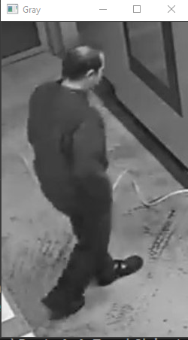
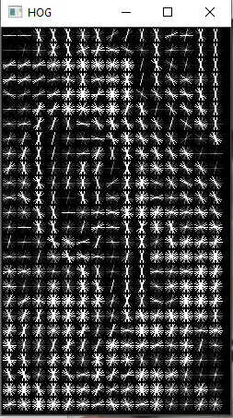
How to Calculate HOG
5 STEPS to Calculating HOG
STEP 3 : Ready-made Functions
SKLEARN
openCV
Using sklearn
from skimage.feature import hog
fd, hog_image = hog(img, orientations=9, pixels_per_cell=(16,16), cells_per_block=(2,2), visualize=True, multichannel=True)
With OpenCV
hog = cv2.HOGDescriptor()
(rects, weights) = hog.detectMultiScale(resizeImg, winStride=(8,8), padding=(8,8), scale=1.04 )

Slide 10
When to use HOG Descriptors
Images are taken from the same angle (ex. Satellite images, Microscope images, Quality Inspection Images)
Much faster than Neural Networks.
Trying to detect a single class of object.
Does not work well when there is too much noise, obstructions, various views and various kinds of objects within the scene.
If computing power not available, HOG combined with some ML algorithm works faster than Neural Networks.
But deep neural networks are always much better at classifying various kinds of defects, provided compute power is available.

