Slide 1
Neural Network Basics
Dr. Binil Starly
James T. Ryan Professor
Edward P. Fitts Department of Industrial & Systems Engineering

Slide 2
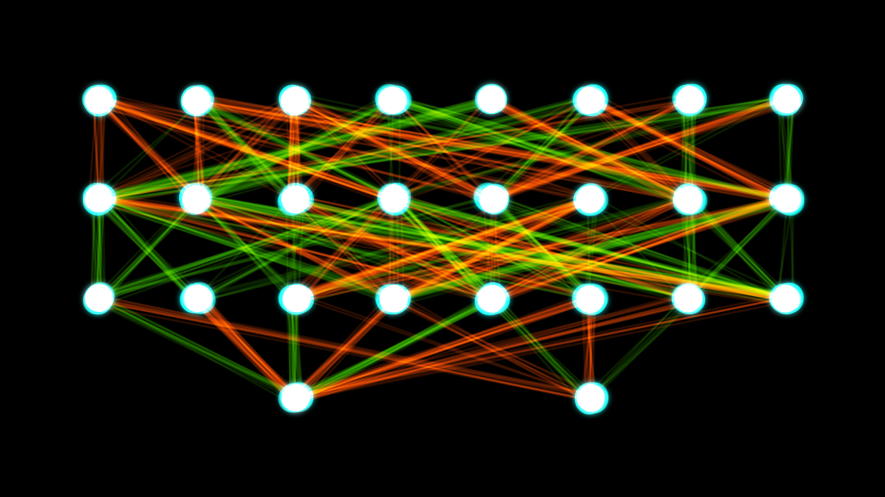
7
Neural Networks
Capable of reproducing some human brain functionality
Example – A NN to learn and classify objects in an image.
It is not a series of if-then statements.
It is only one part of the machine learning tools.
Deep Neural Networks are simply networks that have three or more layers.

Slide 3
7
Structure of a Neural Network
Collection of Neurons – small computing units
Neurons are inter-connected – multi-layer perceptron.
Simple NN have layers one or less than three. Deeper networks have 3 or more layers at minimum.
Even if you had a 100 layers of fully connected neurons, they wouldn’t be called Deep Neural Networks.
Output
Output
Output

Slide 4
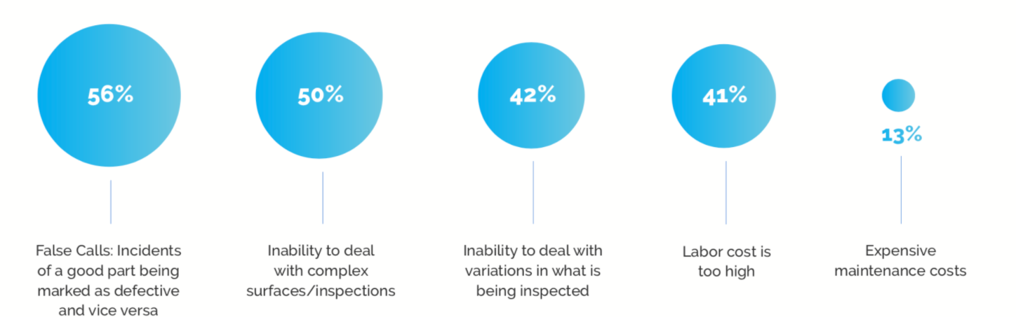
7
Applications of NN in Manufacturing
https://landing.ai/2020-state-of-ai-based-machine-vision-survey/
Image Recognition in Factory Floor Camera Feeds
Path Planning for Robots (stationary and mobile)
Predictive Maintenance of Machine Assets
Text recognition of manufacturing documents
Predict Safety Risk
Augment Production Design
Real-Time Optimization Production Schedule
Real-Time Supply Chain
Notes:
Name some AI based Manufacturing Startups that either offer Products or Services or Uses AI in their production in the World. Write briefly on what they do.

Slide 5
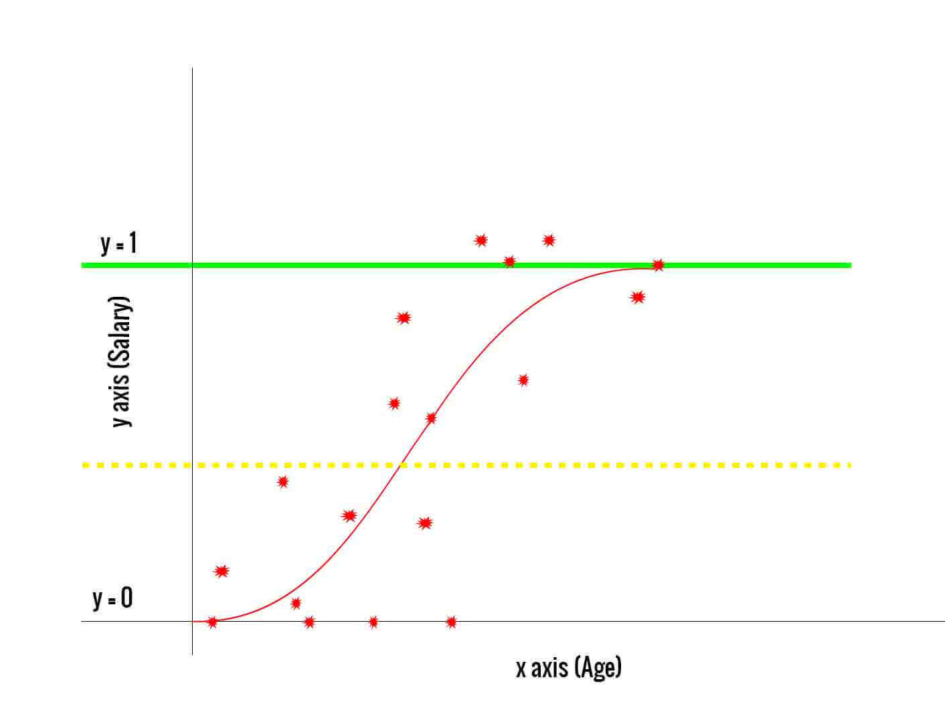
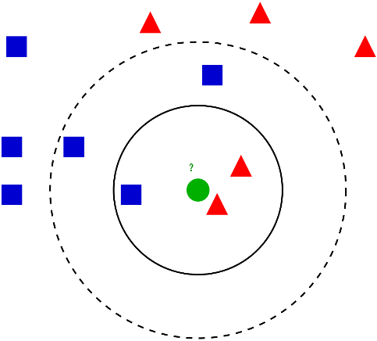
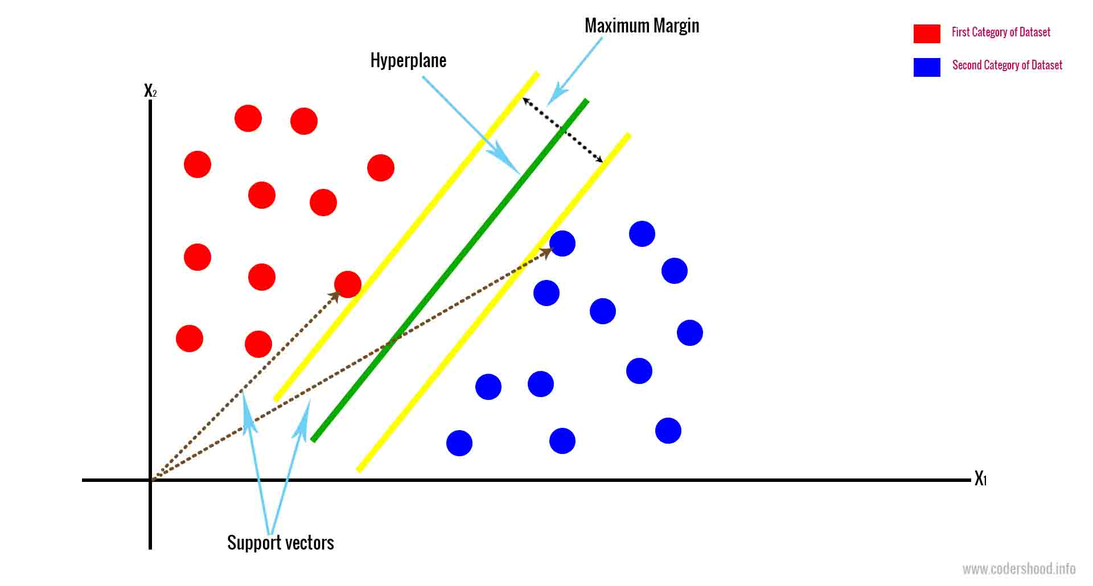
7
Types of Classifiers
Logistic Regression
K-Nearest Neighbors
Support Vector Machines
Decision Trees

Slide 6
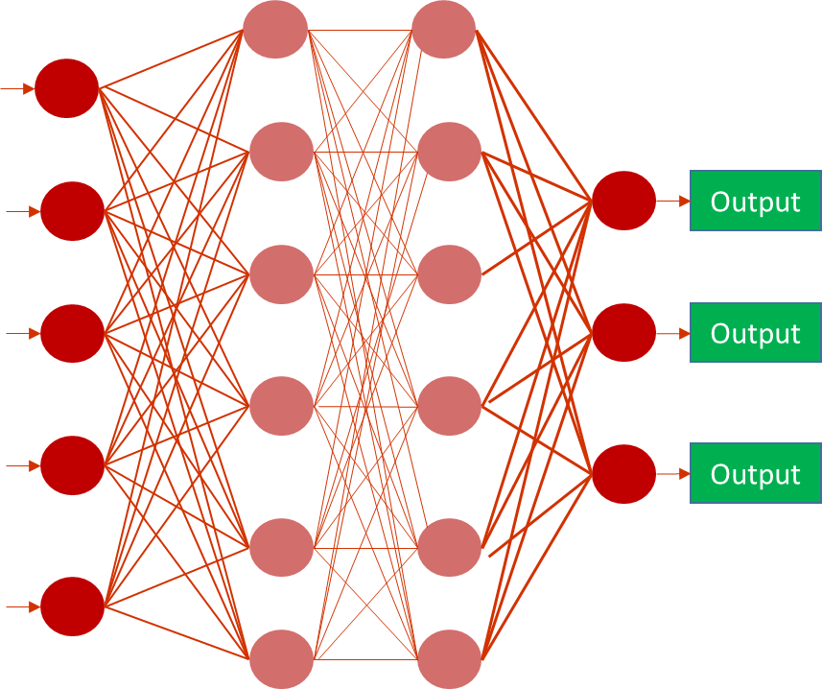
7
Types of Classifiers: Feed Forward NN
Biologically inspired
Architecture if flexible with as many outputs as needed.
Learning algorithm adapts to input
Multiple Inputs, a series of layers with signals moving forward until they reach the output prediction.

Slide 7
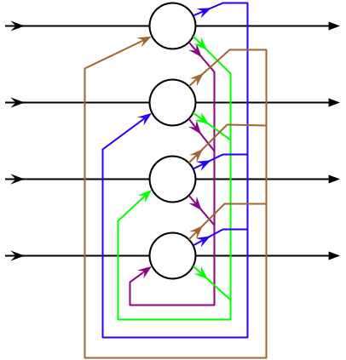
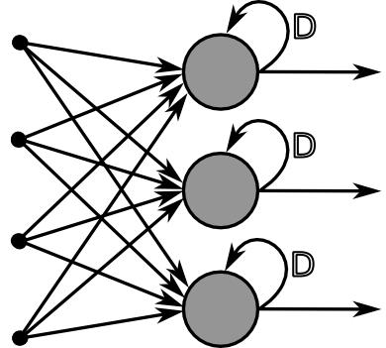
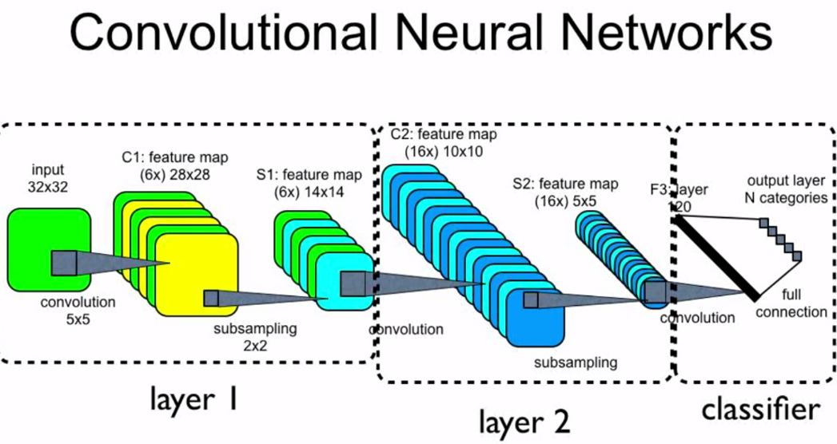
7
Types of Neural Networks
Hopfield Neural Network
Convolutional Neural Networks
Recurrent Neural Networks
Generative Adversarial Networks
Reinforcement Learning

Slide 8
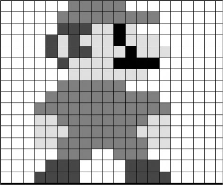
7
Multi-layer Perceptron
Input Layer (Input Vector)
Hidden Layers (composed of Neurons)
Fully Connected. Each node connected to other nodes.
Output Layer. As many neurons as needed to predict the output classes.
Output
Output
Output
Mario Luigi Toad

