Slide 1
Neural Network Components
Dr. Binil Starly
James T. Ryan Professor
Edward P. Fitts Department of Industrial & Systems Engineering

Slide 2
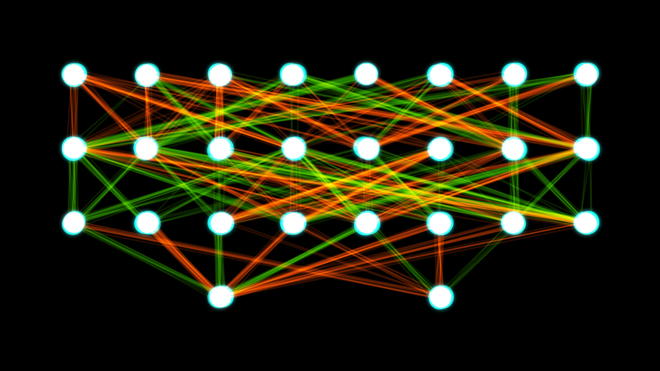
7
Neural Network Components
Neurons and Perceptrons
Weights
Bias
Activation Function
Binary Step
SIGMOID or Logistic (2-class)
Hyberbolic Tangent (tanh)
Rectified Linear Unit (RELU)
Softmax (multi-class normalized class prediction)

Slide 3
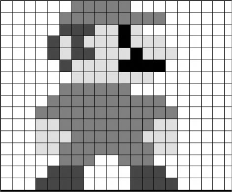
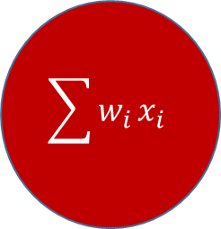




7
Structure of a Neuron
Inputs x₀, x₁, ….x_{n-1}
Assigning weights to each input.
To fire or not, would be to simply add the weights times the input x vector
X₁
$$w_{0}$$
X₂
$$\sum{w_{i}}x_{i}$$
$$w_{1}$$
X₃
$$w_{2}$$
X_{n-1}
$$w_{n−1}$$

Slide 4

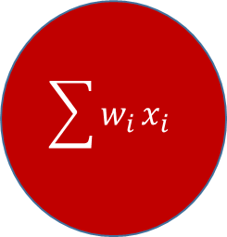



7
Structure of a Neuron
$$w_{0}$$
X₁
$$1$$
$$\sum{w_{i}}x_{i}$$
$$w_{1}$$
X₂
$$−1$$

Slide 5


7
Bias Input to Neuron
X₁
$$w_{0}$$
$$\sum{w_{i}}x_{i}$$
X₂
$$w_{1}$$

Slide 6

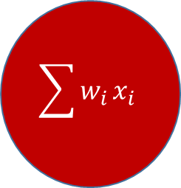




7
Structure of a Neuron
X₁
$$w_{0}$$
$$\sum{w_{i}}x_{i}$$
X₂
$$w_{1}$$
X₃
$$w_{2}$$
X_{n-1}
$$w_{n−1}$$
bias
$$w_{n}$$

Slide 7

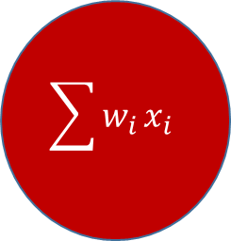




7
Activation Function
Current neuron isn’t actually very useful.
Can lead to very large or small value based on input values. Maybe become too sensitive.
Can lead to dramatic change in results with very little change in actual neuron value.
Not easily trained since it cannot be trained. It is a linear function
X₁
$$w_{0}$$
$$\sum{w_{i}}x_{i}$$
X₂
$$w_{1}$$
X₃
$$w_{2}$$
X_{n-1}
$$w_{n−1}$$
bias
$$w_{n}$$

Slide 8







7
Activation Function
Model the desired threshold behavior
Usually constrain the output values
Provides non-linearity to the neuron – making it easy to train
Training enabled by backpropogation (meaning function should be differentiable)
X₁
$$w_{0}$$
$$\sum{w_{i}}x_{i}$$
X₂
$$w_{1}$$
X₃
$$gz$$
$$w_{2}$$
X_{n-1}
$$w_{n−1}$$
bias
$$w_{n}$$

Slide 9
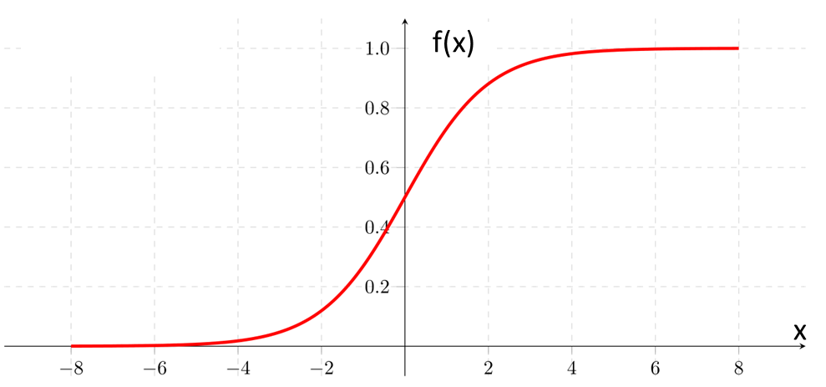
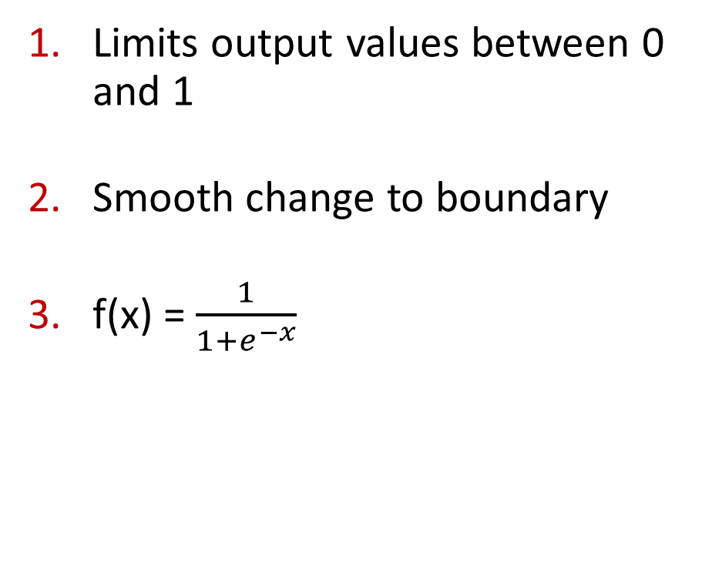
7
Activation Function: Sigmoid Function
Limits output values between 0 and 1
Smooth change to boundary
f(x) = $\frac{1}{1+e^{−x}}$

Slide 10
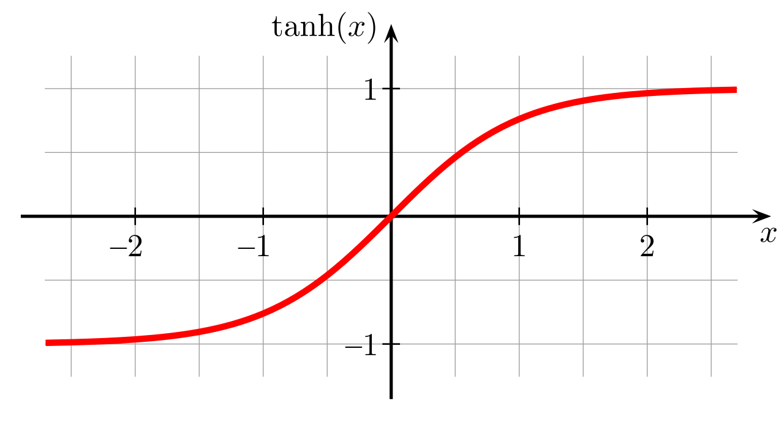
7
Activation Function: Hyberbolic Tangent Function
Limits output values between -1 and 1
Outputs are real numbers.
f(x) = tanh(x)

Slide 11
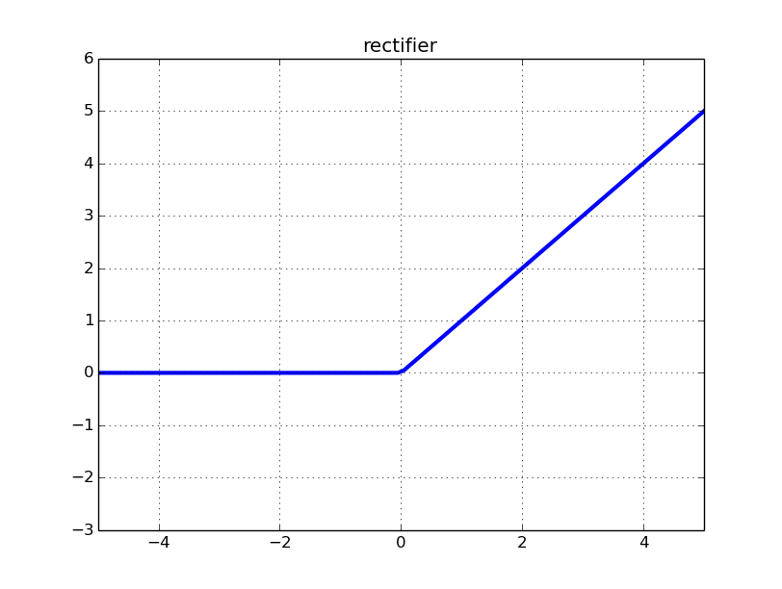
7
Activation Function: Rectified Linear Unit
Limits outputs to positive values
It is unbounded
Quite Popular

Slide 12

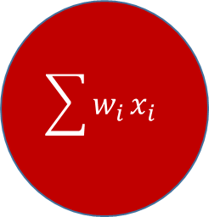




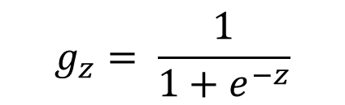
7
Complete Neural Model: Perceptron
X₁
$$w_{0}$$
$$\sum{w_{i}}x_{i}$$
X₂
$$w_{1}$$
$$g_{z}= \frac{1}{1+e^{−z}}$$
X₃
$$w_{2}$$
X_{n-1}
Outcomes from the activation function
If Sigmoid , then 0.5 becomes the threshold for the ‘neuron’ to fire.
$$w_{n−1}$$
bias
$$w_{n}$$

Slide 13
7
Some notes
All values must be real numbers, not integers.
Bias is constant throughout, and only need to deal with figuring out the weights for the bias.
The weights and inputs can be 1-D vectors.
Sum can then be calculated as z = w . x (dot product between w and x)
The sum is fed to a chosen activation function.

