Slide 1
Training the Neural Network
Dr. Binil Starly
James T. Ryan Professor
Edward P. Fitts Department of Industrial & Systems Engineering

Slide 2
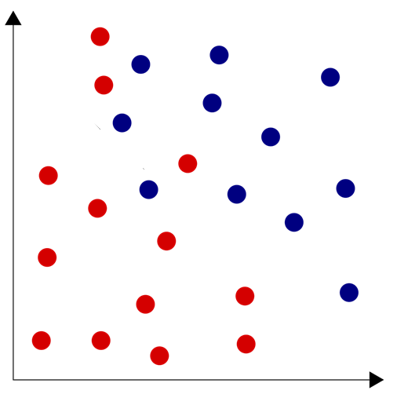
7
Linear Separability Concerns
Under-Fitting
Just Right
Overfitting

Slide 3
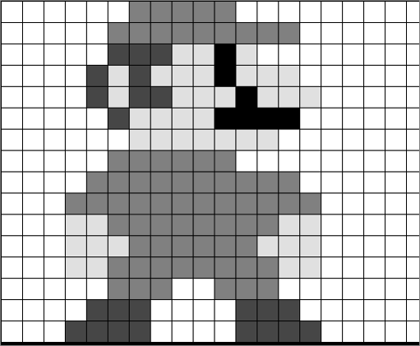
7
Training Process with Datasets
A dataset is a collection of samples with features (X) and labels (Y)
Features: Input Data or a Vector
Labels: Known Categories of each sample
Teach the network by showing various samples

Slide 4
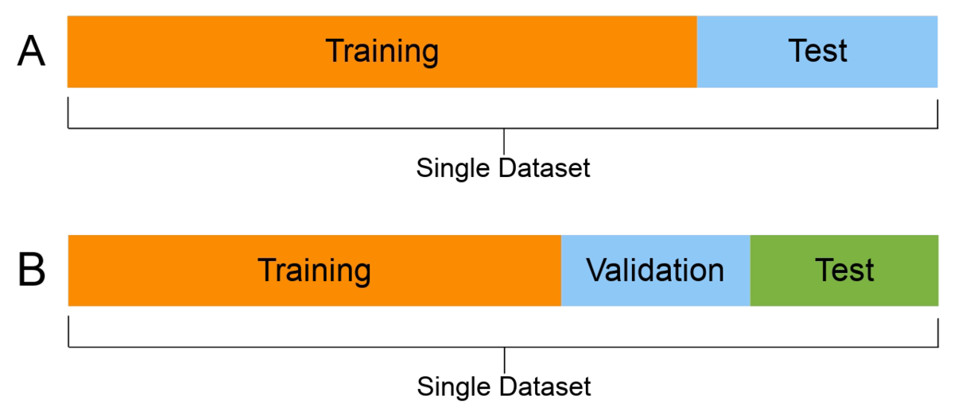
7
Sub-class within Datasets
Feed an Input Sample X to the network
Compare to the output to the label ‘Y’
Calculate the error, say MSE
Use this error to adjust the weights on the neuron
Try again, hopefully next time error reduces.
Minimize the error and objective is to be better classifier.
Train for many “Epochs”
Neural Network Architecture

Slide 5
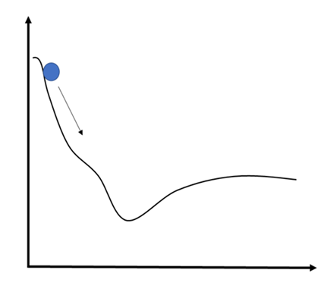
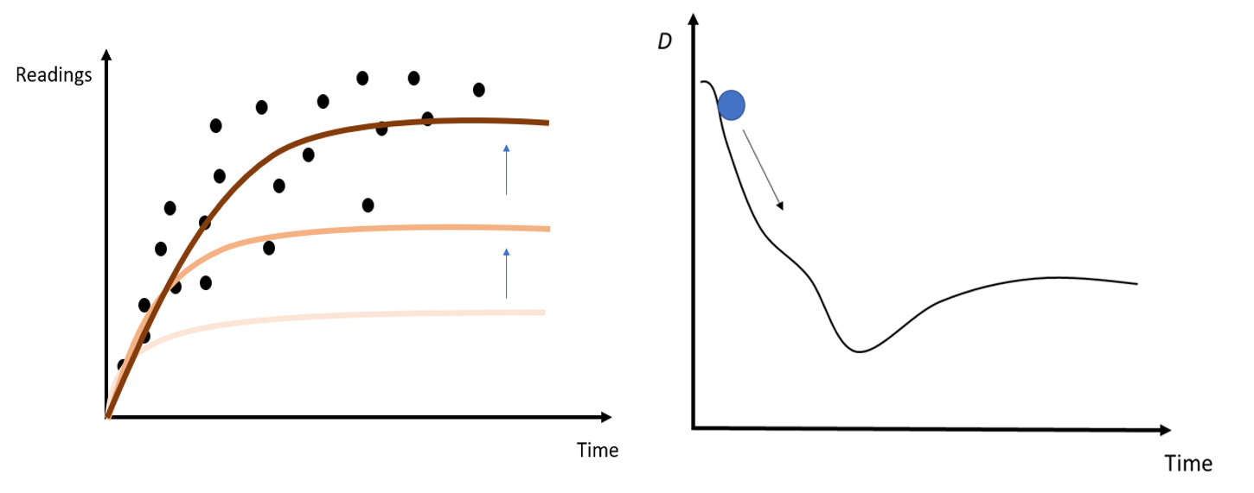
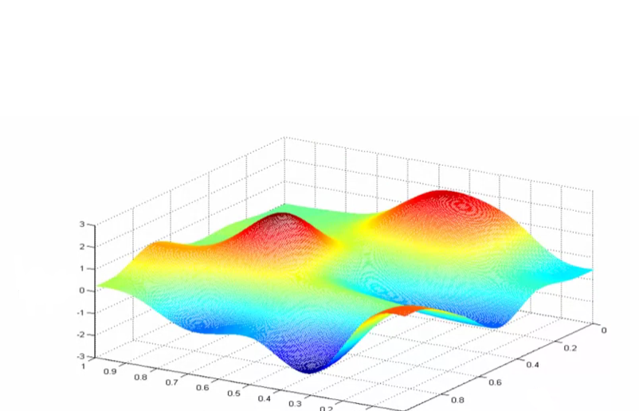
7
Gradient Descent
MSE
Weights

Slide 6

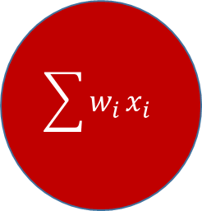



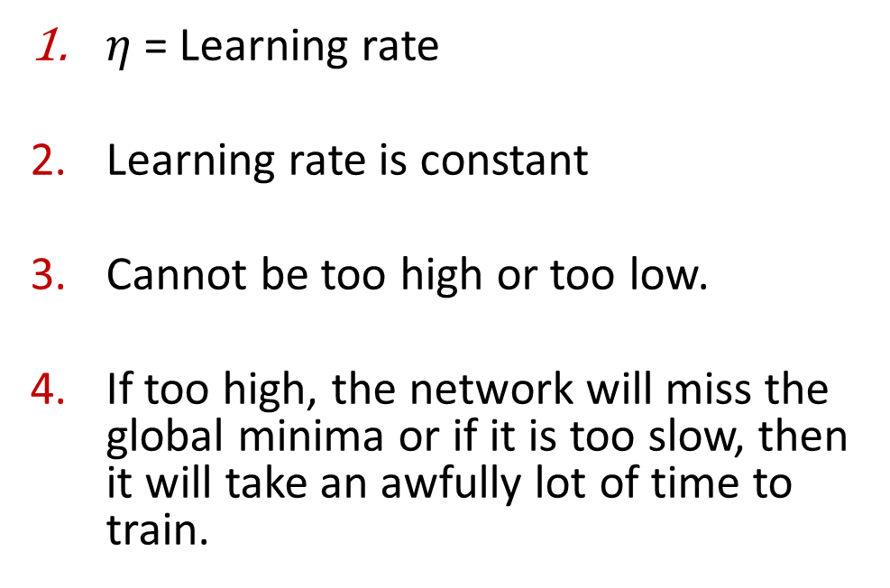

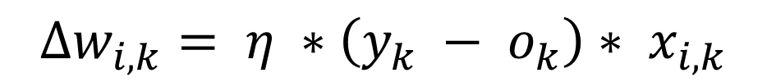
7
Delta Rule
$$∆w_{i,k}= η ∗\left(y_{k} − o_{k}\right)∗ x_{i,k}$$
X₁
$$w_{0}$$
$$\sum{w_{i}}x_{i}$$
X₂
$$w_{1}$$
$η$= Learning rate
Learning rate is constant
Cannot be too high or too low.
If too high, the network will miss the global minima or if it is too slow, then it will take an awfully lot of time to train.
X₃
$$w_{2}$$
X_{n-1}
$$w_{n−1}$$
bias
$$w_{n}$$

Slide 7
7
Forward Propagation
Neuron Activation
Neuron Transfer
Forward Propagation
activation = sum(weight_i * input_i) + bias
Sigmoid
Tanh
ReLU
output = 1 / (1 + e^(-activation))
The algorithm works through each layer of the network calculating the outputs for each neuron. All of the outputs from one layer become inputs to the neurons to the next layer.

Slide 8
7
Backpropagation Technique
Calculates all weight updates through the network layers
Transfer Derivative (derivative = output * (1.0 - output))
Error Backprogation
(error = (actual - output) * transfer_derivative(output))
Where actual is the expected output value for the neuron, output is the output value for the neuron and transfer_derivative() calculates the slope of the neuron’s output value.
In the last layer, the actual value is nothing but the expected value
But in the hidden layers,
error = (weight_k * error_j) * transfer_derivative(output)
Where error_j is the error signal from the jth neuron in the output layer, weight_k is the weight that connects the kth neuron to the current neuron and output is the output for the current neuron.

Slide 9
7
Forward Pass
0
1
y =
x₀
x₁
3
6
1
2
4
Output
x₂
0.2
0.49
o =
X =
Output
x₃
x₄

Slide 10
7
Calculate MSE
-0.2
0.51
0.04
0.261
y - o =
(y – o)² =
x₀
MSE = 0.15
x₁
3
6
1
2
4
Output
x₂
0.2
0.49
o =
X =
Output
x₃
x₄

Slide 11

Output Error Terms
x₀
x₁
Output
For the Output Layer
x₂
$δ_{k}= o_{k}∗\left(1−o_{k}\right)∗(y_{k}−o_{k})$
Output
x₃
x₄

Slide 12
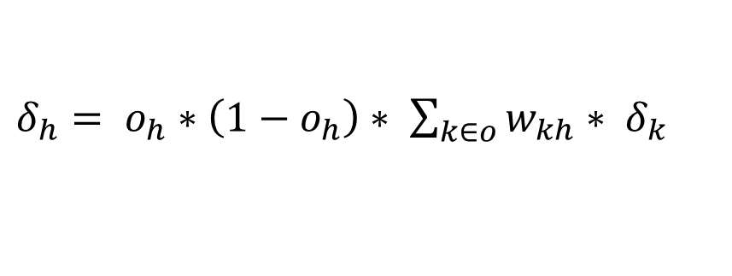
Calculate the Hidden Layer Error
x₀
x₁
Output
x₂
$δ_{h}= o_{h}∗\left(1−o_{h}\right)∗ \sum_{k∈o}{w_{kh}∗ δ_{k}}$
Output
x₃
x₄

Slide 13
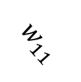




Calculate the Hidden Layer Error
Layer 2
Layer 3
$$δ_{21}$$
$$w_{01}$$
$$δ_{30}$$
Output
$$w_{11}$$
$δ_{21}= o_{h}∗\left(1−o_{h}\right)∗ \sum_{k∈o}{w_{k1}∗ δ_{k}}$
$$δ_{31}$$
Output

Slide 14











Calculate the Hidden Layer Error
Layer 1
Layer 2
$$δ_{20}$$
$$w_{01}$$
$$δ_{21}$$
$$w_{02}$$
$$δ_{12}$$
$δ_{12}= o_{h}∗\left(1−o_{h}\right)∗ \sum_{k∈o}{w_{k2}∗ δ_{k}}$
$$w_{03}$$
$$δ_{22}$$
$$w_{04}$$
$$δ_{23}$$
$$w_{05}$$
$$δ_{24}$$

Slide 15


Apply the Delta Rule
$$∆w_{i,j}= η∗δ_{i}∗ x_{i,j}$$
$$w_{ij}=w_{ij}+ ∆w_{i,j}$$
x₀
x₁
Output
x₂
Output
x₃
x₄

