Slide 1
Loss Functions
Dr. Binil Starly
James T. Ryan Professor
Edward P. Fitts Department of Industrial & Systems Engineering

Slide 2

7
Loss Functions or Criterion
Problem Type | Last Layer Activation | Loss Function
Binary Classification | Sigmoid | Binary cross-entropy
Multi-class, single label classification | Softmax | Categorical Cross-entropy
Multi-class, multi label classification | Sigmoid / ReLU | Binary cross-entropy
Regression to Arbitrary Values | None | Mean Squared Error (MSE)
Regression to Values between 0 and 1 | Sigmoid | Mean Squared Error or binary cross-entropy

Slide 3
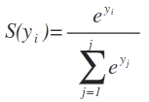

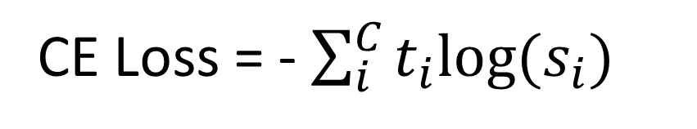
Cross-Entropy Loss Criterion
SOFTMAX Function
CROSS-ENTROPY LOSS
CE Loss = - $\sum_{i}^{C}{t_{i}log⁡(s_{i})}$
where t_{i} and s_{i} are the groundtruth and the score for each class i in C.
An activation function (Sigmoid / Softmax) is applied to the scores before the CE Loss computation.

Slide 4
Negative Log Likelihood (NLL) Loss Criterion
Predicted Probability for 5 classes
Actual Ground Truth
[0.2, 0.1, 0.6, 0.1]
[0, 0, 0, 1]
0.2 * 0 + 0.1 * 0 + 0.6 * 0 + 0.1 * 1 = 0.1
NLL = -1 * ln (0.1) = 2.3
Maximizing the likelihood
Is same as
Minimizing the cross-entropy
Predicted Probability for 5 classes
Actual Ground Truth
[0.1, 0.1, 0.2, 0.6]
[0, 0, 0, 1]
0.1 * 0 + 0.1 * 0 + 0.2 * 0 + 0.6 * 1 = 0.6
NLL = -1 * ln (0.6) = 0.51
The better the prediction, the lower the NLL loss, This is exactly the same for other losses, the better the output, the lower the loss.

