Slide 1

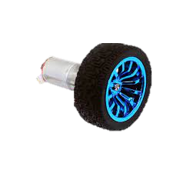
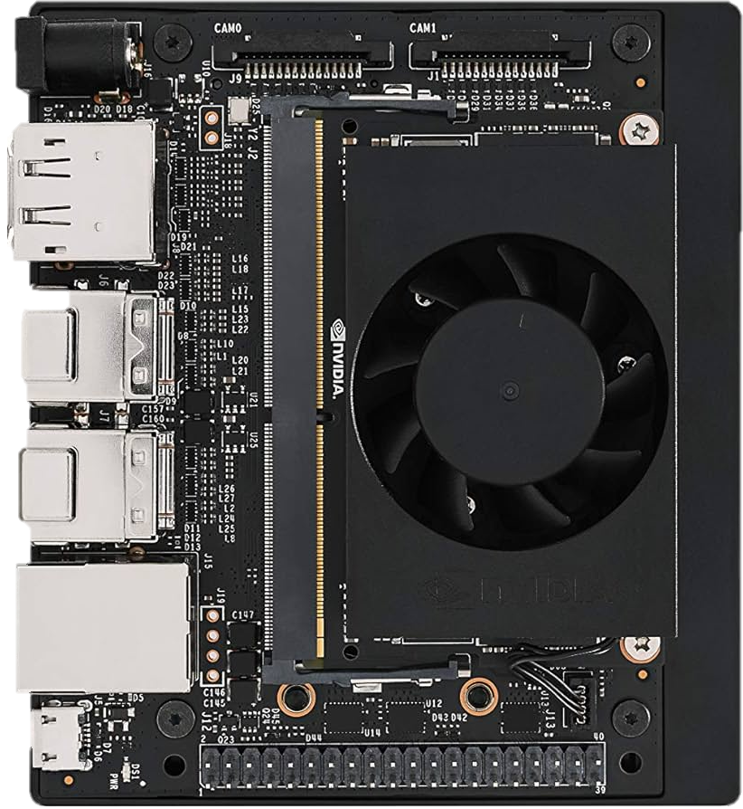
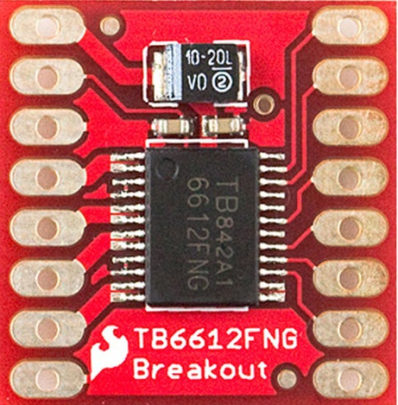
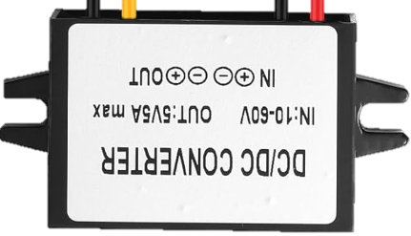

5V
Motor +
GND
Motor -
Chanel A
+12V
Chanel B
-12V
Encoder A
STNDBY
Encoder B

