Slide 1
Using Machine learning to predict school performance in Sd county
Amelia Corea
Parth Korat
Geoff Pawlowski
AshuTosh SawaNT

Slide 2
The Problem
What are we trying to predict and answer with the machine learning model?
Can we use strictly demographic information to accurately predict school ratings
Why is this important?
If we can build a reliable model that predicts school performance based on socio-economic factors, that is a powerful statement. Would also be useful for identifying over or under-performing schools and learning from their instruction models
What was the approach
To use data collected in project #3 and use it to develop various ML models predicting school ratings as defined by GreatSchools.org
How will we know if we have answered this question?
If we develop an accurate model that predicts school ratings against our test data set.

Slide 3
Data Gathering and Cleanup Process Flow
Data Collection
Webscraping
Data Cleaning/Normalization
SQL queries
Machine Learning & Visualization
Scikit-learn
API
Python libraries
.csv files
AWS Cloud Database
PostgreSQL
Jupyter Notebooks
sqlalchemy
pandas
ML Models Tested:
Linear Regression
KNN
Random Forest
Extra Trees
AdaBoost
SVR
Plotly

Slide 4
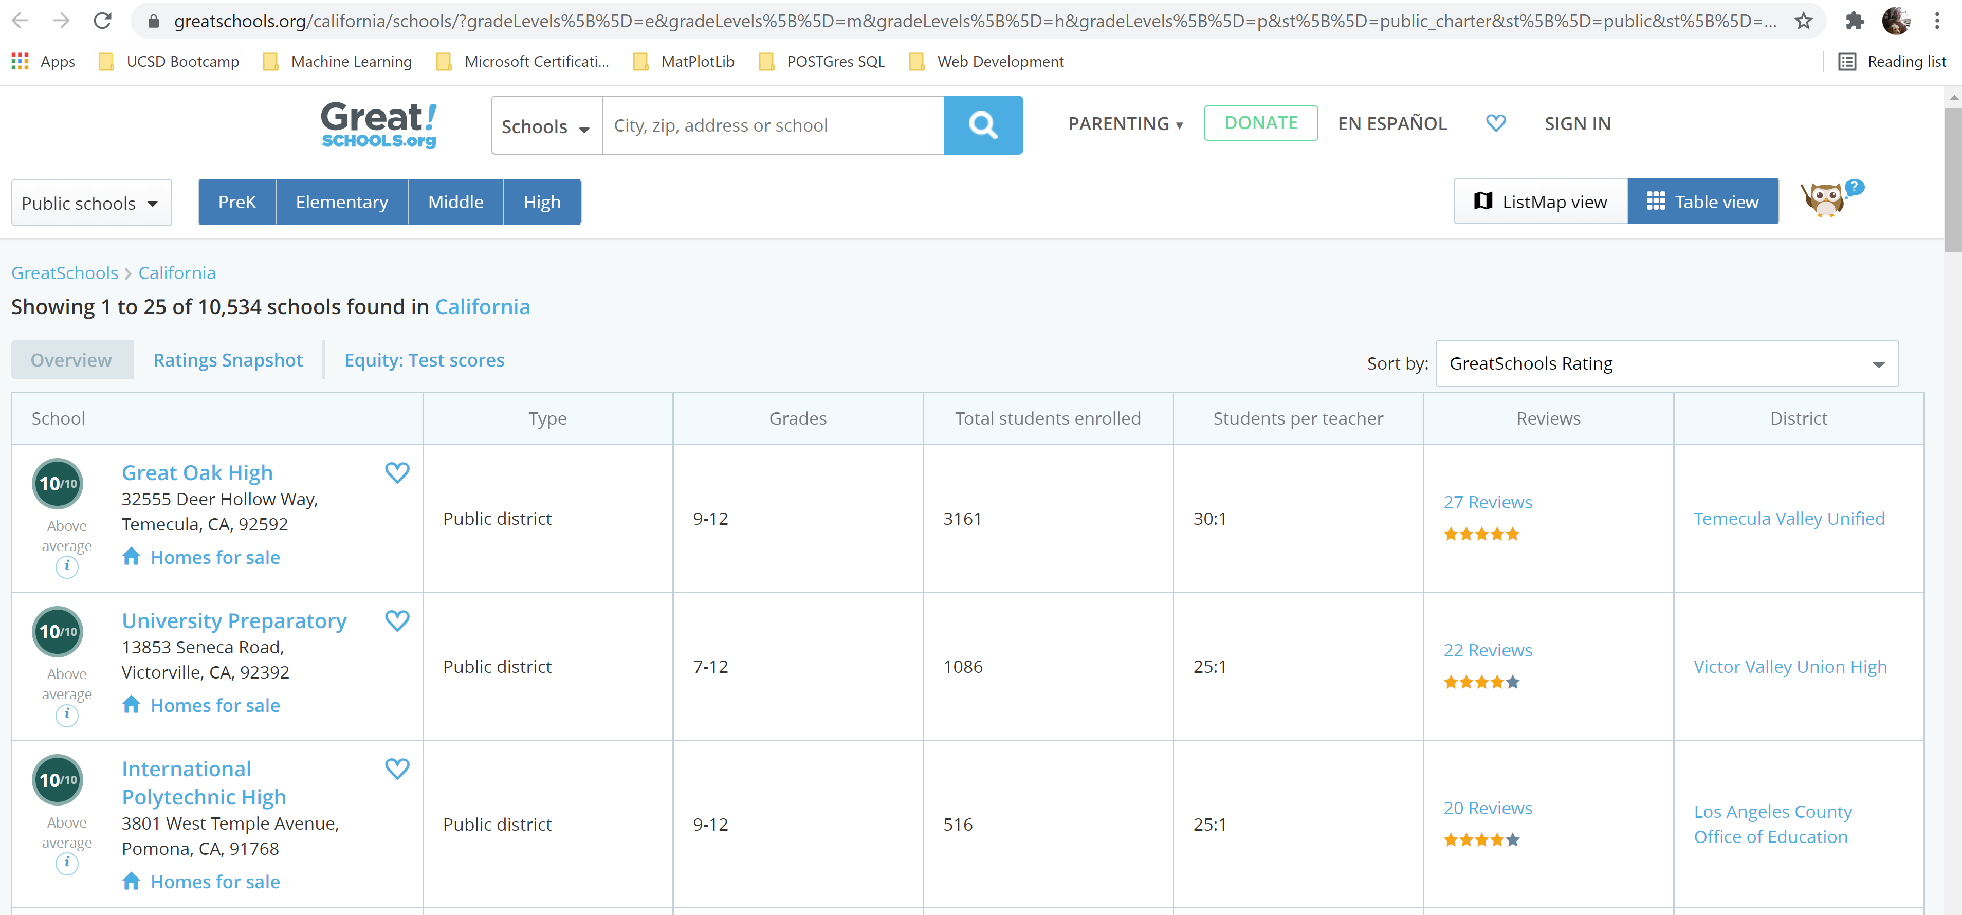
Data Collection
Web scrape Greatschools.org for school info
10,000 + records for California
394 iterative web pages

Slide 5
Data Collection
Census American Communities Survey (5-Yr) – API, Python library censusdata – Over 20,000 variables to consider
Data by zip code and state – 1,700 records per variable
Population by ethnicity
Education levels attained
Median income by ethnicity
Family structure type for school age children
SANDAG.org – Crime reporting data for past 180 days in .csv format
Crime reporting by zip code – 50,000 categorized San Diego County crimes
San Diego County Zip Codes & lat/long
Stitching together from various web data

Slide 6
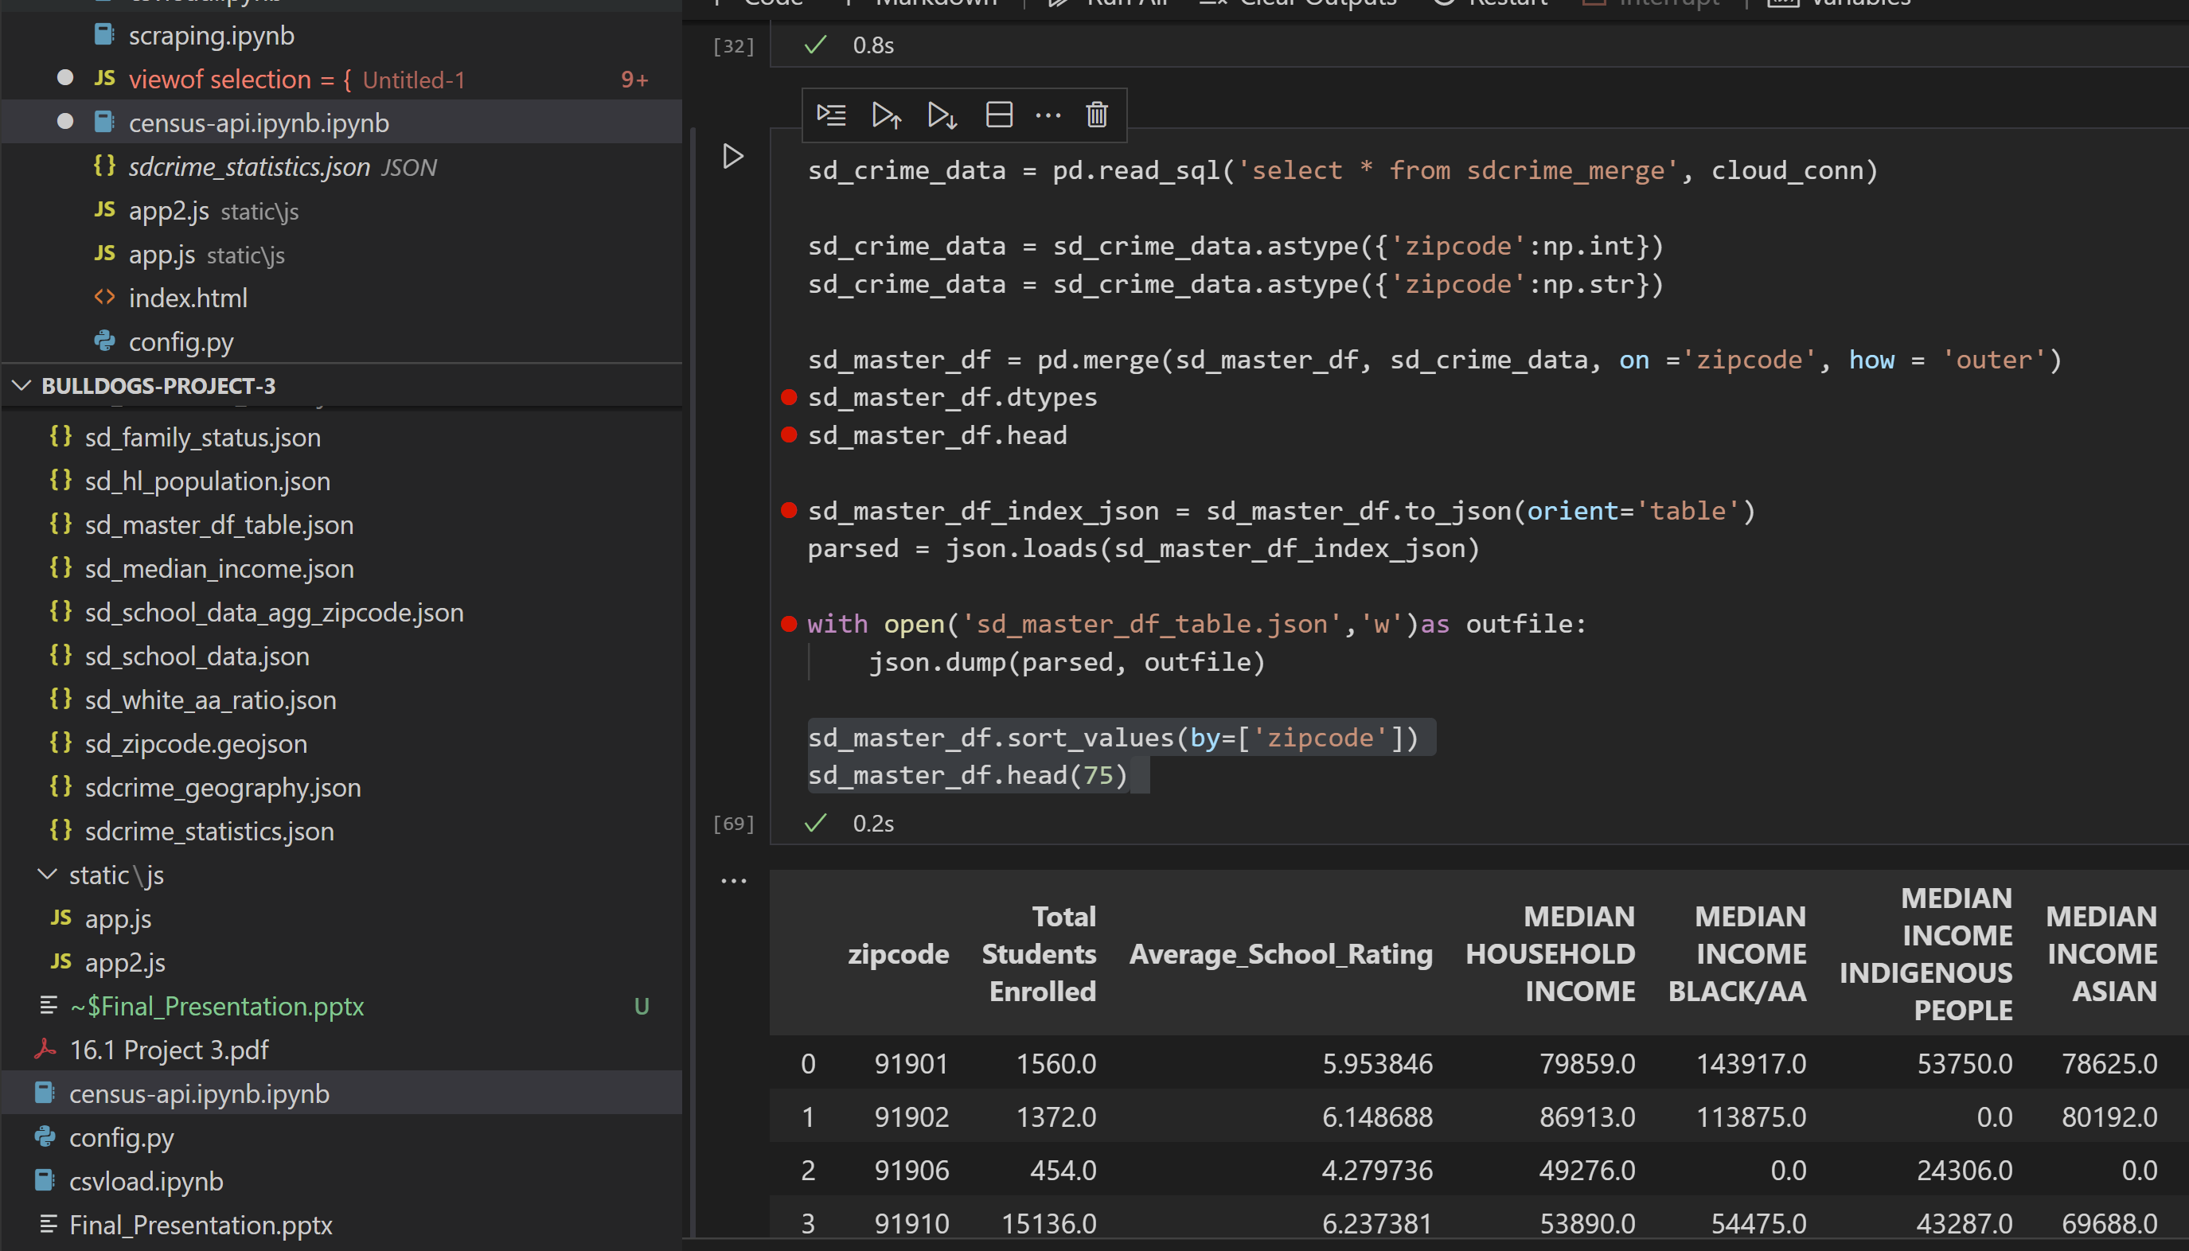
Data Cleaning/Database Creation
Set up PostgreSQL database through Amazon Web Services
Migrated all datasets there
Cleaned and structured with SQL queries
Piped data back to Python to for final merges and jsonification
Pulling from cloud database
Feeds logic/app JavaScript files for visualizations

Slide 7
Machine Learning Models

Slide 8
Take Away
Our map visualization shows there are patterns within the county to be studied
Data is structured for further inspection and analysis (xy scatter plots!)

Slide 9
BACKUP

