Slide 1
Using Machine learning to predict school performance in Sd county
Parth Korat
Geoff Pawlowski
AshuTosh SawaNT
Amelia Corea

Slide 2
The Problem
What are we trying to predict and answer with the machine learning model?
Can we use strictly demographic information to accurately predict school ratings?
Why is this important?
If we can build a reliable model that predicts school performance based on socio-economic factors, that is a powerful statement. Would also be useful for identifying over or under-performing schools and learning from their instruction models
What was the approach
To use data collected in project #3 and use it to develop various ML models predicting school ratings as defined by GreatSchools.org.
How will we know if we have answered this question?
If we develop an accurate model that predicts school ratings against our test data set.

Slide 3








Data Gathering and Cleanup Process Flow
Data Collection
Webscraping
Data Cleaning/Normalization
SQL queries
Machine Learning & Visualization
Scikit-learn
API
Python libraries
.csv files
AWS Cloud Database
PostgreSQL
Jupyter Notebooks
sqlalchemy
pandas
ML Models Tested:
Linear Regression
KNN
Random Forest
Extra Trees
AdaBoost
SVR
Plotly
Deep Learning
K-means Clustering
Tableau

Slide 4
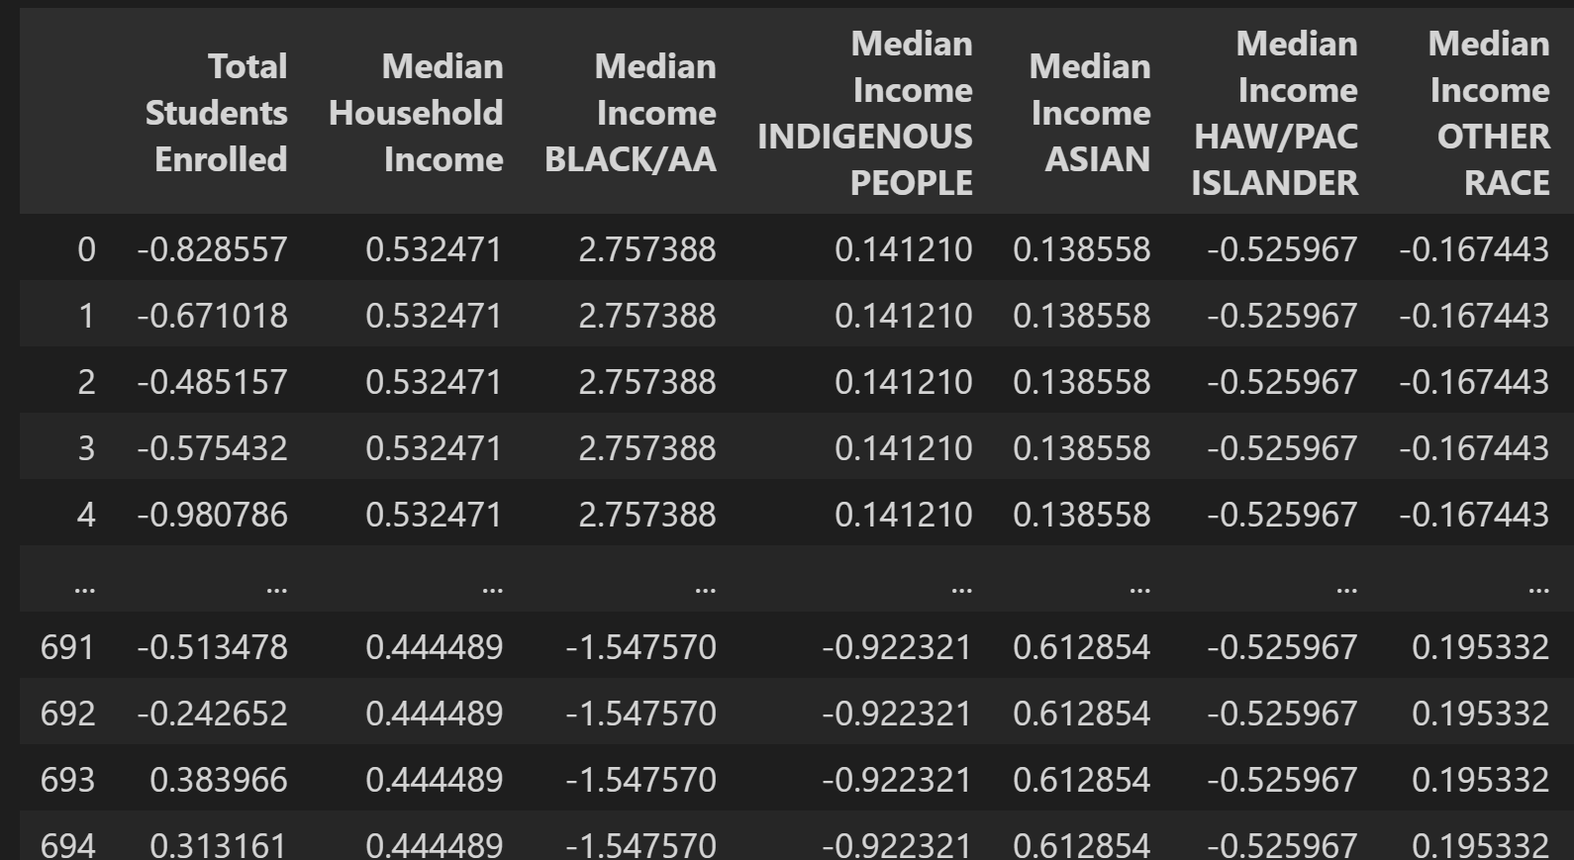
Composition of Machine Learning Dataset
696 Individual Schools
50 Features
Feature Categories
Median Income by Ethnicity at Zipcode Level
Family Structure at Zipcode Level
Educational Attainment Levels at Zipcode Level
Number of Students at School
Crime Rates per Population at Zipcode Level
Population Type by Ethnicity at Zipcode Level
Target – School Rating 1- 10

Slide 5
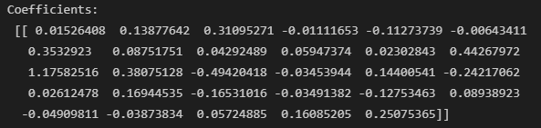
LINEAR REGRESSION MODEL
Multiple Linear Regression is a generalization of Linear Regression, in which there is more than one feature variable for the single outcome variable.
For each feature in our dataset, there is a corresponding weight that effects the outcome y.
Some weights are positive, while others are negative.
Together the weights add up and give the predicted outcome for our model.
The degree to which the weights give the final product are measured by their scale; Greater values have more of an impact than lesser values.

Slide 6
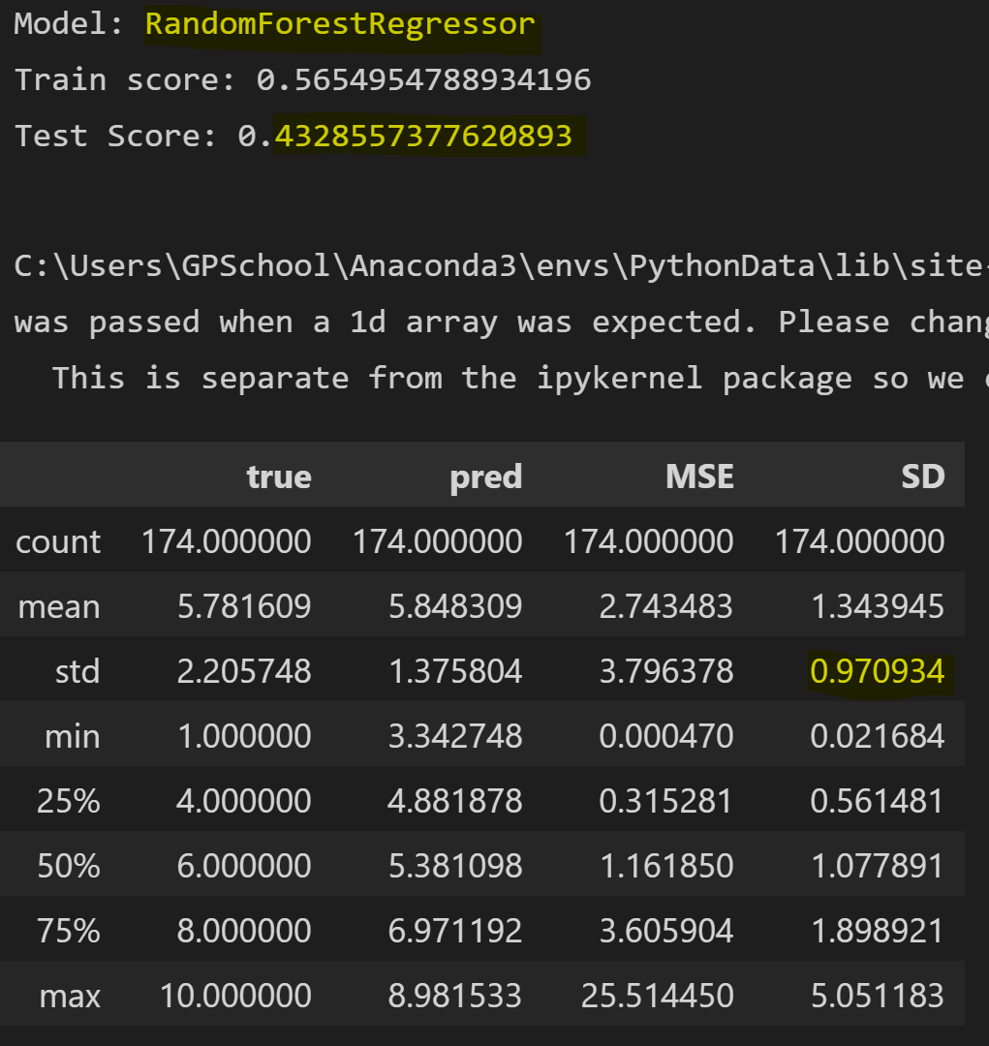
Random Forest MODEL
Ensemble machine learning algorithm
Bootstrap Aggregation/Bagging
Finetuning hyper- parameters to improve overfitting.

Slide 7
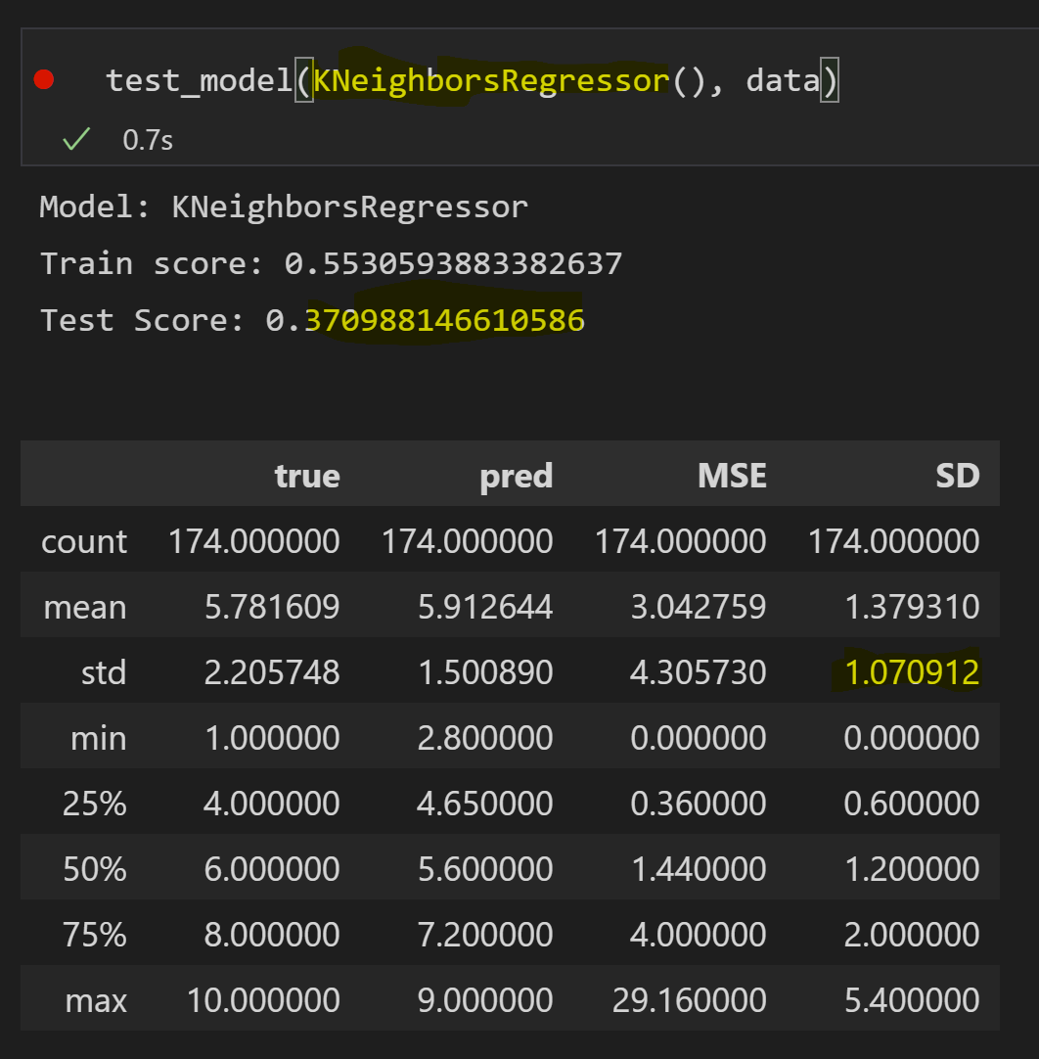
K Nearest neighbors MODEL
Supervised machine learning algorithm
Regression analysis
Finetuning the model to improve accuracy

Slide 8
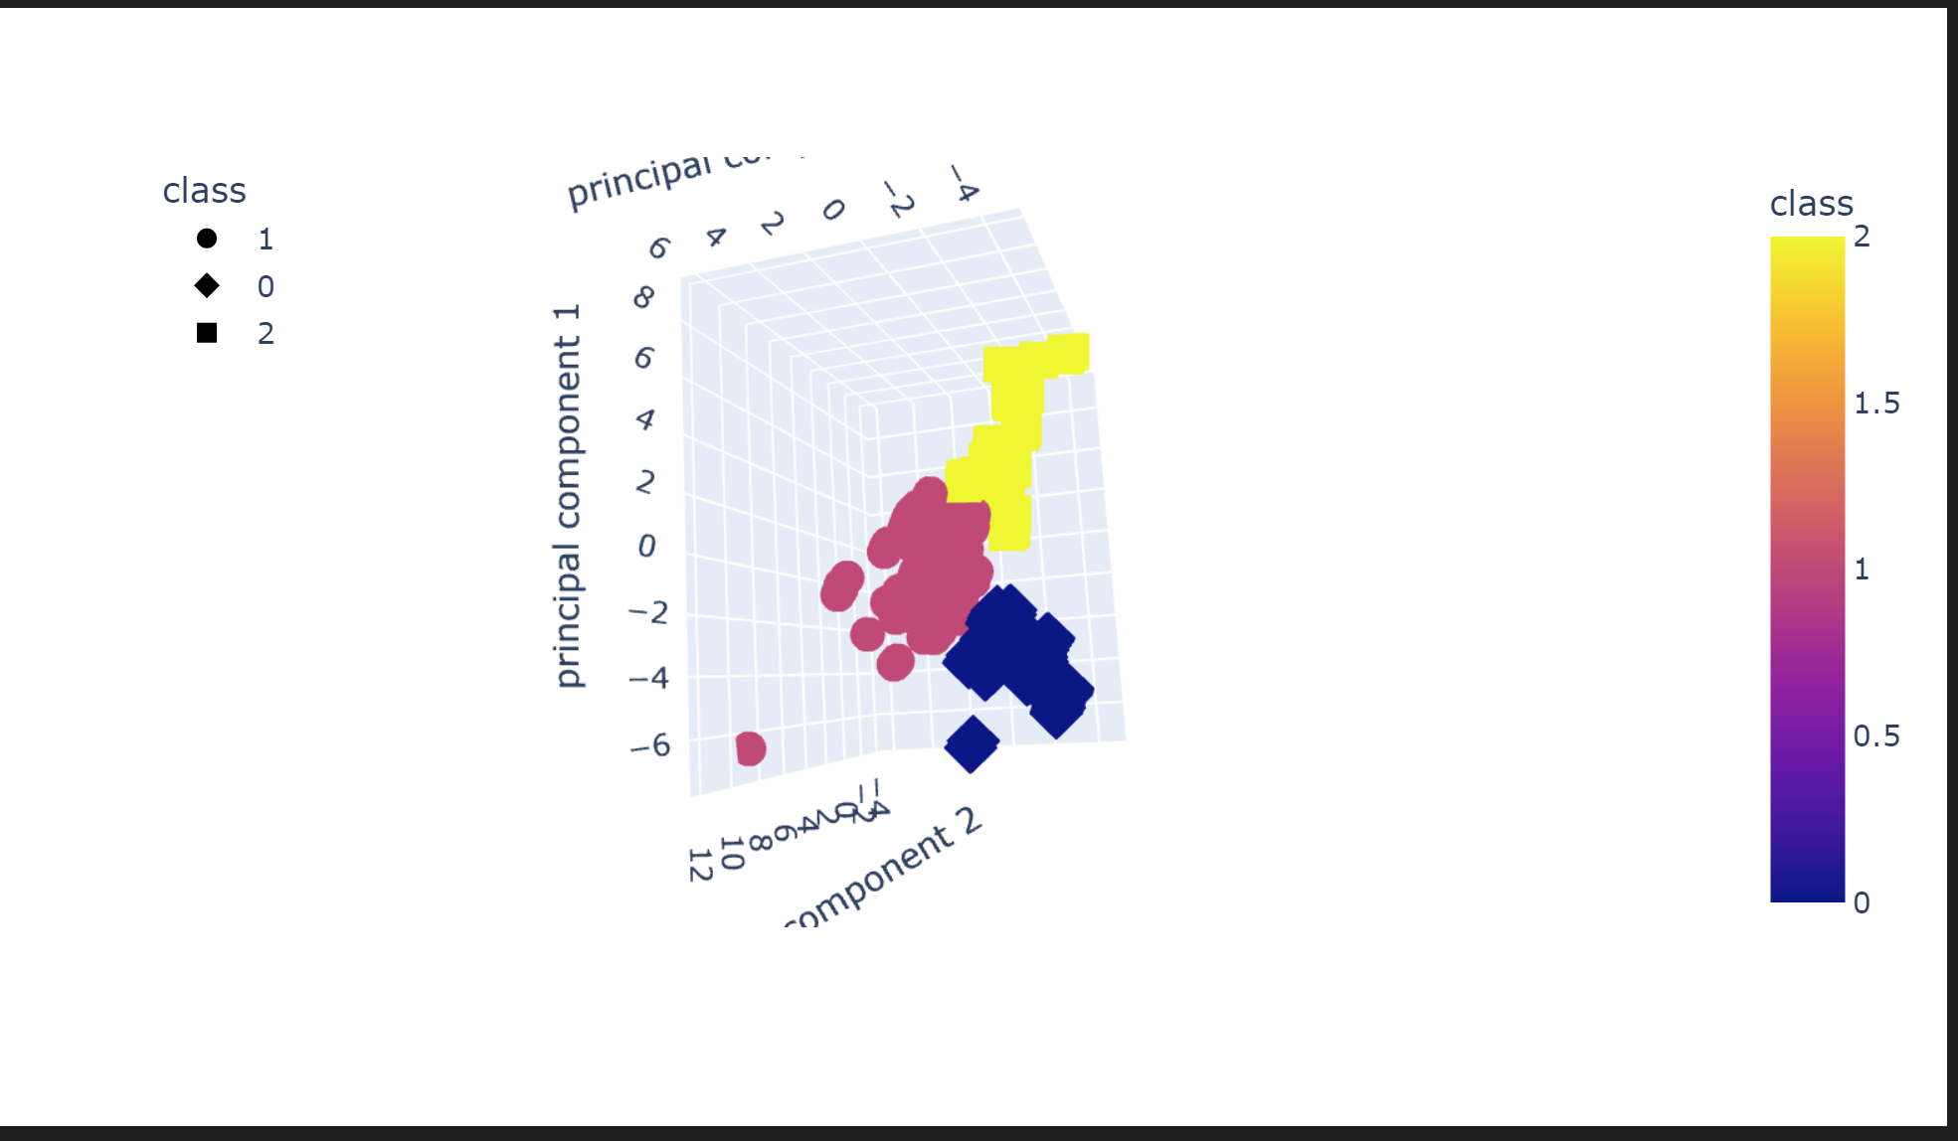
K-Means Clustering with PCA
The schools broke into 3 clusters while explaining ~ 55% of the model variance, using PCA.
Could be Good, Bad, Medium?
Clusters are well defined based on 3-D graphic.
Using socio-economic data solves more than half the equation!

Slide 9
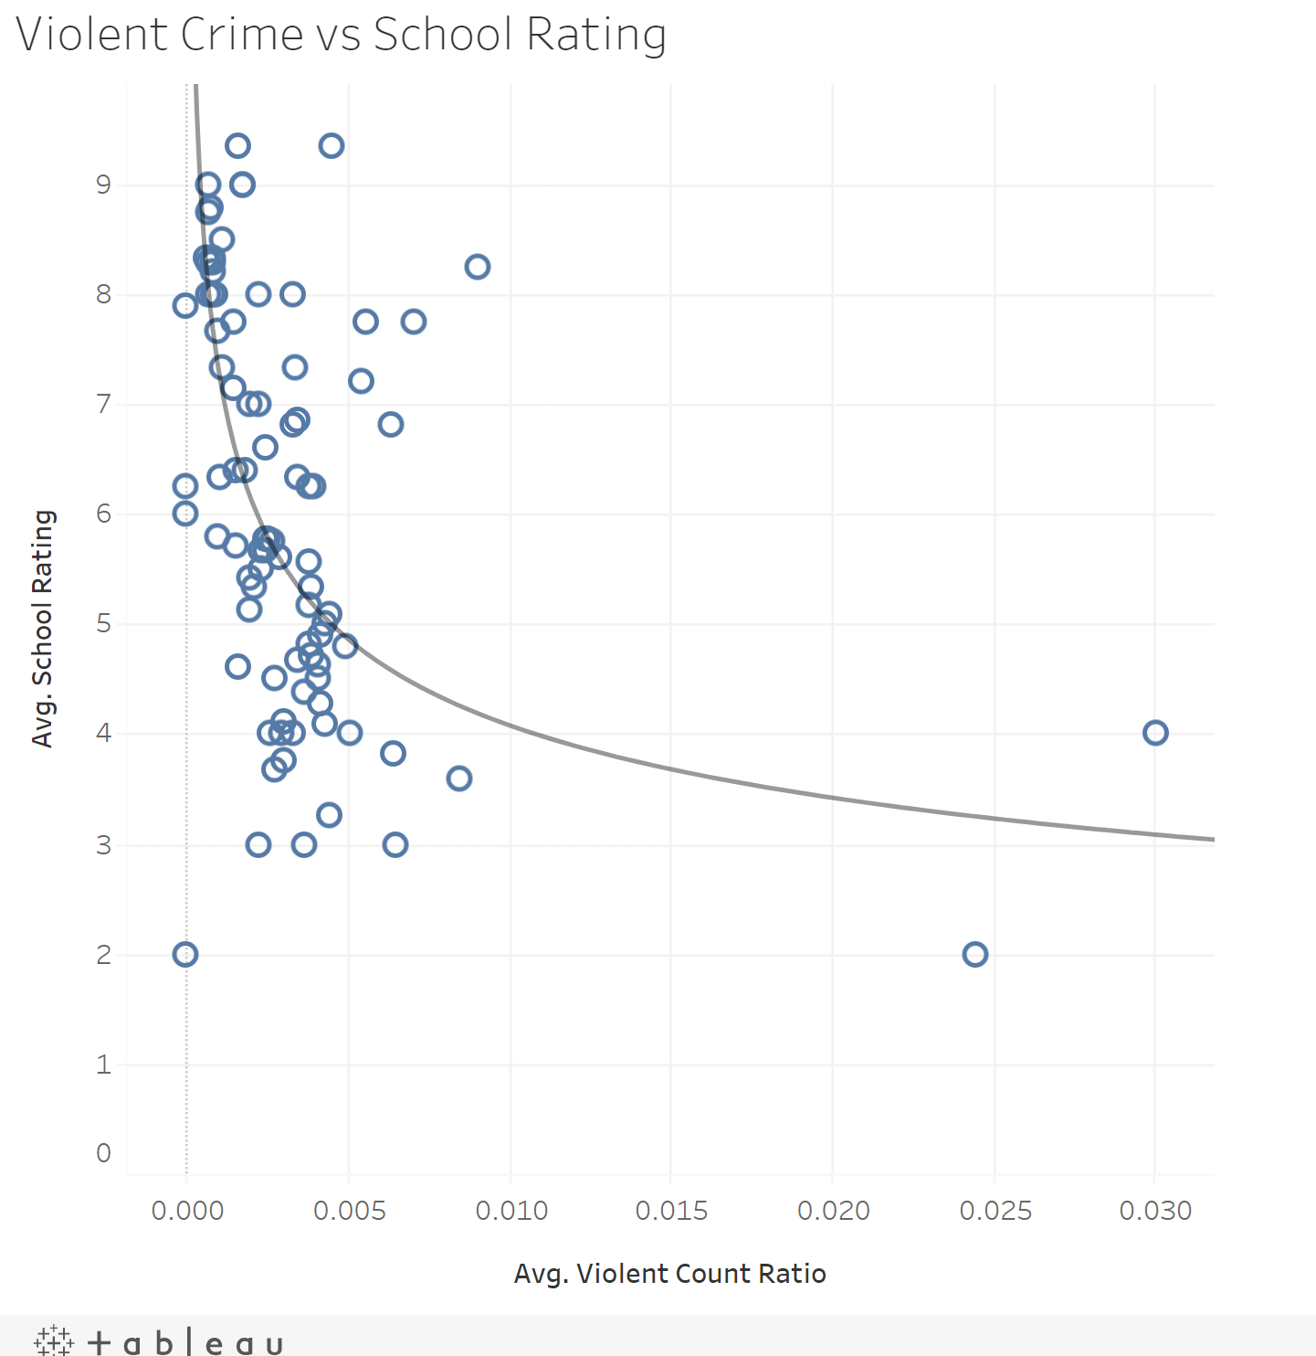
TABLEAU VISUALIZATION
Was able to find several statistically significant socio-economic features correlated with school rating using Tableau
Violent Crime per Capita
Substance Abuse per Capita
Median Income
% Head of Household Married
% of Over 25 Year Olds with at Least a High School Diploma
% of Population White
% of Population Mixed Race
% of Population Hispanic
% of Population Asian
All P-values < .0001

Slide 10
Machine Learning Models
MODEL | TRAINING ACCURACY | TEST ACCURACY | STANDARD DEVIATION
Linear Regression | 0.43 | 0.46 | 0.95
Random Forest | 0.56 | 0.43 | 0.97
Extra Trees | 0.48 | 0.41 | 1.03
SVR | 0.49 | 0.40 | 1.02
AdaBoost | 0.49 | 0.37 | 1.00
KNN | 0.55 | 0.37 | 1.07

Slide 11

Take Away
We created several models that can predict a schools performance rating +/- 1 point ~66% of the time, using just demographic data.
This should make us question how our education dollars and programs are being spent and administered.
This should also make us study outliers to our models to see where “breakaway schools are achieving better outcomes than the demographics would suggest.
Deep Learning Model: LOSS: -1050.78 ACCURACY: 0.011

