Slide 1
Does the Public Education System serve all Residents in San Diego County Equally?
Parth Korat
Geoff Pawlowski
AshuTosh SawaNT
Amelia Corea

Slide 2
The Problem
What are we trying to predict and answer with the machine learning model?
All San Diego County children may not have equal opportunity to quality primary education based on the population statistics in their neighborhoods.
What machine learning model was used?
We used the XXX model to show how crime statistics, median salary, post secondary education…may affect a school’s rating.
What did we find and how could the model be used?
If the model is accurate the model could potentially be used in other regions or for education service agencies and districts to further examine what additional resources or funding may be needed.
How will we know if we have answered this question?
If we find an accurate model that predicts school ratings against our test data set.

Slide 3
Data Gathering and Cleanup Process Flow
Data Collection
Webscraping
Data Cleaning/Normalization
SQL queries
Machine Learning & Visualization
Scikit-learn
API
Python libraries
.csv files
AWS Cloud Database
PostgreSQL
Jupyter Notebooks
sqlalchemy
pandas
ML Models Tested:
Linear Regression
KNN
Random Forest
Extra Trees
AdaBoost
SVR
Plotly
Deep Learning
K-means Clustering
Tableau

Slide 4
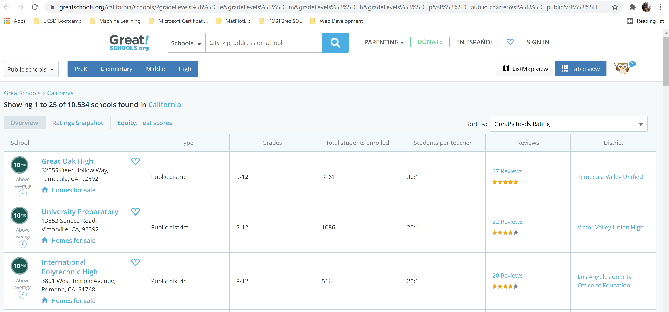
Data Collection
Web scrape Greatschools.org for school info
10,000 + records for California
394 iterative web pages

Slide 5
Data Collection
Census American Communities Survey (5-Yr) – API, Python library censusdata – Over 20,000 variables to consider
Data by zip code and state – 1,700 records per variable
Population by ethnicity
Education levels attained
Median income by ethnicity
Family structure type for school age children
SANDAG.org – Crime reporting data for past 180 days in .csv format
Crime reporting by zip code – 50,000 categorized San Diego County crimes
San Diego County Zip Codes & lat/long
Stitching together from various web data

Slide 6
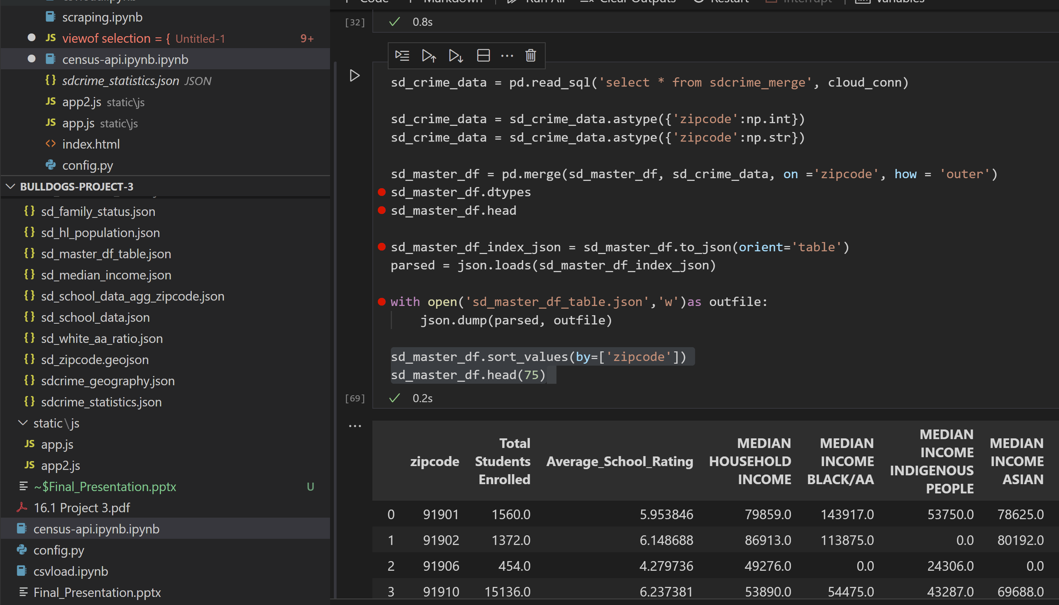
Data Cleaning/Database Creation
Set up PostgreSQL database through Amazon Web Services
Migrated all datasets there
Cleaned and structured with SQL queries
Piped data back to Python to for final merges and jsonification
Pulling from cloud database
Feeds logic/app JavaScript files for visualizations

Slide 7
Machine Learning Models
MODEL | TRAINING ACCURACY | TEST ACCURACY | STANDARD DEVIATION
Linear Regression | 0.43 | 0.46 | 0.95
Random Forest | 0.56 | 0.43 | 0.97
Extra Trees | 0.48 | 0.41 | 1.03
SVR | 0.49 | 0.40 | 1.02
AdaBoost | 0.49 | 0.37 | 1.00
KNN | 0.55 | 0.37 | 1.07
Deep Learning Model: LOSS: -1050.78 ACCURACY: 0.011

Slide 8
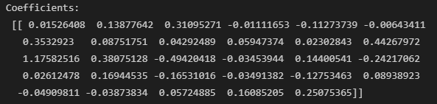
LINEAR REGRESSION MODEL

Slide 9
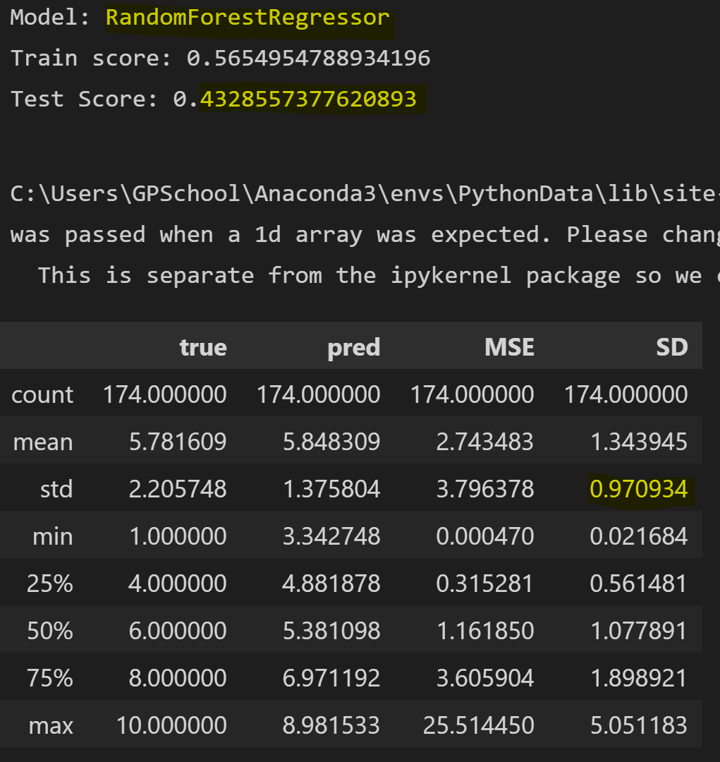
Random Forest MODEL
Ensemble machine learning algorithm
Bootstrap Aggregation/Bagging
Finetuning hyper- parameters to improve overfitting.

Slide 10
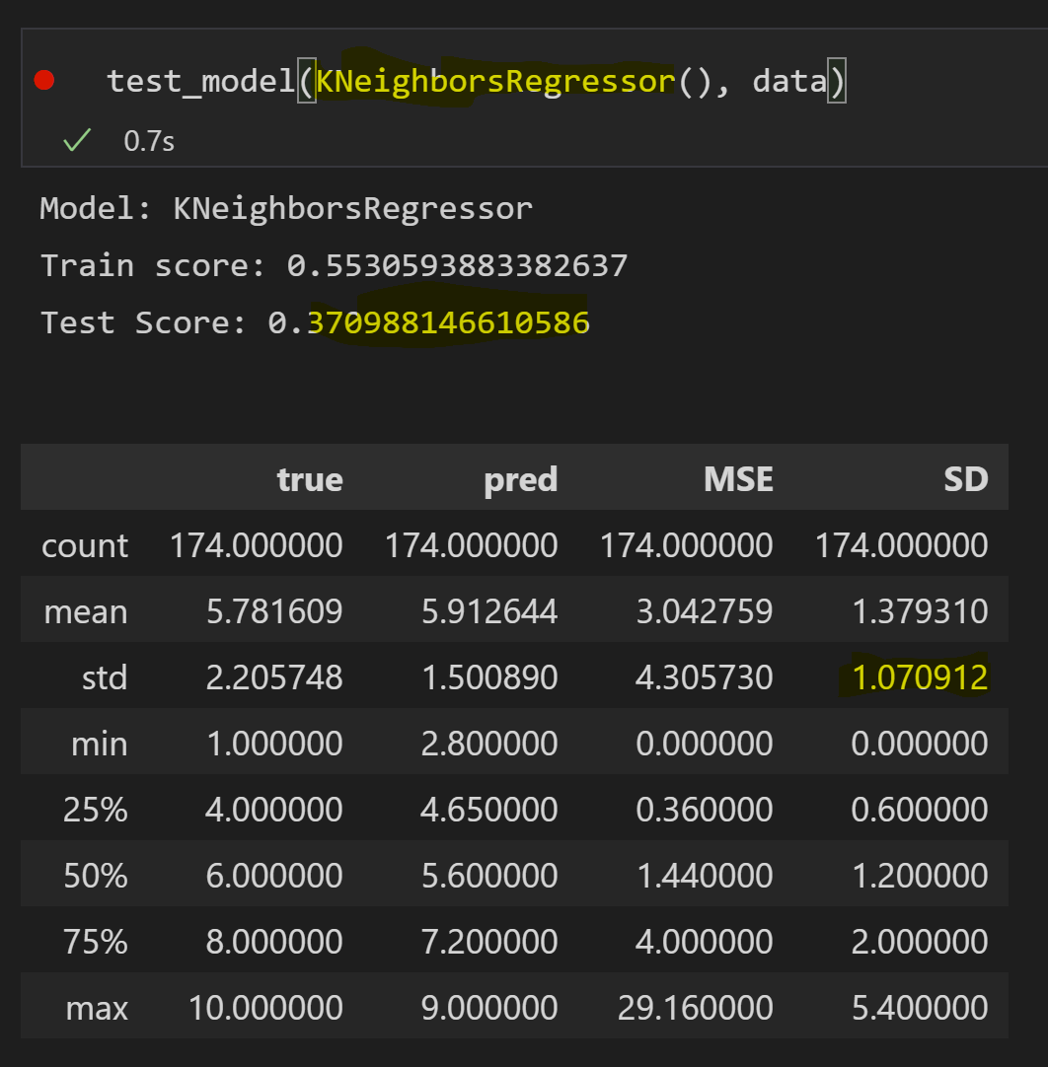
K Nearest neighbors MODEL
Supervised machine learning algorithm
Regression analysis
Finetuning the model to improve accuracy

Slide 11
TABLEAU VISUALIZATION

Slide 12
Take Away
Our map visualization shows there are patterns within the county to be studied
Data is structured for further inspection and analysis (xy scatter plots!)

Slide 13
BACKUP

