Slide 1
Does the Public Education System serve all Residents in San Diego County Equally?
Parth Korat
Geoff Pawlowski
AshuTosh SawaNT

Slide 2
The Problem
What is the problem?
All San Diego County children may not have equal opportunity to quality primary education
Who has this problem?
We intend to answer this question through data analysis & visualization
Why should this problem be solved?
Primary educational outcomes are strong indicators of future success
How will we know if we have answered this question?
If we can detect distinct patterns that show different educational outcomes for different population groups in San Diego County

Slide 3
Process Flow
Data Collection
Webscraping
Data Cleaning/Normalization
SQL queries
JSONify/Visualization
Python json library
API
Python libraries
.csv files
AWS Cloud Database
PostgreSQL
Jupyter Notebooks
sqlalchemy
pandas
Plotly
Live server
Git hub pages
D3

Slide 4
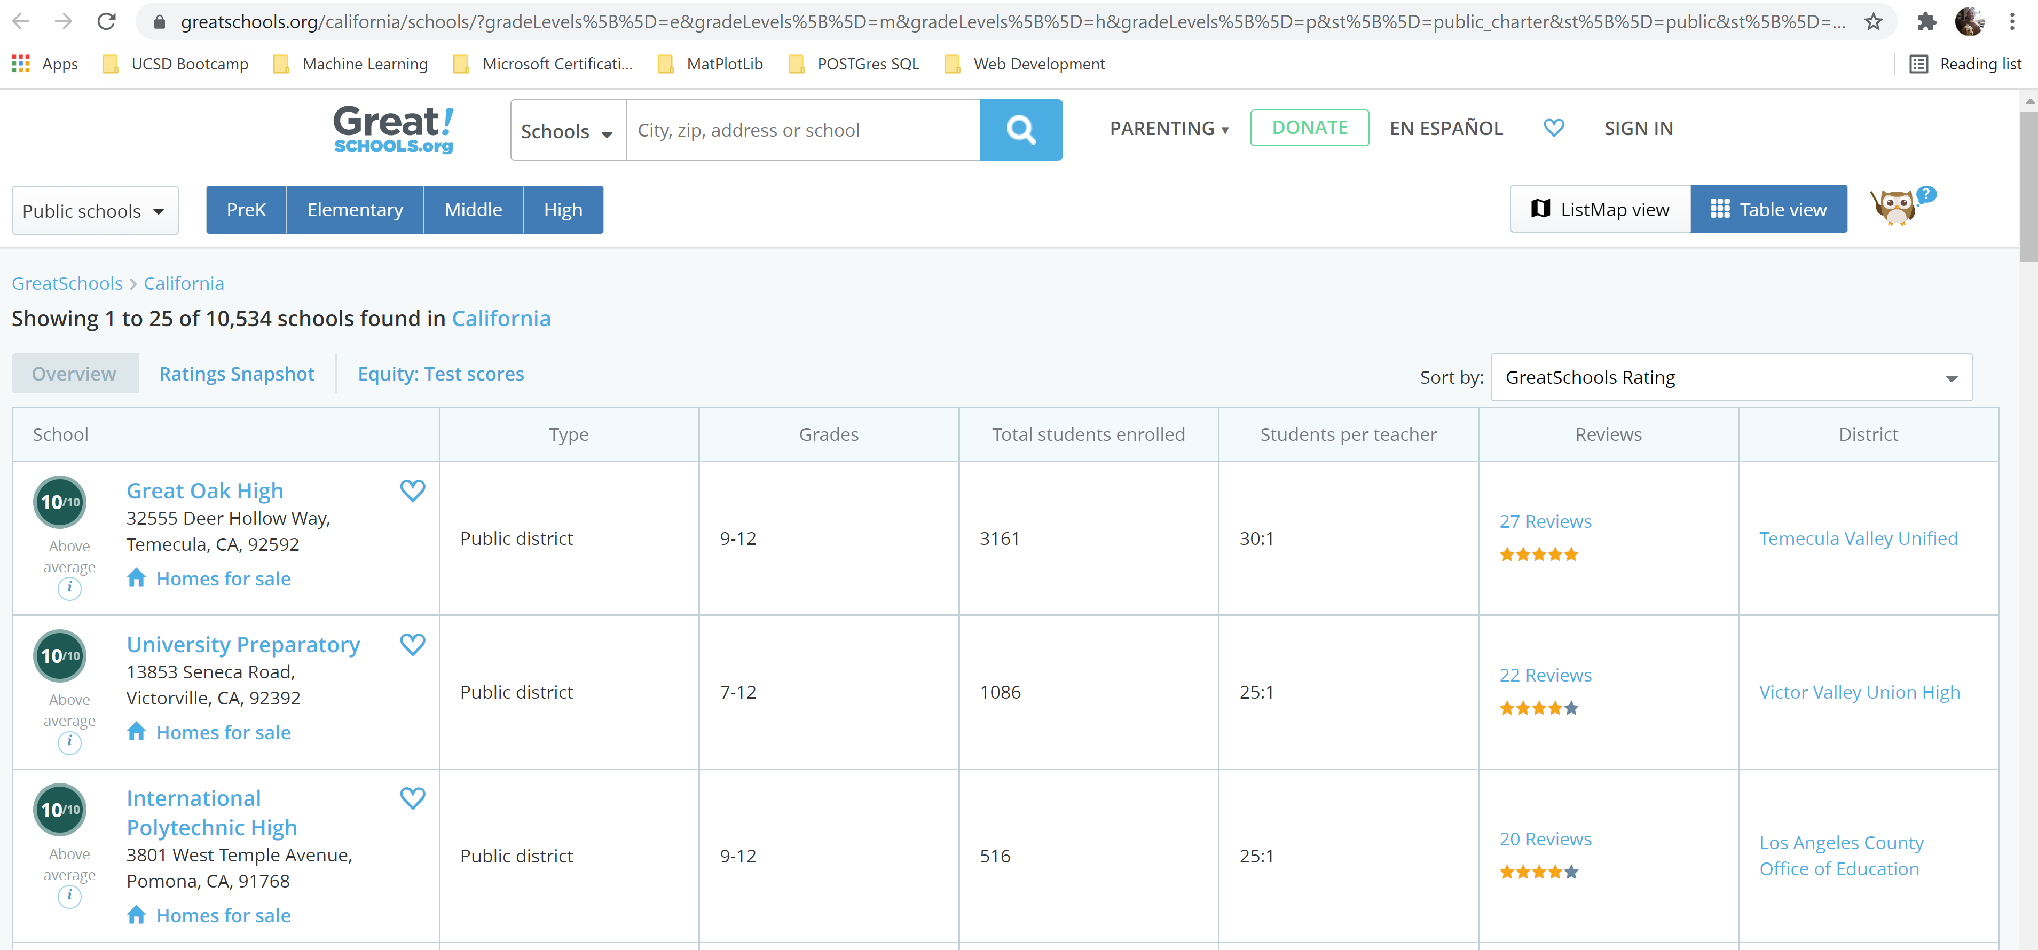
Data Collection
Web scrape Greatschools.com for school info
10,000 + records for California
394 iterative web pages

Slide 5
Data Collection
Census American Communities Survey (5-Yr) – API, Python library censusdata – Over 20,000 variables to consider
Data by zip code and state – 1,700 records per variable
Population by ethnicity
Education levels attained
Median income by ethnicity
Family structure type for school age children
SANDAG.gov – Crime reporting data for past 180 days in .csv format
Crime reporting by zip code – 50,000 categorized San Diego County crimes
San Diego County Zip Codes & lat/long
Stitching together from various web data

Slide 6
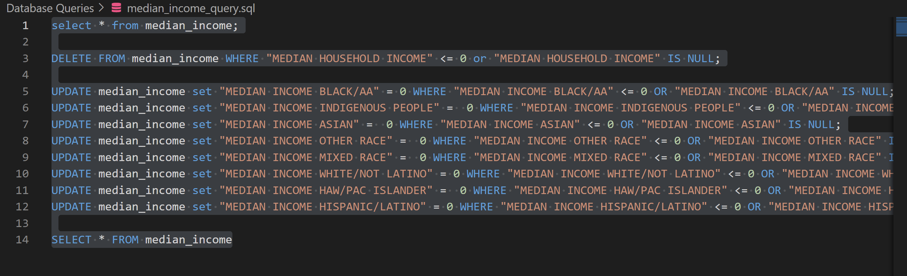
Data Cleaning/Normalization
Set up POSTgres database through Amazon Web Services
Migrated all datasets there
Cleaned and structured with SQL queries
Piped data back to Python to for final merges and jsonification

Slide 7
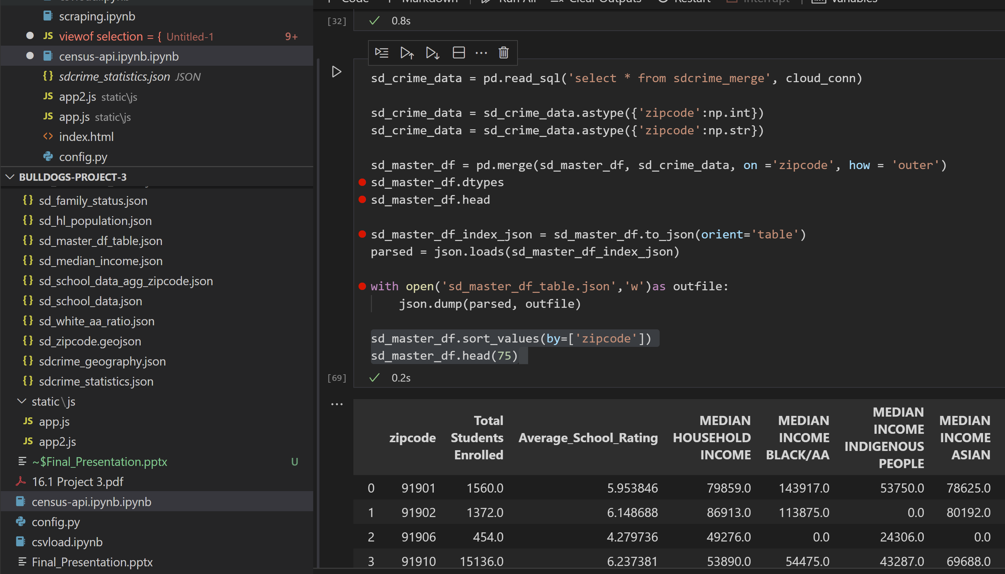
Data Pipeline
Pulling from cloud database
Feeds logic/app JavaScript files for visualizations

Slide 8
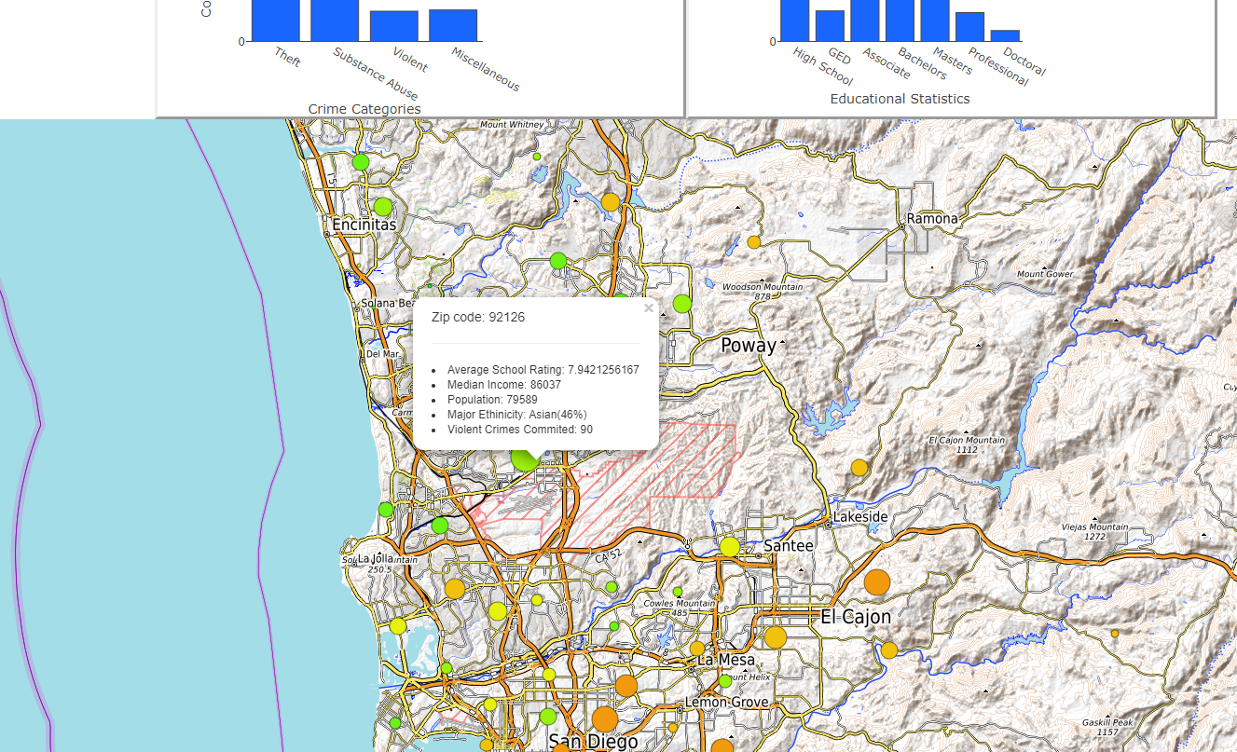
Visualization Demonstration

Slide 9
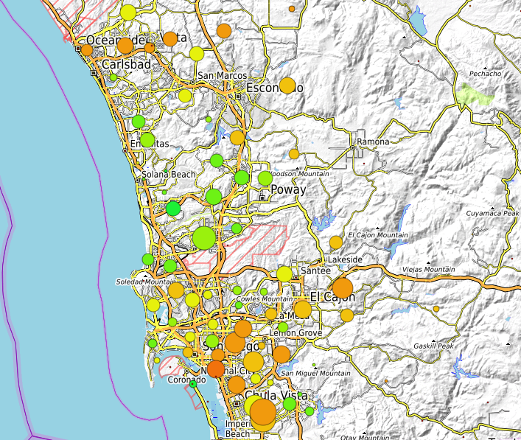
Take Away
Our map visualization shows there are patterns within the county to be studied
Data is structured for further inspection and analysis (xy scatter plots!)

Slide 10
BACKUP

Slide 11
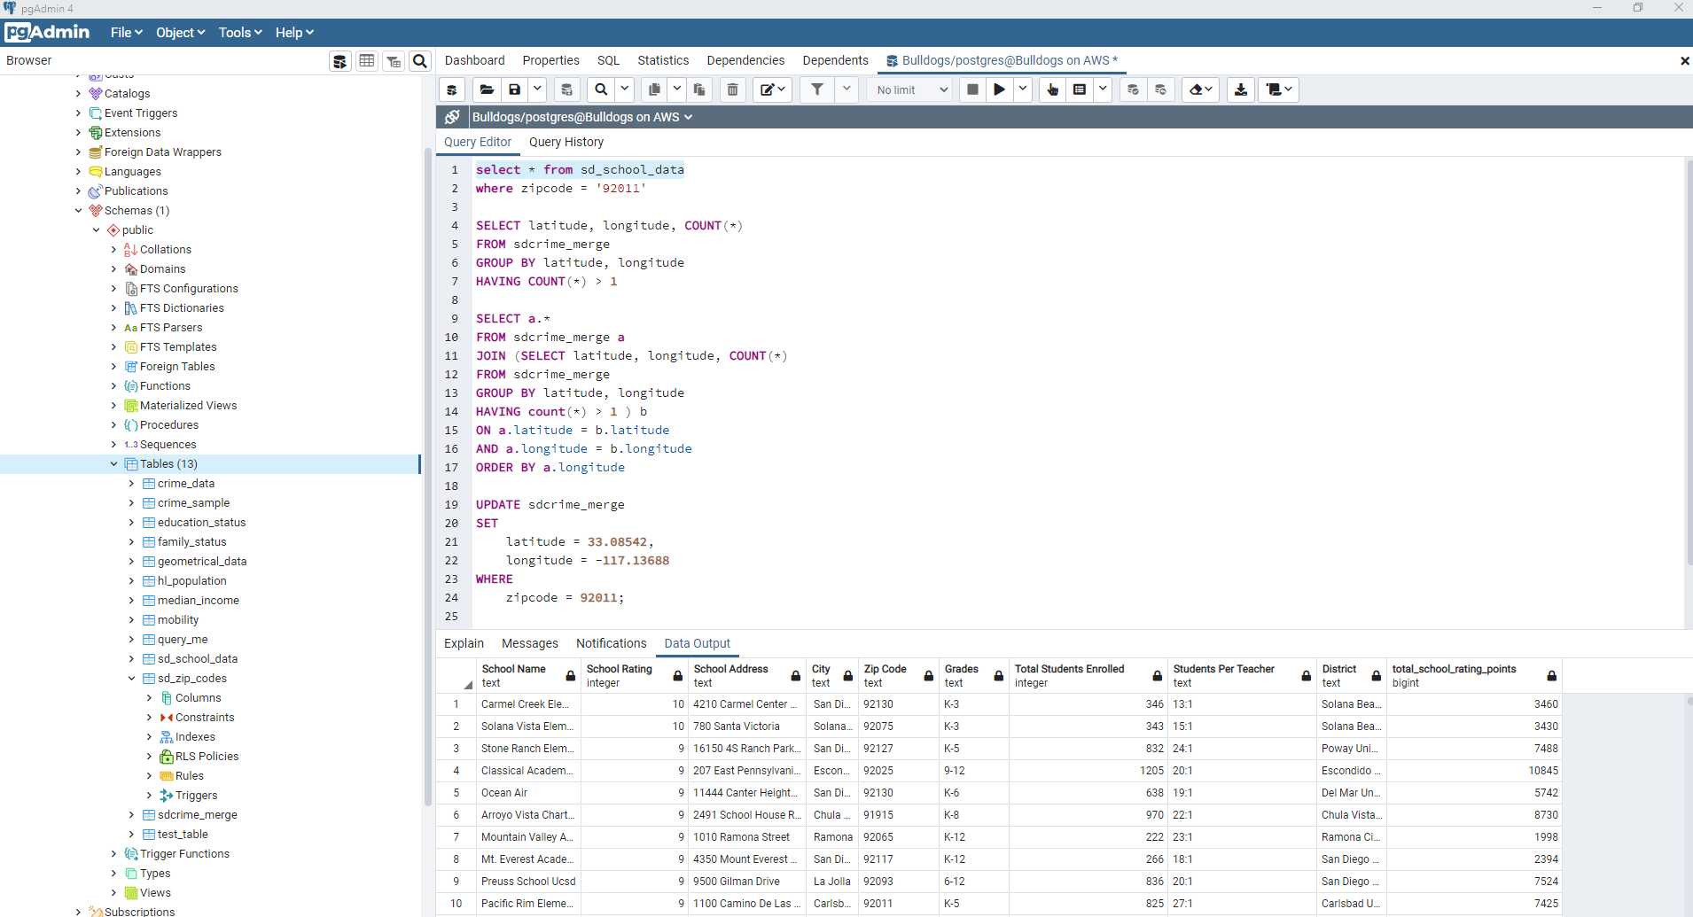
Data Cleaning/Normalization

