Slide 1
Canvas Analysis

Slide 2
Canvas Tools
Announcements: Informational posts shared with the entire course site, which can be commented upon by participants
Assignments : Assess students' understanding and competency. Assignments include Quizzes, graded Discussions, and online submissions.
Collaborations: Allow multiple users to work together.
Conferences: Live web conferencing.
Discussions: Online forums associated with a class.
Files: Canvas’s file-sharing tool. (Personal, Group and Course Files).
Grades: Stores information about student progress in the course.
Home: Course default home page.
Modules: Modules allow instructors to organize content to help control the flow of the course.
Outcomes: Outcomes allow the administration and faculty to track mastery in a course.
Wiki Pages: Custom web pages that instructors create to share information, including links to other Canvas tools.
Groups: Supplementary mini Canvas sites (containing their own files, pages, announcements and discussions) created for students’ group activities.
Quizzes: Graded or ungraded (self-test) online quizzes taken within Canvas.
Settings: Tool instructors or designers use to manage course.
Syllabus: A wiki page with course syllabus.
Notes:
File can be placed in modules, Assignments, or Pages.
Modules are used to organize course content by weeks, units, or a different organizational structure. Modules essentially create a one-directional linear flow of what students should do in a course. Module can contain files, discussions, assignments, quizzes, and other learning materials.

Slide 3
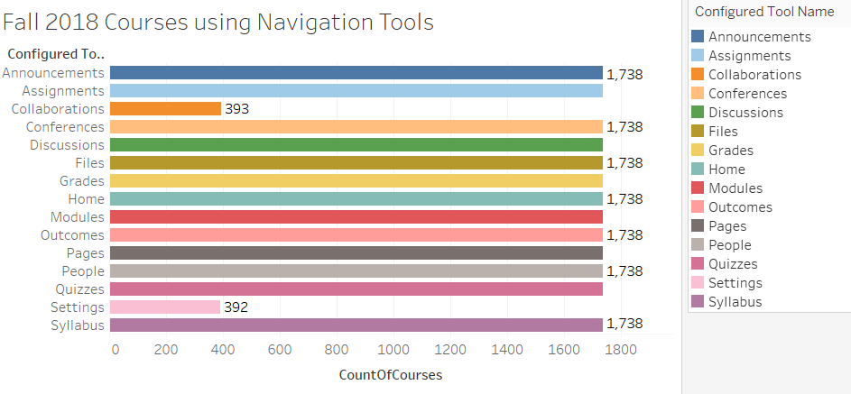
Canvas tools used by courses
Total Course = 1,738

Slide 4
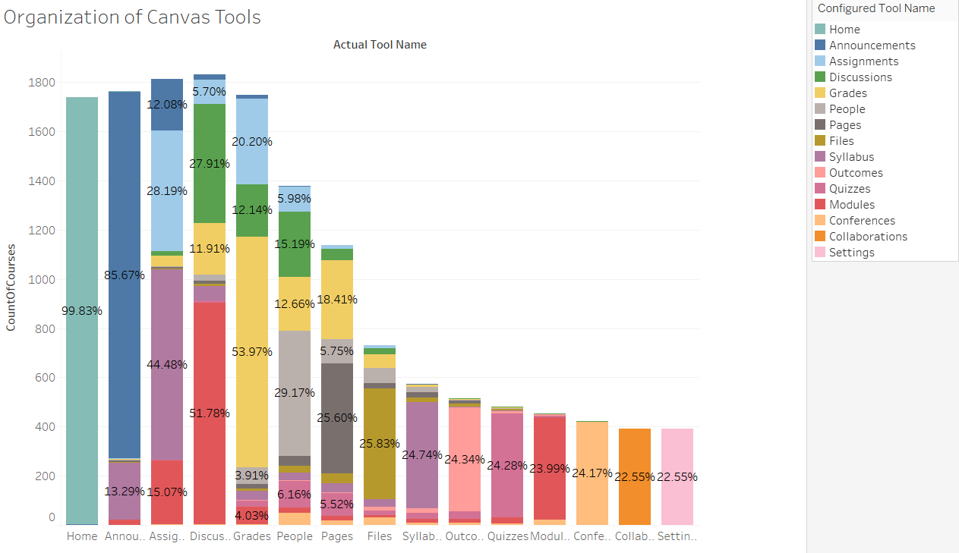

Slide 5
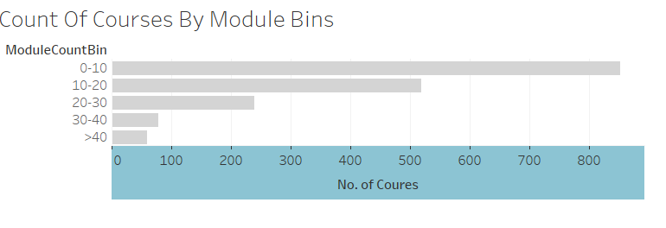
Modules
Module Items: Module can contain files, discussions, assignments, quizzes, and other learning materials.
Adding requirements to modules: Students must complete the defined requirements within the module before the module will be marked complete.
Depending on the module item type, requirements include up to 5 options:
View the item: Must view the item.
Mark as done: Must mark the assignment or page as done before they can progress to the next item.
Contribute to the page: Post a reply to a non-graded discussion or contribute content to a page.
Submit the assignment: Students must submit an assignment, post a reply to a graded discussion, or submit a quiz.
Score at least: Students must meet a minimum submission score.
Module Prerequisite: Students must complete a module before moving to the next module.
Require Sequential Progress: Items within a module should be completed sequentially.

Slide 6
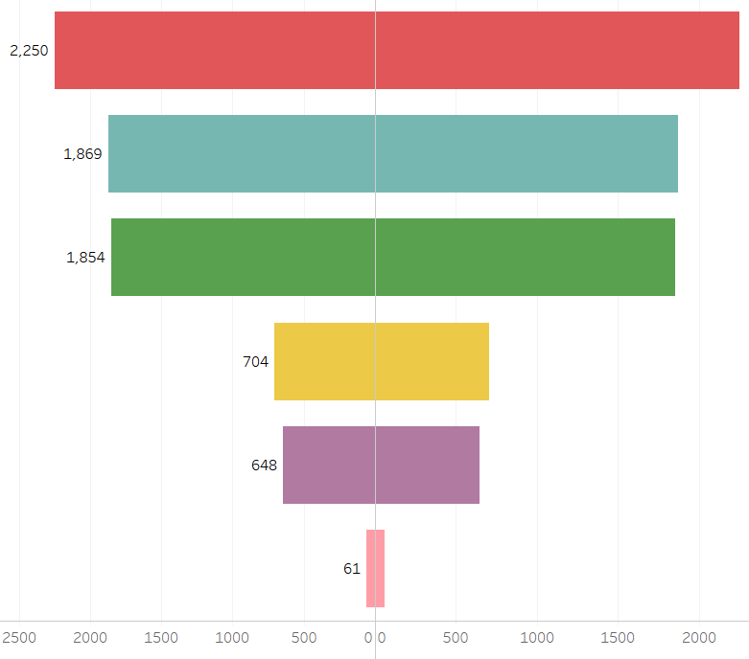
Module Requirement Funnel
Total Number of Courses
Courses with Modules
Courses with Module Items
Courses with requirements set on module items
Courses with module prerequisites
Courses requiring module items to be completed sequentially

Slide 7
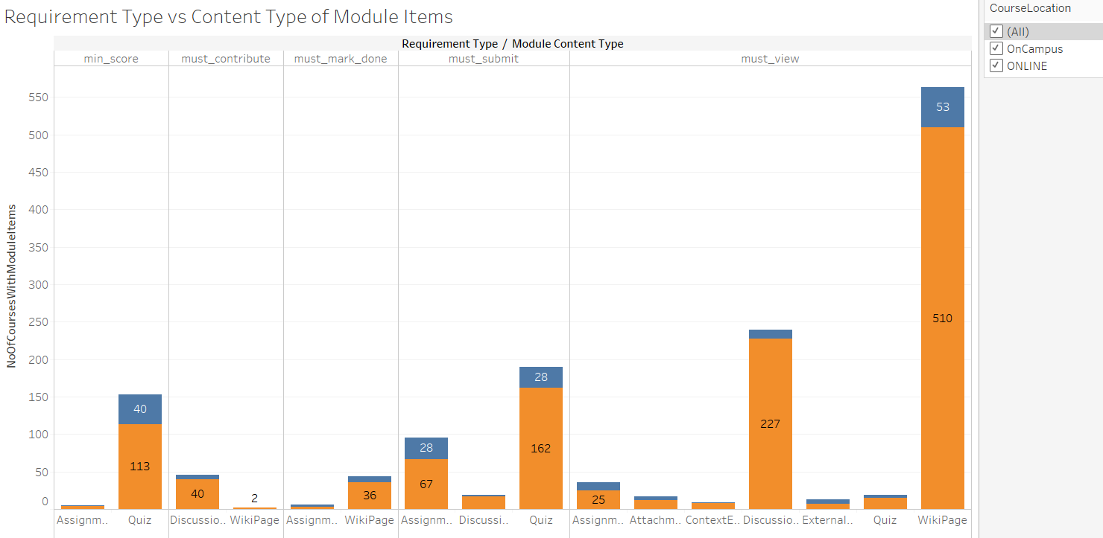

Slide 8
Course Clustering
Discover course design types.
Helps us explore how courses can make most effective use of LMS.
Helps instructors and course designers make use of broad canvas tools.

Slide 9
Feature Engineering
Count Features (for building clusters)
announcements | external tools
assignments | collaborations
course sections | ltis
ta enrollments | lti urls
wiki pages | module urls
attachments | outcomes
modules | quizzes
rubrics | discussion entries
groups | web conferences
quiz questions | calendar events
conversations | location
Student count
Count Features (for building clusters)
announcements | external tools
graded assignments | module urls
ta enrollments | modules
wiki pages | groups
Individual discussions | Group Discussions
quizzes | quiz questions
Not present in canvas data warehouse

Slide 10
Pre-processing
 | Student Count | Total no. of Logins | No. of Logins Per Person | No. of Canvas Tools | Announcement Count | Module Count | Wiki Page Count | Assignment Count | External Tool Count | Total no. of Courses
mean | 70.33 | 11288.14 | 164.92 | 6.32 | 10.81 | 7.37 | 31.14 | 20.19 | 1.91 | 3515
std | 195.44 | 21578.49 | 86.75 | 2.28 | 9.44 | 5.52 | 34.62 | 13.97 | 2.57
min | 0 | 0 | 0 | 0 | 0 | 0 | 0 | 0 | 0
median | 26 | 5895 | 163 | 7 | 9 | 8 | 25 | 18 | 0
max | 1781 | 439560 | 584 | 11 | 94 | 47 | 441 | 111 | 32
Courses hosted on canvas.
Student count between 1 and 300
Excluded ASU Orientation courses
Standard normalization
 | Student Count | Total no. of Logins | No. of Logins Per Person | No. of Canvas Tools | Announcement Count | Module Count | Wiki Page Count | Assignment Count | External Tool Count | Total no. of Courses
mean | 41.74 | 9697.90 | 171.96 | 6.45 | 11.10 | 7.61 | 31.15 | 20.94 | 1.88 | 3362
std | 43.92 | 11256.15 | 82.42 | 2.13 | 9.39 | 5.47 | 34.71 | 13.33 | 2.60
min | 1 | 16 | 5 | 1 | 0 | 0 | 0 | 0 | 0
median | 25 | 5916 | 167 | 7 | 9 | 8 | 25 | 19 | 0
max | 289 | 103227 | 584 | 11 | 94 | 47 | 441 | 111 | 32

Slide 11
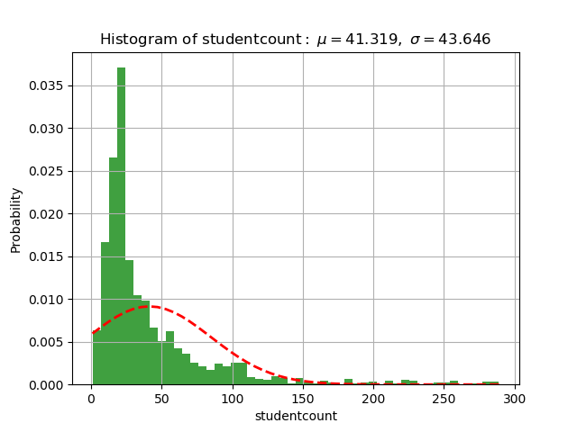
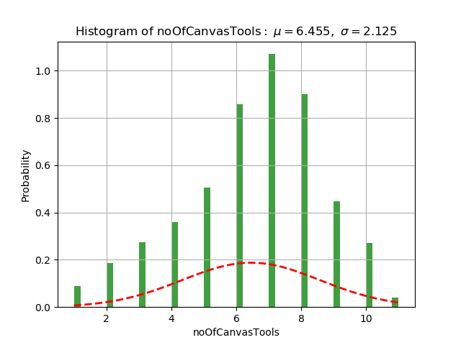
Descriptive Statistics

Slide 12
Iterations
Data collected on:
October 10, 2018 – Number of courses = 1660
November 18, 2018 – Number of courses = 2,250
December 02, 2018 – Number of courses = 2,250
Clustering Techniques:
K-means with 200 iterations
Agglomerative Hierarchical Clustering
Observed similar results with both methods.
Derived 5 clusters

Slide 13
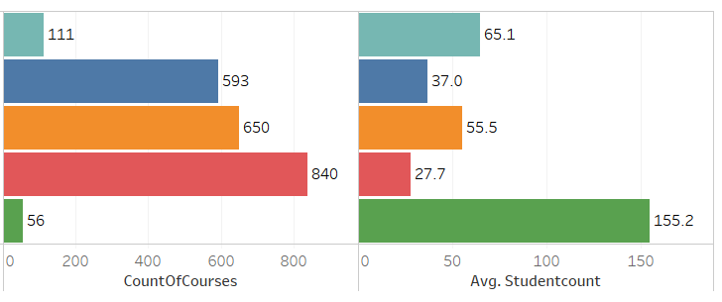
Course counts by type
Lighter Use: Lighter use of canvas tools. Has fewer modules, groups and assignments.
Good Use (Content, Assignments): Content heavy course with most modules than any other group, has one-way discussions between instructors and students.
Good use (Large Courses, Groups): Uses most of the canvas tools, has courses with large student count requiring groups. Assessment Heavy: Have lots of assignments and quizzes.
Mega Courses: Large courses with many groups to manage the class size. Heavy group discussions.
Assessment Heavy (4.93%)
Good use (Content, Assignments) (26.36%)
Good use (Large Courses, Groups) (28.89%)
Lighter use (37.33%)
Mega courses (2.49%)

Slide 14
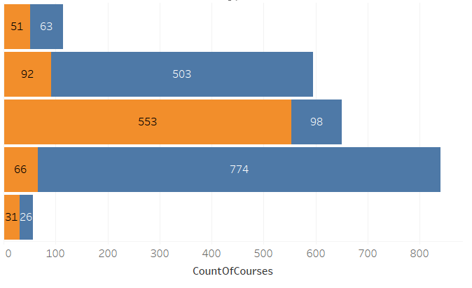
Course counts in clusters by Modality
Assessment Heavy (4.93%)
Good use (Content, Assignments) (26.36%)
Good use (Large Courses, Groups) (28.89%)
Lighter use (37.33%)
Mega courses (2.49%)

Slide 15
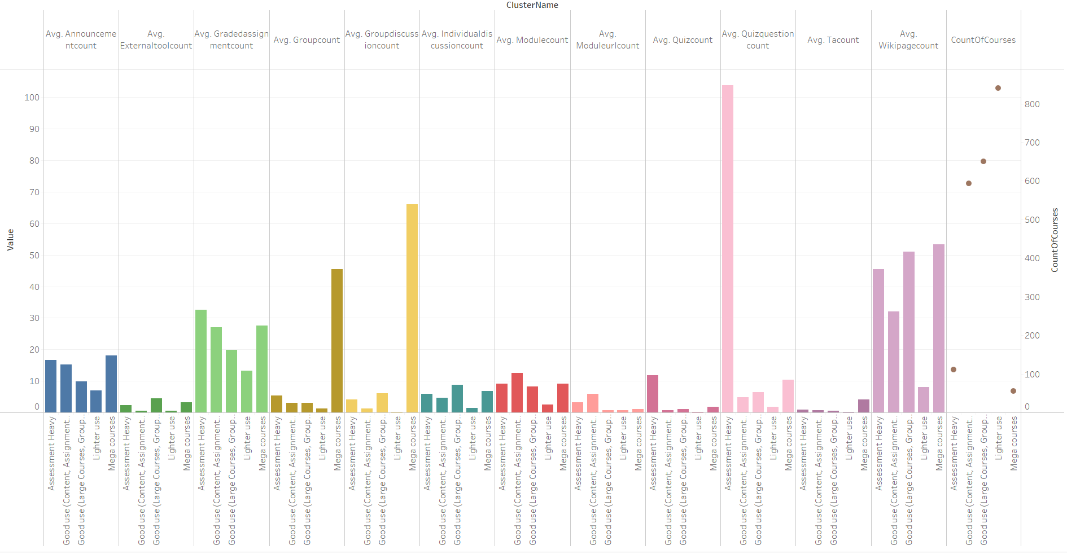

Slide 16
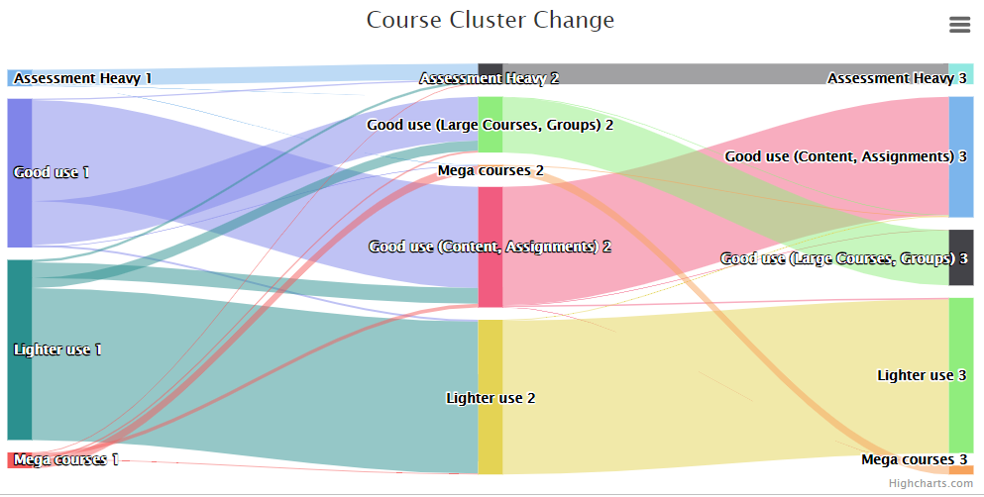
Change of course cluster over time
Oct 10
Nov 18
Dec 02

Slide 17
Additional features
View clusters by School & Colleges.
View Student activity on canvas tools by time.

Slide 18
Questions

