Slide 1
Office 365 & Azure <3 PowerShell
Danny Davis Collabonists UG (haeaftungsbeschraenkt)
collabonists.io

Slide 2
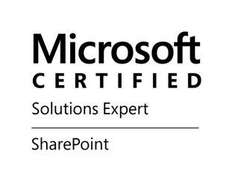
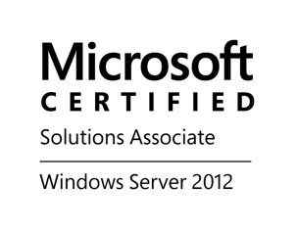
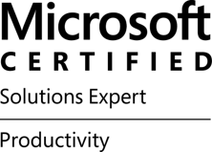
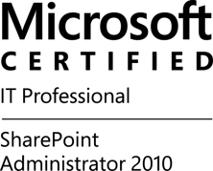
2
About Danny Davis
MCSE SharePoint
MCSE Productivity
MCSA Windows Server 2012
MCITP SharePoint 2010
Lead Consultant
Danny@sprocks.io
www.sprocks.io
dd@collabonists.io
www.collabonists.io
Danny Davis

Slide 3
3
Agenda
What is PowerShell?
What are Modules and how to install?
Connect to the cloud
Magic happens with PowerShell!
Resources
Notes:
Infrastructure as a service are online services that provide high-level APIs used to dereference various low-level details of underlying network infrastructure like physical computing resources, location, data partitioning, scaling, security, backup etc
Google Compute Engine (GCE) is the Infrastructure as a Service (IaaS) component of Google Cloud Platform which is built on the global infrastructure that runs Google's search engine, Gmail, YouTube and other services. Google Compute Engine enables users to launch virtual machines (VMs) on demand. VMs can be launched from the standard images or custom images created by users. GCE users must authenticate based on OAuth 2.0 before launching the VMs. Google Compute Engine can be accessed via the Developer Console, RESTful API or command-line interface (CLI).

Slide 4
4
What is PowerShell?
PowerShell is a framework
used for task automation
and configuration management.
Notes:
Add pictures for framework, task automation and configuration management

Slide 5
5
What is PowerShell?
Formerly know as
Monad (Beta phase, 2002 – 2005)
Windows PowerShell (release, 2006 - 2016)
Open-source and cross-platform since August 2016 (PowerShell Core)
PowerShell is built on .Net Framework
PowerShell Core is built on .Net Core
All major releases are still support and offer backwards compatibility!
Notes:
This make a huge difference in what kind of modules you can use. Modules that are built with.Net Framework in mind will not run with PowerShell Core. This applies for examples to MSOnline or Azure Modules which expect you to have a .Net Framework. Those modules are also not cross-plattform, because you will have to use a Windows machine.

Slide 6
6
What is PowerShell?
Tasks are performed by cmdlets (command-lets)
Cmdlets access data stores (e.g. Registry, file share, SharePoint)
Data stores are made available by providers
Providers and cmdlets can be used in scripts
And finally: Scripts can be packaged into modules
Notes:
Maybe add a graphic like a pyramid or something

Slide 7
7
What is PowerShell?
Tasks are performed by cmdlets (command-lets)
Cmdlets access data stores (e.g. Registry, file share, SharePoint)
Data store are made available by providers
Providers and cmdlets can be used in scripts
And finally: Scripts can be packaged into modules
Notes:
Maybe add a graphic like a pyramid or something

Slide 8
8
What are modules?
Modules are packages containing
Cmdlets
Providers
Functions
Workflows
Variables
Aliases
Notes:
Still needs a picture

Slide 9
9
How to install modules?
Old-fashioned way:
Search for the .exe and install
Usually installs own shell
Modern way:
Find-Module -Name SharePointPnP
Install-Module -Name SharePointPnPPowerShellOnline
You can choose versions with -MinimumVersion, -MaximumVersion, -RequiredVersion

Slide 10
10
Connect to the cloud
Import your module!
Import-Module SharePointPnPPowerShellOnline
Connect to your Service
Connect-PnPOnline -Url $url -Credentials $credentials
$item = Get-PNPListItem -List Lists/$listTitle -Id $itemId
Do stuff!
$item = Get-PNPListItem -List Lists/$listTitle -Id $itemId
Notes:
The Import-Module is always structured in this way. You have your cmdlet followed by the module you want to use. If it is installed you will be able to use all the cmdlets from the module.

Slide 11
11
Connect to the cloud
DEMO TIME!
Notes:
Maybe the rest of the session should be demos?
Connect to the cloud
Get a user from SharePoint Online and Azure AD
Get a list item
Change a user and a list item

