Slide 1
Introduction to Microsoft Teams
Danny Davis Collabonists UG (haeaftungsbeschraenkt)
collabonists.io

Slide 2




2
About Danny Davis
MCSE SharePoint
MCSE Productivity
MCSA Windows Server 2012
MCITP SharePoint 2010
Lead Consultant
Danny@sprocks.io
www.sprocks.io
dd@collabonists.io
www.collabonists.io
Danny Davis

Slide 3
3
Agenda
What is Cloud?
Introducing Teams
Architecture
Licensing
Structure
Managing Teams
Network Planning
Security and Compliance
Change Management and Adoption
Resources
Notes:
Infrastructure as a service are online services that provide high-level APIs used to dereference various low-level details of underlying network infrastructure like physical computing resources, location, data partitioning, scaling, security, backup etc
Google Compute Engine (GCE) is the Infrastructure as a Service (IaaS) component of Google Cloud Platform which is built on the global infrastructure that runs Google's search engine, Gmail, YouTube and other services. Google Compute Engine enables users to launch virtual machines (VMs) on demand. VMs can be launched from the standard images or custom images created by users. GCE users must authenticate based on OAuth 2.0 before launching the VMs. Google Compute Engine can be accessed via the Developer Console, RESTful API or command-line interface (CLI).

Slide 4
4
What is the Cloud?
SAAS
PAAS
IAAS
Cloud

Slide 5
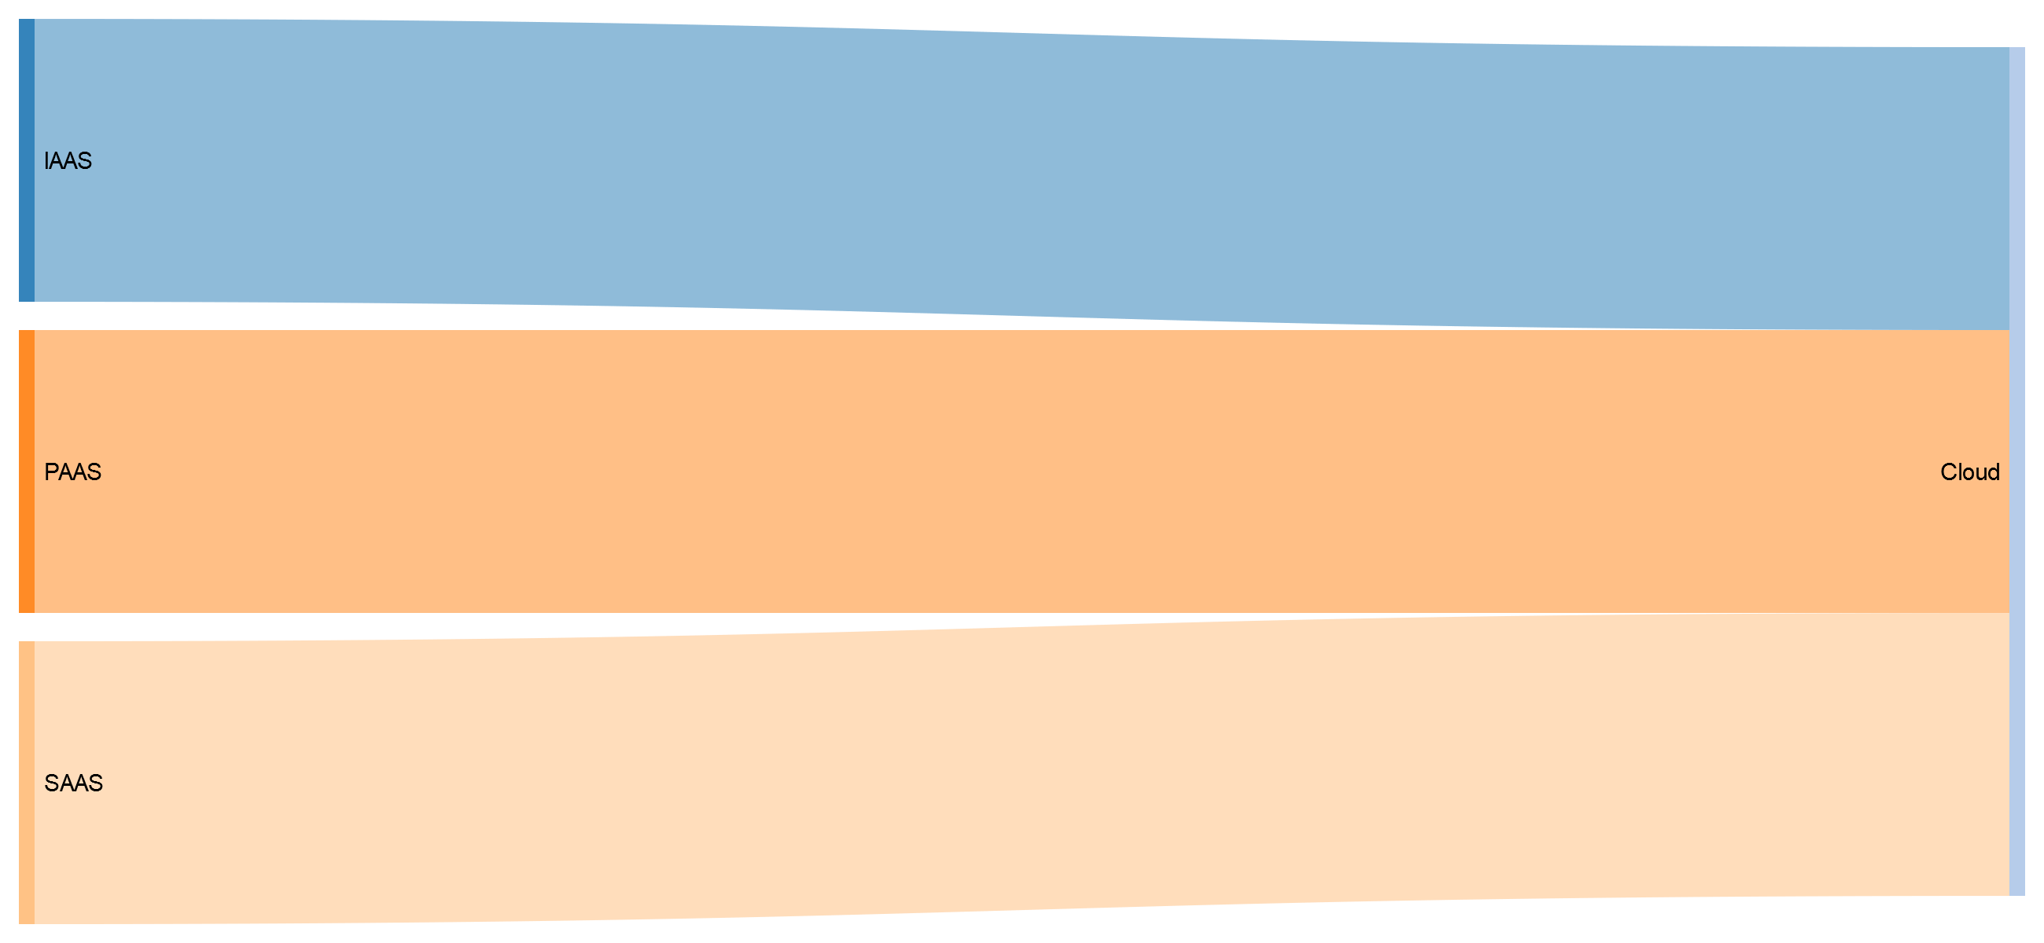
5
What is the Cloud?

Slide 6




6
What is IaaS?
Infrastructure as a service
Virtual platform to run infrastructure
Offers storage as a service
Subscription based
Examples:
Virtual Maschines
Storage
Load balancers
Networks
Notes:
Infrastructure as a service are online services that provide high-level APIs used to dereference various low-level details of underlying network infrastructure like physical computing resources, location, data partitioning, scaling, security, backup etc
Google Compute Engine (GCE) is the Infrastructure as a Service (IaaS) component of Google Cloud Platform which is built on the global infrastructure that runs Google's search engine, Gmail, YouTube and other services. Google Compute Engine enables users to launch virtual machines (VMs) on demand. VMs can be launched from the standard images or custom images created by users. GCE users must authenticate based on OAuth 2.0 before launching the VMs. Google Compute Engine can be accessed via the Developer Console, RESTful API or command-line interface (CLI).

Slide 7
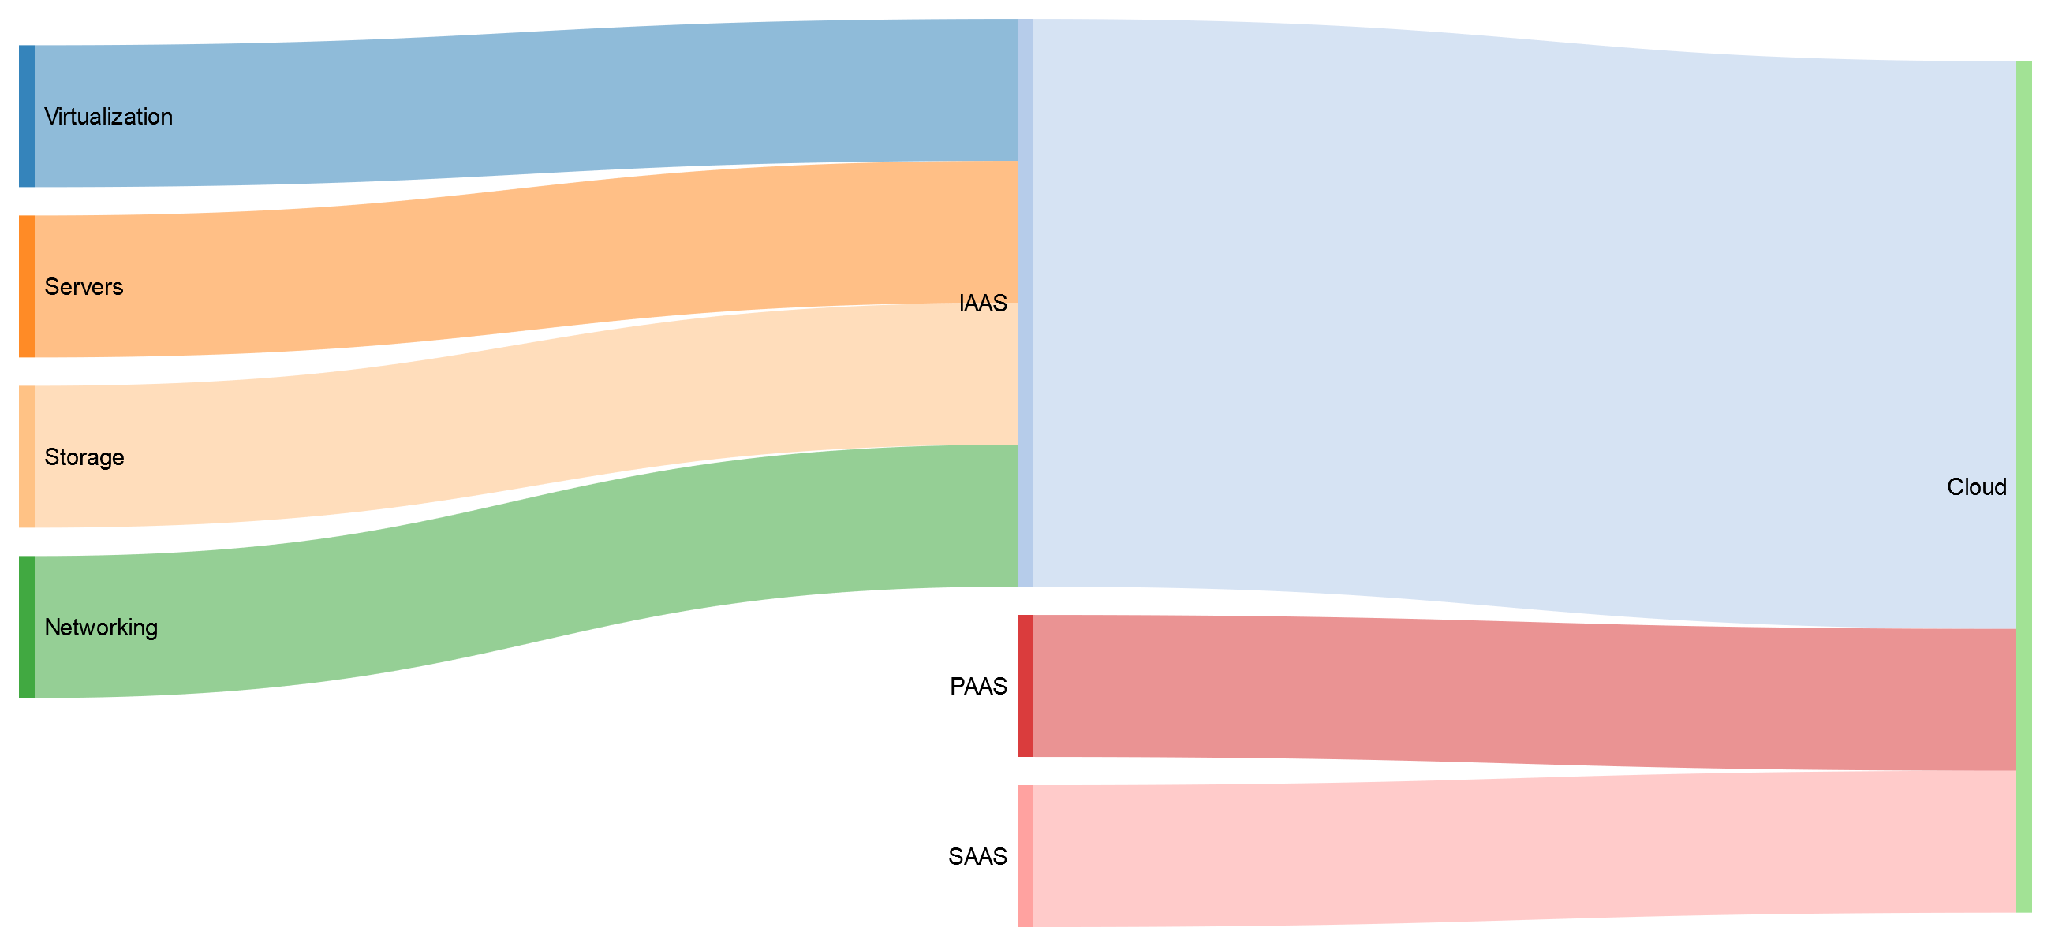
7
What is IaaS?

Slide 8


8
What is PaaS?
Platform as a service!
Third-Party provides hardware and software
Typically for development
Subcription based
Over the internet
No need to host own infrastructure
Notes:
Platform as a service (PaaS) is a cloud computing model in which a third-party provider delivers hardware and software tools -- usually those needed for application development -- to users over the internet. A PaaS provider hosts the hardware and software on its own infrastructure.
AWS Elastic Beanstalk is an easy-to-use service for deploying and scaling web applications and services developed with Java, .NET, PHP, Node.js, Python, Ruby, Go, and Docker on familiar servers such as Apache, Nginx, Passenger, and IIS.
You can simply upload your code and Elastic Beanstalk automatically handles the deployment, from capacity provisioning, load balancing, auto-scaling to application health monitoring. At the same time, you retain full control over the AWS resources powering your application and can access the underlying resources at any time.
Google App Engine is a web framework and cloud computing platform for developing and hosting web applications in Google-managed data centers. Applications are sandboxed and run across multiple servers

Slide 9
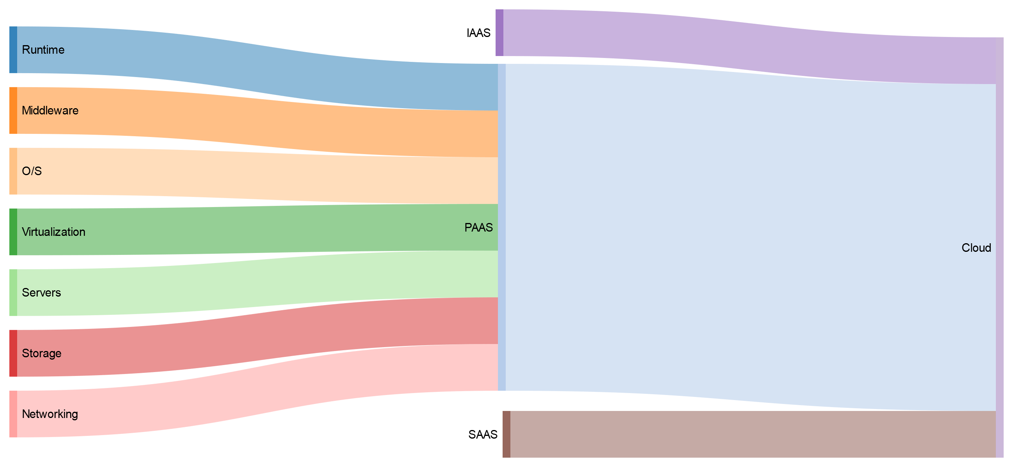
9
What is PaaS?

Slide 10






10
What is SaaS?
Software as a service!
Consume Services
Subscription based model
Usually no software install needed
No Servers needed
Basically no influence over changes in software
Examples
Exchange Online
SharePoint Online
Youtube
Notes:
Software as a Service is a method of software delivery where Software is accessed online via subscriptions rather than bought and installed.
CWD Solution GmbH - FOYB

Slide 11
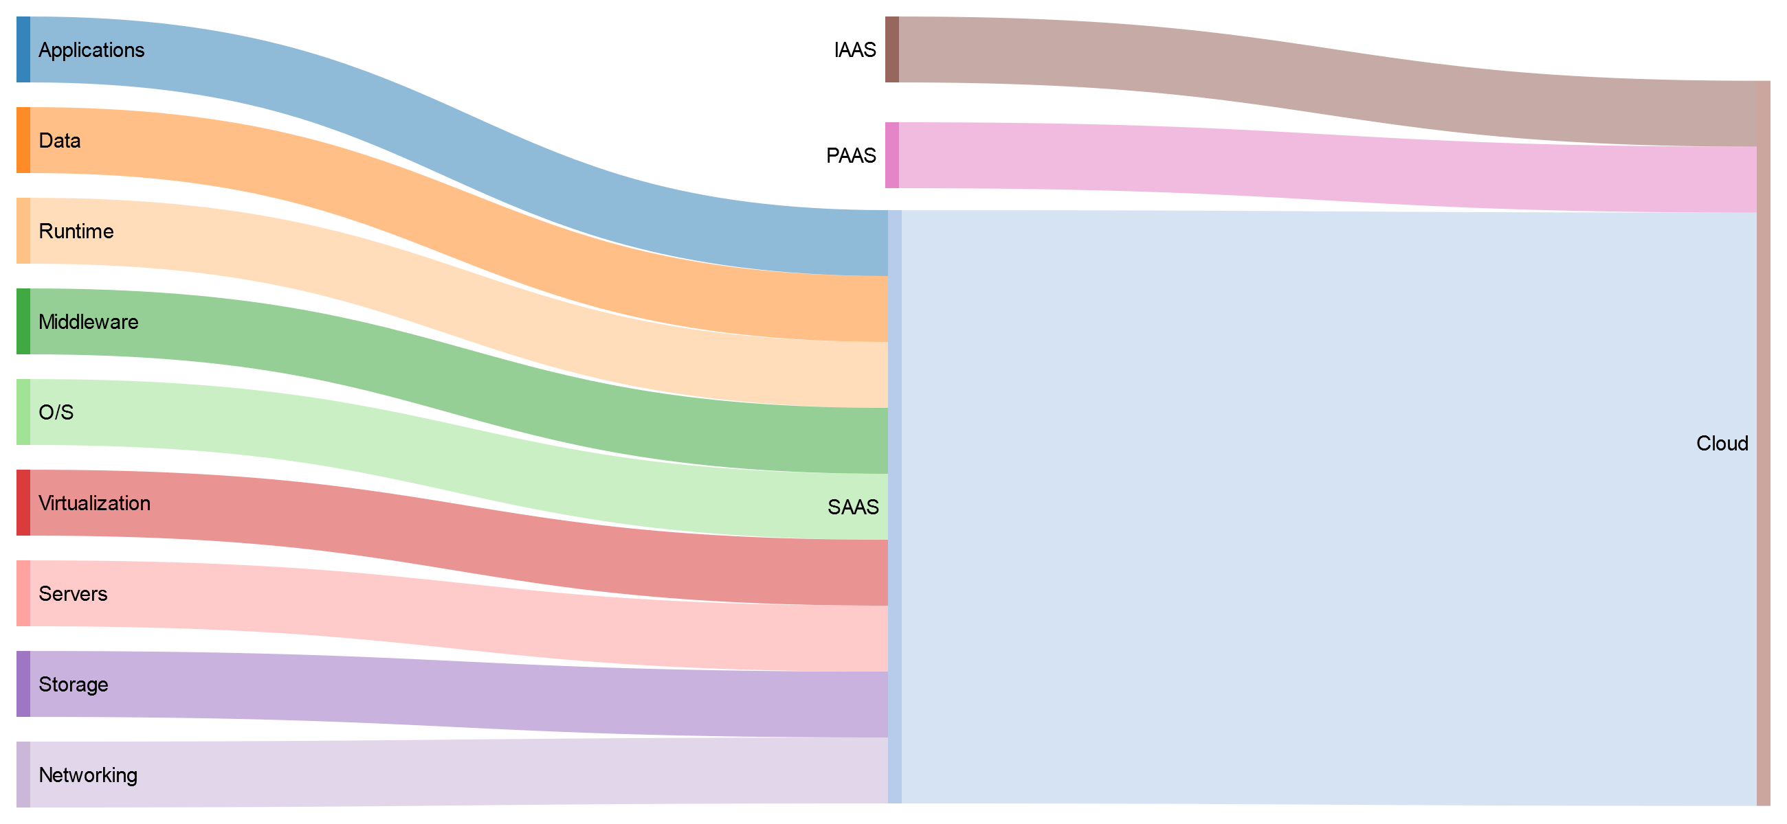
11
What is SaaS?

Slide 12
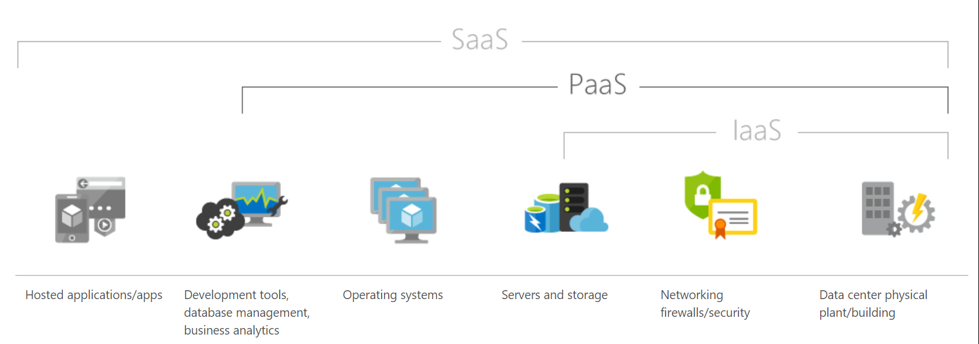
12
IaaS vs. PaaS vs. SaaS
What do you have to manage?

Slide 13
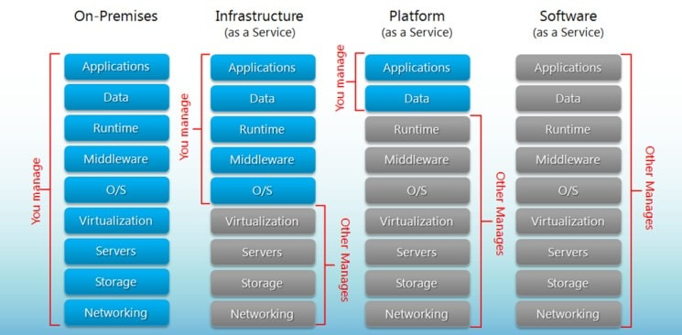
13
On-Premise vs. IaaS vs. PaaS vs. SaaS
What do you have to manage?

Slide 14
14
On-Premise vs. IaaS vs. PaaS vs. SaaS
What do you have to manage?
You |  | Your Provider
On-Premise | IaaS | PaaS | SaaS
Applications | Applications | Applications | Applications
Data | Data | Data | Data
Runtime | Runtime | Runtime | Runtime
Middleware | Middleware | Middleware | Middleware
O/S | O/S | O/S | O/S
Virtualization | Virtualization | Virtualization | Virtualization
Servers | Servers | Servers | Servers
Storage | Storage | Storage | Storage
Networking | Networking | Networking | Networking
Notes:
<svg id="sankey_svg" height="600" width="800" xmlns="http://www.w3.org/2000/svg" version="1.1"><title>Your Diagram Title</title><!-- Generated with SankeyMATIC on Thu Mar 21 2019 11:35:30 GMT+0100 (Central European Standard Time)--><g><rect width="100%" height="100%" fill="rgb(255, 255, 255)"></rect><g transform="translate(12,12)"><g><path class="link" d="M393,205.2C579.5,205.2 579.5,195.45527244339576 766,195.45527244339576" style="fill: none; stroke-width: 194.4; stroke: rgb(174, 199, 232); stroke-opacity: 0.5;"><title>SAAS &#8594; Cloud: 9</title></path><path class="link" d="M393,396C579.5,396 579.5,368.25527244339577 766,368.25527244339577" style="fill: none; stroke-width: 151.2; stroke: rgb(140, 86, 75); stroke-opacity: 0.5;"><title>PAAS &#8594; Cloud: 7</title></path><path class="link" d="M393,532.8000000000001C579.5,532.8000000000001 579.5,487.0552724433957 766,487.0552724433957" style="fill: none; stroke-width: 86.4; stroke: rgb(196, 156, 148); stroke-opacity: 0.5;"><title>IAAS &#8594; Cloud: 4</title></path><path class="link" d="M10,10.799999999999887C196.5,10.799999999999887 196.5,118.79999999999997 383,118.79999999999997" style="fill: none; stroke-width: 21.6; stroke: rgb(31, 119, 180); stroke-opacity: 0.5;"><title>Applications &#8594; SAAS: 1</title></path><path class="link" d="M10,50.39999999999989C196.5,50.39999999999989 196.5,140.39999999999998 383,140.39999999999998" style="fill: none; stroke-width: 21.6; stroke: rgb(255, 127, 14); stroke-opacity: 0.5;"><title>Data &#8594; SAAS: 1</title></path><path class="link" d="M10,89.99999999999989C196.5,89.99999999999989 196.5,162 383,162" style="fill: none; stroke-width: 21.6; stroke: rgb(255, 187, 120); stroke-opacity: 0.5;"><title>Runtime &#8594; SAAS: 1</title></path><path class="link" d="M10,151.1999999999999C196.5,151.1999999999999 196.5,183.6 383,183.6" style="fill: none; stroke-width: 21.6; stroke: rgb(44, 160, 44); stroke-opacity: 0.5;"><title>Middleware &#8594; SAAS: 1</title></path><path class="link" d="M10,212.39999999999992C196.5,212.39999999999992 196.5,205.2 383,205.2" style="fill: none; stroke-width: 21.6; stroke: rgb(152, 223, 138); stroke-opacity: 0.5;"><title>O/S &#8594; SAAS: 1</title></path><path class="link" d="M10,273.5999999999999C196.5,273.5999999999999 196.5,226.79999999999998 383,226.79999999999998" style="fill: none; stroke-width: 21.6; stroke: rgb(214, 39, 40); stroke-opacity: 0.5;"><title>Virtualization &#8594; SAAS: 1</title></path><path class="link" d="M10,356.3999999999999C196.5,356.3999999999999 196.5,248.39999999999998 383,248.39999999999998" style="fill: none; stroke-width: 21.6; stroke: rgb(255, 152, 150); stroke-opacity: 0.5;"><title>Servers &#8594; SAAS: 1</title></path><path class="link" d="M10,439.19999999999993C196.5,439.19999999999993 196.5,269.99999999999994 383,269.99999999999994" style="fill: none; stroke-width: 21.6; stroke: rgb(148, 103, 189); stroke-opacity: 0.5;"><title>Storage &#8594; SAAS: 1</title></path><path class="link" d="M10,521.9999999999999C196.5,521.9999999999999 196.5,291.59999999999997 383,291.59999999999997" style="fill: none; stroke-width: 21.6; stroke: rgb(197, 176, 213); stroke-opacity: 0.5;"><title>Networking &#8594; SAAS: 1</title></path><path class="link" d="M10,111.5999999999999C196.5,111.5999999999999 196.5,331.2 383,331.2" style="fill: none; stroke-width: 21.6; stroke: rgb(255, 187, 120); stroke-opacity: 0.5;"><title>Runtime &#8594; PAAS: 1</title></path><path class="link" d="M10,172.7999999999999C196.5,172.7999999999999 196.5,352.8 383,352.8" style="fill: none; stroke-width: 21.6; stroke: rgb(44, 160, 44); stroke-opacity: 0.5;"><title>Middleware &#8594; PAAS: 1</title></path><path class="link" d="M10,233.99999999999991C196.5,233.99999999999991 196.5,374.4 383,374.4" style="fill: none; stroke-width: 21.6; stroke: rgb(152, 223, 138); stroke-opacity: 0.5;"><title>O/S &#8594; PAAS: 1</title></path><path class="link" d="M10,295.19999999999993C196.5,295.19999999999993 196.5,396 383,396" style="fill: none; stroke-width: 21.6; stroke: rgb(214, 39, 40); stroke-opacity: 0.5;"><title>Virtualization &#8594; PAAS: 1</title></path><path class="link" d="M10,377.99999999999994C196.5,377.99999999999994 196.5,417.59999999999997 383,417.59999999999997" style="fill: none; stroke-width: 21.6; stroke: rgb(255, 152, 150); stroke-opacity: 0.5;"><title>Servers &#8594; PAAS: 1</title></path><path class="link" d="M10,460.79999999999995C196.5,460.79999999999995 196.5,439.2 383,439.2" style="fill: none; stroke-width: 21.6; stroke: rgb(148, 103, 189); stroke-opacity: 0.5;"><title>Storage &#8594; PAAS: 1</title></path><path class="link" d="M10,543.5999999999999C196.5,543.5999999999999 196.5,460.8 383,460.8" style="fill: none; stroke-width: 21.6; stroke: rgb(197, 176, 213); stroke-opacity: 0.5;"><title>Networking &#8594; PAAS: 1</title></path><path class="link" d="M10,316.7999999999999C196.5,316.7999999999999 196.5,500.40000000000003 383,500.40000000000003" style="fill: none; stroke-width: 21.6; stroke: rgb(214, 39, 40); stroke-opacity: 0.5;"><title>Virtualization &#8594; IAAS: 1</title></path><path class="link" d="M10,399.5999999999999C196.5,399.5999999999999 196.5,522 383,522" style="fill: none; stroke-width: 21.6; stroke: rgb(255, 152, 150); stroke-opacity: 0.5;"><title>Servers &#8594; IAAS: 1</title></path><path class="link" d="M10,482.3999999999999C196.5,482.3999999999999 196.5,543.6 383,543.6" style="fill: none; stroke-width: 21.6; stroke: rgb(148, 103, 189); stroke-opacity: 0.5;"><title>Storage &#8594; IAAS: 1</title></path><path class="link" d="M10,565.1999999999999C196.5,565.1999999999999 196.5,565.2 383,565.2" style="fill: none; stroke-width: 21.6; stroke: rgb(197, 176, 213); stroke-opacity: 0.5;"><title>Networking &#8594; IAAS: 1</title></path></g><g><g class="node" transform="translate(0,-1.1368683772161603e-13)"><rect height="21.6" width="10" id="r0" style="fill: rgb(31, 119, 180); fill-opacity: 0.9; stroke-width: 0; stroke: rgb(15, 58, 88);" shape-rendering="crispEdges"><title>Applications: 1</title></rect><text x="16" y="10.8" dy=".35em" text-anchor="start" style="stroke-width: 0; font-family: sans-serif; font-size: 15px; font-weight: 400; fill: rgb(0, 0, 0);">Applications</text></g><g class="node" transform="translate(383,107.99999999999997)"><rect height="194.4" width="10" id="r1" style="fill: rgb(174, 199, 232); fill-opacity: 0.9; stroke-width: 0; stroke: rgb(85, 97, 113);" shape-rendering="crispEdges"><title>SAAS: 9</title></rect><text x="-6" y="97.2" dy=".35em" text-anchor="end" style="stroke-width: 0; font-family: sans-serif; font-size: 15px; font-weight: 400; fill: rgb(0, 0, 0);">SAAS</text></g><g class="node" transform="translate(0,39.59999999999989)"><rect height="21.6" width="10" id="r2" style="fill: rgb(255, 127, 14); fill-opacity: 0.9; stroke-width: 0; stroke: rgb(124, 62, 6);" shape-rendering="crispEdges"><title>Data: 1</title></rect><text x="16" y="10.8" dy=".35em" text-anchor="start" style="stroke-width: 0; font-family: sans-serif; font-size: 15px; font-weight: 400; fill: rgb(0, 0, 0);">Data</text></g><g class="node" transform="translate(0,79.19999999999989)"><rect height="43.2" width="10" id="r3" style="fill: rgb(255, 187, 120); fill-opacity: 0.9; stroke-width: 0; stroke: rgb(124, 91, 58);" shape-rendering="crispEdges"><title>Runtime: 2</title></rect><text x="16" y="21.6" dy=".35em" text-anchor="start" style="stroke-width: 0; font-family: sans-serif; font-size: 15px; font-weight: 400; fill: rgb(0, 0, 0);">Runtime</text></g><g class="node" transform="translate(0,140.3999999999999)"><rect height="43.2" width="10" id="r4" style="fill: rgb(44, 160, 44); fill-opacity: 0.9; stroke-width: 0; stroke: rgb(21, 78, 21);" shape-rendering="crispEdges"><title>Middleware: 2</title></rect><text x="16" y="21.6" dy=".35em" text-anchor="start" style="stroke-width: 0; font-family: sans-serif; font-size: 15px; font-weight: 400; fill: rgb(0, 0, 0);">Middleware</text></g><g class="node" transform="translate(0,201.5999999999999)"><rect height="43.2" width="10" id="r5" style="fill: rgb(152, 223, 138); fill-opacity: 0.9; stroke-width: 0; stroke: rgb(74, 109, 67);" shape-rendering="crispEdges"><title>O/S: 2</title></rect><text x="16" y="21.6" dy=".35em" text-anchor="start" style="stroke-width: 0; font-family: sans-serif; font-size: 15px; font-weight: 400; fill: rgb(0, 0, 0);">O/S</text></g><g class="node" transform="translate(0,262.7999999999999)"><rect height="64.80000000000001" width="10" id="r6" style="fill: rgb(214, 39, 40); fill-opacity: 0.9; stroke-width: 0; stroke: rgb(104, 19, 19);" shape-rendering="crispEdges"><title>Virtualization: 3</title></rect><text x="16" y="32.400000000000006" dy=".35em" text-anchor="start" style="stroke-width: 0; font-family: sans-serif; font-size: 15px; font-weight: 400; fill: rgb(0, 0, 0);">Virtualization</text></g><g class="node" transform="translate(0,345.5999999999999)"><rect height="64.80000000000001" width="10" id="r7" style="fill: rgb(255, 152, 150); fill-opacity: 0.9; stroke-width: 0; stroke: rgb(124, 74, 73);" shape-rendering="crispEdges"><title>Servers: 3</title></rect><text x="16" y="32.400000000000006" dy=".35em" text-anchor="start" style="stroke-width: 0; font-family: sans-serif; font-size: 15px; font-weight: 400; fill: rgb(0, 0, 0);">Servers</text></g><g class="node" transform="translate(0,428.3999999999999)"><rect height="64.80000000000001" width="10" id="r8" style="fill: rgb(148, 103, 189); fill-opacity: 0.9; stroke-width: 0; stroke: rgb(72, 50, 92);" shape-rendering="crispEdges"><title>Storage: 3</title></rect><text x="16" y="32.400000000000006" dy=".35em" text-anchor="start" style="stroke-width: 0; font-family: sans-serif; font-size: 15px; font-weight: 400; fill: rgb(0, 0, 0);">Storage</text></g><g class="node" transform="translate(0,511.19999999999993)"><rect height="64.80000000000001" width="10" id="r9" style="fill: rgb(197, 176, 213); fill-opacity: 0.9; stroke-width: 0; stroke: rgb(96, 86, 104);" shape-rendering="crispEdges"><title>Networking: 3</title></rect><text x="16" y="32.400000000000006" dy=".35em" text-anchor="start" style="stroke-width: 0; font-family: sans-serif; font-size: 15px; font-weight: 400; fill: rgb(0, 0, 0);">Networking</text></g><g class="node" transform="translate(383,320.4)"><rect height="151.20000000000002" width="10" id="r10" style="fill: rgb(140, 86, 75); fill-opacity: 0.9; stroke-width: 0; stroke: rgb(68, 42, 36);" shape-rendering="crispEdges"><title>PAAS: 7</title></rect><text x="-6" y="75.60000000000001" dy=".35em" text-anchor="end" style="stroke-width: 0; font-family: sans-serif; font-size: 15px; font-weight: 400; fill: rgb(0, 0, 0);">PAAS</text></g><g class="node" transform="translate(383,489.6)"><rect height="86.4" width="10" id="r11" style="fill: rgb(196, 156, 148); fill-opacity: 0.9; stroke-width: 0; stroke: rgb(96, 76, 72);" shape-rendering="crispEdges"><title>IAAS: 4</title></rect><text x="-6" y="43.2" dy=".35em" text-anchor="end" style="stroke-width: 0; font-family: sans-serif; font-size: 15px; font-weight: 400; fill: rgb(0, 0, 0);">IAAS</text></g><g class="node" transform="translate(766,98.25527244339574)"><rect height="432" width="10" id="r12" style="fill: rgb(227, 119, 194); fill-opacity: 0.9; stroke-width: 0; stroke: rgb(111, 58, 95);" shape-rendering="crispEdges"><title>Cloud: 20</title></rect><text x="-6" y="216" dy=".35em" text-anchor="end" style="stroke-width: 0; font-family: sans-serif; font-size: 15px; font-weight: 400; fill: rgb(0, 0, 0);">Cloud</text></g></g></g></g></svg>

Slide 15
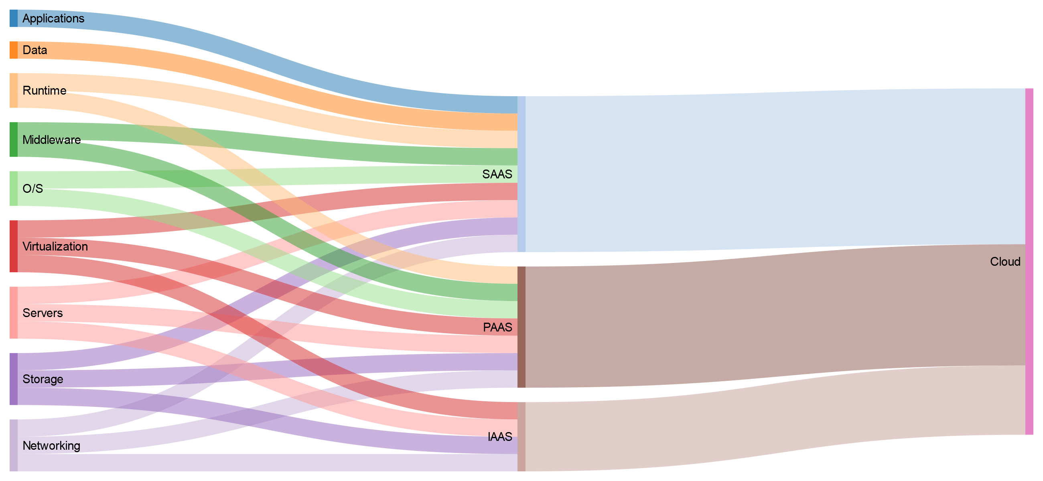
15
What does the provider do?
SaaS
PaaS
IaaS
Notes:
<svg id="sankey_svg" height="600" width="800" xmlns="http://www.w3.org/2000/svg" version="1.1"><title>Your Diagram Title</title><!-- Generated with SankeyMATIC on Thu Mar 21 2019 11:35:30 GMT+0100 (Central European Standard Time)--><g><rect width="100%" height="100%" fill="rgb(255, 255, 255)"></rect><g transform="translate(12,12)"><g><path class="link" d="M393,205.2C579.5,205.2 579.5,195.45527244339576 766,195.45527244339576" style="fill: none; stroke-width: 194.4; stroke: rgb(174, 199, 232); stroke-opacity: 0.5;"><title>SAAS &#8594; Cloud: 9</title></path><path class="link" d="M393,396C579.5,396 579.5,368.25527244339577 766,368.25527244339577" style="fill: none; stroke-width: 151.2; stroke: rgb(140, 86, 75); stroke-opacity: 0.5;"><title>PAAS &#8594; Cloud: 7</title></path><path class="link" d="M393,532.8000000000001C579.5,532.8000000000001 579.5,487.0552724433957 766,487.0552724433957" style="fill: none; stroke-width: 86.4; stroke: rgb(196, 156, 148); stroke-opacity: 0.5;"><title>IAAS &#8594; Cloud: 4</title></path><path class="link" d="M10,10.799999999999887C196.5,10.799999999999887 196.5,118.79999999999997 383,118.79999999999997" style="fill: none; stroke-width: 21.6; stroke: rgb(31, 119, 180); stroke-opacity: 0.5;"><title>Applications &#8594; SAAS: 1</title></path><path class="link" d="M10,50.39999999999989C196.5,50.39999999999989 196.5,140.39999999999998 383,140.39999999999998" style="fill: none; stroke-width: 21.6; stroke: rgb(255, 127, 14); stroke-opacity: 0.5;"><title>Data &#8594; SAAS: 1</title></path><path class="link" d="M10,89.99999999999989C196.5,89.99999999999989 196.5,162 383,162" style="fill: none; stroke-width: 21.6; stroke: rgb(255, 187, 120); stroke-opacity: 0.5;"><title>Runtime &#8594; SAAS: 1</title></path><path class="link" d="M10,151.1999999999999C196.5,151.1999999999999 196.5,183.6 383,183.6" style="fill: none; stroke-width: 21.6; stroke: rgb(44, 160, 44); stroke-opacity: 0.5;"><title>Middleware &#8594; SAAS: 1</title></path><path class="link" d="M10,212.39999999999992C196.5,212.39999999999992 196.5,205.2 383,205.2" style="fill: none; stroke-width: 21.6; stroke: rgb(152, 223, 138); stroke-opacity: 0.5;"><title>O/S &#8594; SAAS: 1</title></path><path class="link" d="M10,273.5999999999999C196.5,273.5999999999999 196.5,226.79999999999998 383,226.79999999999998" style="fill: none; stroke-width: 21.6; stroke: rgb(214, 39, 40); stroke-opacity: 0.5;"><title>Virtualization &#8594; SAAS: 1</title></path><path class="link" d="M10,356.3999999999999C196.5,356.3999999999999 196.5,248.39999999999998 383,248.39999999999998" style="fill: none; stroke-width: 21.6; stroke: rgb(255, 152, 150); stroke-opacity: 0.5;"><title>Servers &#8594; SAAS: 1</title></path><path class="link" d="M10,439.19999999999993C196.5,439.19999999999993 196.5,269.99999999999994 383,269.99999999999994" style="fill: none; stroke-width: 21.6; stroke: rgb(148, 103, 189); stroke-opacity: 0.5;"><title>Storage &#8594; SAAS: 1</title></path><path class="link" d="M10,521.9999999999999C196.5,521.9999999999999 196.5,291.59999999999997 383,291.59999999999997" style="fill: none; stroke-width: 21.6; stroke: rgb(197, 176, 213); stroke-opacity: 0.5;"><title>Networking &#8594; SAAS: 1</title></path><path class="link" d="M10,111.5999999999999C196.5,111.5999999999999 196.5,331.2 383,331.2" style="fill: none; stroke-width: 21.6; stroke: rgb(255, 187, 120); stroke-opacity: 0.5;"><title>Runtime &#8594; PAAS: 1</title></path><path class="link" d="M10,172.7999999999999C196.5,172.7999999999999 196.5,352.8 383,352.8" style="fill: none; stroke-width: 21.6; stroke: rgb(44, 160, 44); stroke-opacity: 0.5;"><title>Middleware &#8594; PAAS: 1</title></path><path class="link" d="M10,233.99999999999991C196.5,233.99999999999991 196.5,374.4 383,374.4" style="fill: none; stroke-width: 21.6; stroke: rgb(152, 223, 138); stroke-opacity: 0.5;"><title>O/S &#8594; PAAS: 1</title></path><path class="link" d="M10,295.19999999999993C196.5,295.19999999999993 196.5,396 383,396" style="fill: none; stroke-width: 21.6; stroke: rgb(214, 39, 40); stroke-opacity: 0.5;"><title>Virtualization &#8594; PAAS: 1</title></path><path class="link" d="M10,377.99999999999994C196.5,377.99999999999994 196.5,417.59999999999997 383,417.59999999999997" style="fill: none; stroke-width: 21.6; stroke: rgb(255, 152, 150); stroke-opacity: 0.5;"><title>Servers &#8594; PAAS: 1</title></path><path class="link" d="M10,460.79999999999995C196.5,460.79999999999995 196.5,439.2 383,439.2" style="fill: none; stroke-width: 21.6; stroke: rgb(148, 103, 189); stroke-opacity: 0.5;"><title>Storage &#8594; PAAS: 1</title></path><path class="link" d="M10,543.5999999999999C196.5,543.5999999999999 196.5,460.8 383,460.8" style="fill: none; stroke-width: 21.6; stroke: rgb(197, 176, 213); stroke-opacity: 0.5;"><title>Networking &#8594; PAAS: 1</title></path><path class="link" d="M10,316.7999999999999C196.5,316.7999999999999 196.5,500.40000000000003 383,500.40000000000003" style="fill: none; stroke-width: 21.6; stroke: rgb(214, 39, 40); stroke-opacity: 0.5;"><title>Virtualization &#8594; IAAS: 1</title></path><path class="link" d="M10,399.5999999999999C196.5,399.5999999999999 196.5,522 383,522" style="fill: none; stroke-width: 21.6; stroke: rgb(255, 152, 150); stroke-opacity: 0.5;"><title>Servers &#8594; IAAS: 1</title></path><path class="link" d="M10,482.3999999999999C196.5,482.3999999999999 196.5,543.6 383,543.6" style="fill: none; stroke-width: 21.6; stroke: rgb(148, 103, 189); stroke-opacity: 0.5;"><title>Storage &#8594; IAAS: 1</title></path><path class="link" d="M10,565.1999999999999C196.5,565.1999999999999 196.5,565.2 383,565.2" style="fill: none; stroke-width: 21.6; stroke: rgb(197, 176, 213); stroke-opacity: 0.5;"><title>Networking &#8594; IAAS: 1</title></path></g><g><g class="node" transform="translate(0,-1.1368683772161603e-13)"><rect height="21.6" width="10" id="r0" style="fill: rgb(31, 119, 180); fill-opacity: 0.9; stroke-width: 0; stroke: rgb(15, 58, 88);" shape-rendering="crispEdges"><title>Applications: 1</title></rect><text x="16" y="10.8" dy=".35em" text-anchor="start" style="stroke-width: 0; font-family: sans-serif; font-size: 15px; font-weight: 400; fill: rgb(0, 0, 0);">Applications</text></g><g class="node" transform="translate(383,107.99999999999997)"><rect height="194.4" width="10" id="r1" style="fill: rgb(174, 199, 232); fill-opacity: 0.9; stroke-width: 0; stroke: rgb(85, 97, 113);" shape-rendering="crispEdges"><title>SAAS: 9</title></rect><text x="-6" y="97.2" dy=".35em" text-anchor="end" style="stroke-width: 0; font-family: sans-serif; font-size: 15px; font-weight: 400; fill: rgb(0, 0, 0);">SAAS</text></g><g class="node" transform="translate(0,39.59999999999989)"><rect height="21.6" width="10" id="r2" style="fill: rgb(255, 127, 14); fill-opacity: 0.9; stroke-width: 0; stroke: rgb(124, 62, 6);" shape-rendering="crispEdges"><title>Data: 1</title></rect><text x="16" y="10.8" dy=".35em" text-anchor="start" style="stroke-width: 0; font-family: sans-serif; font-size: 15px; font-weight: 400; fill: rgb(0, 0, 0);">Data</text></g><g class="node" transform="translate(0,79.19999999999989)"><rect height="43.2" width="10" id="r3" style="fill: rgb(255, 187, 120); fill-opacity: 0.9; stroke-width: 0; stroke: rgb(124, 91, 58);" shape-rendering="crispEdges"><title>Runtime: 2</title></rect><text x="16" y="21.6" dy=".35em" text-anchor="start" style="stroke-width: 0; font-family: sans-serif; font-size: 15px; font-weight: 400; fill: rgb(0, 0, 0);">Runtime</text></g><g class="node" transform="translate(0,140.3999999999999)"><rect height="43.2" width="10" id="r4" style="fill: rgb(44, 160, 44); fill-opacity: 0.9; stroke-width: 0; stroke: rgb(21, 78, 21);" shape-rendering="crispEdges"><title>Middleware: 2</title></rect><text x="16" y="21.6" dy=".35em" text-anchor="start" style="stroke-width: 0; font-family: sans-serif; font-size: 15px; font-weight: 400; fill: rgb(0, 0, 0);">Middleware</text></g><g class="node" transform="translate(0,201.5999999999999)"><rect height="43.2" width="10" id="r5" style="fill: rgb(152, 223, 138); fill-opacity: 0.9; stroke-width: 0; stroke: rgb(74, 109, 67);" shape-rendering="crispEdges"><title>O/S: 2</title></rect><text x="16" y="21.6" dy=".35em" text-anchor="start" style="stroke-width: 0; font-family: sans-serif; font-size: 15px; font-weight: 400; fill: rgb(0, 0, 0);">O/S</text></g><g class="node" transform="translate(0,262.7999999999999)"><rect height="64.80000000000001" width="10" id="r6" style="fill: rgb(214, 39, 40); fill-opacity: 0.9; stroke-width: 0; stroke: rgb(104, 19, 19);" shape-rendering="crispEdges"><title>Virtualization: 3</title></rect><text x="16" y="32.400000000000006" dy=".35em" text-anchor="start" style="stroke-width: 0; font-family: sans-serif; font-size: 15px; font-weight: 400; fill: rgb(0, 0, 0);">Virtualization</text></g><g class="node" transform="translate(0,345.5999999999999)"><rect height="64.80000000000001" width="10" id="r7" style="fill: rgb(255, 152, 150); fill-opacity: 0.9; stroke-width: 0; stroke: rgb(124, 74, 73);" shape-rendering="crispEdges"><title>Servers: 3</title></rect><text x="16" y="32.400000000000006" dy=".35em" text-anchor="start" style="stroke-width: 0; font-family: sans-serif; font-size: 15px; font-weight: 400; fill: rgb(0, 0, 0);">Servers</text></g><g class="node" transform="translate(0,428.3999999999999)"><rect height="64.80000000000001" width="10" id="r8" style="fill: rgb(148, 103, 189); fill-opacity: 0.9; stroke-width: 0; stroke: rgb(72, 50, 92);" shape-rendering="crispEdges"><title>Storage: 3</title></rect><text x="16" y="32.400000000000006" dy=".35em" text-anchor="start" style="stroke-width: 0; font-family: sans-serif; font-size: 15px; font-weight: 400; fill: rgb(0, 0, 0);">Storage</text></g><g class="node" transform="translate(0,511.19999999999993)"><rect height="64.80000000000001" width="10" id="r9" style="fill: rgb(197, 176, 213); fill-opacity: 0.9; stroke-width: 0; stroke: rgb(96, 86, 104);" shape-rendering="crispEdges"><title>Networking: 3</title></rect><text x="16" y="32.400000000000006" dy=".35em" text-anchor="start" style="stroke-width: 0; font-family: sans-serif; font-size: 15px; font-weight: 400; fill: rgb(0, 0, 0);">Networking</text></g><g class="node" transform="translate(383,320.4)"><rect height="151.20000000000002" width="10" id="r10" style="fill: rgb(140, 86, 75); fill-opacity: 0.9; stroke-width: 0; stroke: rgb(68, 42, 36);" shape-rendering="crispEdges"><title>PAAS: 7</title></rect><text x="-6" y="75.60000000000001" dy=".35em" text-anchor="end" style="stroke-width: 0; font-family: sans-serif; font-size: 15px; font-weight: 400; fill: rgb(0, 0, 0);">PAAS</text></g><g class="node" transform="translate(383,489.6)"><rect height="86.4" width="10" id="r11" style="fill: rgb(196, 156, 148); fill-opacity: 0.9; stroke-width: 0; stroke: rgb(96, 76, 72);" shape-rendering="crispEdges"><title>IAAS: 4</title></rect><text x="-6" y="43.2" dy=".35em" text-anchor="end" style="stroke-width: 0; font-family: sans-serif; font-size: 15px; font-weight: 400; fill: rgb(0, 0, 0);">IAAS</text></g><g class="node" transform="translate(766,98.25527244339574)"><rect height="432" width="10" id="r12" style="fill: rgb(227, 119, 194); fill-opacity: 0.9; stroke-width: 0; stroke: rgb(111, 58, 95);" shape-rendering="crispEdges"><title>Cloud: 20</title></rect><text x="-6" y="216" dy=".35em" text-anchor="end" style="stroke-width: 0; font-family: sans-serif; font-size: 15px; font-weight: 400; fill: rgb(0, 0, 0);">Cloud</text></g></g></g></g></svg>

Slide 16

16
Office 365

Slide 17
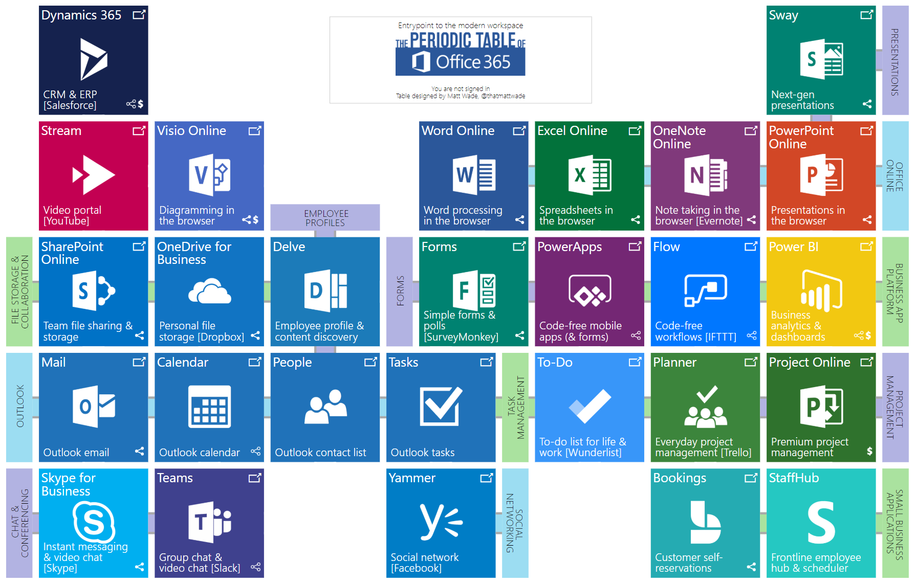
17
Office 365 - Features
https://app.jumpto365.com/
Notes:
https://app.jumpto365.com/

Slide 18
18
Office 365 - Features
File Management | Personal productivity | Communication | Collaboration | Business Apps | Admin & Security
OneDrive | Calendar | Outlook | Teams | PowerBi | Admin
SharePoint | People | Teams | Planner | PowerApps | Security & Compliance
Delve | Tasks | SharePoint | Forms | Flow
 | Excel | Yammer |  | Dynamics 365
 | Word | Skype for Business (S4B) |  | Project
 | PowerPoint | Stream
 | OneNote | Sway
 | To-Do

Slide 19

19
Microsoft Teams

Slide 20
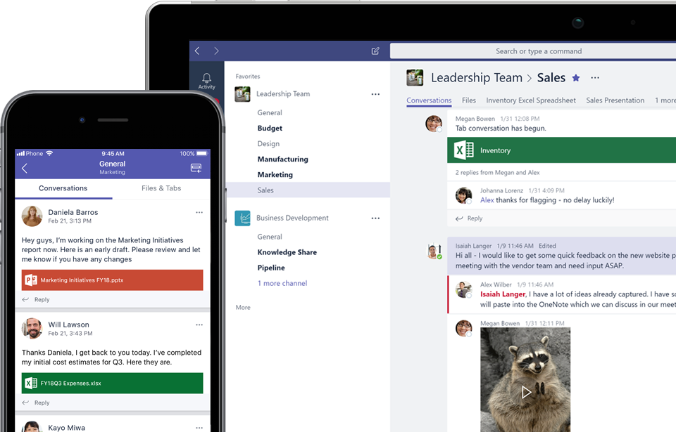
20
Introducing Microsoft Teams
Modern communication for modern teams
People can see content and chat history anytime
Team chats and activities are visible to the entire team
Use private chats for small group conversations
Voice and video meetings right within Teams
Built-in access to SharePoint, OneNote and Planner
Mobile access on Android & iOS

Slide 21
Interactive Session Checklist
Complete | Task | Who
 | Sign-in to https://teams.microsoft.com and install desktop client* | All
 | Create a team | Team lead
 | Add remaining attendees to team as members | Team lead
 | Create a channel | Team lead
 | Start a conversation | Team lead
 | Reply to a conversation | All
 | @Mention someone in the conversation | Team lead / All
 | Add a tab | Team lead
 | Promote a member to owner | Team lead
 | Demote an owner to member | Team lead
 | Share a file | Team lead / All
 | Ask T-bot a question | Team lead / All
*Users can alternatively participate by using the web client in a supported browser
Notes:
One of the workshop attendees should be sharing their screen at this time. This person will be identified as the team lead in the checklist.
*Users can alternatively participate by using the web client in a supported browser

Slide 22
Interactive Session Checklist
Complete | Task | Who
 | Search for and add a new bot | Team lead / All
 | Start a Meet now in the channel | Team lead
 | Invite someone to join the Meet now | Team lead
 | Schedule a meeting | Team lead / All
 | Start a private (1:1) chat | Team lead / All
 | Start a private group chat | Team lead / All
 | Add a connector | Team lead
 | Send a Giphy or Sticker | Team lead / All
 | Download the Microsoft Teams mobile apps | All
 | Use mobile apps to participate in a conversation | All
 | Use mobile apps to participate in a 1:1 audio call | All
Notes:
One of the workshop attendees should be sharing their screen at this time. This person will be identified as the team lead in the checklist.
Meet Now* be careful of audio/video devices, and performance and feedback issues. The intent here is to just introduce the ability.

Slide 23

23
Microsoft Teams - Demo

Slide 24

24
Microsoft Teams

Slide 25
25
Microsoft Teams
Built on existing technologies
Cloud-only tool
Requirements:
Exchange
Office 365 Groups are based on Exchange
SharePoint Online
Without SPO, users won’t be able to share files in teams
OneDrive for Business
Without OneDrive, users won’t be able to share files in private chats

Slide 26
26
Office 365 Groups
When you create a team in Microsoft Teams, on the backend, you’re creating an Office 365 Group
Existing groups can be transitioned into teams
Restricting team creation can be accomplished through group creation policies

Slide 27
27
Skype for Business
Interoperability between Teams and Skype for Business is currently available for peer to peer (P2P) instant messaging and calling only.
For a Teams user to send an IM to a Skype for Business user, the Teams user must be enabled with their account homed in Skype for Business Online.
Incoming Skype for Business messages and calls can be responded to on the Teams client

Slide 28
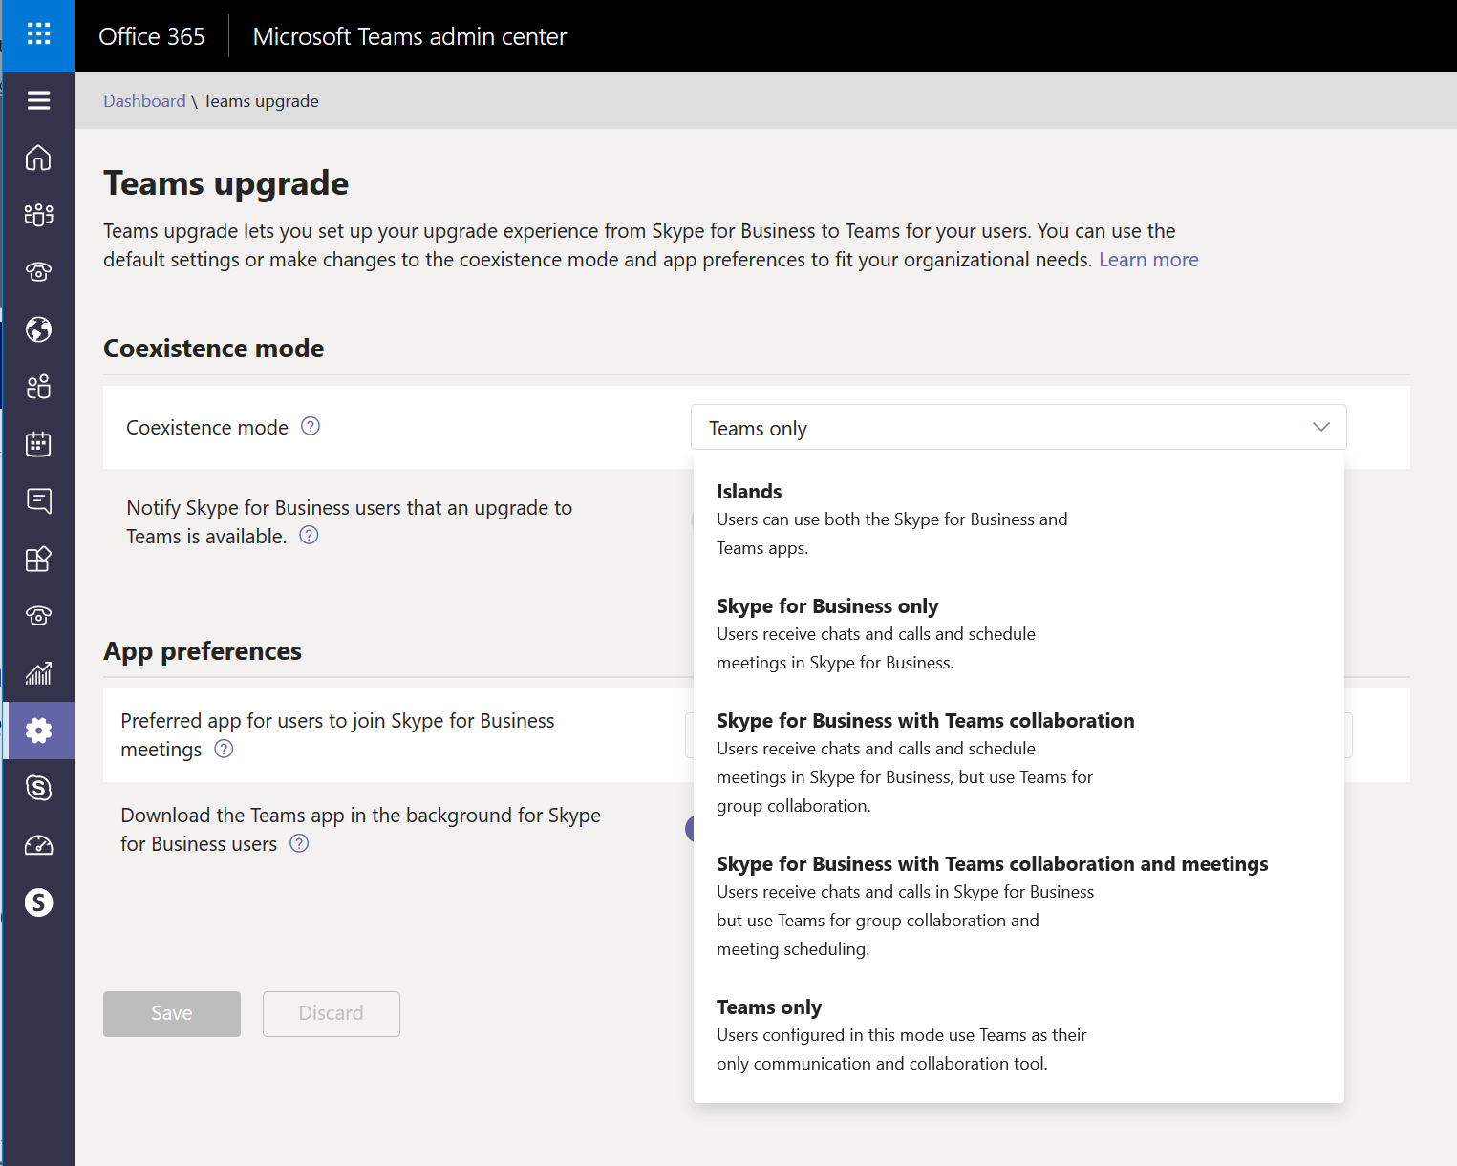
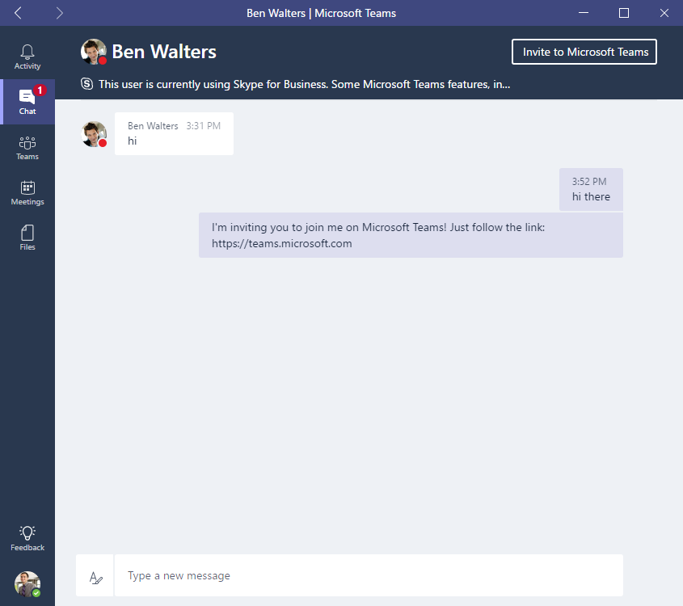
28
Skype for Business

Slide 29

29
Microsoft Teams

Slide 30

30
Microsoft Teams
Business Essentials
Enterprise E1
Education
Enterprise E3
Education Plus
Business Premium
Enterprise E4 (retired)
Education E3 (retired)
Enterprise E5
Education E5

Slide 31
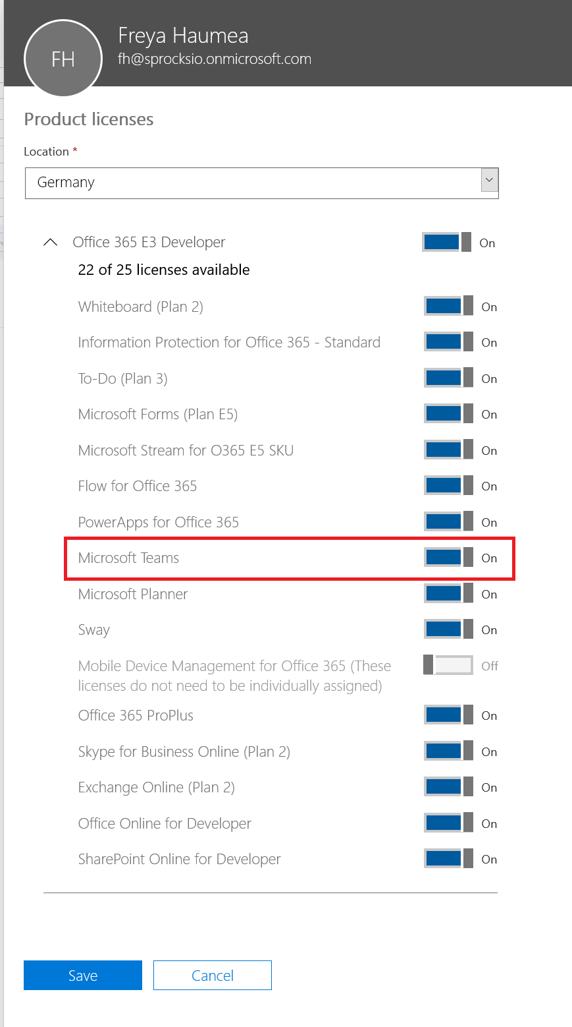
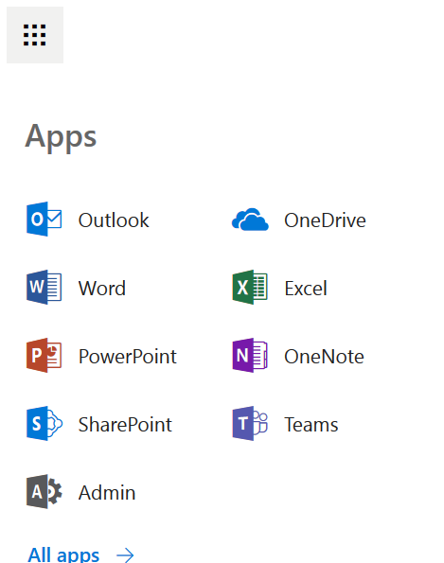
31
Microsoft Teams
By default, Teams will be activated for all users with an eligible O365 subscription
User can see Teams when they are logged into O365

Slide 32

32
Microsoft Teams

Slide 33
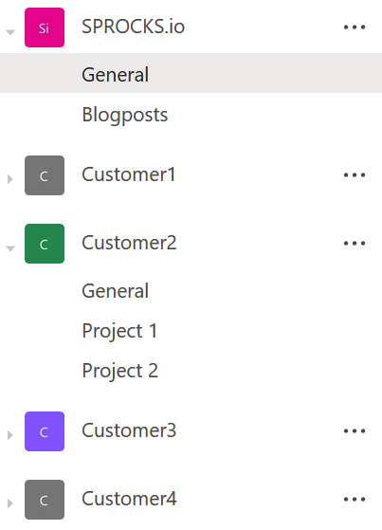
33
Microsoft Teams - Structure
Teams
Content and people surrounding projects, business units or teams
Channels
Sections dedicated to certain aspects of teams
Keep conversations organized and on topic
Extended by tabs, connectors and bots

Slide 34
34
Microsoft Teams - Structure
Organization
Team
Team
Team
Channel
Conversations
Files
Notes
Tabs
Connectors
Channel
Conversation
Files
Channel
Channel
Conversations
Notes
Connectors
Conversations
Conversations
Tabs
Channel

Slide 35
35
Microsoft Teams - Structure
Roles in Microsoft Teams
Owner
Can invite users to team
Creates the team
Assigns roles
Responsible for managing team-wide settings
Team member
Invited to the team
Guests
Office 365 users from outside (other organizations)

Slide 36
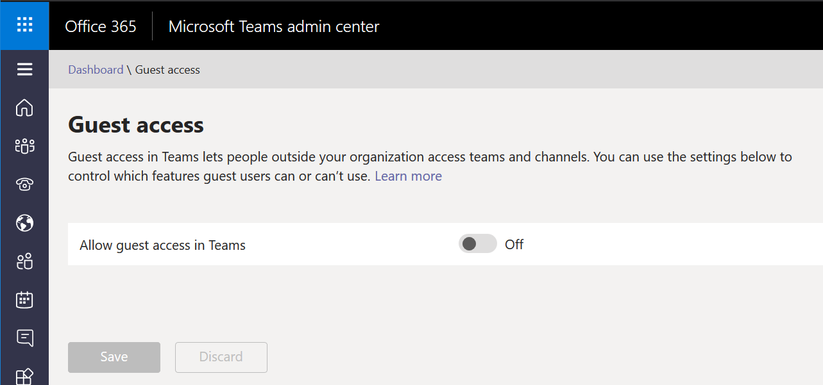
36
Microsoft Teams - Structure
Guest access
Tenant-level setting
Turned off by default
When enabled, team owner can add external users
Only Azure AD or O365 school / work accounts are currently supported

Slide 37
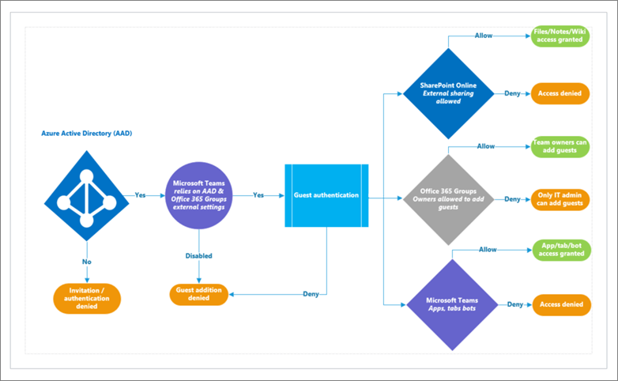
37
Microsoft Teams - Structure
Guest access

Slide 38
38
Microsoft Teams - Structure
 | Team Owner | Team Member | Team Guests
Create team | ✓ | - | -
Leave team | ✓ | ✓ | ✓
Edit team name/description | ✓ | - | -
Delete team | ✓ | - | -
Add channel | ✓ | ✓* | ✓*
Edit channel name/description | ✓ | ✓* | ✓*
Delete channel | ✓ | ✓* | ✓*
Add members | ✓** | - | -
Add tabs | ✓ | ✓* | -
Add connectors | ✓ | ✓* | -
Add bots | ✓ | ✓* | -
*can be restricted through Teams settings by team owner
Notes:
Tabs, Bots and Connectors can be controlled at a tenant level and if turned off, will not show up for the individual teams.
All permissions are set on a per team basis.
* Can be restricted through Team settings by the owner
** After adding a member to a team, an Owner can also promote a Member to Owner status. It is also possible for an Owner to demote their own status to a Member
Guests cannot be made Team Owners

Slide 39
39
Microsoft Teams - Structure
Gather your team – stakeholders, champions & early adopters
Prioritize business scenarios
Complete technical planning
Complete pilots and broad onboarding
Measure, manage & drive adoption
Drive Value
Envision
Onboard
Continuous Adoption & Success Measurement
Notes:
Tabs, Bots and Connectors can be controlled at a tenant level and if turned off, will not show up for the individual teams.
All permissions are set on a per team basis.
* Can be restricted through Team settings by the owner
** After adding a member to a team, an Owner can also promote a Member to Owner status. It is also possible for an Owner to demote their own status to a Member
Guests cannot be made Team Owners
Complete technical planning
(network, security, mobile support & deployment

Slide 40
Implementation Phases
Gather your team – stakeholders, champions & early adopters
Prioritize business scenarios
Complete technical planning
(network, security, mobile support & deployment)
Complete pilots and broad onboarding
Measure, manage, & drive adoption
For Office 365 and Teams
Drive Value
Envision
Onboard
Continuous Adoption & Success Measurement
Notes:
Now that we have better understanding of teams all up, let’s get into the specifics of how we will roll this out for your organization.
A typical Teams journey may take the following form:
Download the Practical Guidance for Teams Quick Start & Planning Guide to gather greater details for the 5 steps on this slide. https://www.microsoft.com/download/55981
Step One: Get your people together
Step Two: Prioritize your business scenarios
Step Three: Complete Technical Planning
Step Four: Conduct pilots and deploy Teams
Step Five: Measure usage, manage satisfaction, and drive adoption
Change Management is a crucial part of this journey and we will cover it later on in this presentation
During the journey, one of the first uses of Teams in your environment will be the IT pilot. You may also consider leveraging this pilot to help your team engage with the planning, delivery and operation of Teams and outreach to the business users.

Slide 41

41
Microsoft Teams

Slide 42
42
Microsoft Teams - Managing Teams
Lightweight administrations that places the burden on IT Pros instead of IT administrators
Microsoft Teams will check if all features are available and will continue to do so
Microsoft Teams is supposed to grow organically
Microsoft Teams is also supposed to empower users to enhance collaboration
PowerShell Cmdlets are available, but some are in preview
Teams also has a front-end to configure policies and features (https://admin.teams.microsoft.com)
Notes:
Speaker notes:
Make sure to inform the attendees of the following specifics:
Teams does not have any custom RBAC roles in the Office 365 Administrator roles
At the tenant-level, Teams can be enabled or disabled for an entire license type using an on/off slider available in Office 365 Admin center*
Features available to all Teams users within the tenant can be configured from the Office 365 Admin center
Owners and members of teams should be managed from Teams clients
PowerShell commandlets are in preview.
Download link: https://www.powershellgallery.com/packages/MicrosoftTeams/0.9.1
*Will be removed soon, license management will need to be managed as all other Office 365 workloads

Slide 43
43
Microsoft Teams - Managing Teams
Teams should be managed through the Teams Client
Teams-enabled users will create an O365 Group and become the owner if they have the permission to create Groups
By default, all users with a mailbox in Exchange Online have the ability to create Office 365 Groups
Teams that are created in Microsoft Teams will not show up in Outlook, you can set them to visible with PowerShell
Notes:
find-module *exchangeonline*
Install-Module -Name ExchangeOnlineShell -Repository PSGallery
$UserCredential = Get-Credential
$Session = New-PSSession -ConfigurationName Microsoft.Exchange -ConnectionUri https://outlook.office365.com/powershell-liveid/ -Credential $UserCredential -Authentication Basic -AllowRedirection
Import-PSSession $Session -DisableNameChecking
Set-UnifiedGroup -Identity "Customer1" -HiddenFromExchangeClientsEnabled:$false

Slide 44

44
Microsoft Teams

Slide 45
45
Microsoft Teams - Network Planning
Teams combines three forms of traffic:
Data between the Office 365 online environment and external data sources with the Teams client (signalling, presence, chat, file upload and download, and tabs, connectors, and bots connections)
Peer to peer real time communications traffic (audio, video, desktop sharing)
Conferencing real time communications traffic (audio, video, desktop sharing)
To ensure optimal flow, traffic must be allowed to flow both between network sites and Office 365, as well as between the internal network segments (e.g. between sites over the WAN)
If your organization restricts computers on your network from connecting to the Internet, be sure to whitelist the required Office 365 URLs and IP address ranges.
Notes:
Speaker notes:
When presenting this slide, if Internet access is available, click the link and review the network requirements for Teams
Explain the preference of UDP traffic and why that is preferred for real time media over TCP.
If needed, the 3 upcoming slides show the call flow data for different scenarios.
Calculator: http://aka.ms/bwcalc

Slide 46
Microsoft Teams MyAdvisor
Microsoft has created a dedicated site for calculating the potential impact of Teams traffic on your LAN, WAN and Internet segments.
Please see the Network Planner at http://aka.ms/bwcalc for more details
Notes:
Speaker notes:
Drive the discussion on bandwidth calculations by leveraging the information shared at http://aka.ms/bwcalc.
Take the opportunity to do some specific calculations for the attendees of the workshop, to get an initial understanding of what network impact that can expect from Teams.
If needed, leverage the next set of hidden slides to dive into the bandwidth requirements.

Slide 47
47
Microsoft Teams - Network Planning
Value | Client to Microsoft Edge | Customer Edge to Microsoft Edge
Latency (one way) | < 50 ms | < 30 ms
Latency (RTT or round-trip time) | < 100 ms | < 60 ms
Burst packet loss | <10% during any 200-ms interval | <1% during any 200-ms interval
Packet loss | <1% during any 15-sec interval | <0.1% during any 15-sec interval
Packet inter-arrival Jitter | <30 ms during any 15-sec interval | <15ms during any 15-sec interval
Packet reorder | <0.05% out-of-order packets | <0.01% out-of-order packets
Notes:
These metrics cover two network segments Client to Microsoft Edge and the subsection of Customer Edge to Microsoft Edge, the next slide covers the Network Readiness Assessment and tooling that you can use to understand if you meet these metrics.
For more details please see here: https://support.office.com/article/Media-Quality-and-Network-Connectivity-Performance-in-Skype-for-Business-Online-5fe3e01b-34cf-44e0-b897-b0b2a83f0917

Slide 48
Network Assessment
Ensure all required URLs and IP addresses are allowed, and the network performance metrics are meeting the requirements for real time media
Conduct network assessment on each site using Skype for Business Network Assessment Tool
Additional documentation on Network Assessment can be referenced from Network Readiness Assessment
Notes:
To test both network segments (Client to Microsoft Edge and Customer Edge to Microsoft Edge) the Microsoft Network Assessment Tool can be used (source: https://www.microsoft.com/en-us/download/details.aspx?id=53885).
This tool can be deployed on both the client PC directly, as well as a PC/laptop connected to the Customer Network Edge.
The tool includes limited documentation, but a deeper documentation around the usage of the tool can be found here: Network Readiness Assessment https://myadvisor.fasttrack.microsoft.com/CloudVoice/Offers?pageState=NetworkReadiness
By running this Network Readiness Assessment, you can validate your networks readiness to run real time media applications, such as Teams.
Note: this is the same Network Readiness Assessment that is recommended to be run for customers who are looking to successfully deploy Skype for Business.

Slide 49

49
Microsoft Teams

Slide 50
50
Microsoft Teams – Security & Compliance
Uses common O365 authentication
Cloud Identity
Synchronized Identity
Federated Identity
Modern authentication includes MFA
Notes:
Teams is built on Office 365 and leverages the rich authentication options offered by the platform including aligning with existing Office 365 Azure Active Directory authentication policies. 3 authentication schemes are available. Those being, Cloud Identity, Synchronized Identity and Federated Identify.
Cloud Identity represents users being homed in Azure Active Directory.
Synchronized Identity is on-premises accounts sync’d to the cloud via Azure Active Directory Sync with Password sync. Authentication still occurs in the cloud.
Federated Identity represents having an ADFS deployment where access to Office 365 services will redirect to the ADFS deployment for on-premises authentication and authorization.
Additionally, MFA, smart card, and certificate-based authentication are supported via Active Directory Authentication Language (ADAL) integration. Depending on the Authentication scheme selection, there are different MFA features available.
Cloud Only
Phone Call
Text Messages
Mobile App Notification
Mobile App Verification Code
Hybrid Setup
MFA for Office 365
Azure MFA module (ADFS integrated)
Physical or virtual smart card (ADFS integrated)

Slide 51
51
Microsoft Teams – Security & Compliance
Auditing and Reporting
Teams activities/events are available through Audit Log Search.
Compliance Content Search
Content Search can be used to search Teams through rich filtering capabilities and exported to a specific container for compliance and litigation support (with or without an eDiscovery case).
Notes:
Auditing/reporting:
Needs to be turned on at a tenant level in order for logs to be available (it will take up to 24 hours after turning this on for the logs to appear).
The following are examples of events captured:
Team Creation
Team Deletion
Added Channel
Changed Setting
The complete event list across Office 365 is quite extensive and can be found here https://support.office.com/en-us/article/Search-the-audit-log-in-the-Office-365-Security-Compliance-Center-0d4d0f35-390b-4518-800e-0c7ec95e946c?ui=en-US&rs=en-US&ad=US
Content Search
OneNote is only covered through content search.
Content Search and eDiscovery do not require enablement within the Security and Compliance center.
- To learn more of how to leverage these services, see the appropriate sections below (Content Search https://docs.microsoft.com/en-us/MicrosoftTeams/content-search and https://docs.microsoft.com/en-us/MicrosoftTeams/ediscovery-investigation).

Slide 52
52
Microsoft Teams – Security & Compliance
Compliance Capability | Office 365 Business Essentials | Office 365 Business Premium | Office 365 Enterprise E1 | Office 365 Enterprise E3/E4 | Office 365 Enterprise E5
Archive | - | - | - | ✓ | ✓
In-Place eDiscovery | - | - | - | ✓ | ✓
Advanced eDiscovery | - | - | - | - | ✓
Legal Hold | - | - | - | ✓ | ✓
Compliance Content Search | - | - | - | ✓ | ✓
Auditing and Reporting | ✓ | ✓ | ✓ | ✓ | ✓
Conditional Access* | ✓ | ✓ | ✓ | ✓ | ✓
* Conditional Access required additional licenses
Notes:
When it comes to the information protection capabilities, Office 365 subscriptions and the associated standalone licenses will determine the available feature set.
Additionally, Microsoft is considering providing the following security features for Teams. Once available, guidance will be provided on how customers can leverage the features:
Tenant-specific retention Policy
Data loss prevention (DLP)
Customer Lockbox
Right Management

Slide 53
53
Microsoft Teams – Security & Compliance
Location of the data in Microsoft Teams is based on the tenant affinity
Regions
Americas
EMEA
APAC

Slide 54

54
Microsoft Teams

Slide 55
55
Microsoft Teams – Change Management & Adoption
Organic growth is expected
Change management strategy is very important
Effective change management will ensure that users will see the value of Teams faster and is the foundation for growth over time
It is important to get executives, sponsors and key users on board
Notes:
As mentioned during the Teams journey, change management is a critical part of rolling out Teams.
Organic growth is expected, however having a change management strategy will help your users along the journey.
Getting executive and direct report sponsorships to support adoption of Teams is very important as part of the change management strategy

Slide 56
56
Microsoft Teams – Change Management & Adoption
Key Roles
Service Owners
IT Professionals
Executive Sponsor
Champions
Pilot Group
Notes:
It’s very important to identify the key stakeholders:
Executive Sponsors are key leaders within the organization and their participation is essential in driving employee adoption. They have the greatest influence on company culture and can actively communicate the value and benefits of a new technology and way of working throughout the organization.
Service Owners/IT Professionals are responsible for ensuring people use the service and get value from it. Setting Service Owners within your organization is important to ensure the business goals set for Office 365 are realized.
Gaining buy-in from every user across an organization is a challenge.
Champions can help alleviate this challenge and play an important role in the adoption of Office 365. They are knowledgeable, committed to furthering their expertise and are willing to provide peer coaching and assistance. They help translate Office 365 into the reality of their department or team.
Pilot Group is the first set of users within your organization that you would like to have use Teams

Slide 57

57
Microsoft Teams

Slide 58
58
Microsoft Teams – Resources
Complete Teams admin documentation http://aka.ms/successwithteams
Microsoft Teams roadmap to stay up-to date http://aka.ms/teamsroadmap
Microsoft Teams Technical Community https://aka.ms/TeamsTechCommunity
Microsoft Teams UserVoice https://aka.ms/TeamsUserVoice
Driving Adoption Community https://aka.ms/DriveAdoption
Notes:
Complete Teams admin documentation http://aka.ms/successwithteams
Microsoft Teams roadmap to stay up-to date http://aka.ms/teamsroadmap
Microsoft Teams Technical Community https://aka.ms/TeamsTechCommunity
Microsoft Teams UserVoice https://aka.ms/TeamsUserVoice
Driving Adoption Community https://aka.ms/DriveAdoption

