Slide 1
TR069 Utility-TR181
MitraStar Technology Corporation, PQA SW-3
Tony Hsieh
2016/04/08

Slide 2
TR181 Structure
TR069 Utility
Server069
181.Html

Slide 3
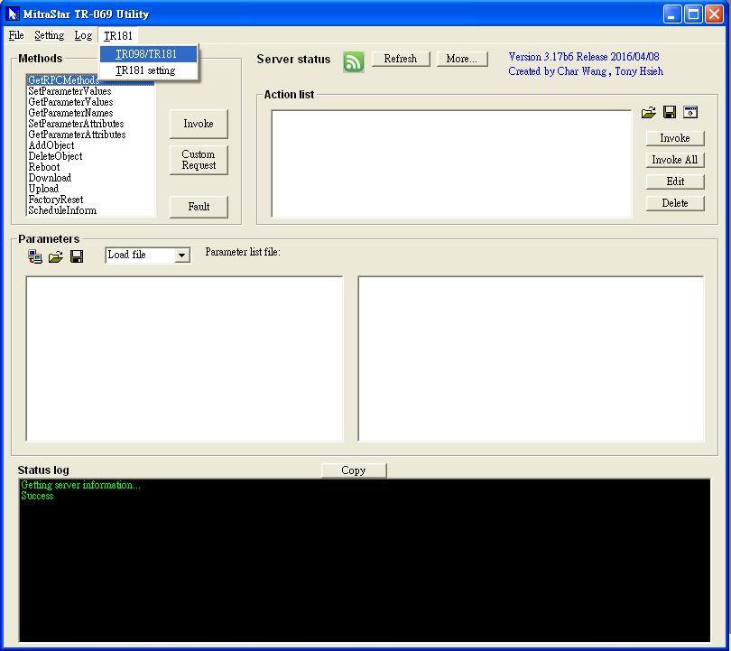
TR181

Slide 4
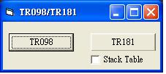
TR181
Button:
TR098
(Root: InternetGatewayDevice.)
2. TR181
(Root: Device.)
CheckBox:
Stack Table=Off, do nothing.
Stack Table=On, then click TR181.
GetParameterNames(NextLevel) Device.InterfaceStack.
Count Stack Interfaces Number and generate batch file.
Execute batch file.
Compute Stack Table and generate 181.html

Slide 5
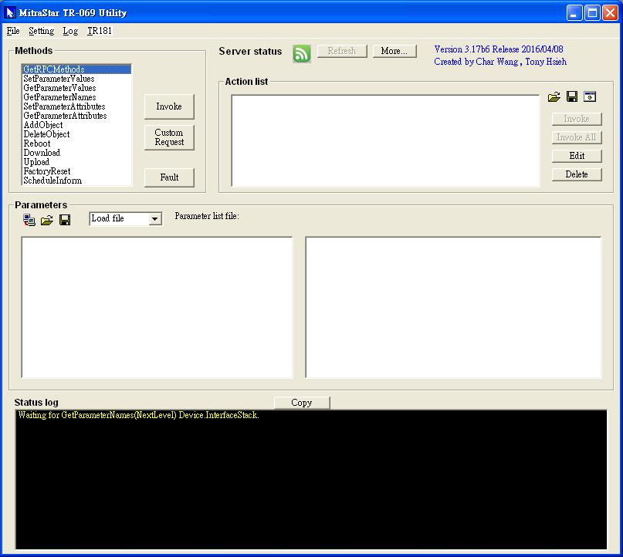
TR181-Waiting

Slide 6
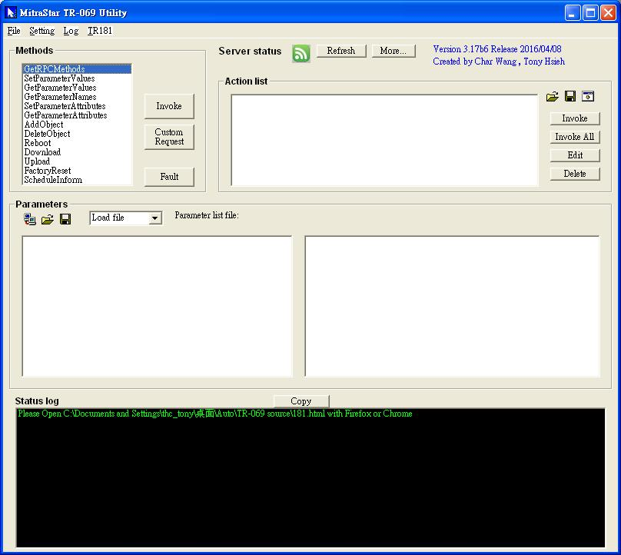
TR181-Finish

Slide 7
TR181
Keyboard “CTRL+F” can explore TR069 Utility directory folder

Slide 8
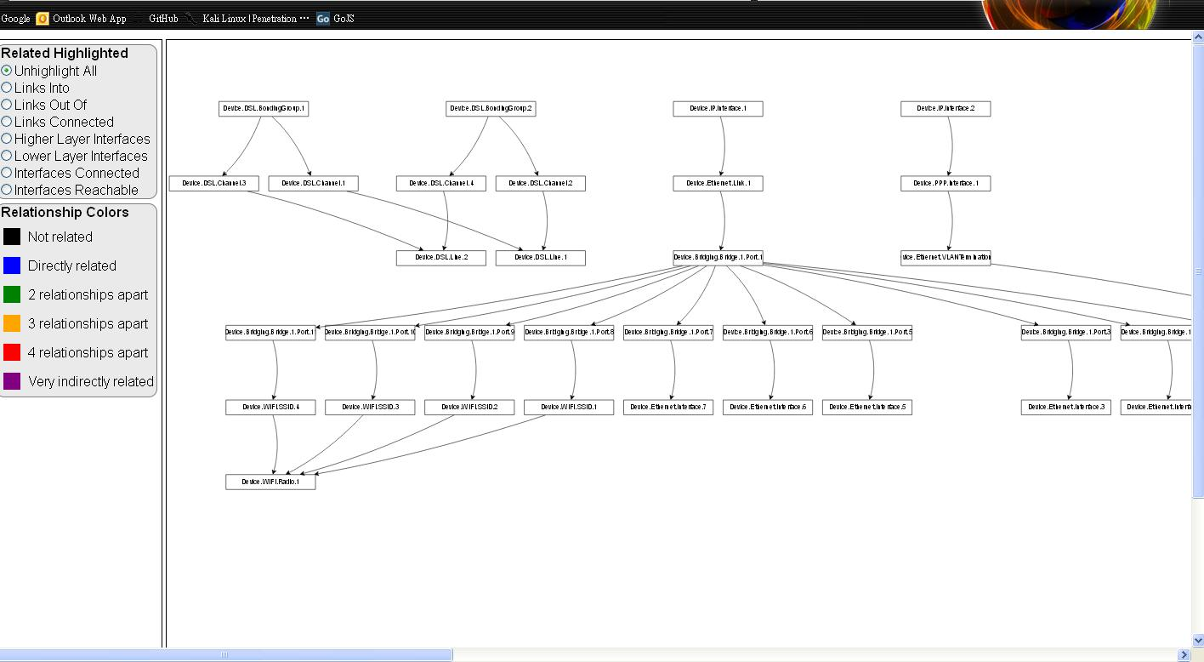
TR181-HTML
HighLight 選單
Visual Interfaces

Slide 9
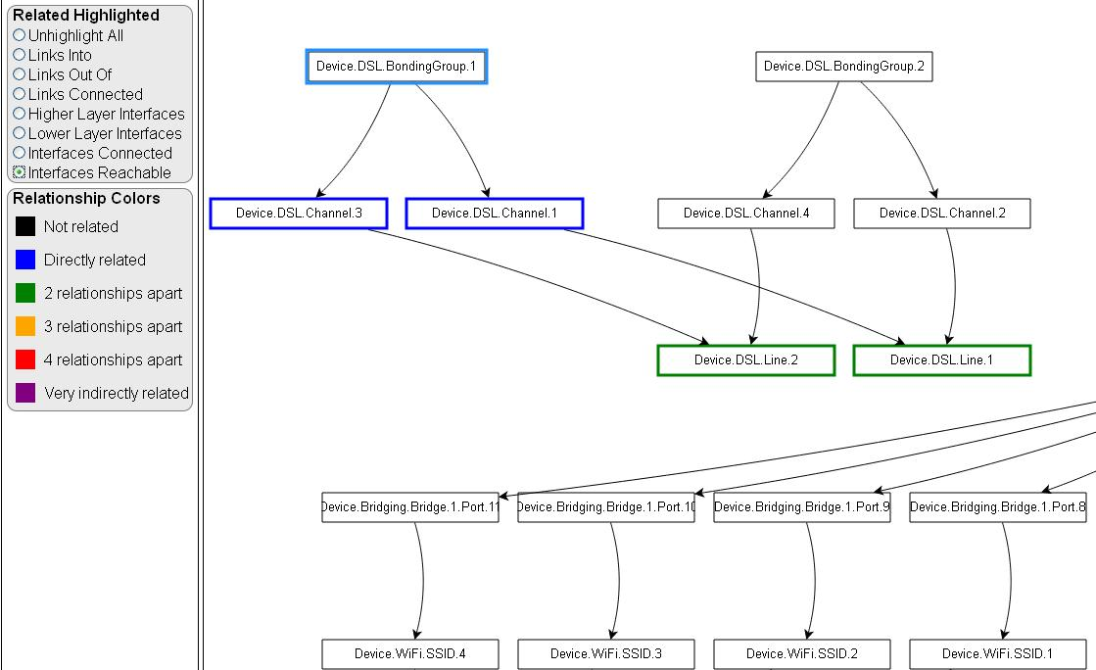
TR181-HTML

Slide 10
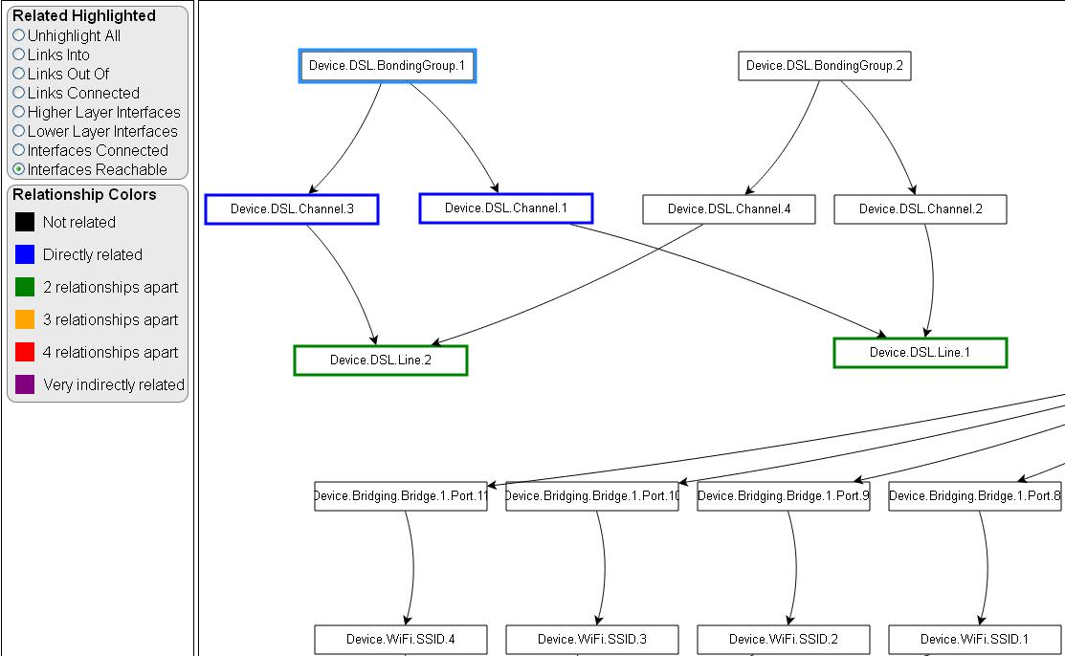
TR181-HTML

Slide 11
TR181-HTML
Visual Interfaces Node Action
Click → HighLight this node
DoubleClick → GetParameterNames(NextLevel) this node and synch up with TR069 Utility.

Slide 12
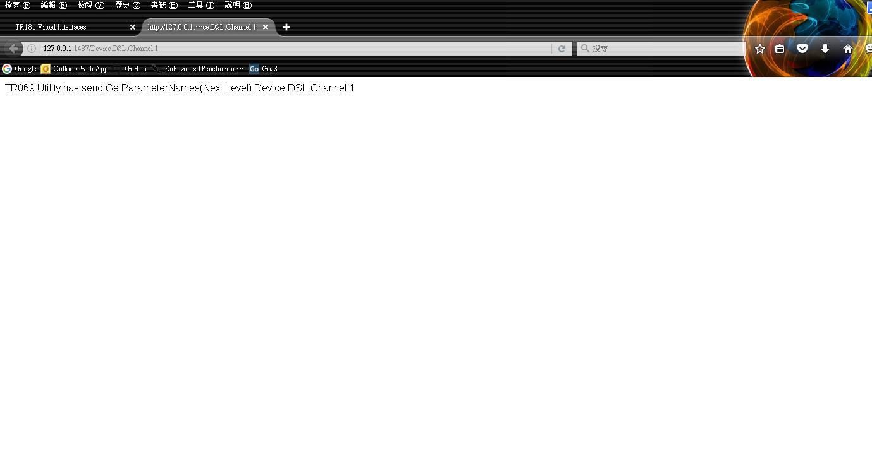
TR181-HTML

Slide 13
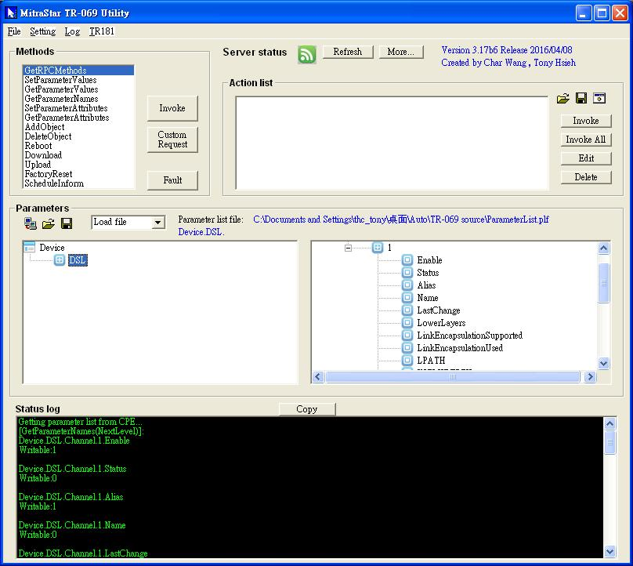
TR181-HTML

Slide 14
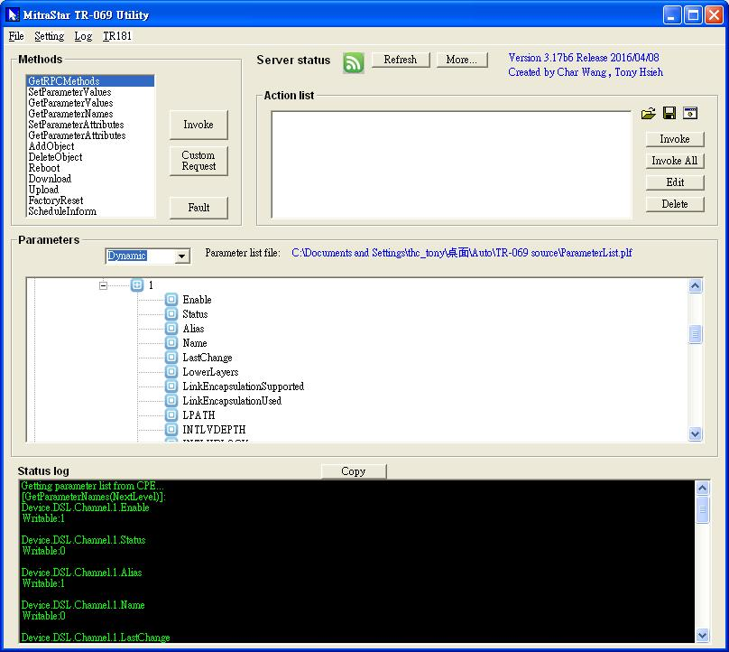
TR181-HTML

Slide 15
TR181
GPV Device.InterfaceStack. i.HigherLayer;Device.InterfaceStack.i.LowerLayer
Response at TR069Reult.txt
GetParameterNames Device.Stack.
Response at TR069Reult.txt
TR069 Utility
Server069
181.Html
Generate 181.html
Double Click node
GetParameterNames node.data

Slide 16
The End
Thanks for Listening

