Slide 1

Python
Lecture 1. Python basic concepts

Slide 2

OVERVIEW
What is Python?
Syntax
Types
Operators
Strings
Regular Expressions

Slide 3
What is python?
Multi-purpose (Web, Scripting, GUI, etc. )
Object oriented
Interpreted
Strongly typed and Dynamically typed
Focus on readability and productivity

Slide 4
Why python?
Designed to be easy to learn and master
Clean, clear syntax
Very few keywords
Highly portable
Run almost anywhere - high-end servers and workstations down to windows CE
Uses machine independent byte-codes
Extensible
Designed to be extensible using C/C++, allowing access to many external libraries

Slide 5
Python programs
Python programs and modules are written as text files with traditionally a “*.py” extension.
Each Python module has its own discrete namespace
Namespace within a Python module is a global one
Python programs and modules differentiated only by the way they are called
“*.py” files executed directly are the programs (often referred to as script)
“*.py” files referenced via the “import” statement are modules

Slide 6

Hello world
hello_world.py

Slide 7
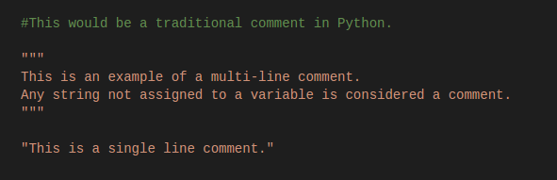
Comments

Slide 8
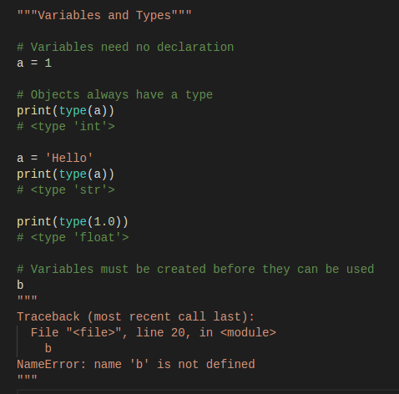
Variables and Types

Slide 9
Is Python strongly typed?
Python is strongly, dynamically typed.
Strong typing means that the type of a value doesn't suddenly change. A string containing only digits doesn't magically become a number, as may happen in Perl. Every change of type requires an explicit conversion.
Dynamic typing means that runtime objects (values) have a type, as opposed to static typing where variables have a type.

Slide 10
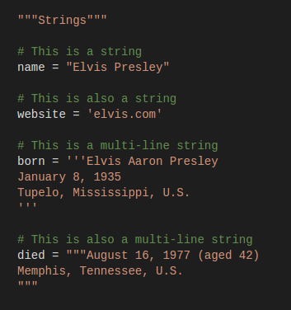
Types. Strings

Slide 11
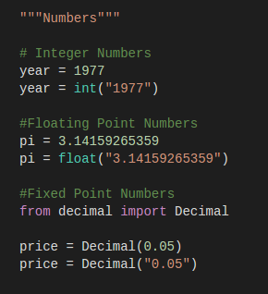
Types. Numbers

Slide 12
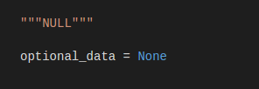
Types. NULL

Slide 13
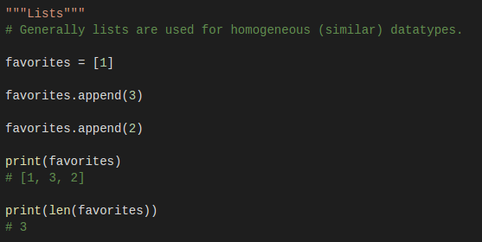
Types. Lists

Slide 14
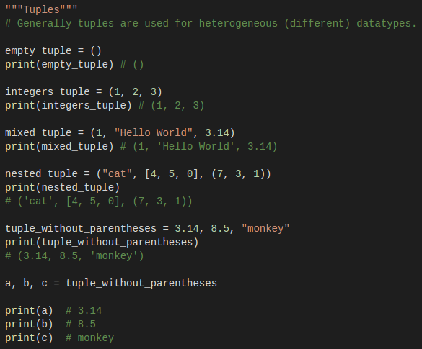
Types. Tuples

Slide 15
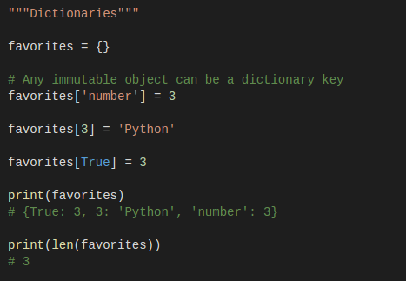
Types. Dictionaries

Slide 16
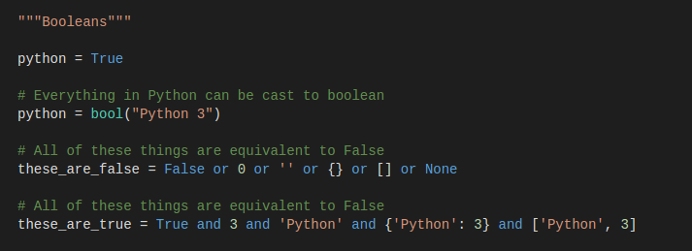
Types. Booleans

Slide 17
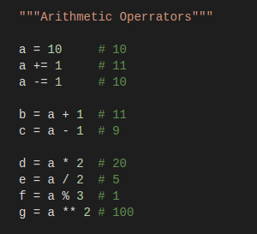
Arithmetic operators

Slide 18
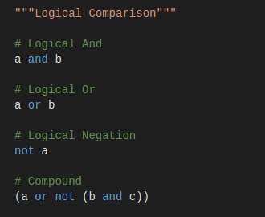
Logical Comparison

Slide 19
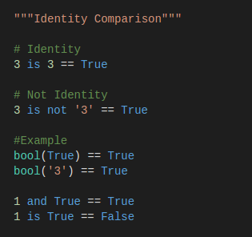
Identity Comparison

Slide 20
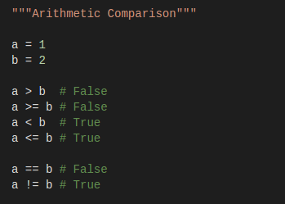
Arithmetic Comparison

Slide 21
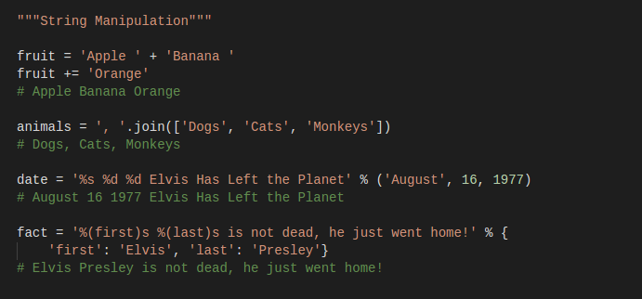
String Manipulation

Slide 22
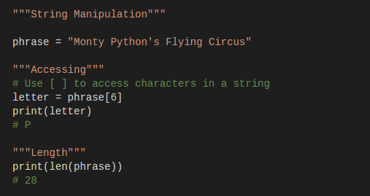
String Manipulation

Slide 23
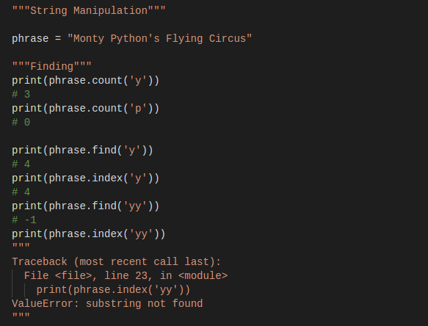
String Manipulation

Slide 24
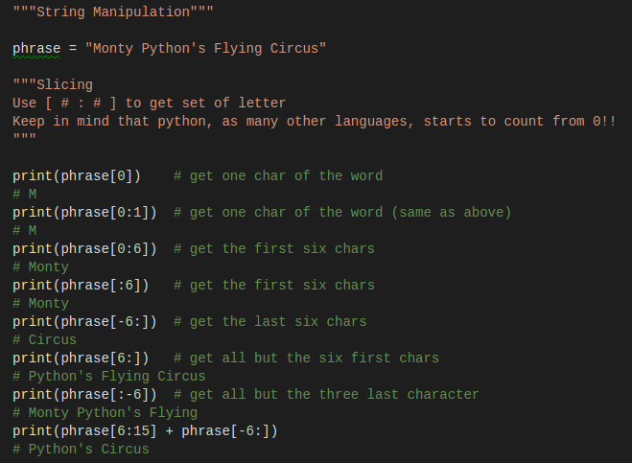
String Manipulation

Slide 25
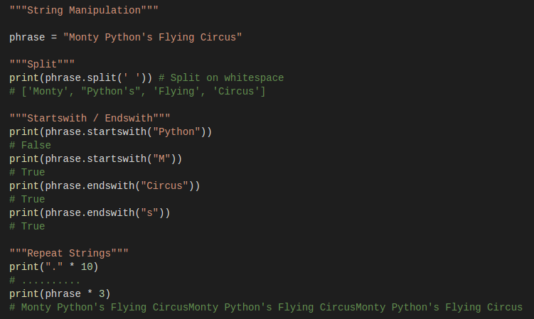
String Manipulation

Slide 26
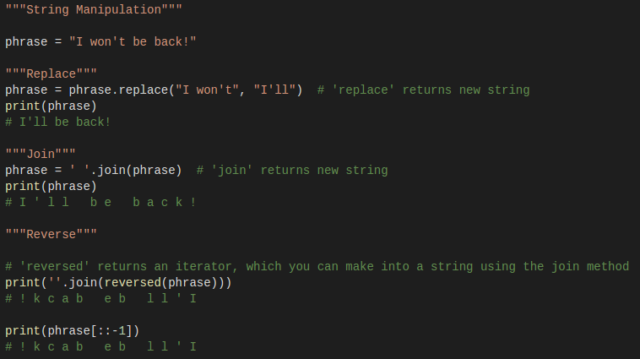
String Manipulation

Slide 27
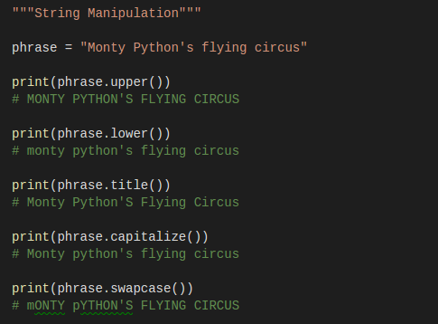
String Manipulation

Slide 28
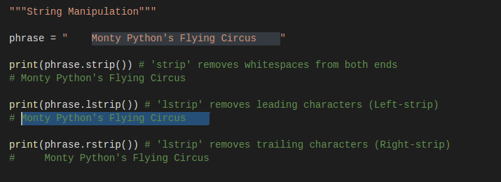
String Manipulation

Slide 29
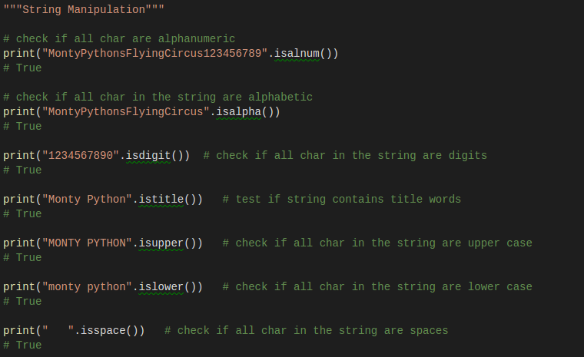
String Manipulation

Slide 30

Regular Expressions

Slide 31
Importance of Regular Expressions
In last few years, there has been a dramatic shift in usage of general purpose programming languages for data science and machine learning. This was not always the case – a decade back this thought would have met a lot of skeptic eyes!
This means that more people / organizations are using tools like Python for solving their data needs. This is where Regular Expressions become super useful. Regular expressions are normally the default way of data cleaning and wrangling in most of these tools. Be it extraction of specific parts of text from web pages, making sense of twitter data or preparing your data for text mining – Regular expressions are your best bet for all these tasks.

Slide 32
What is Regular Expressions?
Regular expression is a sequence of character(s) mainly used to find and replace patterns in a string or file.
Regular expressions use two types of characters:
Meta characters: As the name suggests, these characters have a special meaning, similar to * in wild card.
Literals (like a,b,1,2…)

Slide 33
Regular Expressions
The most common uses of regular expressions are:
Search a string (search and match)
Finding a string (findall)
Break string into a sub strings (split)
Replace part of a string (sub)

Slide 34
Regular Expressions
In Python, we have module “re” that helps with regular expressions. So you need to import library re before you can use regular expressions in Python.
The ‘re’ package provides multiple methods to perform queries on an input string. Here are the most commonly used methods, I will discuss:
re.match()
re.search()
re.findall()
re.split()
re.sub()
re.compile()

Slide 35
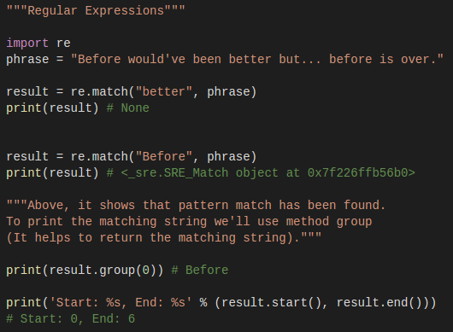
Regular Expressions. Match
re.match(pattern, str). This method finds match if it occurs at start of the string.

Slide 36
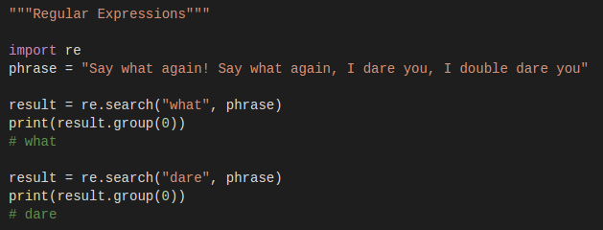
Regular Expressions. Search
re.search(pattern, string). It is similar to match() but it doesn’t restrict us to find matches at the beginning of the string only.

Slide 37
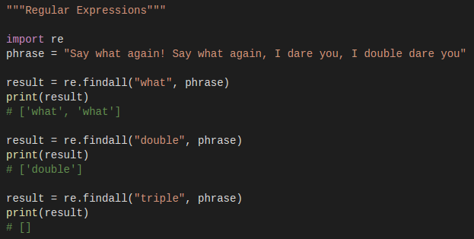
Regular Expressions. Findall
re.findall (pattern, string). It helps to get a list of all matching patterns. It has no constraints of searching from start or end.

Slide 38
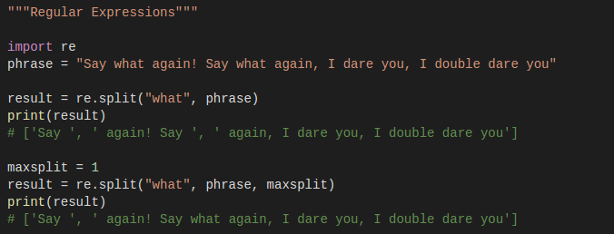
Regular Expressions. Split
re.split(pattern, string, [maxsplit=0]). This methods helps to split string by the occurrences of given pattern.

Slide 39
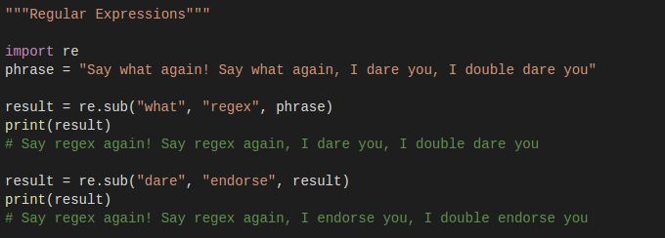
Regular Expressions. Sub
re.sub(pattern, repl, string). It helps to search a pattern and replace with a new sub string. If the pattern is not found, string is returned unchanged.

Slide 40
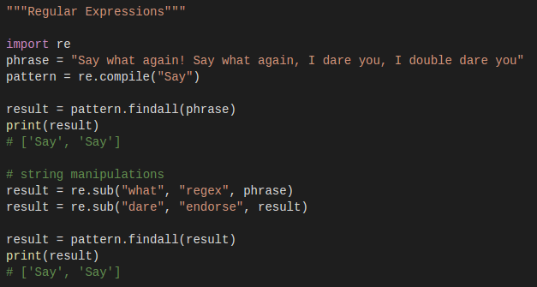
Regular Expressions. Compile
re.compile(pattern, repl, string). We can combine a regular expression pattern into pattern objects, which can be used for pattern matching. It also helps to search a pattern again without rewriting it

Slide 41
Regular Expressions
Till now, we looked at various methods of regular expression using a constant pattern (fixed characters). But, what if we do not have a constant search pattern and we want to return specific set of characters (defined by a rule) from a string?
This can easily be solved by defining an expression with the help of pattern operators (meta and literal characters). Let’s take a look at the most common pattern operators.

Slide 42
Commonly used operators
Regular expressions can specify patterns, not just fixed characters. Here are the most commonly used operators that helps to generate an expression to represent required characters in a string or file. It is commonly used in web scrapping and text mining to extract required information.
. | Matches with any single character except newline ‘\n’.
? | Match 0 or 1 occurrence of the pattern to its left
+ | 1 or more occurrences of the pattern to its left
* | 0 or more occurrences of the pattern to its left
\w | Matches with an alphanumeric character whereas \W (upper case W) matches non alphanumeric character.
\d | Matches with digits [0-9] and /D (upper case D) matches with non-digits.
\s | Matches with a single whitespace character (space, newline, return, tab, form) and \S (upper case S) matches any non-whitespace character.

Slide 43
Commonly used operators
[..] | Matches any single character in a square bracket and [^..] matches any single character not in square bracket
\ | It is used for special meaning characters like \. to match a period or \+ for plus sign.
^ and $ | ^ and $ match the start or end of the string respectively
{n,m} | Matches at least n and at most m occurrences of preceding expression if we write it as {,m} then it will return at least any minimum occurrence to max m preceding expression.
a | b | Matches either a or b
( ) | Groups regular expressions and returns matched text
\t, \n, \r | Matches tab, newline, return
\b | boundary between word and non-word and /B is opposite of /b

Slide 44
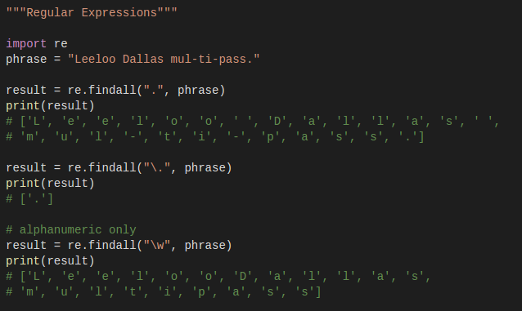
Regular Expressions
Find chars

Slide 45
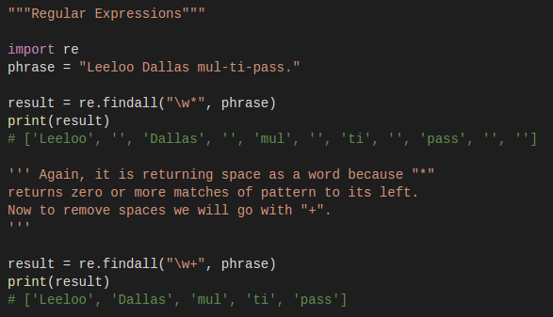
Regular Expressions
Find words

Slide 46
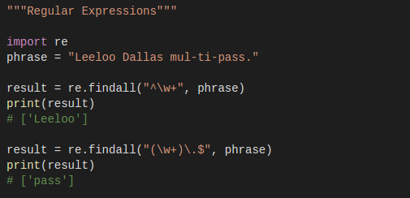
Regular Expressions
Find first/last word

Slide 47
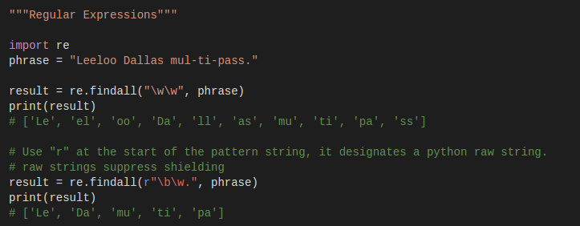
Regular Expressions
Find first two character of each word

Slide 48
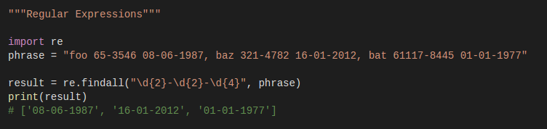
Regular Expressions
Find dates from the given string

Slide 49
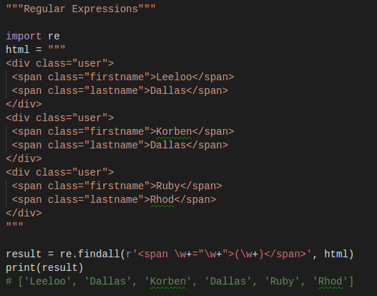
Regular Expressions
HTML

Slide 50
Thanks for watching

