Slide 1

Python
Lecture 2. Python Data structures.

Slide 2

OVERVIEW
Object’s identity, type, value
Mutable and immutable objects
List
Tupple
Dictionary
Set

Slide 3
Object’s identity
Everything in Python is an object.
An object’s identity never changes once it has been created.
You may think of it as the object’s address in memory.
The ‘is’ operator compares the identity of two objects.
The id() function returns an integer representing its identity.
This is an integer which is guaranteed to be unique and constant for this object during its lifetime.
Two objects with non-overlapping lifetimes may have the same id() value.
For CPython, id(x) is the memory address where x is stored.

Slide 4
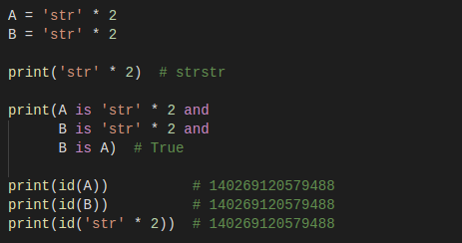
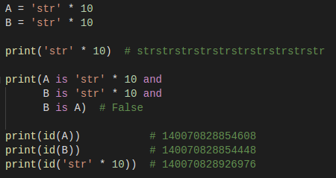
Object’s identity

Slide 5
Object’s identity
You may think that some objects have the same id. It’s wrong.
Objects don't have the same id, and as a matter of fact this is not true for any type of objects that you define separately.
Every time you define an object in Python, you'll create a new object with a new identity.
But there are some exceptions for small integers (between -5 and 256) and small strings (interned strings, with a special length (usually less than 20 character)) which are singletons and have same id (actually one object with multiple pointer)

Slide 6
Object’s type
An object’s type determines the operations that the object supports (e.g., “does it have a length?”) and also defines the possible values for objects of that type.
A = 10
print(A.bit_length()) # 4
A = "t"
print(A.capitalize()) # T
The type() function returns an object’s type
Like its identity, an object’s type is also unchangeable.

Slide 7
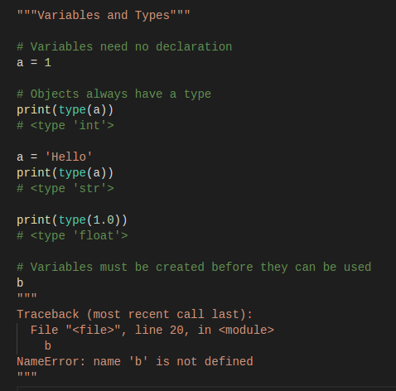
Object’s type

Slide 8
Object’s value
The value of some objects can change.
Objects whose value can change are said to be mutable.
Objects whose value is unchangeable once they are created are called immutable.
An object’s mutability is determined by its type.
The value of an immutable container object that contains a reference to a mutable object can change when the latter’s value is changed.
However the container is still considered immutable, because the collection of objects it contains cannot be changed
So, immutability is not strictly the same as having an unchangeable value

Slide 9
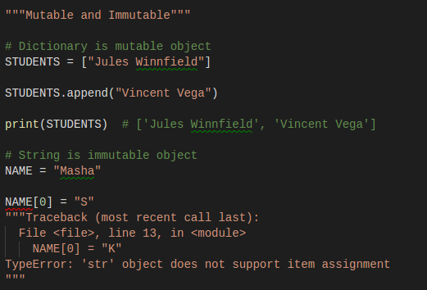
Mutable and immutable types?
All objects in Python can be either mutable or immutable.
A mutable object can be changed after it is created, and an immutable object can’t.

Slide 10
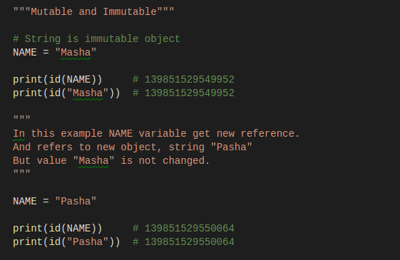
Mutable and immutable types?

Slide 11
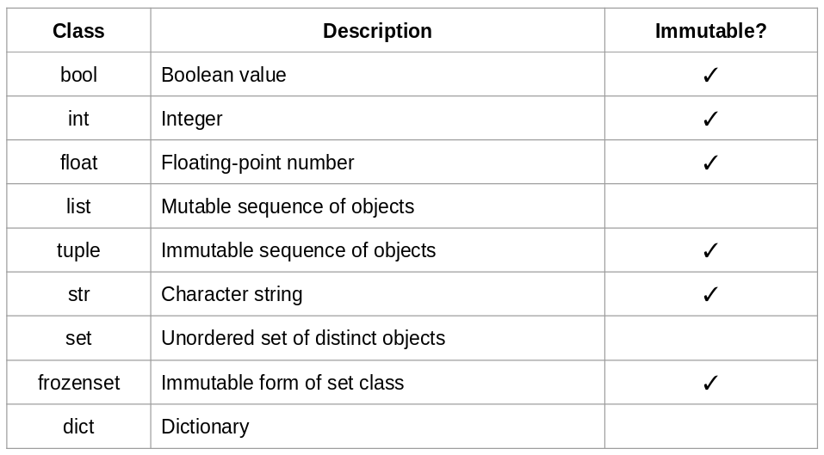
Mutable and immutable types?

Slide 12
List
A List is a data structure that holds an ordered collection of items i.e. you can store a sequence of items in a list.
The list of items should be enclosed in square brackets so that Python understands that you are specifying a list. Once you have created a list, you can add, remove or search for items in the list. Since we can add and remove items, we say that a list is a mutable data type i.e. this type can be altered.

Slide 13
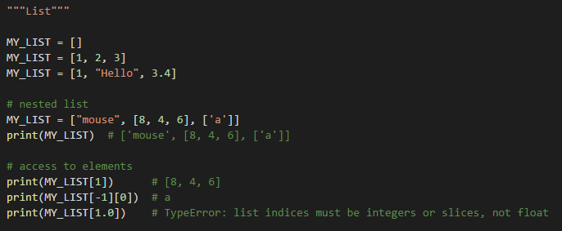
List

Slide 14
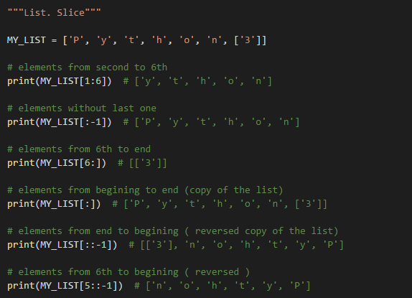
List. Slice

Slide 15
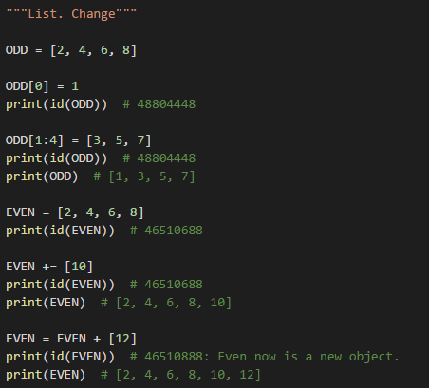
List. Change

Slide 16
List
Here are methods of list objects:
.append(x) - add an item to the end of the list.
.extend(L) - extend the list by appending all the items in the given list.
.insert(i, x) - insert an item at a given position. The first argument is the index of the element before which to insert.
.remove(x) - remove the first item from the list whose value is x.
.pop([i]) - remove the item at the given position in the list, and return it. If no index is specified,pop() removes and returns the last item in the list. (The square brackets around the i in the method signature denote that the parameter is optional)

Slide 17
List
Here are methods of list objects:
.index(x) - return the index in the list of the first item whose value is x. It is an error if there is no such item.
.count(x) - return the number of times x appears in the list.
.sort() - sort the items of the list, in place.
.reverse() - reverse the elements of the list, in place.

Slide 18
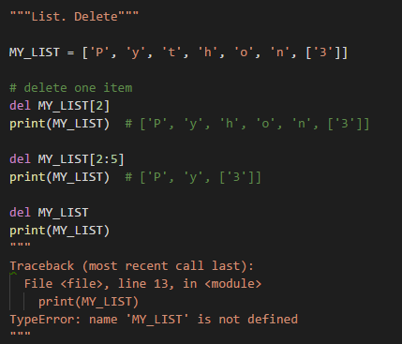
List. Delete
We can delete one or more items from a list using the keyword del. It can even delete the list entirely.

Slide 19
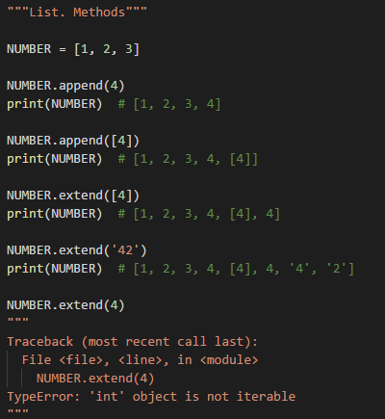
List. Methods

Slide 20
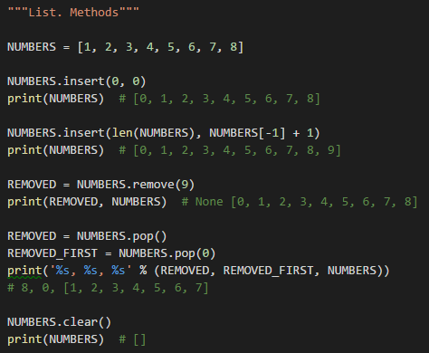
List. Methods

Slide 21
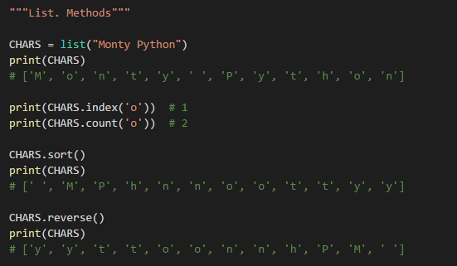
List. Methods

Slide 22
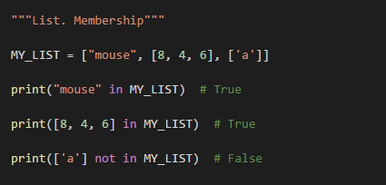
List Membership Test

Slide 23
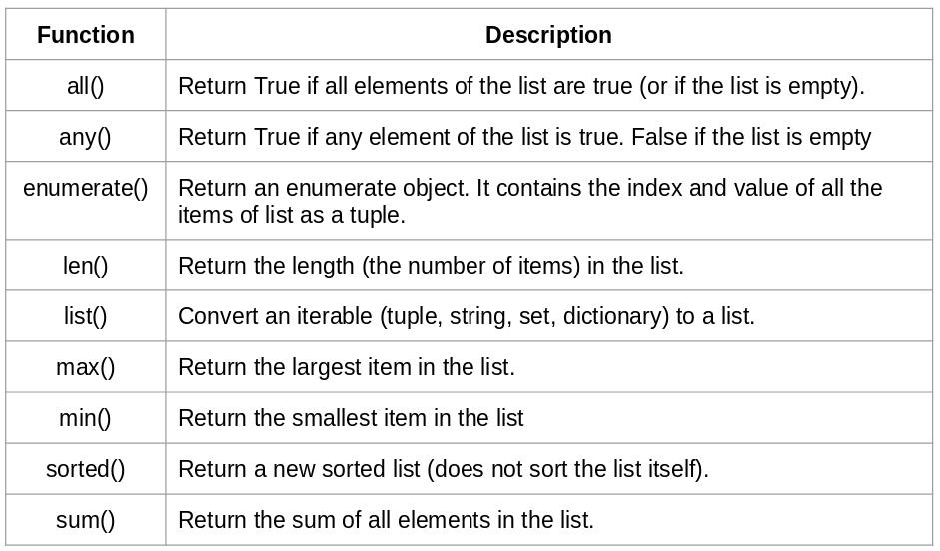
List. Built-in Functions

Slide 24
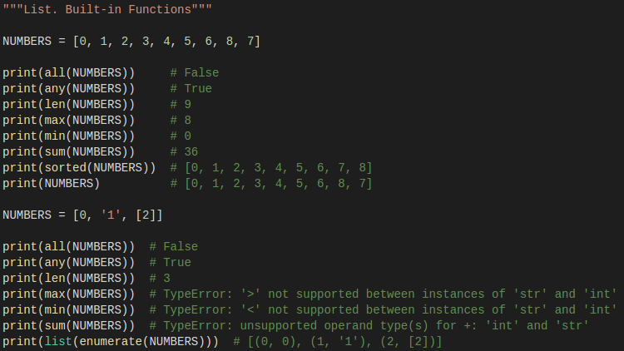
List. Built-in Functions

Slide 25
Tuples
In Python programming, a tuple is similar to a list. The difference between the two is that we cannot change the elements of a tuple once it is assigned whereas in a list, elements can be changed.
A tuple is created by placing all the items (elements) inside a parentheses (), separated by comma. The parentheses are optional but is a good practice to write it.
A tuple can have any number of items and they may be of different types (integer, float, list, string etc.).

Slide 26
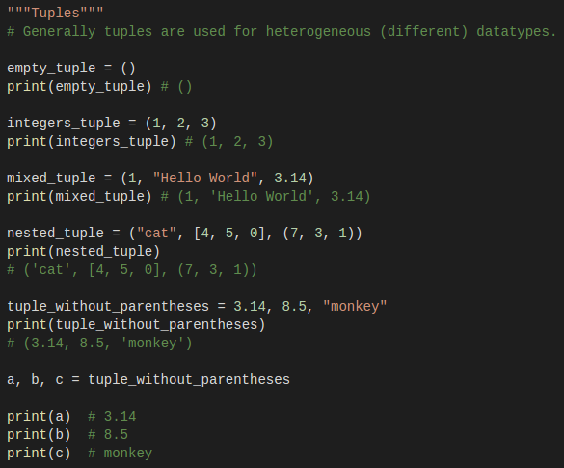
Tuples

Slide 27
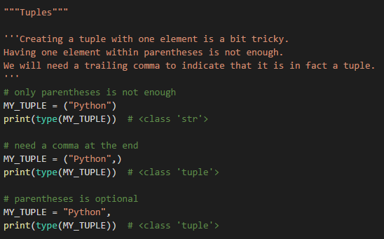
Tuples

Slide 28
Tuples
Advantages of implementing a tuple over a list.
Since tuple are immutable, iterating through tuple is faster than with list. So there is a slight performance boost.
Tuples that contain immutable elements can be used as key for a dictionary. With list, this is not possible.
If you have data that doesn't change, implementing it as tuple will guarantee that it remains write-protected.

Slide 29
Tuples
Access to elements is the same as access to list elements.
Built-in Functions with Tuple are the same as with List.
Tuple membership test is the same as list membership test.
Tuple slice operations are the same as list slice operations. As a result we have a new tuple.

Slide 30
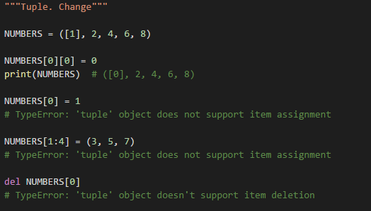
Tuples. Change

Slide 31
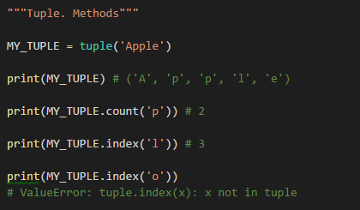
Tuples. Methods

Slide 32
Dictionary
Python dictionary is an unordered collection of items. While other compound data types have only value as an element, a dictionary has a key: value pair.
Dictionaries are optimized to retrieve values when the key is known.
Creating a dictionary is as simple as placing items inside curly braces {} separated by comma.
An item has a key and the corresponding value expressed as a pair, key: value.
While values can be of any data type and can repeat, keys must be of immutable type (string, number or tuple with immutable elements) and must be unique.

Slide 33
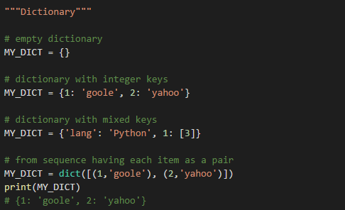
Dictionary

Slide 34
Dictionary
Here are methods of dictionary objects:
.clear() - remove all items from the dictionary.
.copy() - return a shallow copy of the dictionary.
.fromkeys(seq[, v]) - return a new dictionary with keys from seq and value equal to v (defaults to None).
.get(key[,d]) - return the value of key. If key doesnot exit, return d (defaults to None).
.items() - return a new view of the dictionary's items (key, value)
.keys() - return a new view of the dictionary's keys.

Slide 35
Dictionary
Here are methods of dictionary objects:
.pop(key[,d]) - remove the item with key and return its value or d if key is not found. If d is not provided and key is not found, raises KeyError.
.popitem() - remove and return an arbitrary item (key, value). Raises KeyError if the dictionary is empty.
.setdefault(key[,d]) - If key is in the dictionary, return its value. If not, insert key with a value of d and return d (defaults to None).
.update([other]) - update the dictionary with the key/value pairs from other, overwriting existing keys.
.values() - return a new view of the dictionary's values

Slide 36
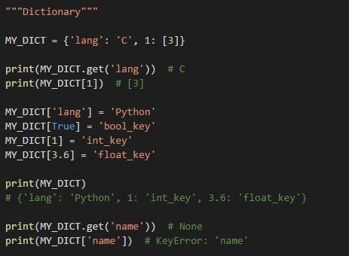
Dictionary. Access and change

Slide 37
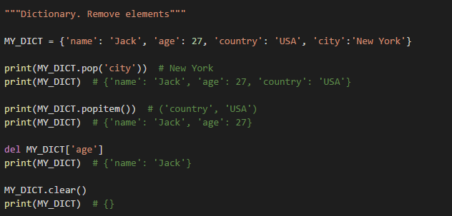
Dictionary. Remove elements

Slide 38
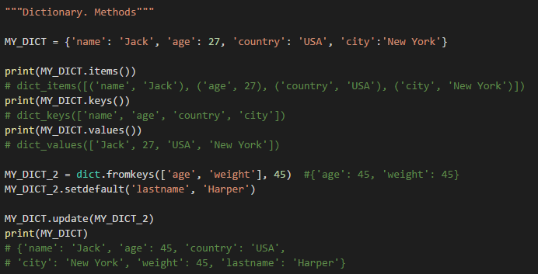
Dictionary. Methods

Slide 39
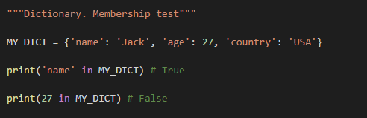
Dictionary. Membership
Membership tests for key only not value

Slide 40
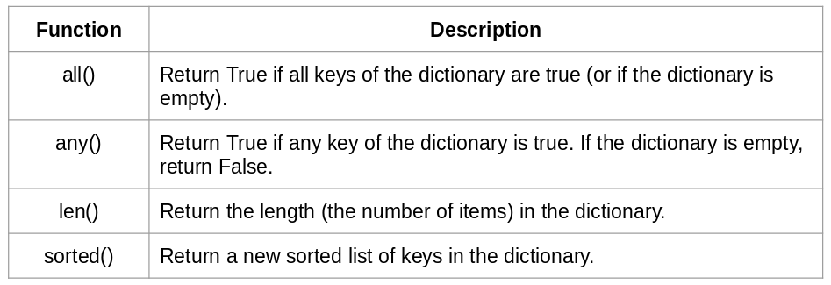
Dictionary. Built-in Functions

Slide 41
Set
A set is an unordered collection of items. Every element is unique (no duplicates) and must be immutable (which cannot be changed).
However, the set itself is mutable. We can add or remove items from it.
Sets are mutable. But since they are unordered, indexing have no meaning.
We cannot access or change an element of set using indexing or slicing. Set does not support it.
We can add single element using the add() method and multiple elements using the update() method. The update() method can take tuples, lists, strings or other sets as its argument. In all cases, duplicates are avoided.

Slide 42
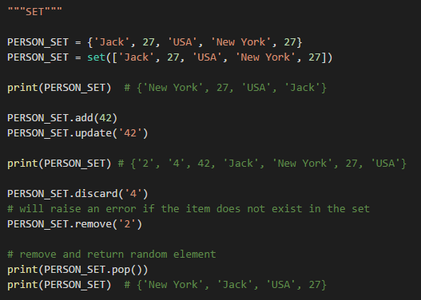
Set

Slide 43
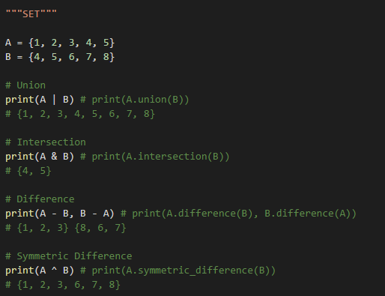
Set Operations

Slide 44
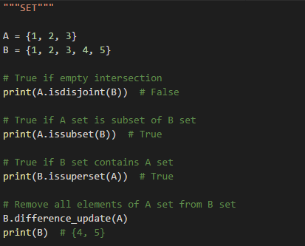
Set Operations

Slide 45
Frozenset
Frozenset is a new class that has the characteristics of a set, but its elements cannot be changed once assigned. While tuples are immutable lists, frozensets are immutable sets.
Sets can't be used as dictionary keys. On the other hand, frozensets can be used as keys to a dictionary.
Frozensets can be created using the function frozenset().
Being immutable it does not have method that add or remove elements.

Slide 46
Thanks for watching

