Slide 1

CUNY - Data 612 Final Project Movie Plot Recommender
Violeta Stoyanova
Peter Kowalchuk

Slide 2
Agenda
Recommender Objective
Databricks setup
Data
TF-IDF
pySPark dataframe
Model
Recommendation
Conclusions

Slide 3
Recommender Objective Provide movie recommendation based on plot supplied words
Recommender
Words
Type in desired movie plot (or one word)
Recommended movie with desired plot
TF-IDF
weights
Movies

Slide 4
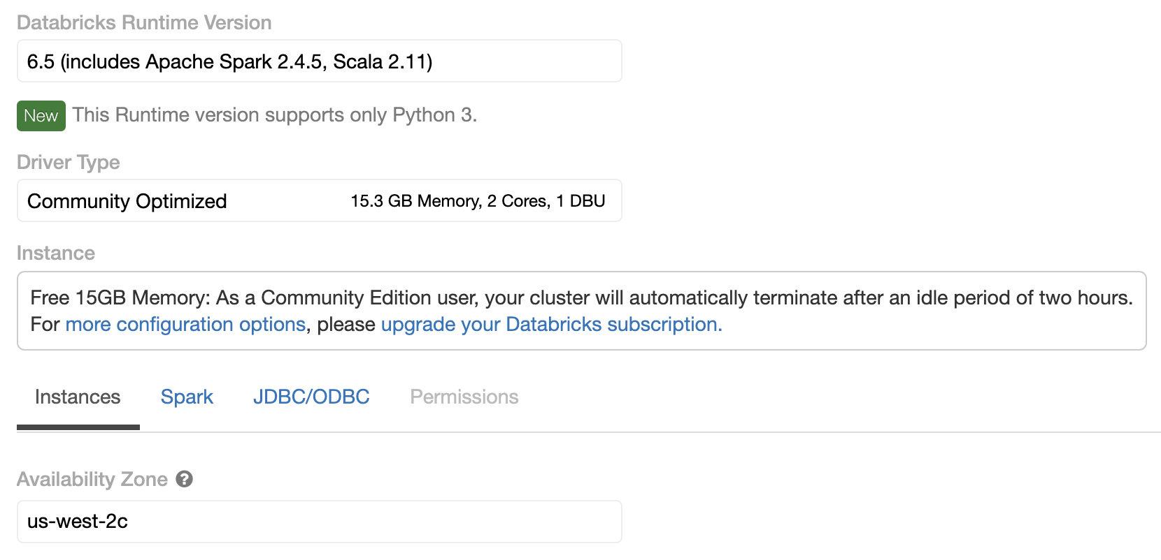
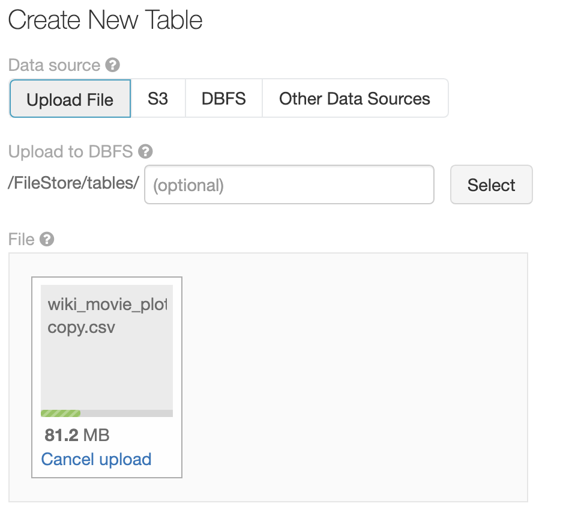
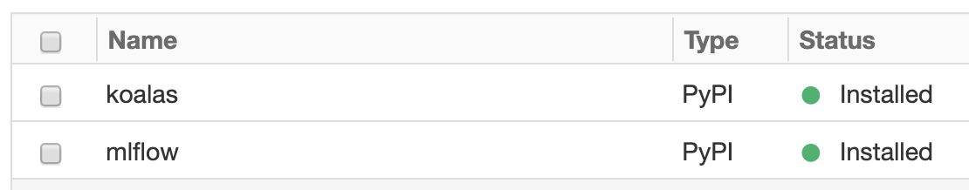
Databricks setup Data and cluster initialization
Data uploaded manually from
https://www.kaggle.com/jrobischon/wikipedia-movie-plots
Default Cluster + 2 libraries

Slide 5
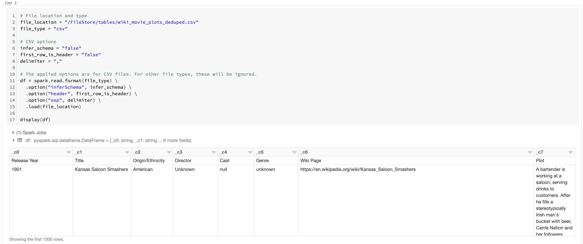
Data Only reviews with plot selected
Data available from DBFS – 134,113 movies available – 69,981 with plots

Slide 6
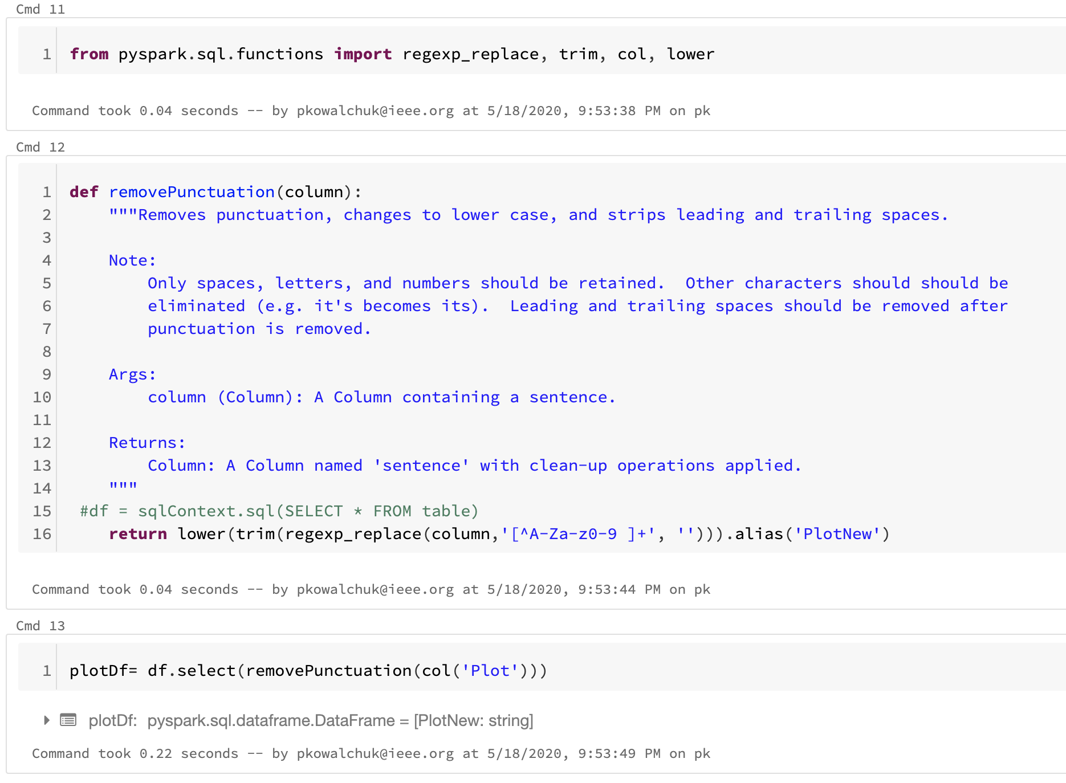
Data Punctuation is removed
REGEX function is used to remove punctuation

Slide 7
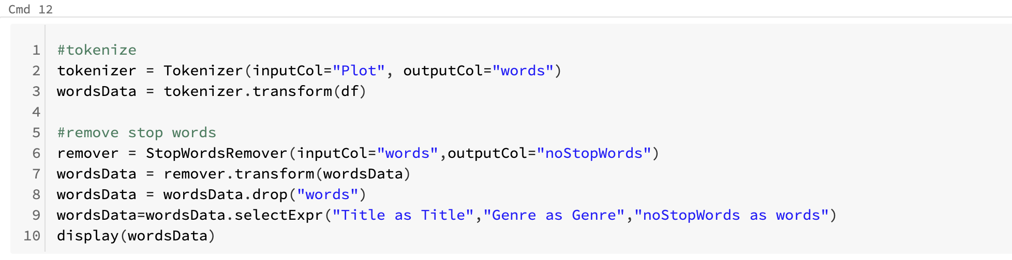

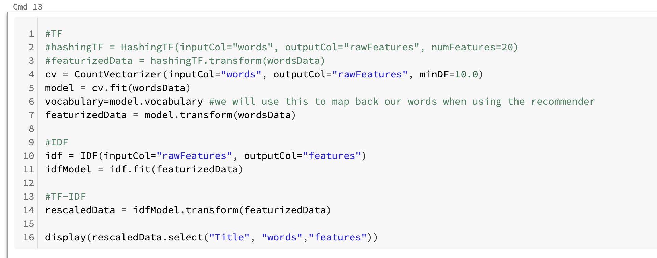

TF-IDF Sparse vectors generated with word weights
Words tokenized, cleaned and TF and IDF calculated to compute TF-IDF weights

Slide 8
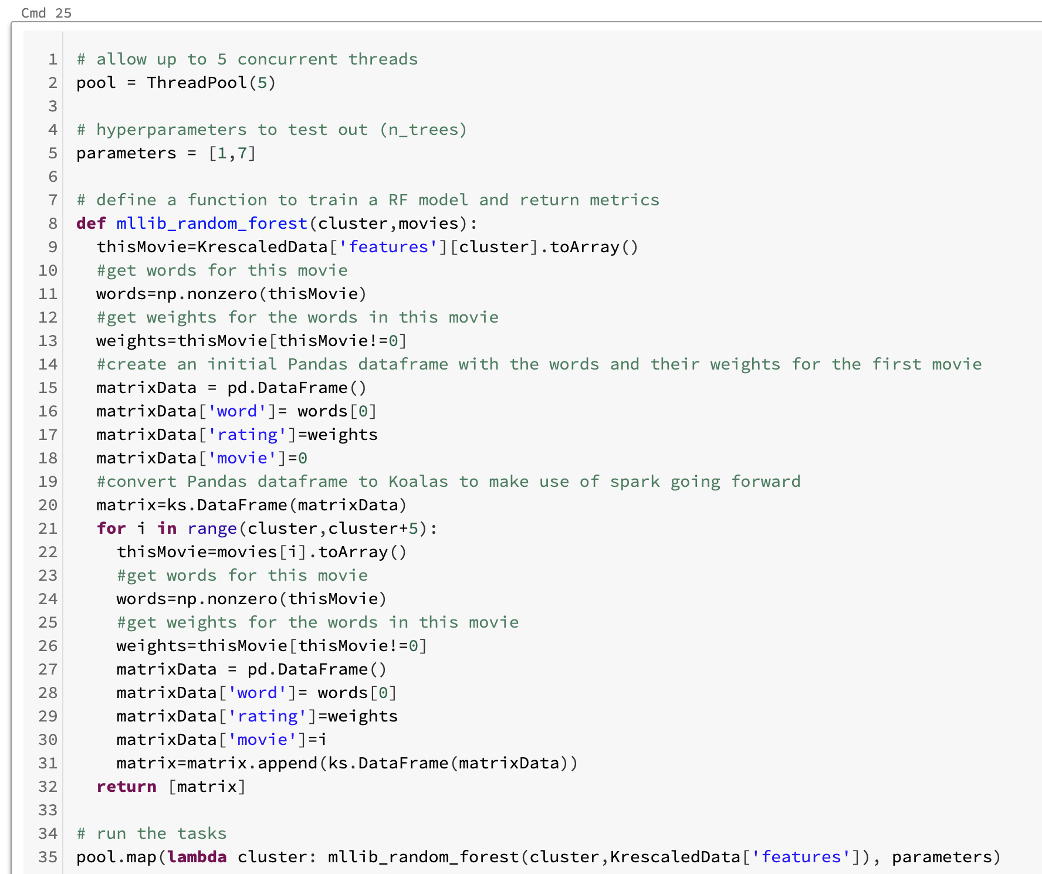
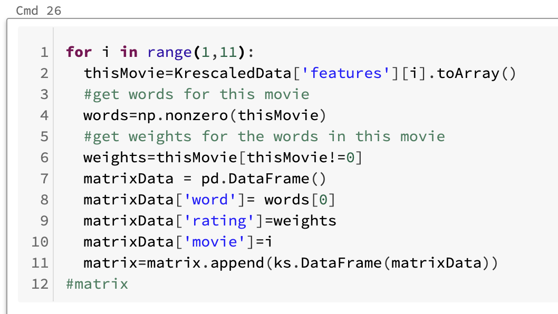


pySPark dataframe Sparse vectors added to a new dataframe
Slow process using Koalas spark dataframe
Parallelizing append loop did not speed up process

Slide 9
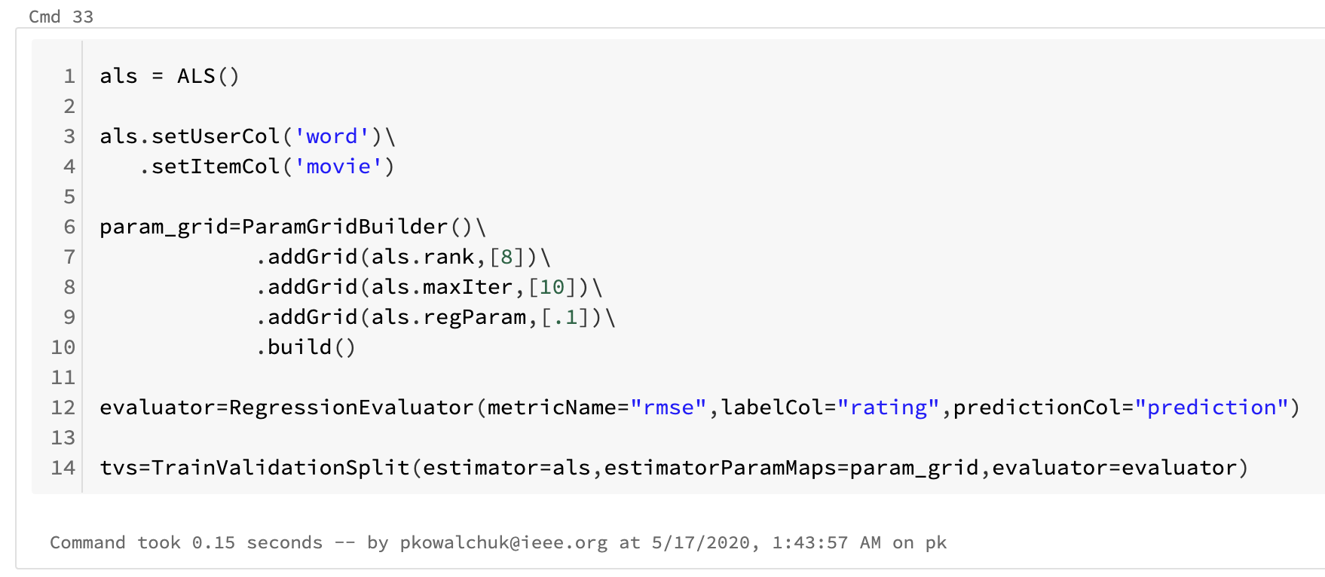
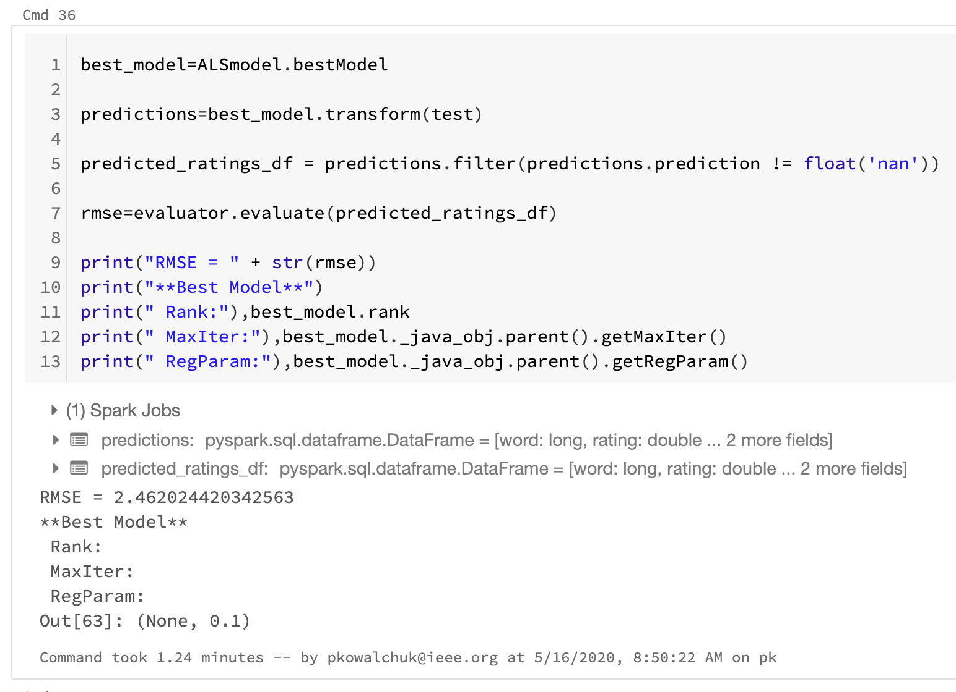
Model ALS model
pyspark.ml ALS model with k=8

Slide 10
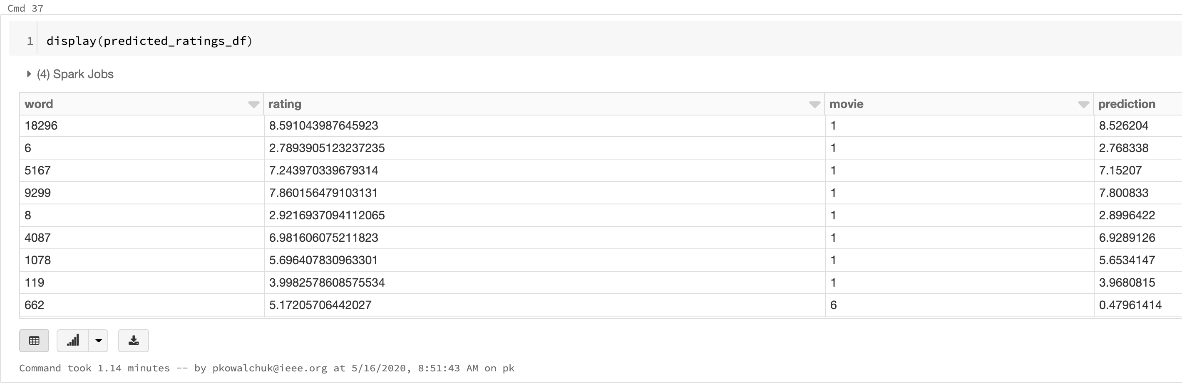
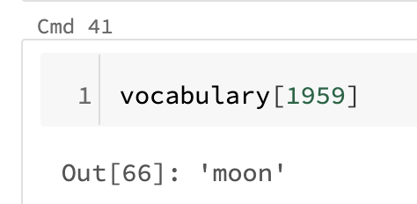
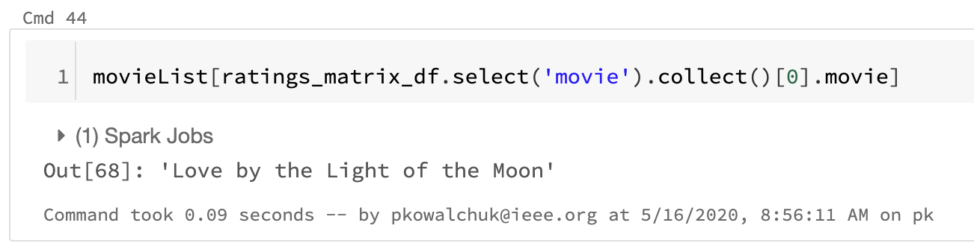
Recommendation Word prediction
Movie predicted ratings
Prediction based on given word

Slide 11
Conclusions Recommender is good base code for more elaborate systems
Good overall predicted ratings results
We proved that a recommendation can be made from a word based on movie plot
This code can be used as a building block for recommenders with multi word input
Koalas does not seem to perform efficiently even though it is a spark abstraction
Building the model input dataframe is a bottle neck in this code
Append for loop needs to be refactored

