Slide 1
Introduction to Drilling Data Analytics with Python
Peter Kowalchuk
Online Course. October 2024

Slide 2
Tuesday

Slide 3
Data Exploration, Event Detection and Basic Statistics
Making use of data
Data exploration
Classes, attributes, methods - object oriented programing
Event detection with Python
Intro to Statistics

Slide 4
Advanced Data Management
Matrices and Dataframes
Pandas
Loading data
Data files CSV, LAS y WITSML
Data fusion/concatenation
Data grouping

Slide 5
Recap
Development environments
Conda environments
IDE - Jupyter Notebooks
Python variables
Numeric - integer and float
String
Lists
Dictionaries
For Loop
If

Slide 6
Two more structures
If… else… elif
While loop

Slide 7
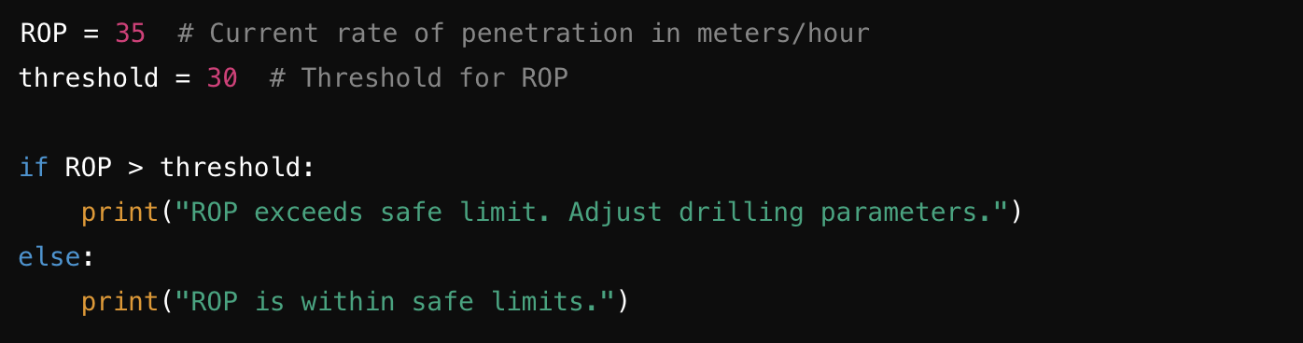
If statement
If… else…

Slide 8
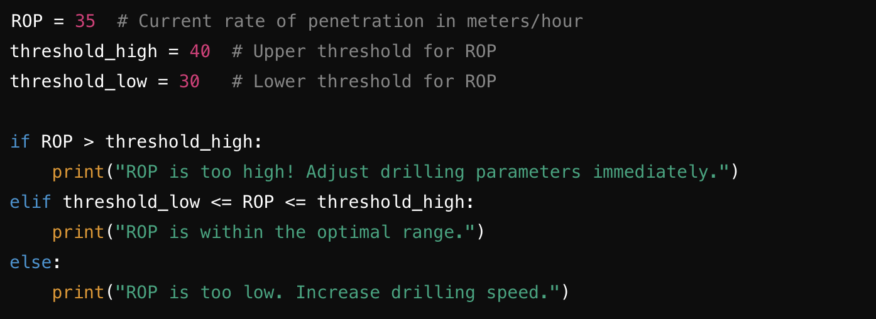
If statement
If… elif… else…

Slide 9
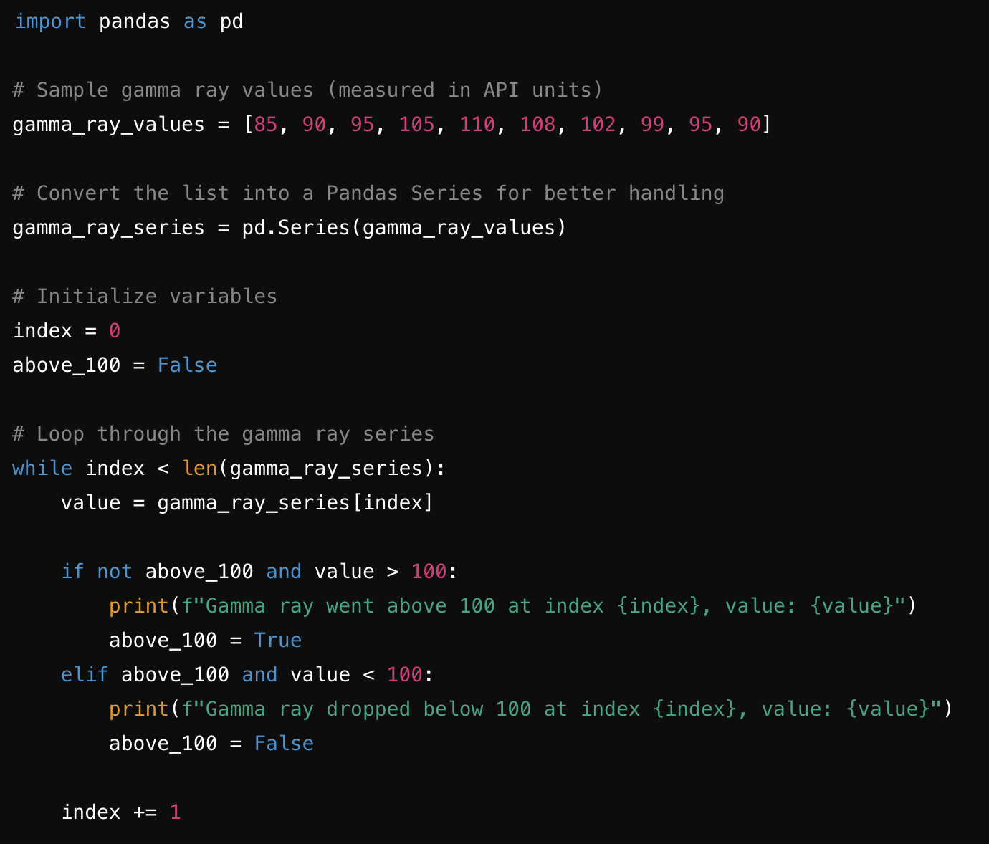
While loop

Slide 10
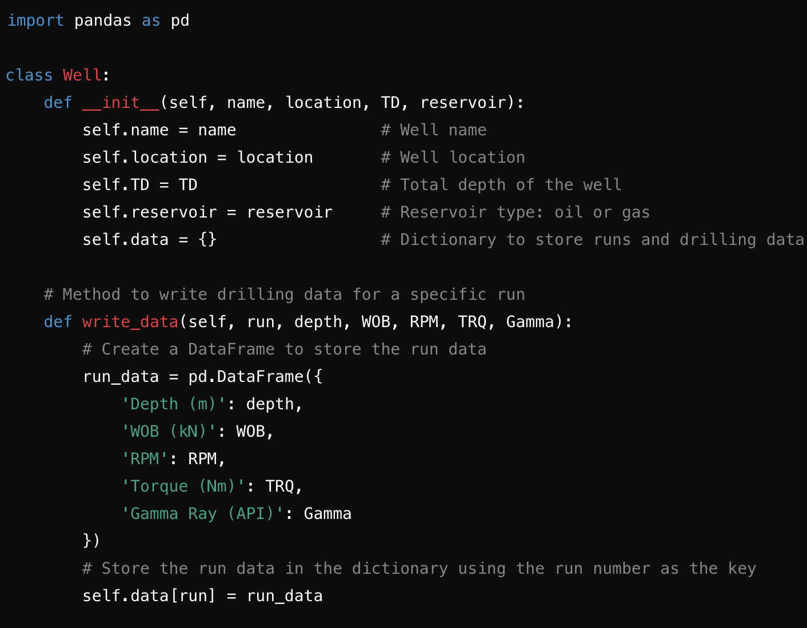
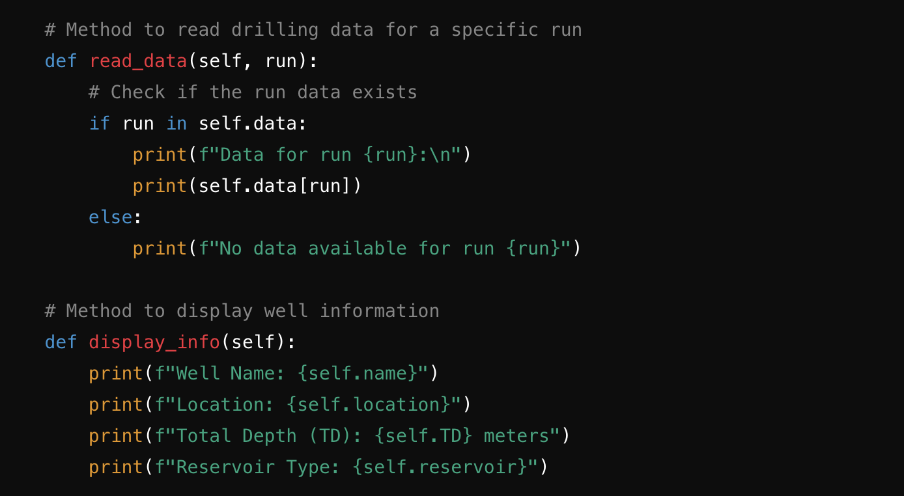
One more type
Classes in Python

Slide 11
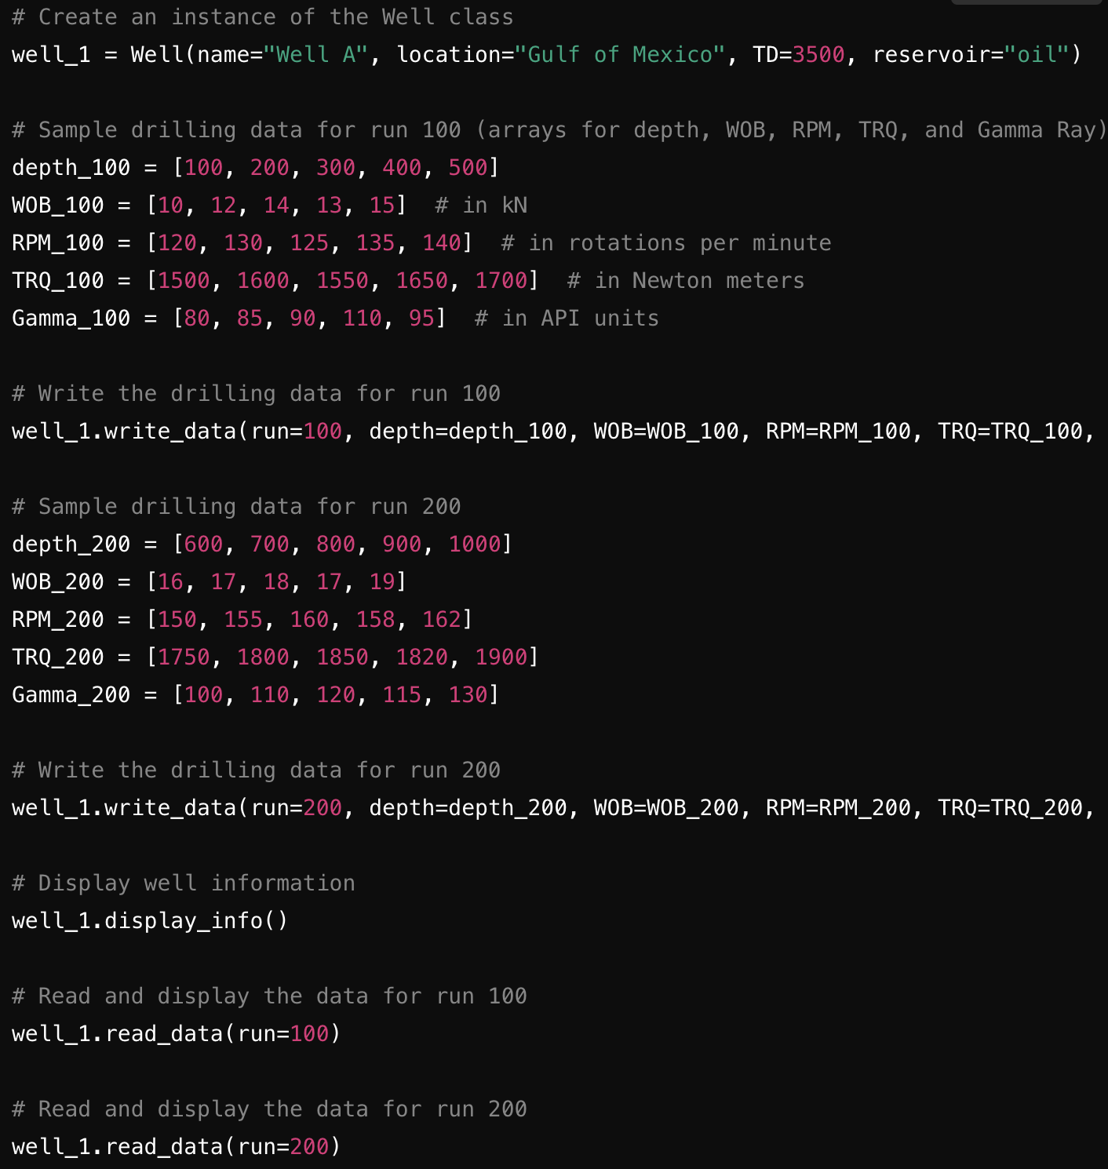

One more type
Classes in Python

Slide 12
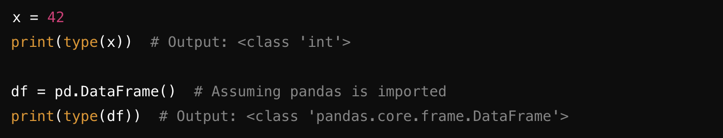
One more type
Classes in Python

Slide 13
Classes and Objects
Object Oriented Programing
What is a Class in Python?
Class: A blueprint or template for creating objects (instances). It defines the attributes (data) and methods (functions) that the objects will have.
Attributes: Variables that store information about the object (e.g., name, location, depth in a well).
Methods: Functions that define the behavior or actions of the object (e.g., calculating, updating, or retrieving data).

Slide 14
Classes and Objects
Object Oriented Programing
Important Characteristics:
Instantiation:
Creating an object from a class. Each object is an instance of the class.
Constructor (__init__ method):
A special method that initializes an object with attributes when it's created.
Encapsulation:
Bundling of data (attributes) and methods into a single entity (class), allowing for organized code and data protection.

Slide 15
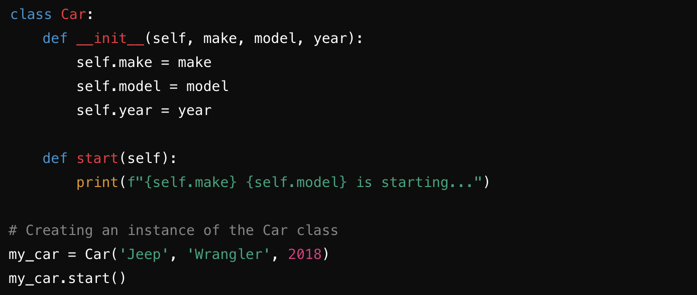
Classes and Objects
Object Oriented Programing

Slide 16
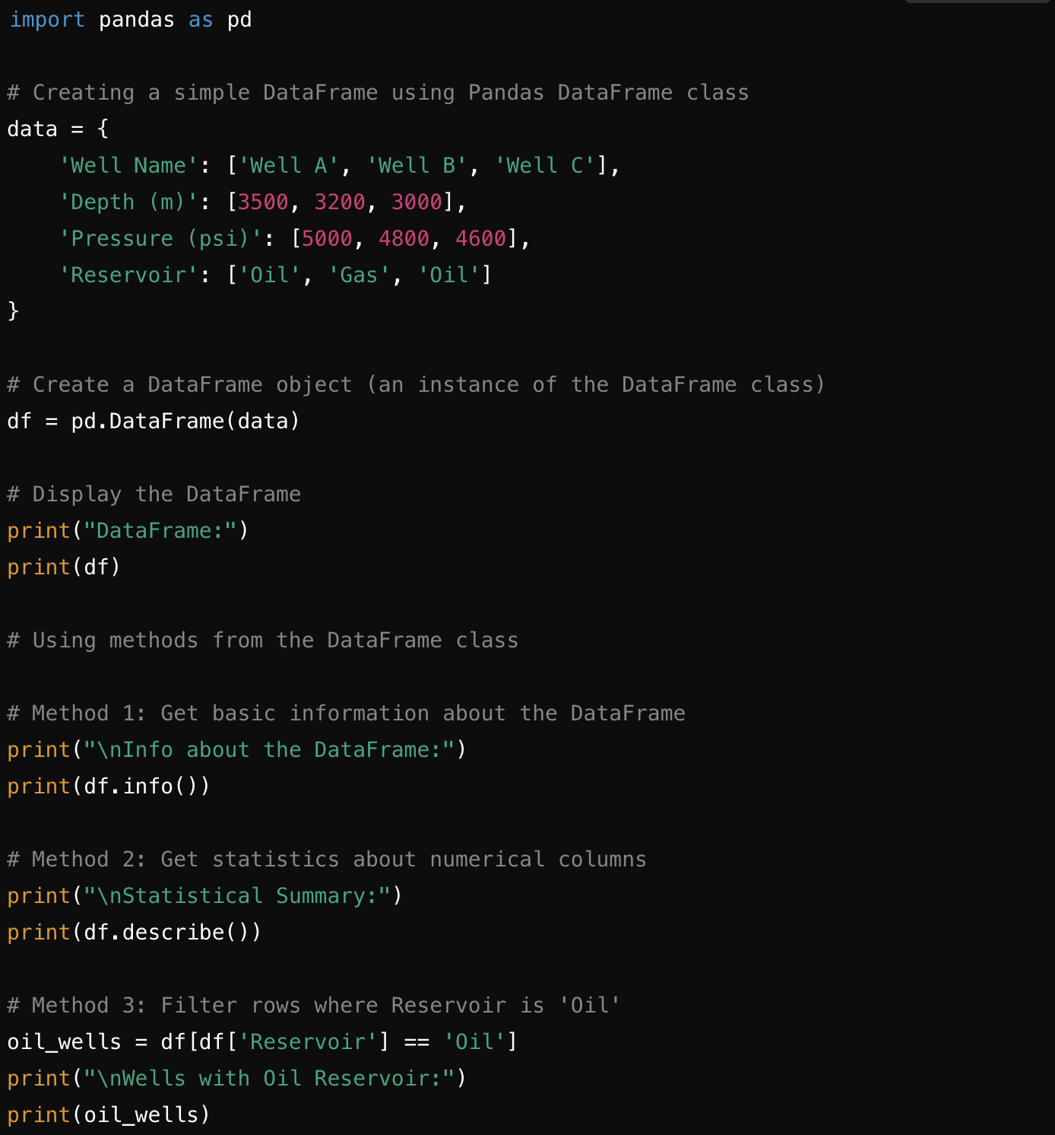
Classes and Objects
Pandas library

Slide 17
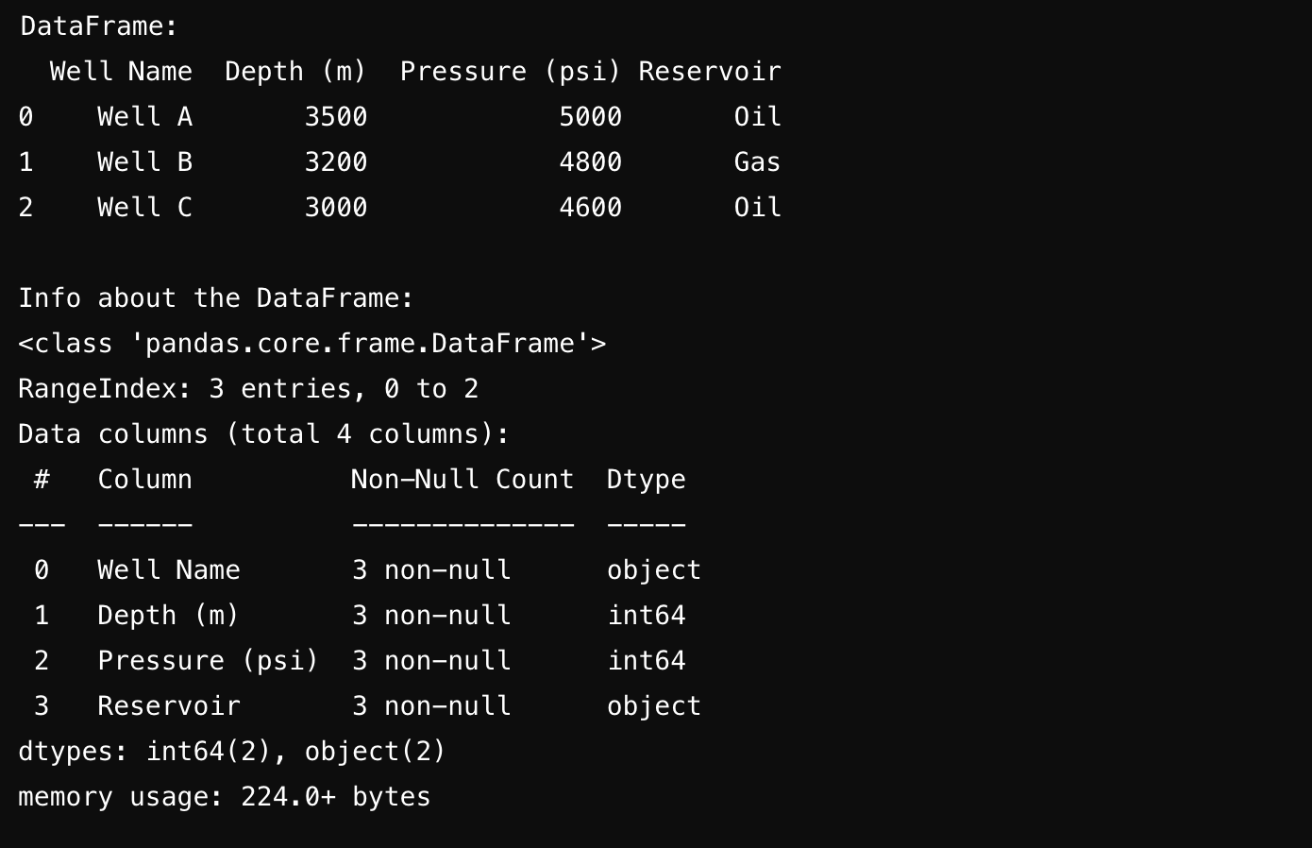
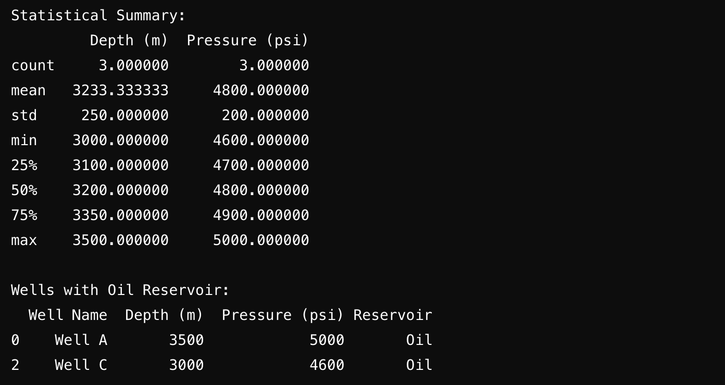
Classes and Objects
Pandas library

Slide 18
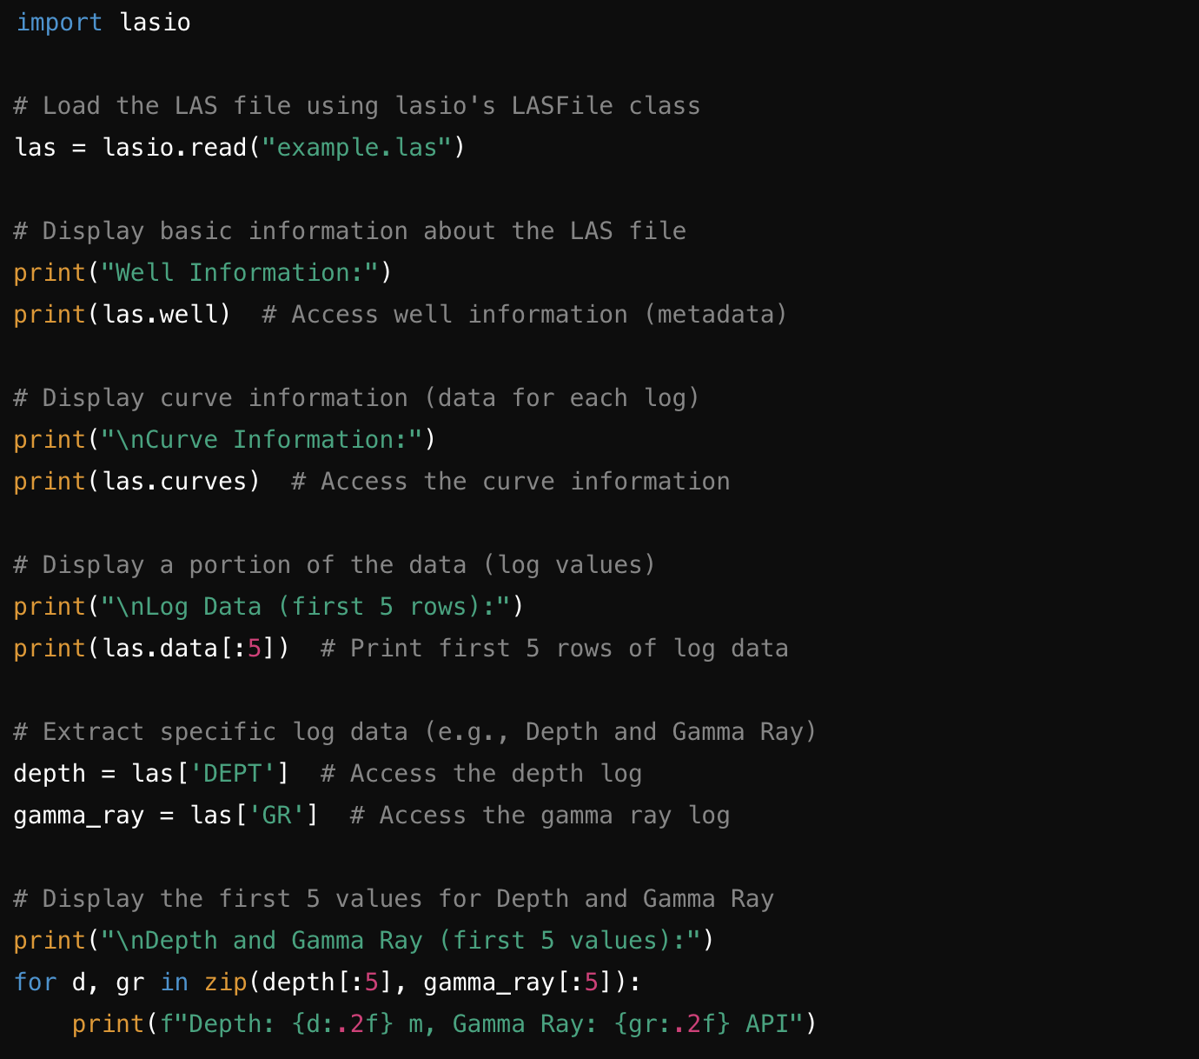
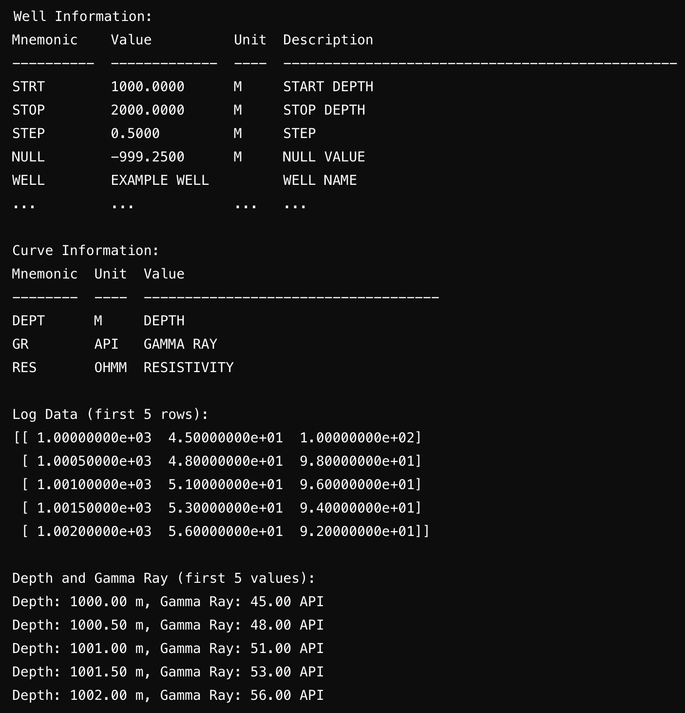
Classes and Objects
Lasio library

Slide 19
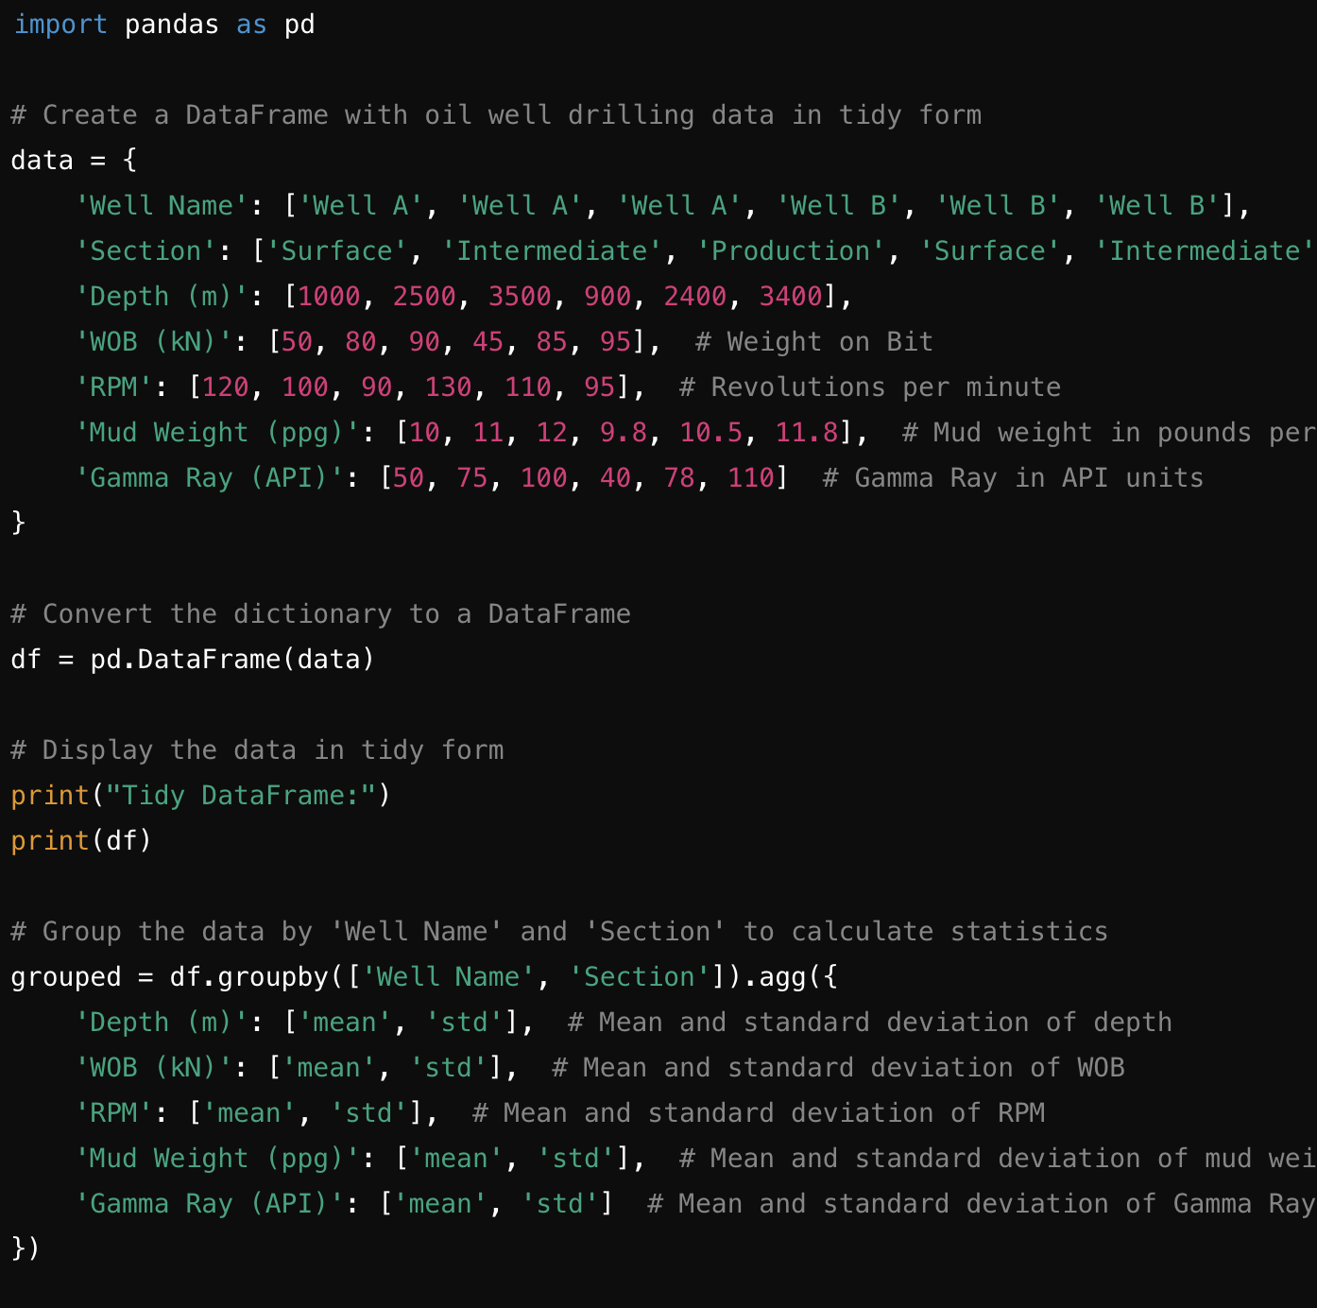
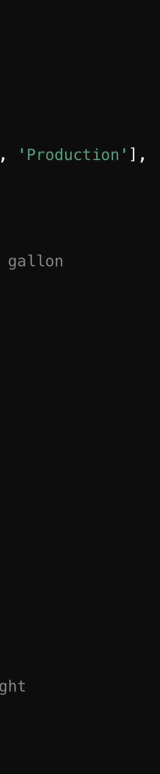
Data Formats
Tidy Data

Slide 20
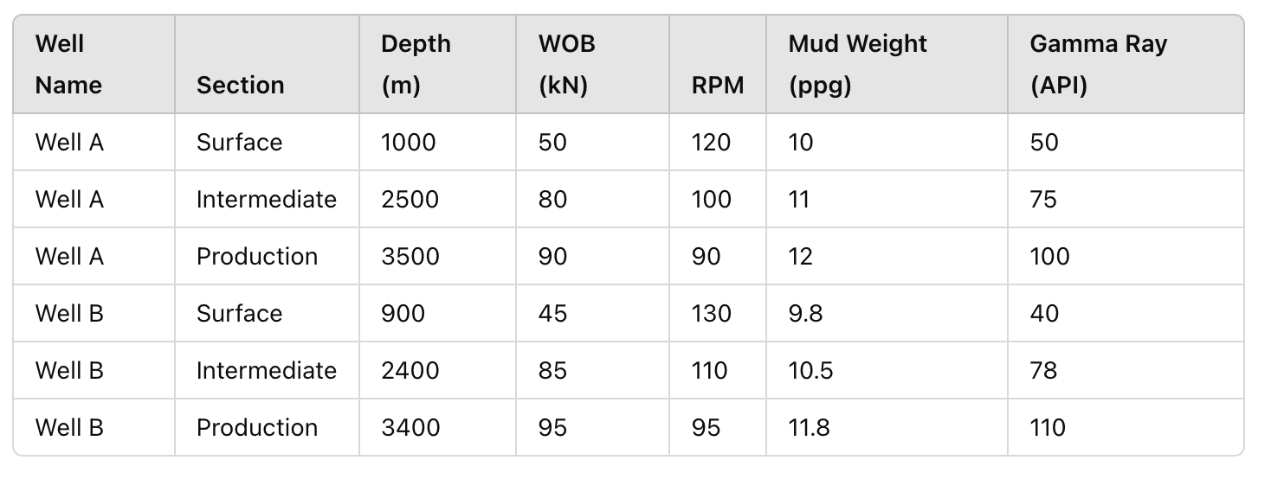
Data Formats
Tidy Data
\

Slide 21
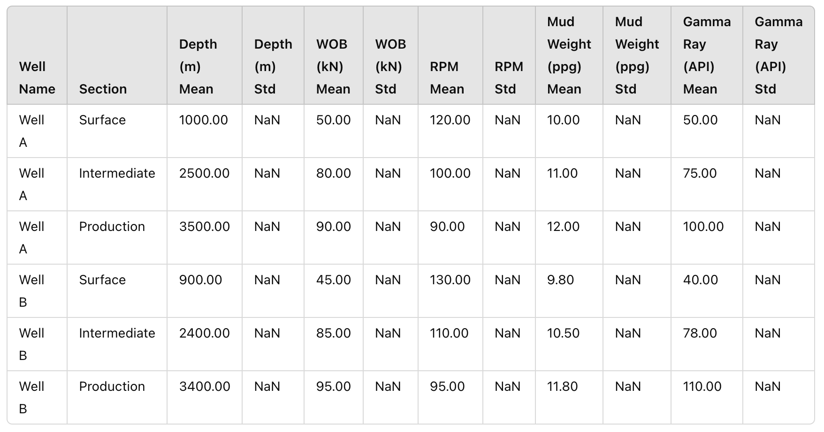
Data Formats
Tidy Data
\

Slide 22
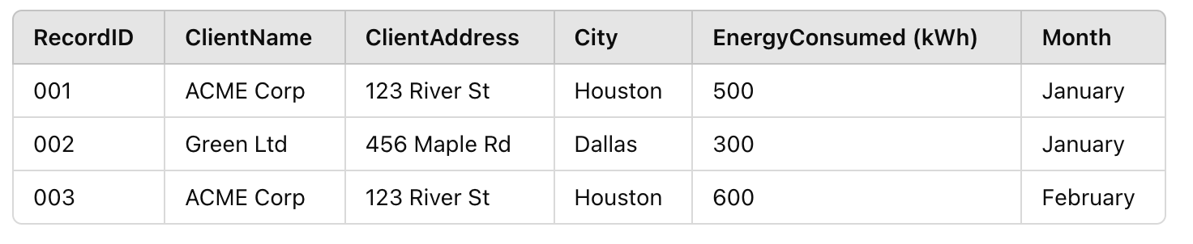
First Normal Form?
Normalized Tables

Slide 23
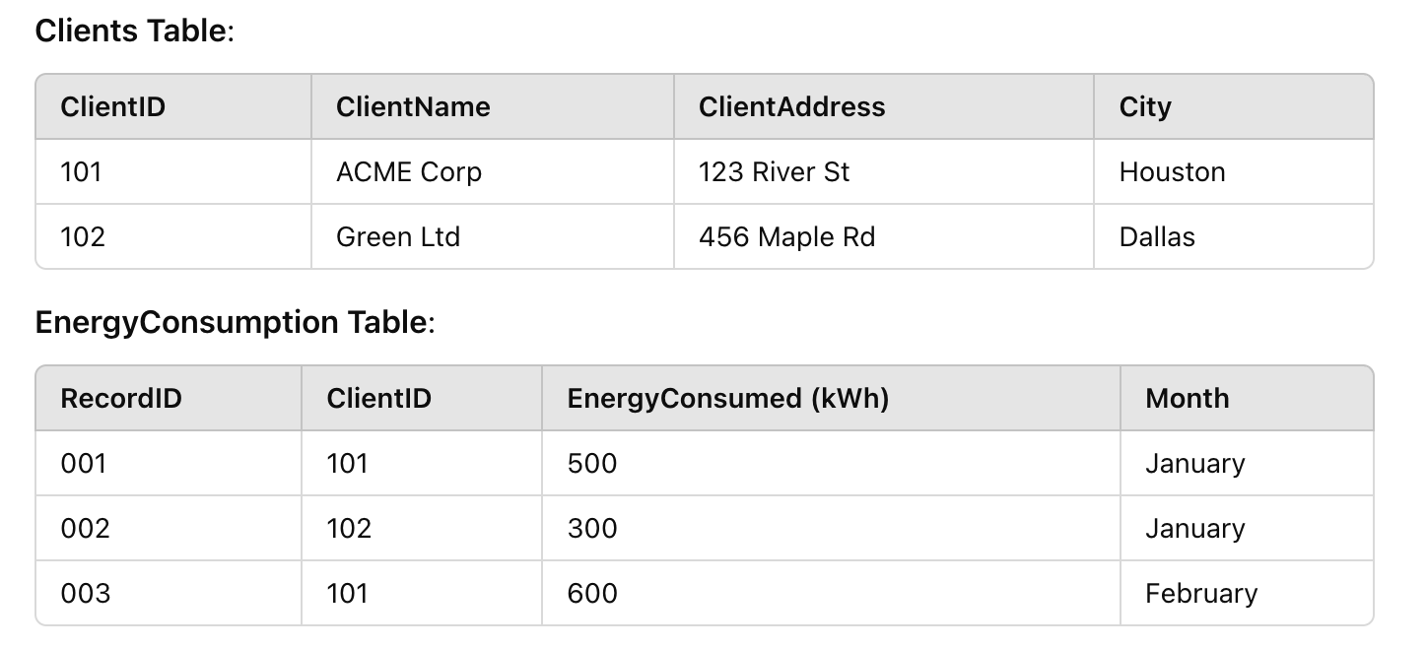
Second Normal Form
Normalized Tables

Slide 24
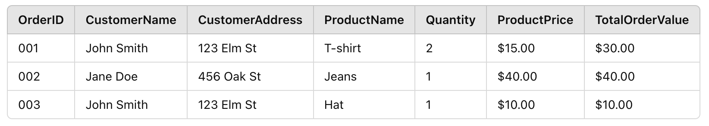
First Normal Form?
Normalized Tables

Slide 25
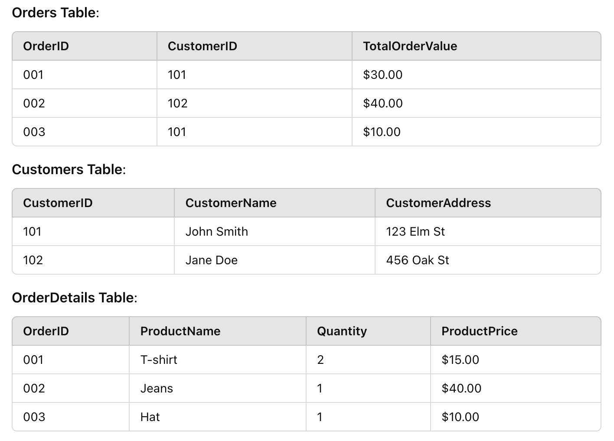
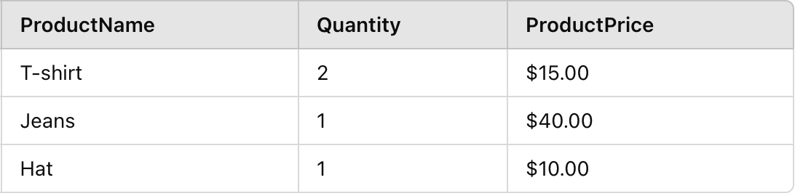
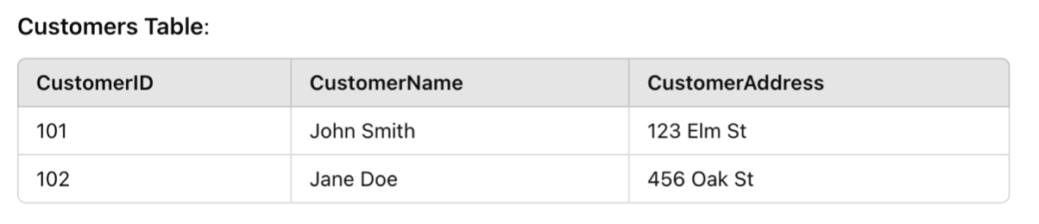
Second Normal Form
Normalized Tables

Slide 26
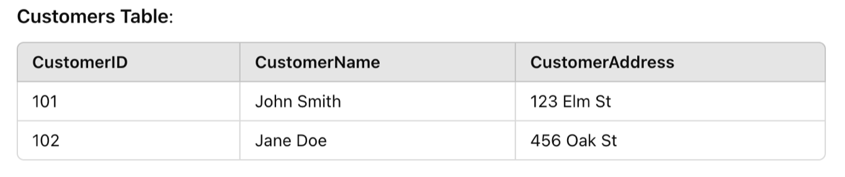
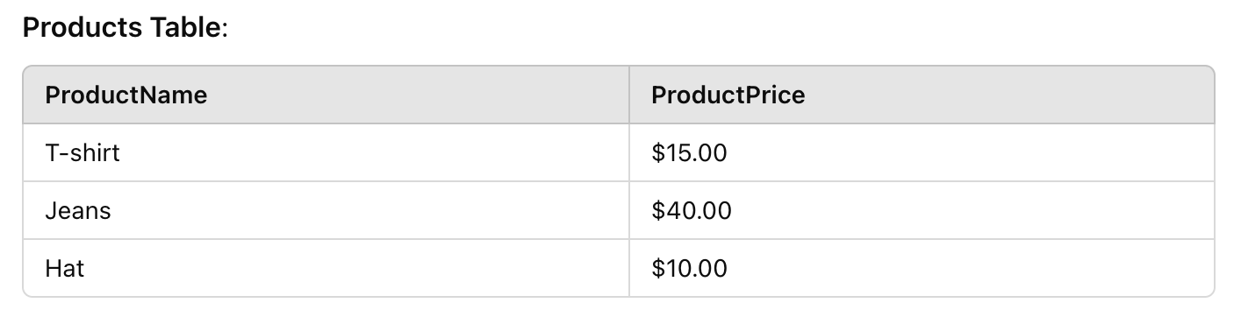
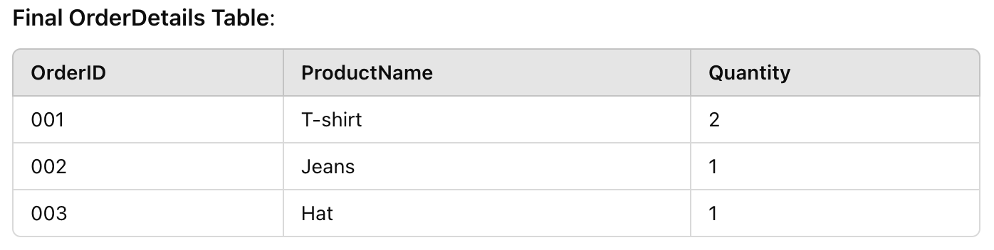
Third Normal Form
Normalized Tables

Slide 27
Summary
Normalized Tables
1NF: Remove repeating groups, ensure atomic values.
2NF: Remove partial dependency (non-key attributes depend on the whole primary key).
3NF: Remove transitive dependency (attributes depend only on the primary key).

Slide 28
Numpy and Pandas
Data libraries
Numpy
Matrices (XD) for numerical computing
Pandas
Built on top of Numpy
Series (1D) and Dataframes (2D) for data manipulation and analysis

Slide 29
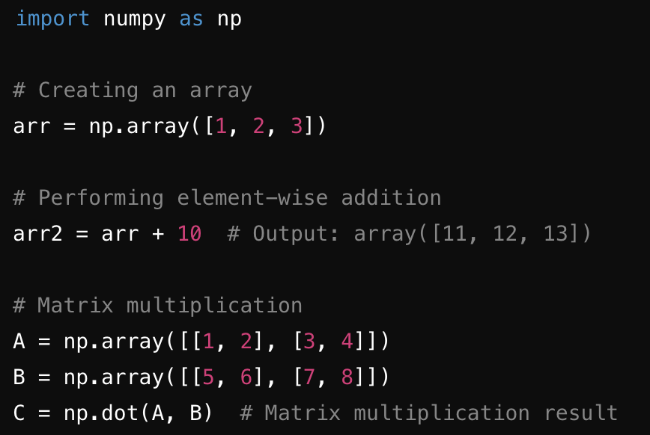
Numpy
Multi dimensional matrix

Slide 30
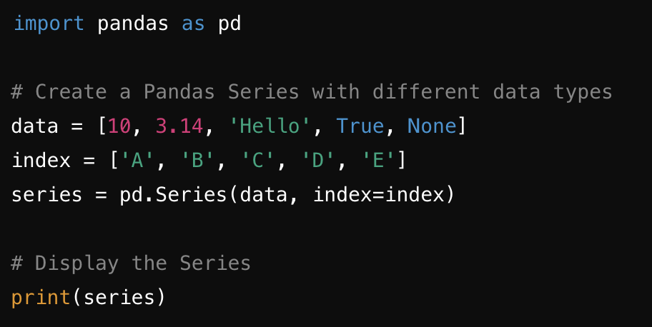
Pandas Sequence
Multiple data types

Slide 31
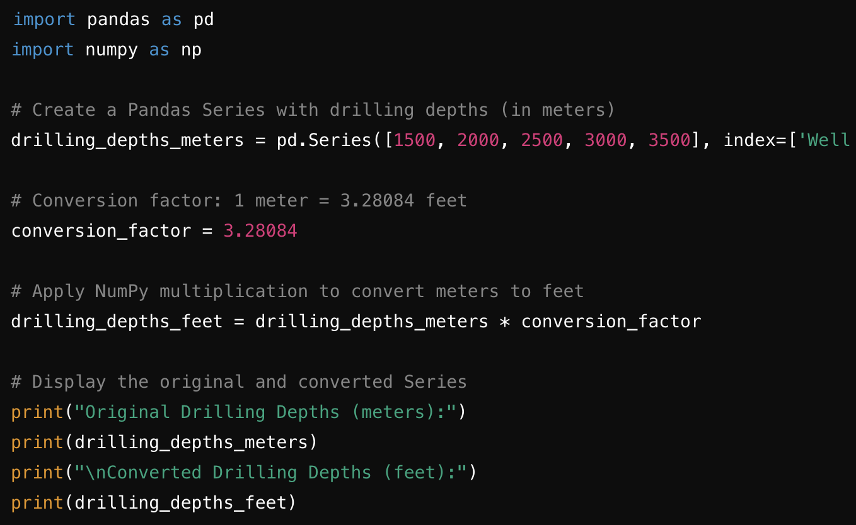
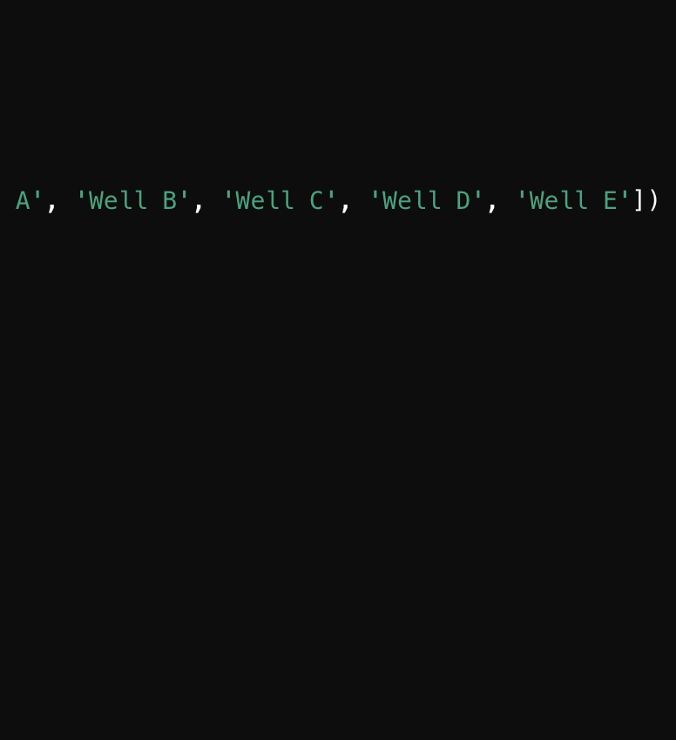
Pandas Sequence
Multiple numerical calculations

Slide 32
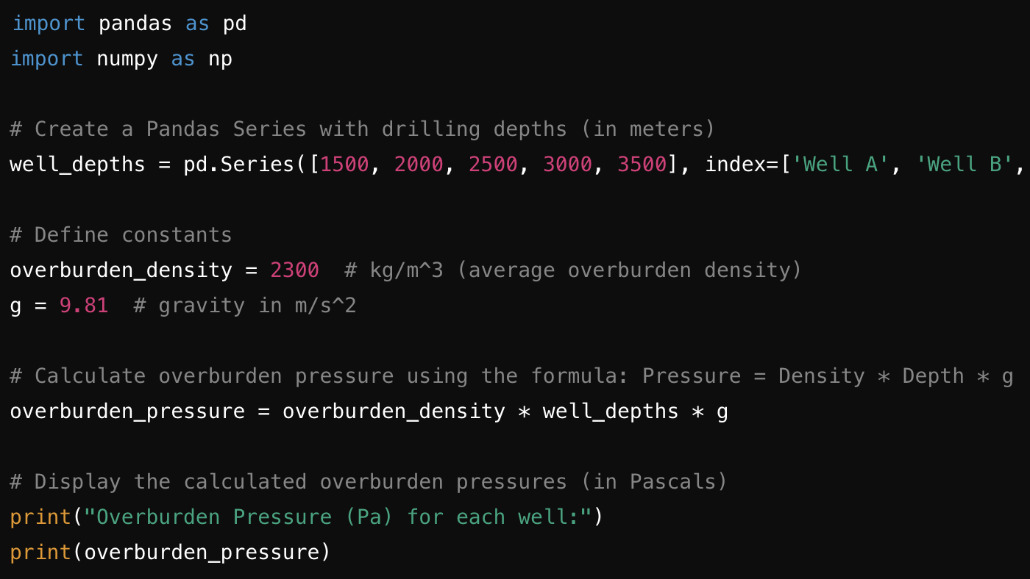
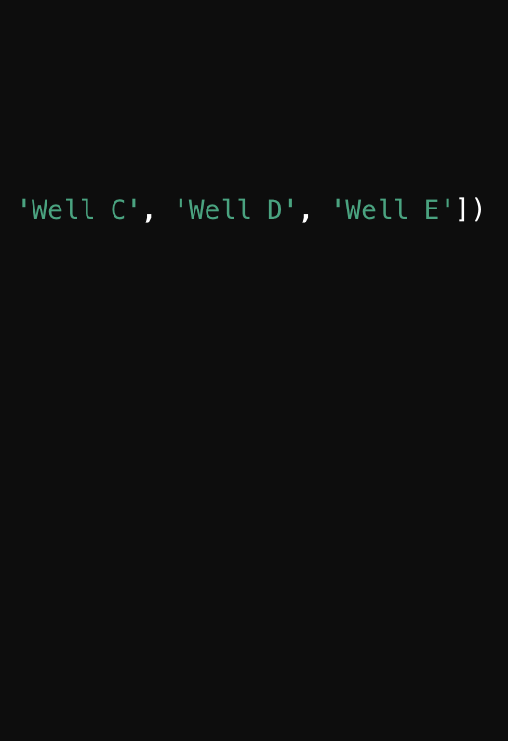
Pandas Sequence
Multiple numerical calculations

Slide 33
What is a Pandas DataFrame?
2-dimensional labeled data structure, similar to a table in a database or an Excel spreadsheet
Key Features:
Rows and columns: Data is organized in labeled rows and columns.
Heterogeneous data: It can hold different data types (e.g., integers, strings, floats).
Flexible operations: Supports operations like filtering, merging, sorting, and grouping.
Indexed: Both rows and columns have labels (index).

Slide 34

What is a Pandas DataFrame?

Slide 35
Pandas Dataframe
Multiple numerical calculations
import pandas as pd
# Create a DataFrame to represent well sections and their parameters
data = {
'Well Section': ['Surface', 'Intermediate', 'Production'],
'Depth (meters)': [0, 2000, 4000],
'Mud Weight (ppg)': [8.5, 10.0, 12.0], # pounds per gallon
'Pore Pressure (psi)': [0, 8000, 15000], # in psi
}
# Create DataFrame
well_df = pd.DataFrame(data)
# Convert mud weight from ppg to psi (1 ppg ≈ 0.4335 psi per foot of depth)
# Approximate depth is used to calculate mud weight in psi
well_df['Mud Weight (psi)'] = well_df['Mud Weight (ppg)'] * 0.4335 * well_df['Depth (meters)']
# Calculate the difference between mud weight and pore pressure
well_df['Pressure Control (psi)'] = well_df['Mud Weight (psi)'] - well_df['Pore Pressure (psi)']
# Display the DataFrame
print(well_df)

Slide 36
Pandas Dataframe
Multiple numerical calculations
import pandas as pd
# Create a DataFrame to represent well sections and their parameters
data = {
'Well Section': ['Surface', 'Intermediate', 'Production', 'Deep Production', 'Final Section'],
'Depth (meters)': [0, 2000, 4000, 6000, 8000],
'Mud Weight (ppg)': [8.5, 10.0, 12.0, 14.0, 16.0], # pounds per gallon
'Pore Pressure (psi)': [0, 8000, 15000, 25000, 35000], # in psi
}
# Create DataFrame
well_df = pd.DataFrame(data)
# Convert mud weight from ppg to psi (1 ppg ≈ 0.4335 psi per foot of depth)
# Approximate depth is used to calculate mud weight in psi
well_df['Mud Weight (psi)'] = well_df['Mud Weight (ppg)'] * 0.4335 * well_df['Depth (meters)']
# Calculate the difference between mud weight and pore pressure
well_df['Pressure Control (psi)'] = well_df['Mud Weight (psi)'] - well_df['Pore Pressure (psi)']
# Identify sections at risk of blowout
well_df['Blowout Risk'] = well_df['Pressure Control (psi)'] < 0
# Display the DataFrame
print(well_df)
# Find sections at risk of blowout
blowout_risk_sections = well_df[well_df['Blowout Risk']]
print("\nSections at Risk of Blowout:")
print(blowout_risk_sections[['Well Section', 'Depth (meters)', 'Pressure Control (psi)']])

Slide 37
iimport pandas as pd
# Create a DataFrame comparing average drilling parameters for two wells
data = {
'Well Section': ['Surface', 'Intermediate', 'Production', 'Final Section'],
'Well A: Average Depth (meters)': [0, 2000, 4000, 6000],
'Well A: Average Rate of Penetration (m/h)': [10, 12, 8, 6], # meters per hour
'Well A: Average Weight on Bit (kN)': [50, 80, 120, 100], # kilonewtons
'Well A: Average Mud Weight (ppg)': [8.5, 10.0, 12.0, 14.0], # pounds per gallon
'Well A: Average Torque (Nm)': [1000, 1200, 1500, 1300], # Newton meters
'Well A: Average Pressure (psi)': [0, 8000, 15000, 25000], # pounds per square inch
'Well B: Average Depth (meters)': [0, 2100, 3900, 5800],
'Well B: Average Rate of Penetration (m/h)': [9, 14, 7, 5], # meters per hour
'Well B: Average Weight on Bit (kN)': [55, 85, 110, 90], # kilonewtons
'Well B: Average Mud Weight (ppg)': [8.0, 11.0, 13.0, 15.0], # pounds per gallon
'Well B: Average Torque (Nm)': [950, 1250, 1400, 1200], # Newton meters
'Well B: Average Pressure (psi)': [0, 8200, 14800, 24000], # pounds per square inch
}
# Create DataFrame
comparison_df = pd.DataFrame(data)
# Convert average mud weights from ppg to kg/m^3 for additional analysis
comparison_df['Well A: Average Mud Weight (kg/m^3)'] = comparison_df['Well A: Average Mud Weight (ppg)'] * 119.826
comparison_df['Well B: Average Mud Weight (kg/m^3)'] = comparison_df['Well B: Average Mud Weight (ppg)'] * 119.826
# Calculate differences between Well A and Well B
comparison_df['Depth Difference (meters)'] = comparison_df['Well A: Average Depth (meters)'] - comparison_df['Well B: Average Depth (meters)']
comparison_df['ROP Difference (m/h)'] = comparison_df['Well A: Average Rate of Penetration (m/h)'] - comparison_df['Well B: Average Rate of Penetration (m/h)']
comparison_df['WOB Difference (kN)'] = comparison_df['Well A: Average Weight on Bit (kN)'] - comparison_df['Well B: Average Weight on Bit (kN)']
comparison_df['Mud Weight Difference (ppg)'] = comparison_df['Well A: Average Mud Weight (ppg)'] - comparison_df['Well B: Average Mud Weight (ppg)']
comparison_df['Torque Difference (Nm)'] = comparison_df['Well A: Average Torque (Nm)'] - comparison_df['Well B: Average Torque (Nm)']
comparison_df['Pressure Difference (psi)'] = comparison_df['Well A: Average Pressure (psi)'] - comparison_df['Well B: Average Pressure (psi)']
# Display the DataFrame
print(comparison_df)

