Slide 1
Spin-phonon Coupling in Transition Metal Complexes
Patryk Kozlowski

Slide 2
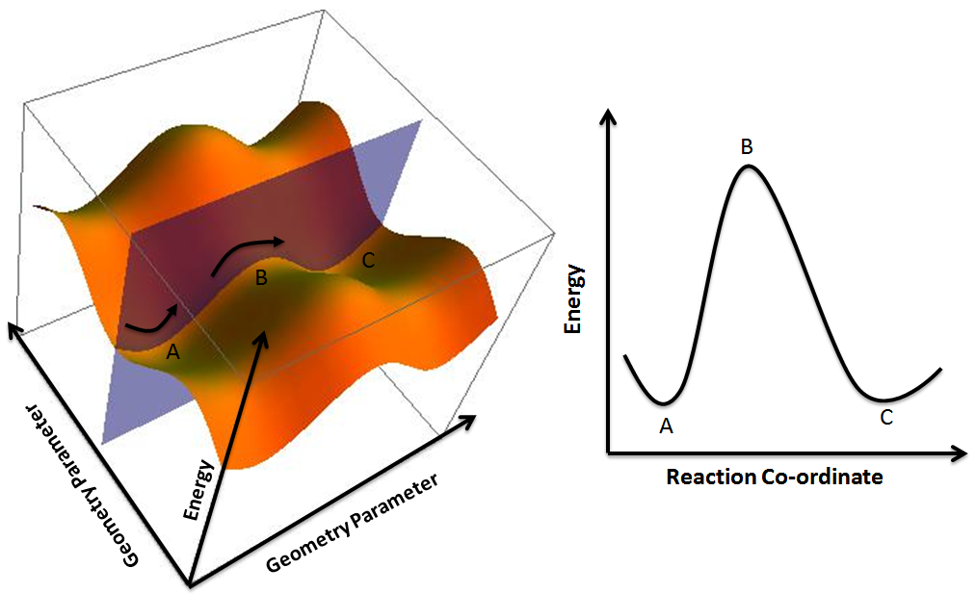
Background
Non-adiabatic dynamics and the coupling of vibrations to spin states (spin-phonon coupling) are important throughout science
  i.e. photochemistry, quantum computing, single-molecule magnets, photoactive materials
Relevant properties commonly correlated to non-equilibrium processes

Slide 3
Structural Contributions to Intersystem Crossing
How do the ¹A_{1g} and ⁵T_{2g} spin states in Co(III) coordination complexes interconvert?
Unique electron spin configurations give rise to unique equilibrium geometries
Differing geometries need to be reconciled for spin states to interconvert
Molecular vibrations bridge these structural differences
We investigate how molecular vibrations facilitate intersystem crossings via spin-phonon coupling.
Energy (cm⁻¹)
⁵T_{2g}
¹A_{1g}
S=0
S=2
Average M-L Bond Length (Å)

Slide 4
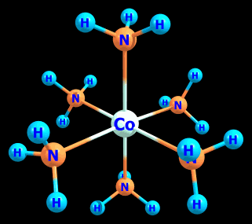
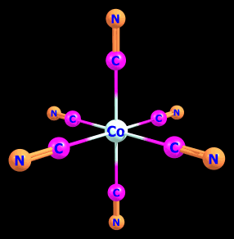
Building a Computational Model
Describes spin-phonon coupling
  Used here to probe the ¹A_{1g} /⁵T_{2g} intersystem crossing
Calibrated to spectroscopic data
[Co(III)(NH₃)₆]³⁺
[Co(III)(CN)₆]³⁻
Notes:
In the next few slides will show the process by which we probe the intersystem crossing occurs between spin states

Slide 5
Density Functional Theory (DFT)
Computational quantum mechanical method used to determine properties of a many-electron system
Used to optimize equilibrium geometries and find vibrational modes for the ¹A_{1g} and ⁵T_{2g} spin states
[Co(III)(NH₃)₆]³⁺ |  | BP86 | TPSSh | B3LYP | Experiment
Singlet M-L Bond Distance (Å) |  | 2.03 | 2.02 | 2.04 | 1.96
Quintet Distortion (Å) | Axial | -0.18 | -0.17 | -0.16 | -0.12
 | Equatorial | 0.18 | 0.17 | 0.16 | 0.12
Wilson, R. B.; Solomon, E. J. Am. Chem. Soc. 1980, 102 (12), 4085–4095.

Slide 6
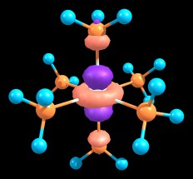
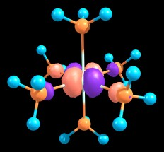
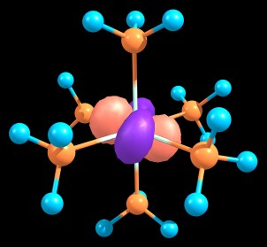
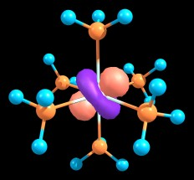
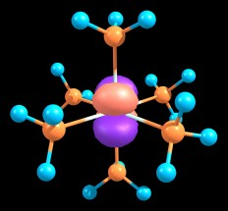
Active Space for CASSCF/NEVPT2 Calculations
e_{g}
t_{2g}

Slide 7
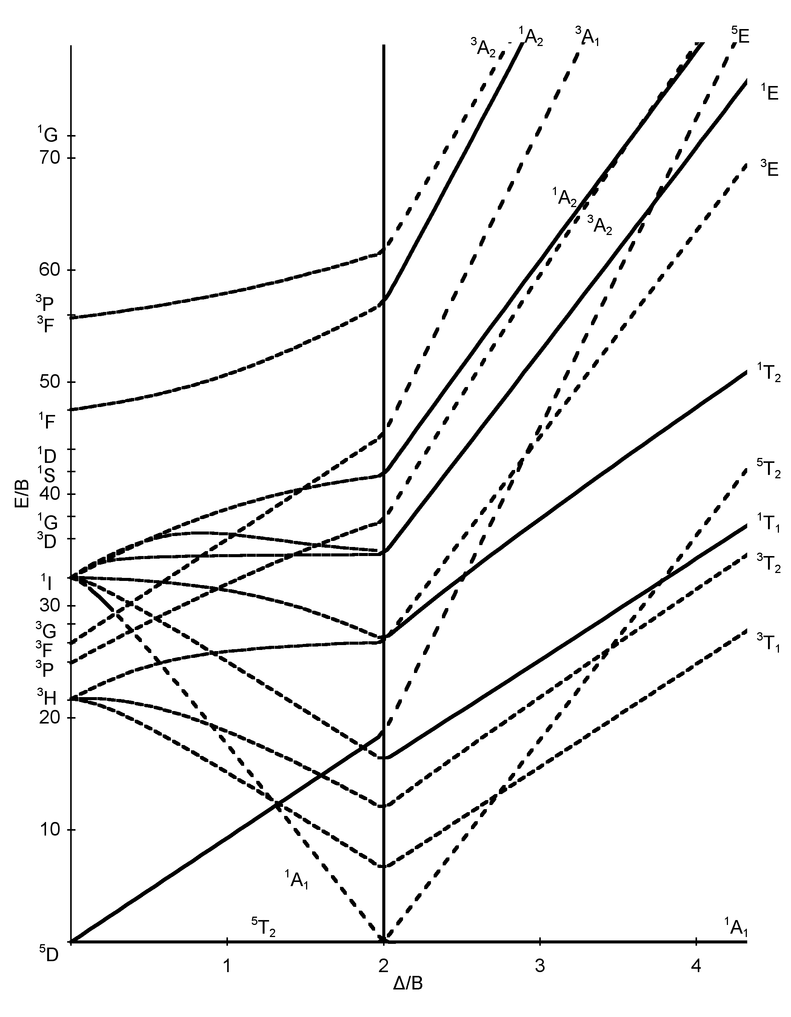
CASSCF/NEVPT2 Energies
[Co(III)(NH₃)₆]³⁺
Spin State | NEVPT2 Energies (cm⁻¹) | Experimental Energies (cm⁻¹)
³T₁ | 12740 | 13000
 | 12796
 | 12804
⁵T₂ | 14191 | 16630
 | 14214
 | 14223
¹T₁ | 22051 | 21200
 | 22114
 | 22124
¹T₂ | 34980 | 29550
 | 35091
 | 35106
Jørgensen, C. K. Spectroscopy of Transition-Group Complexes. In Advances in Chemical Physics; John Wiley & Sons, Ltd, 2007; pp 33–146.
Notes:
Calibrated computational model by comparing NEVPT2 transition energies to spectroscopic data at the ¹A_{1g} equilibrium geometry (¹A_{1g} ground state)
Vertical slice of potential energy surface

Slide 8
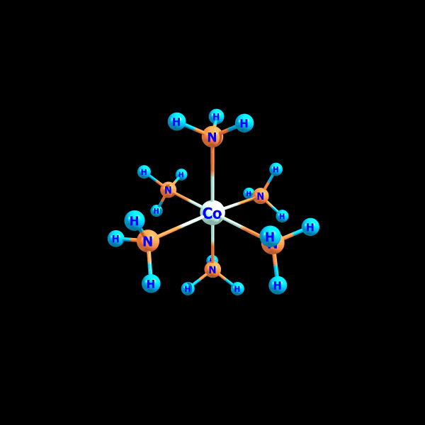
Locating the Intersystem Crossing
Calculated NEVPT2 transition energies along the totally symmetric normal mode of vibration
Identified point of intersystem crossing
  difficult to locate spectroscopically; readily located computationally
Energy (cm⁻¹)
⁵T_{2g}
¹A_{1g}
M-L Bond Distortion (Å)

Slide 9
¹A_{1g} /⁵T_{2g} Intersystem Crossing
shown below in the absence of spin-orbit coupling (SOC)
[Co(III)(NH₃)₆]³⁺
[Co(III)(CN)₆]³⁻
Notes:
-Compare hexammine with hexacyanide and explain difference in quintet positioning (ISC happening at drastically distortion from quintet equilibrium geometry…due to stronger ligand field from cyanide)
- Reason for no parabola is because these graphs are showing energies relative to the ground state

Slide 10
Turning on SOC and Relativistic Effects
⁵T_{2g} splits into 15 sublevels in the absence of a magnetic field
  This phenomenon is known as zero-field splitting (ZFS)
[Co(III)(NH₃)₆]³⁺
[Co(III)(CN)₆]³⁻
Notes:
Not much difference between the two
Explain singlet moving through states as well as characteristic feature of spin-forbidden crossing

Slide 11
General Spin-phonon Coupling in [Co(III)(NH₃)₆]³⁺
Literature suggests the totally symmetric mode is not always the only spin-phonon active mode
Rapidly changing ZFS near intersystem crossing point indicates a mode is spin-phonon active
  Mode 22
22
26
2
22
Brady, C.; McGarvey, J. J.; McCusker, J. K.; Toftlund, H.; Hendrickson, D. N. In Spin Crossover in Transition Metal Compounds III; Springer-Verlag: Berlin/Heidelberg, 2004; Vol. 235, pp 1–22.

Slide 12
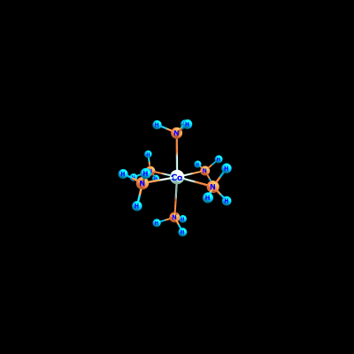
Analysis of Mode 22 (from previous slide)
This mode mirrors distortions of the ⁵T_{2g} equilibrium geometry from the ¹A_{1g} equilibrium geometry identified by DFT and spectroscopy
Mode 22

Slide 13
Summary
developed a general experimentally calibrated computational model to define non-equilibrium dynamics and spin-phonon coupling in transition metal complexes
Gained insight on the mechanism governing the ¹A_{1g} /⁵T_{2g} intersystem crossing in [Co(III)(NH₃)₆]³⁺ and [Co(III)(CN)₆]³⁻
Identified a spin-phonon active normal mode of vibration for the ¹A_{1g} /⁵T_{2g} intersystem crossing in [Co(III)(NH₃)₆]³⁺

Slide 14
Future Directions
Investigate spin-orbit coupled absorption spectra along regular the identified spin-phonon active mode (Mode 21)
The computational model developed is general
  will be extended to other Co(III) coordination complexes
  will be extended to coordination complexes involving other transition metals

Slide 15
Acknowledgements
Professor Ryan Hadt
Hadt Group
  Gautam Stroscio, Nick Higdon, Dr. Alec Follmer, Alexandra Barth, Jaron Tong, Ruben Mirzoyan, Ryan Ribson
John Stauffer Charitable Trust

Slide 16
Questions?

Slide 17
References
Wilson, R. B.; Solomon, E. I. Spectroscopic Studies of Photochemically Important Transition Metal Excited States. 2. The 1T1g, 3T1g, and 5T2g Excited States of Hexaamminecobalt(III). J. Am. Chem. Soc. 1980, 102 (12), 4085–4095. https://doi.org/10.1021/ja00532a018.
Brady, C.; McGarvey, J. J.; McCusker, J. K.; Toftlund, H.; Hendrickson, D. N. Time-Resolved Relaxation Studies of Spin Crossover Systems in Solution. In Spin Crossover in Transition Metal Compounds III; Springer-Verlag: Berlin/Heidelberg, 2004; Vol. 235, pp 1–22. https://doi.org/10.1007/b95420.
Jørgensen, C. K. Spectroscopy of Transition-Group Complexes. In Advances in Chemical Physics; John Wiley & Sons, Ltd, 2007; pp 33–146. https://doi.org/10.1002/9780470143513.ch2.

