Slide 1
Elucidating Catalysis with the “Gold Standard” of Quantum Chemistry
Patryk Kozlowski

Slide 2
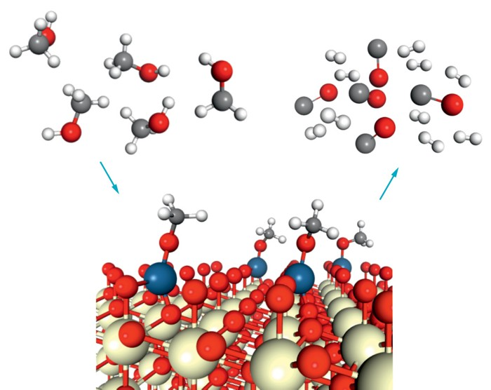
What do catalysts do?
Increase the rate, efficiency, and selectivity of chemical reactions
Used to produce fuels and chemicals
Example: artificial fertilizers from the Haber-Bosch process
Notes:
- just about a half of the world population today depends on these artificial fertilizers for food
- in Haber-Bosch process iron catalyzes the conversion of atmospheric nitrogen to ammonia, which is then used in artificial fertilizers

Slide 3

The catalytic mechanism
Gaseous reactants adsorb onto the catalyst surface
Bound reactants transform into the desired product(s)
Product(s) desorb from the catalyst surface
Notes:
Or chemically bind
To illustrate the catalytic mechanism on a microscopic scale, we’ll take a look at this video depiction of nitrogen transforming into ammonia in the Haber-Bosch process

Slide 4
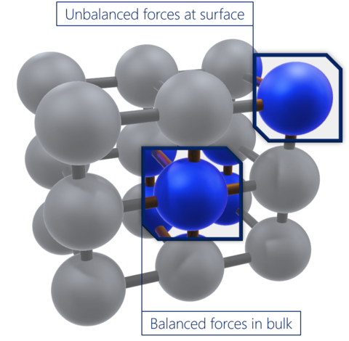
Why do catalysts bind reactants?
Catalyst surface atoms are unstable relative to bulk atoms
Instability causes reactivity
The surface energy quantifies the instability of a surface relative to the bulk
Understanding catalysis requires a way to obtain accurate surface energies
Notes:
In the first place
Arises from surface atoms’ lack of stabilizing intermolecular attractions with respect to bulk atoms

Slide 5
Theoretical approach
Density functional theory (DFT) inadequate for accurately computing surface energies [1]
Coupled-cluster theory is the “gold standard” of quantum chemistry at the molecular level
Coupled-cluster methods, like CCSD, have shown success in accurately computing properties of materials [2]
We computed surface energies using the simpler MP2 and more robust CCSD perturbative methods
Compared performance with DFT
Notes:
- the workhorse computational method of surface science

Slide 6
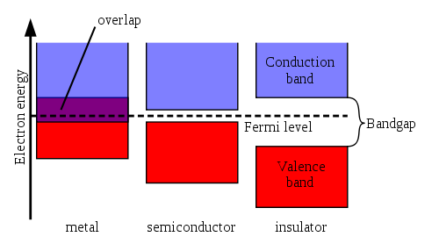
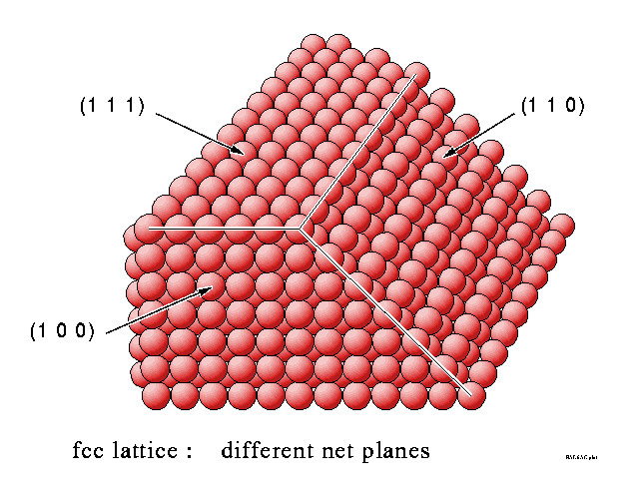
System chosen for study: platinum
Metal, so gapless
But the perturbative MP2 and CCSD methods struggle to simulate gapless systems
A gap was introduced artificially
Focus on the platinum (111) surface
Notes:
a common catalyst
HOMO and LUMO degenerate in energy
A variety of surfaces exist, depending on the orientation by which one cuts the bulk material

Slide 7
Platinum lattice spacing (Å) optimization
Basis set dependence
Minimal gth-szv basis overestimated
More robust gth-dzvp basis underestimated
Basis Set | DFT |  |  |  | Hartree Fock | Experiment [3]
 | PBE | LDA | BLYP | B3LYP
gth-szv | 4.20 | 4.05 | 4.63 | 4.05 | 4.12 | 3.92
gth-dzvp | 3.61 | 3.57 | 3.66 | 3.62 | 3.69
Notes:
Fair theoretical lattice constants (Å) with respect to experiment

Slide 8
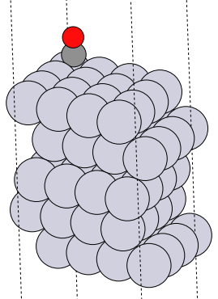
Finite size effects
z
y
x
Material surfaces are ~infinite in size
To compute their properties, need to approximate surfaces as finite in size
Two finite size approximations
Surface layer sampling
K-point sampling
Notes:
- Next, before we look at my computed surface energies, I will make an important comment about the effects of finite size
- As more surface layers and k-points are sampled, results become more accurate as we approach the thermodynamic limit of a real catalyst surface, which is approximately infinite in size

Slide 9
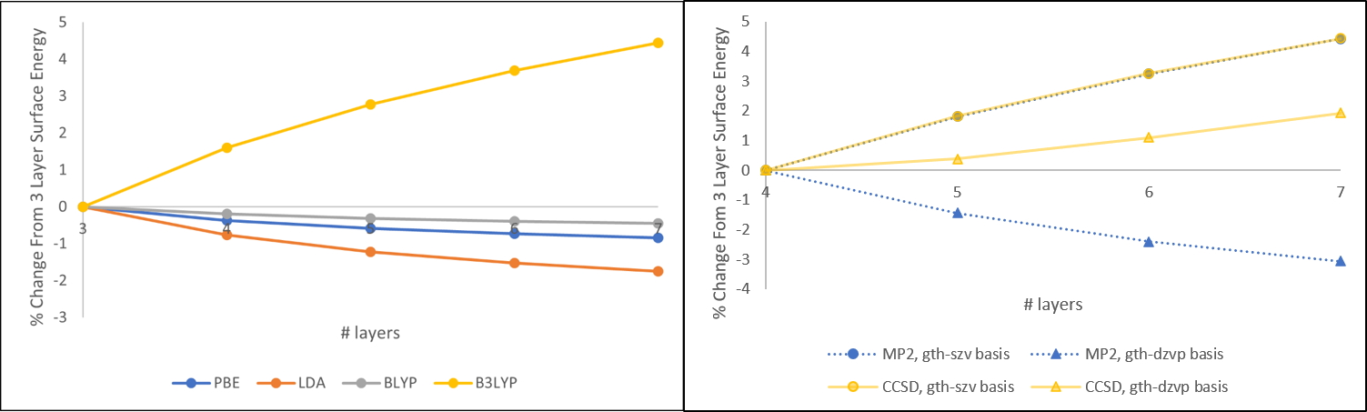
Surface Energies: surface layer convergence
Monotonic convergence as more layers sampled
Notes:
With number k-points held constant at 1
Left plot: DFT, right plot: MP2 and CCSD
This observed monotonic convergence as we sample more and more layers can be rationalized as follows: as you sample more and more layers, the distance between the newly added layer with the catalyst surface on top increases, and so the interaction between newly added layer with the catalyst surface decrease
So each new layer added changes the surface energy less than the previous layer added because of the decreased interaction, and so why we see monotonic convergence
These plots are useful since if one was interested in getting the most accurate results possible, one could make a logistic fit to each of these curves in order to get an upper limit value for the surface energy in the thermodynamic limit of an infinite number of layers sampled, providing most accurate description to a real catalyst surface

Slide 10
Surface Energies: DFT k-point convergence
Oscillatory convergence as more k-points sampled
In thermodynamic limit, gth-dzvp basis more accurate than gth-szv
Corroborates literature trend of DFT overestimating surface stability [1]
Notes:
With number of layers held constant
An expected, but nevertheless important detail to notice is that surface energies approached in the thermodynamic limit by the more robust gth-dzvp basis more accurate than those of the minimal gth-szv basis
Just to note, I have not included error bars on this black experimental benchmark line, since the experimental errors are negligibly small with respect to the scale of the y-axis
Which corresponds to underestimation of surface energies
Both plots show DFT yielding lower surface energies w.r.t. experiment when moving to the right towards the thermodynamic limit

Slide 11
Surface Energies: MP2/CCSD k-point convergence
Perturbative methods struggled
MP2 surface energies less accurate than DFT
Numerical convergence issues in CCSD calculations with >1 k-point sampled
Notes:
-Comparison most apt at gth-dzvp basis with 9 k-points sampled
- MP2 surface energy ~5 J/m^2 off of the experimental value

Slide 12
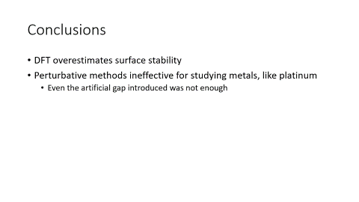
Conclusions
DFT overestimates surface stability
Perturbative methods ineffective for studying metals, like platinum
Even the artificial gap introduced was not enough

Slide 13
Future Directions
Benchmark performance of perturbative MP2 and CCSD methods for computing surface energies of non-metal catalysts
Compute other quantities relevant to catalysis
Adsorption energy
Notes:
In which sufficiently large gaps would exist
One example
- Which measures the net difference between the energy of a free reactant gas molecule and its energy once adsorbed onto a catalyst surface

Slide 14
Acknowledgments
Professor Garnet Chan
Yang Gao
John Stauffer Charitable Trust

Slide 15
References
[1] Schimka, L.; Harl, J.; Stroppa, A.; Grüneis, A.; Marsman, M.; Mittendorfer, F.; Kresse, G. Accurate Surface and Adsorption Energies from Many-Body Perturbation Theory. Nature Materials 2010, 9 (9), 741–744. https://doi.org/10.1038/nmat2806.
[2] Booth, G. H.; Grüneis, A.; Kresse, G.; Alavi, A. Towards an Exact Description of Electronic Wavefunctions in Real Solids. Nature 2013, 493 (7432), 365–370. https://doi.org/10.1038/nature11770.
[3] Properties: Platinum - Properties and Applications https://www.azom.com/properties.aspx?ArticleID=601 (accessed Jul 8, 2020).
[4] Boer, F. R.; Boom, R.; Mattens, W. C. M.; Miedema, A. R.; Niessen, A. K. Cohesion in Metals: Transition Metal Alloys; North-Holland, 1988.

Slide 16
Thanks for listening!

