Slide 1

Character Recognition
Name:-
Pankaj Kumar
Roll No:-
57
Section:-
KM046
Course:-
INT-246
Registration No:-
11910254

Slide 2
Introduction
Handwriting recognition is the ability of a machine to receive and interpret handwritten input from multiple sources like paper documents, photographs, touch screen devices etc. The main aim of this project is to design expert system for, “Handwritten Character (Digit) Recognition using Neural Network” that can effectively recognize a particular character of type format using the Convolutional Neural Network (CNN) approach. Handwriting recognition has been one of the active and challenging research areas in the field of image processing and pattern recognition. It has numerous applications which include, reading aid for blind, bank cheques and conversion of any handwritten document into structural digit form.

Slide 3
Libraries Used
This project is based on neural networks and for this purpose Python is used. The libraries used in this project are: TensorFlow and Keras, NumPy, Matplotlib, Pandas, seaborn.
Matplotlib
It provides an object-oriented API for embedding plots into applications using general-purpose GUI toolkits like Tkinter. Each pyplot function makes some change to a figure: e.g., creates a figure, creates a plotting area in a figure, plots some lines in a plotting area, decorates the plot with labels, etc.

Slide 4
Numpy
NumPy can be used to perform a wide variety of mathematical operations on arrays. It adds powerful data structures to Python that guarantee efficient calculations with arrays and matrices and it supplies an enormous library of high-level mathematical functions that operate on these arrays and matrices.
Tensorflow & Keras
It is an open source artificial intelligence library, using data flow graphs to build models. It allows developers to create large-scale neural networks with many layers. TensorFlow is mainly used for: Classification, Perception, Understanding, Discovering, Prediction and Creation .Keras is a powerful and easy-to-use free open source Python library for developing and evaluating deep learning models. It wraps the efficient numerical computation libraries Theano. Keras allows users to productize deep models.

Slide 5
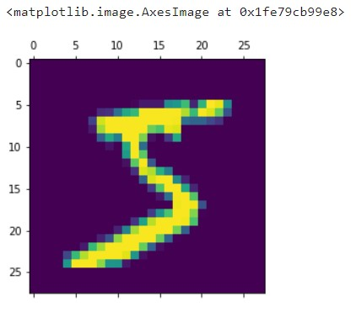
Code
import tensorflow as tf
from tensorflow import keras
import matplotlib.pyplot as plt
matplotlib inline
import numpy as np
(X_train, y_train) , (X_test, y_test) = keras.datasets.mnist.load_data()
len(X_train)
len(X_test)
X_train[0].shape
X_train[0]
plt.matshow(X_train[0])
y_train[0]
X_train = X_train / 255
X_test = X_test / 255
X_train[0]
plt.matshow(X_train[0])

Slide 6
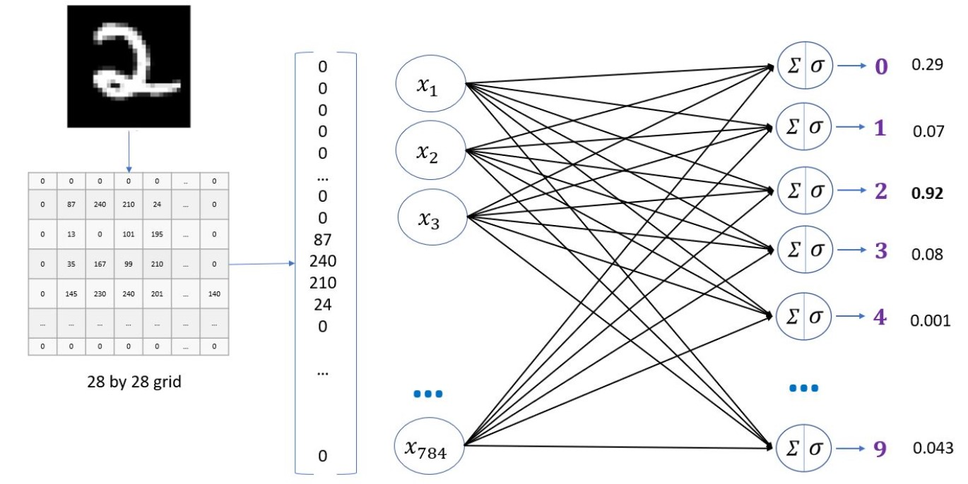
y_train[0]
X_train = X_train / 255
X_test = X_test / 255
X_train[0]
X_train_flattened = X_train.reshape(len(X_train), 28*28)
X_test_flattened = X_test.reshape(len(X_test), 28*28)
X_train_flattened.shape
X_train_flattened[0]

Slide 7
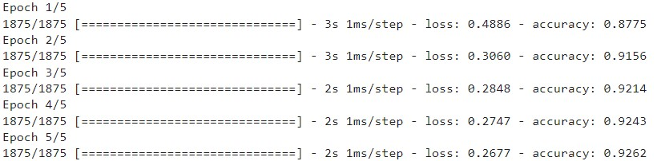
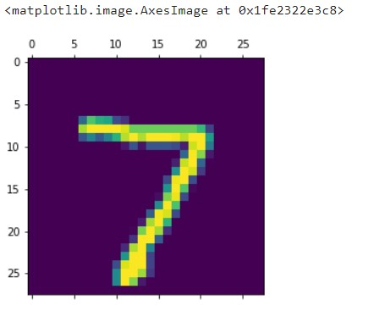
model = keras.Sequential([keras.layers.Dense(10, input_shape=(784,), activation='sigmoid')])
model.compile(optimizer='adam',loss='sparse_categorical_crossentropy',metrics=['accuracy'])
model.fit(X_train_flattened, y_train, epochs=5)
model.evaluate(X_test_flattened, y_test)
y_predicted = model.predict(X_test_flattened)
y_predicted[0]
plt.matshow(X_test[0])

Slide 8
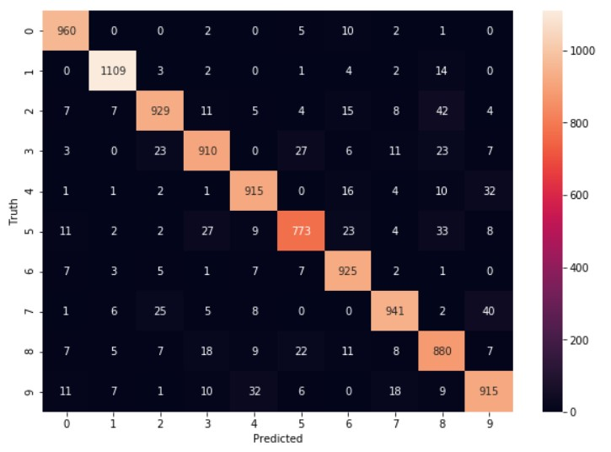
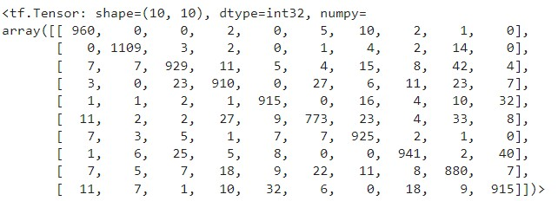
np.argmax(y_predicted[0])
y_predicted_labels = [np.argmax(i) for i in y_predicted]
y_predicted_labels[:5]
cm = tf.math.confusion_matrix(labels=y_test,predictions=y_predicted_labels)
cm
import seaborn as sn
plt.figure(figsize = (10,7))
sn.heatmap(cm, annot=True, fmt='d')
plt.xlabel('Predicted')
plt.ylabel('Truth')

Slide 9
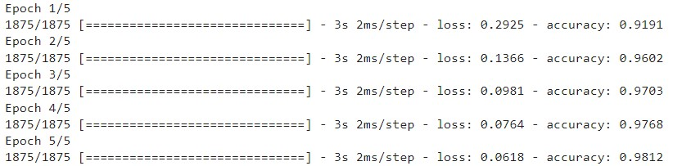
model = keras.Sequential([
keras.layers.Dense(100, input_shape=(784,), activation='relu'),
keras.layers.Dense(10, activation='sigmoid')
])
model.compile(optimizer='adam',
loss='sparse_categorical_crossentropy',
metrics=['accuracy'])
model.fit(X_train_flattened, y_train, epochs=5)

Slide 10
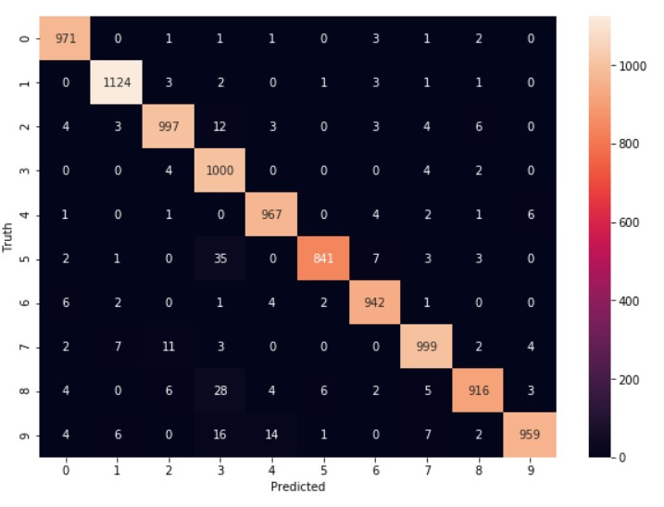
model.evaluate(X_test_flattened,y_test)
y_predicted = model.predict(X_test_flattened)
y_predicted_labels = [np.argmax(i) for i in y_predicted]
cm = tf.math.confusion_matrix(labels=y_test,predictions=y_predicted_labels)
plt.figure(figsize = (10,7))
sn.heatmap(cm, annot=True, fmt='d')
plt.xlabel('Predicted')
plt.ylabel('Truth')

Slide 11
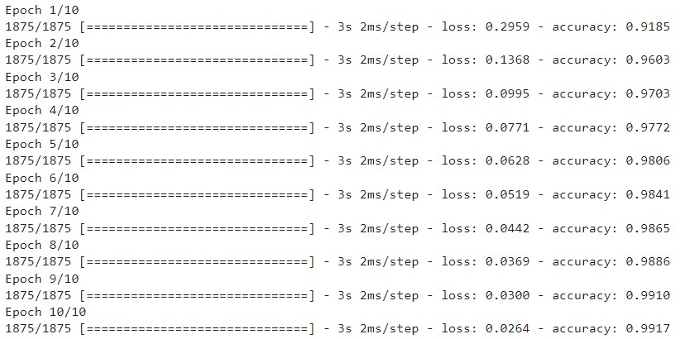
model = keras.Sequential([
keras.layers.Flatten(input_shape=(28, 28)),
keras.layers.Dense(100, activation='relu'),
keras.layers.Dense(10, activation='sigmoid')
])
model.compile(optimizer='adam',
loss='sparse_categorical_crossentropy',
metrics=['accuracy'])
model.fit(X_train, y_train, epochs=10)
model.evaluate(X_test,y_test)

Slide 12


