Slide 1
WELCOME

Slide 2
What if you come to know in just 1 Sec you can install and run an OS..???
wow

Slide 3
TEAM INTRODUCTION
Pratyush Kumar Pathak
18BTRCS068
(B section)
Panchami V Urs
18BTRCS063
(B section)
Aman Sharma
18BTRCS036
(A section)
Rohit L Hulekal
18BTRCS026
(A section)

Slide 4
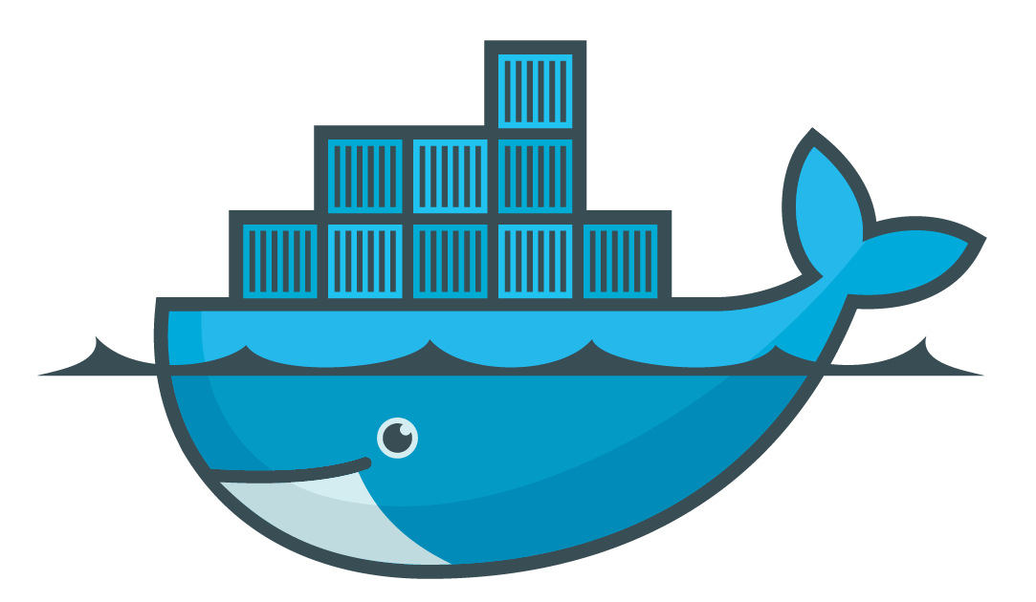
DOCKER
BUILD – SHIP - RUN

Slide 5
AGENDA
Introduction
History
What is Docker Container and How Docker works?
Why Docker?
Summary
Q/A

Slide 6
INTRODUCTION
Docker is a tool of DevOps world which is used to install (deploy) and run any OS within a second.
It is a computer program that performs operating-system-level virtualization, also known as “containerization”.
Originally built for Linux
Docker now runs on Windows and MacOS as well.

Slide 7
HISTORY
Docker Inc. was founded by Solomon Hykes and launched in 2011.
It was first released as open-source in March 2013.
In Feb 2016 Docker introduces first commercial product - Now called Docker Enterprise Edition
only 7 years ago, but it is already used by a lot of companies, like: Spotify, The New York Times, PayPal, Uber and more

Slide 8
What Is Docker Container and How it Works?
Docker is an open source project that makes it easy to create containers and container-based apps.
Docker is not a virtual machine (VM)
A Docker container, unlike a virtual machine, does not require or include a separate operating system. Instead, it relies on the kernel’s functionality and uses resource isolation for CPU and memory, and separate namespaces to isolate the application’s view of the operating system.

Slide 9
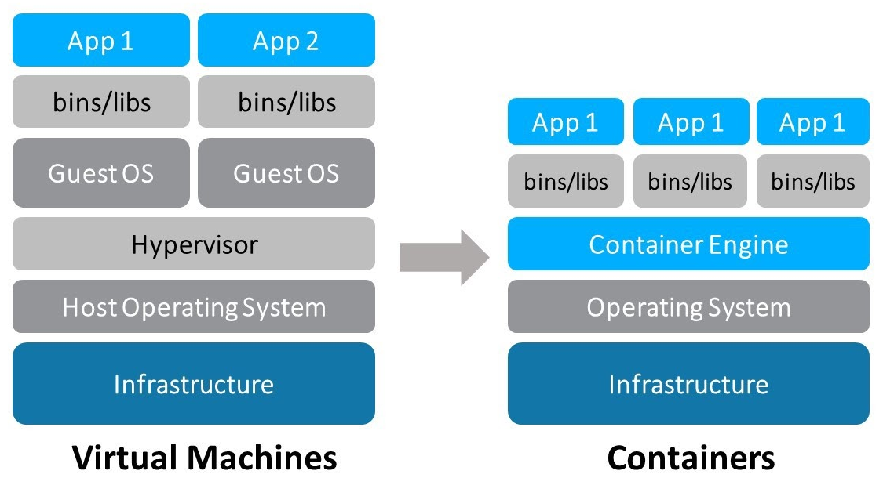
Based on the short description above, the following image shows a comparison between virtual machines and Docker containers.
As we can see, Docker containers are simpler than virtual machines and using it we can avoid the overhead of starting and maintaining VMs.

Slide 10
Container interacts with its own private filesystem; this filesystem is provided by a Docker image. An image includes everything needed to run an application - the code or binary, runtimes, dependencies, and any other filesystem objects required.
We can create our images and share it to Docker Hub. So that anyone can download and use it.
Docker Hub is a registry where we can upload our download any images which are created by any developer.
An image is based on another image, with some additional customization. For example, you may build an image which is based on the ubuntu image, but installs the Apache web server and your application, as well as the configuration details needed to make your application run

Slide 11
Some Basic Commands of Docker:
# Build a Docker image
$ docker build -t [image_name]:[tag]
# Run a Docker container specifying a name
$ docker run --name [container_name] [image_name]:[tag]
# Show running containers
$ docker ps
# Show all containers
$ docker ps -a
# Show Docker images
$ docker images

Slide 12
# Stop a Docker container
$ docker stop [container_id_or_name]
# Remove a Docker container
$ docker rm [container_id_or_name]
# Remove a Docker image
$ docker rmi [image_id_or_name]
Every command has it helps page, so you can call for example:
$ docker build --help
$ docker run --help
And see the OPTIONS you can pass to it.

Slide 13
Some other useful commands to perform operations in multiple items:
# Stop all running containers forcefully
$ docker stop $(docker ps -f)
# Remove all containers
$ docker rm $(docker ps -af)
# Remove all images
$ docker rmi $(docker images -af)

Slide 14
Why DOCKER?
Return on Investment and Cost Savings
Productivity
CI Efficiency
Docker enables you to build a container image and use that same image across every step of the deployment process.
Simplicity and Faster Configurations
Rapid Deployment and Testing
Security
Docker ensures that applications that are running on containers are completely segregated and isolated from each other

Slide 15
SUMMARY
We have covered the introduction in that what is Docker and then the History part.
Then we have seen what is containers and Images.
Then, how docker works.
Then we have seen some basics and useful commands of Docker.
Then we also seen why we need docker and why it is important.

Slide 16



Any Questions? Or any Comments?
Please feel free to ask

Slide 17

Thank You..!!
Thank Y0u for your attention

