Slide 1
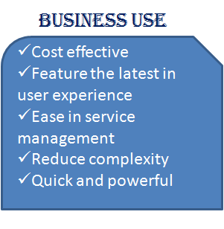
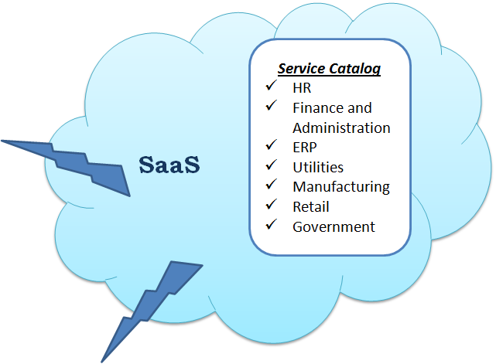
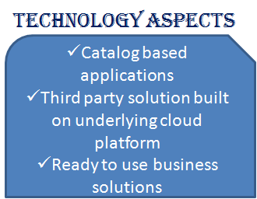
Cluster: Application Unleashed, Praveen Kumar Pendyala
Building block: All in A Catalog
Notes:
Summary: Provide Software as Service (SaaS) in the form of service catalog to specific industry or business - Listing required business processes or basic functionalities required for the organization
Business use: Replacing the traditional business process development with catalog based applications are cost effective, time saving, easy to manage services, reduce complexity
Technology Aspects: To bring this aspect in reality following technological aspects play very important role : (as mentioned in slide)

Slide 2

Cluster: Application Unleashed, Praveen Kumar Pendyala
Building block: Reborn in the Cloud
Why ?
Business use
+ Reduce decision risks.
+ Promote rapid user adoption.
+ Lower TCO of IT investments
+ Build IT agility.
+ Low cost : Virtual machines instead of physical hardware.
+ Secure data recovery in case of disaster.
Technology
Strategy
+ IaaS solution : SkySight.
+ Provides : Virtual machines, virtual networks, network connectivity and back-up.
+ Nov 2011 : Migration of VDAB
+ Determine degree of feasibility.
+ Determine viable Cloud patterns.
Notes:
1. Capgemeni offers an assessment methodology and a roadmap for Cloud migration to reduce decision risks, promote rapid user adoption, lower Total Cost of Ownership (TCO) of IT investments, and build IT agility. Strategically speaking, the Reborn in the Cloud block determines the degree of Cloud feasibility and if feasible, the viable Cloud patterns – IaaS, PaaS and/ or SaaS as well as public, private, or hybrid.
2. The main reason why Companies nowadays would choose to migrate to Business Cloud is low cost. By replicating virtual machines into a private cloud, you're certainly reducing costs compared to installing physical hardware. Using cloud would provide also a secure data recovery in case of disaster. This good investment would probably save them some good money.
3. The Reborn in the Cloud adopt SkySight an IaaS solution co-developed with Microsoft Azure. SkySight delivers safely the optimal workload allocation to public, private, and hybrid cloud services. SkySight provides a varied pool of services: Virtual machines, virtual networks, network connectivity and back-up.
4. Capgemini succeeded to migrate VDAB to the Google Apps cloud service. Actually,Capgemini conducted a study on the requirements of VDAB, and identified two greatest areas of opportunity for cloud as the email and calendar service, and the collaboration environment. An architecture study was carried out to arrive at the right technical solution and identified that Google Apps met VDAB’s needs more completely than any other cloud-enabled package. The go live took place in November 2011

Slide 3
Cluster: Application Unleashed, Praveen Kumar Pendyala
Building block: Elastic Business
Microsoft Azure
Amazon EC2
Google Cloud
Success
Elasticity
Business use
Rapidly scaling up in response to managing peak demands and then shrink back just as fast.
Technology aspects
flexible and agile
elastic architecture
on demand pricing
scalable components
no long-term commitments
real-time infrastructure
cloud services
Notes:
Summary
Elasticity aims at rapidly scaling up in response to managing peak demands and then shrink back just as fast.
Business use
“Elastic business” introduces a new business model that allows big enterprises to be more flexible and agile on the rapidly changing digital world. On-Demand resources let the customer to pay for what he used with no long-term commitments.
Technology aspects
Requirement for adopting cloud services is an elastic architecture using real-time infrastructure and application load monitoring, supporting scalable application components and real-time automation of the provisioning infrastructure. Most famous providers are Amazon EC2, IBM Cloud Computing, Google Cloud Platform and Microsoft Azure.

Slide 4
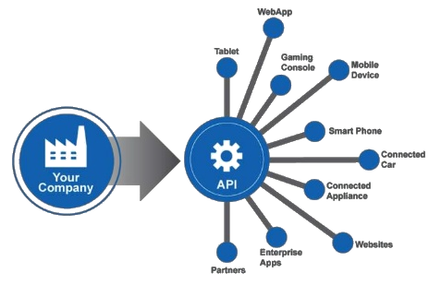
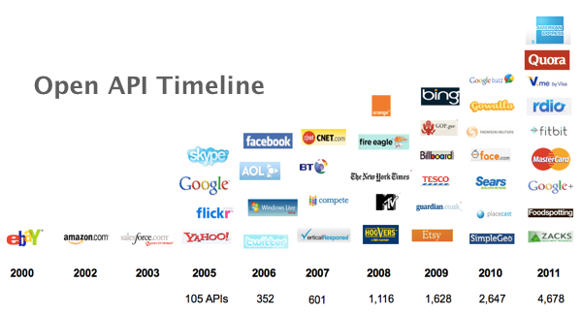
Cluster: Application Unleashed, Praveen Kumar Pendyala Building block: API Economy
Advantages
Accelerated development cycles
Higher traffic volume
Increased revenue
Brand exposure
Technological Aspects
Cloud SaaS
Cloud APIs
Data governance
Notes:
Introduction : We are moving from a product first to API first approach. Advantages:
Support for faster and independent development of applications from in-house and 3rd party developers
Higher traffic volume : traffic now comes from 3rd parties as well
Increased revenue - obviously, right?
Brand exposure
Technological aspects:
Cloud based Software as a Service solutions
Cloud based elastic APIs
APIs access for services and data to allow rapid & independent innovations - good example : DeepDream - API access to Google’s Neural Network!
Open API - a common authentication API which is now a de facto standard across the tech industry

Slide 5
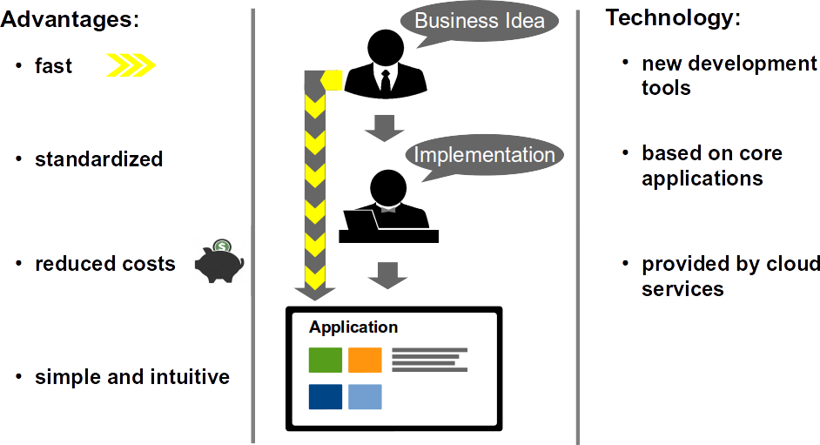
Cluster: Application Unleashed, Praveen Kumar Pendyala Building block: No App Apps
Notes:
Summary
The idea behind No App Apps is to reduce the time consuming requirement and interaction process between domain and IT specialists as much as possible by providing easy-to-use software development tools.
Business Use
Time and manpower for application building gets reduced because the domain specialist can easily build his own apps. No time consuming communication is needed. Therefore costs get reduced.
Technology aspects
A new and powerful class of application building tools is necessary, which use a catalog of UI, logic blocks and core applications that could be flexible combined and communicate via standardized APIs.

